Slide 1
BILP(MILP) method를 이용한 위성군 분석 및 설계/최적화
이진진
석사과정 4학기
2023-11-01

Slide 2
목차
참고 문헌 정보
연구 진행 상황
연구 결과
결론

Slide 3
참고 문헌 정보

Slide 4
BILP(MILP) 설계기법 참고 문헌
기존의 논문
Hang Woon Lee, Seiichi Shimizu, Shoji Yoshikawa, and Koki Ho, “Satellite Constellation Pattern Optimization for Complex Regional Coverage”, 2020 Journal of Spacecraft and Rockets 57:6, 1309-1327
추가로 참고한 논문
Hang Woon Lee, Seiichi Shimizu, Shoji Yoshikawa, and Koki Ho, “Binary Integer Linear Programming Formulation for Optimal Satellite Constellation Reconfiguration”, 2020 AAS/AIAA Astrodynamics Specialist Conference
Quasi-symmetric과 BILP의 결과를 비교하는 내용을 중점적으로 다룬 기존의 논문에 비해 더욱 자세한 BILP 설계기법의 과정을 수학적으로 제시한 논문
Hang Woon Lee, and Koki Ho, “Regional Constellation Reconfiguration Problem: Integer Linear Programming Formulation and Lagrangian Heuristic Method”, 2023 Journal of Spacecraft and Rockets 0 0:0, 1-18
위의 논문에 Lagrangian Heuristic Method에 관한 내용을 추가한 논문

Slide 5
연구 진행 상황

Slide 6
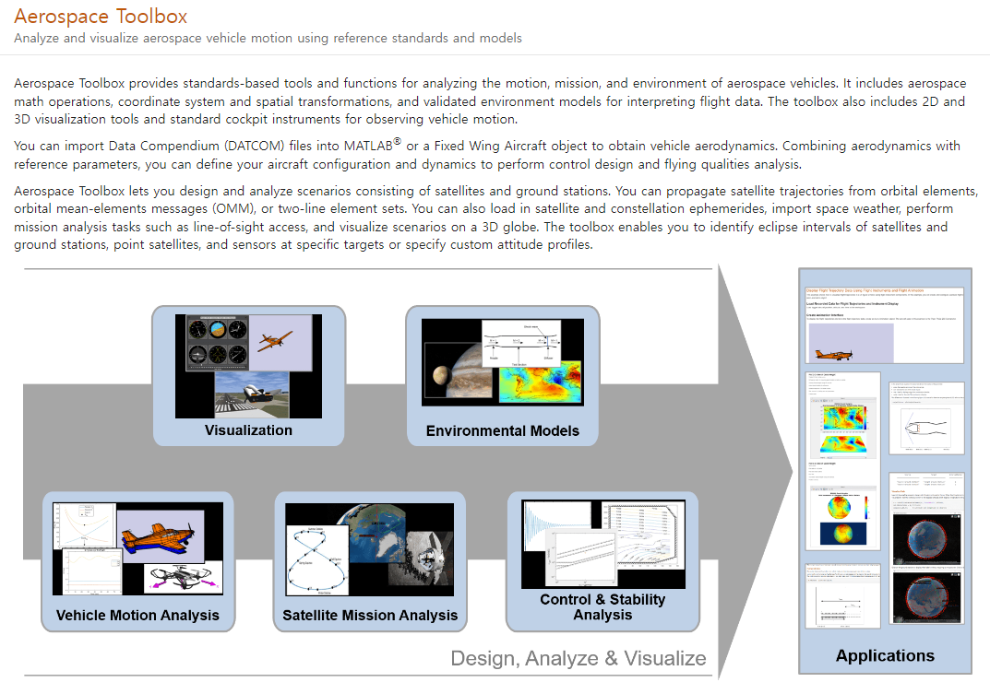
연구 진행상황
Matlab Library

Slide 7
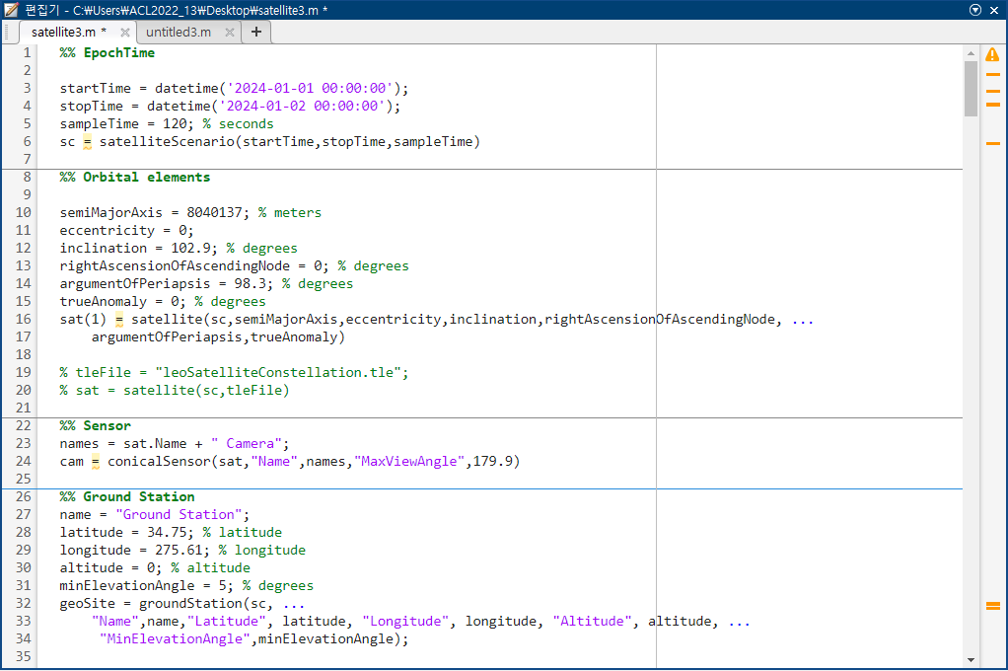
연구 진행상황
Matlab coding

Slide 8
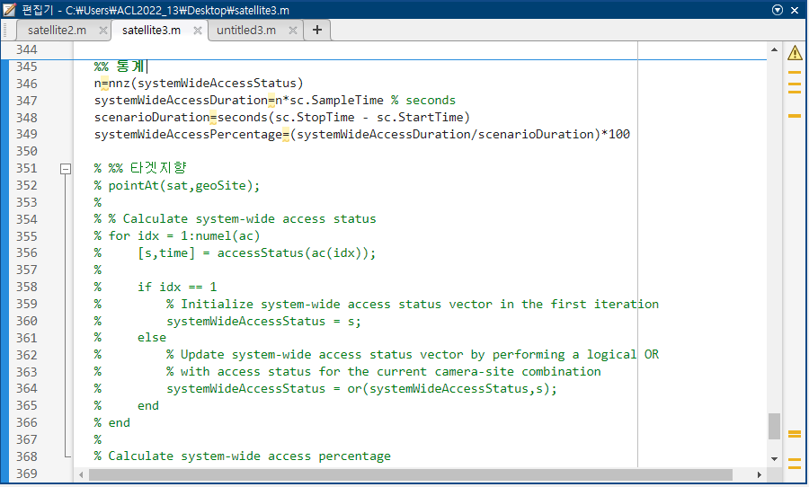
연구 진행상황
Matlab coding

Slide 9
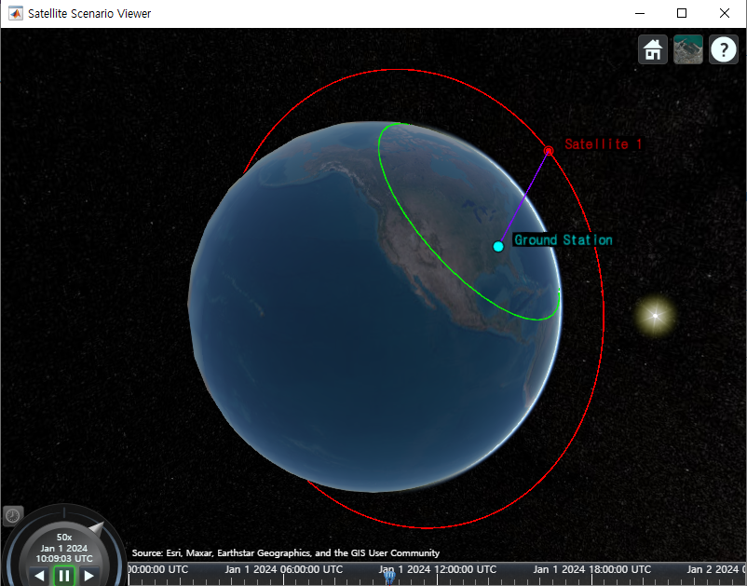
연구 진행상황
Matlab coding

Slide 10
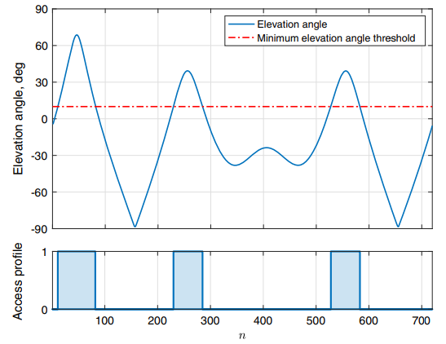
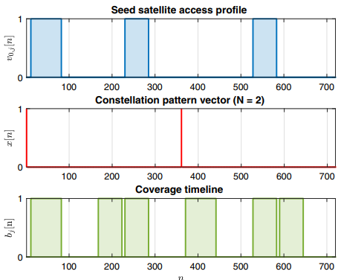
연구 진행상황
참고문헌 개요(APC Composition)
출처 : Hang Woon Lee, Seiichi Shimizu, Shoji Yoshikawa, and Koki Ho, “Satellite Constellation Pattern Optimization for Complex Regional Coverage”, 2020 Journal of Spacecraft and Rockets 57:6, 1309-1327

Slide 11
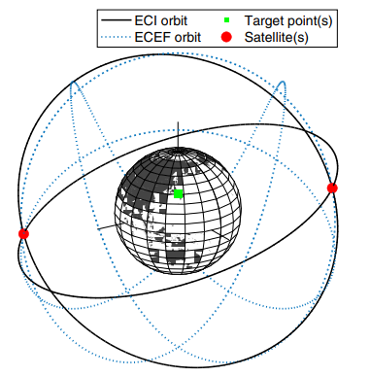
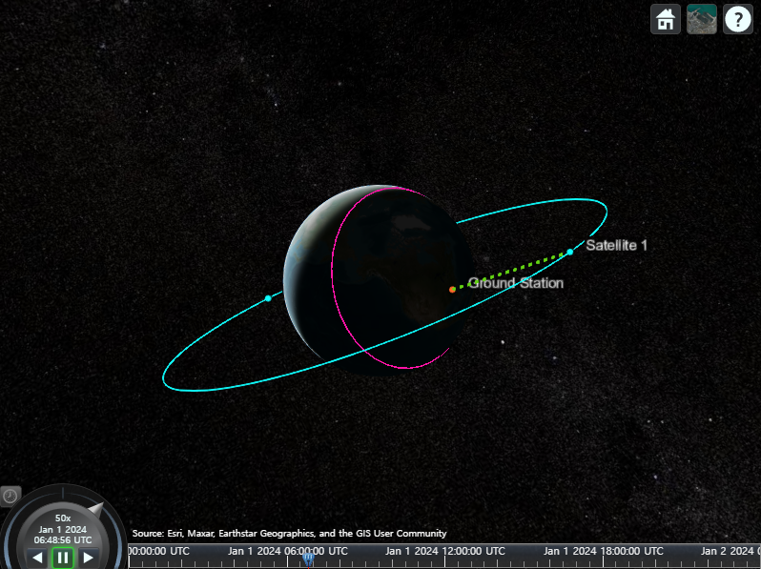
연구 진행상황
참고문헌 개요(APC Composition)
출처 : Hang Woon Lee, Seiichi Shimizu, Shoji Yoshikawa, and Koki Ho, “Satellite Constellation Pattern Optimization for Complex Regional Coverage”, 2020 Journal of Spacecraft and Rockets 57:6, 1309-1327

Slide 12
연구 결과

Slide 13
연구 진행상황
참고문헌 예시(Example 1)
Example (1) : single-fold continuous coverage over a single target point
Example (2) : time-varying coverage over a single target point
Example (3) : single-fold continuous coverage over multiple target points
Example (4) : time-varying and spatially varying coverage over multiple target points
Example (5) : multiple subconstellations over multiple target points
Seed Satellite OE | 𝜀(min) | Target 𝜙 | Target λ | Coverage Req | n | Time Step
[12/1, 0, 102.9˚, 0˚, 98.3˚, 0˚] | 5˚ | 34.75˚N | 84.39°W | 1 | 720 | 120s
n = [0, 33, 65, 98, 131, 164, 196, 229, 262, 295, 327, 360, 393, 425, 458, 491, 524, 556, 589, 622, 655, 687]
출처 : Hang Woon Lee, Seiichi Shimizu, Shoji Yoshikawa, and Koki Ho, “Satellite Constellation Pattern Optimization for Complex Regional Coverage”, 2020 Journal of Spacecraft and Rockets 57:6, 1309-1327

Slide 14
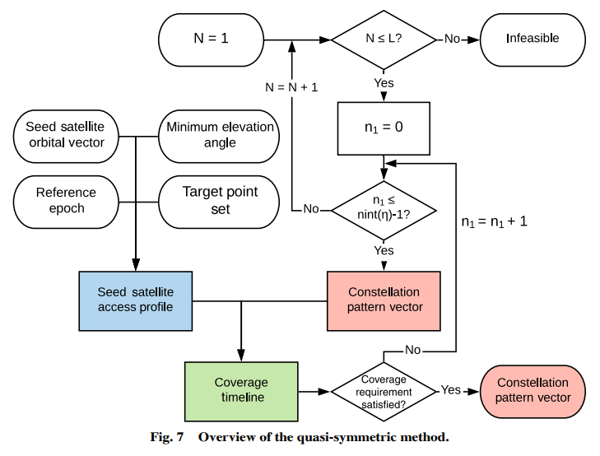
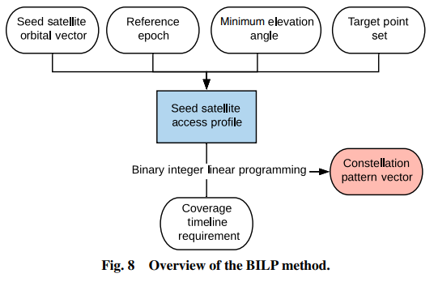
연구 진행상황
참고문헌 예시(Example 1)
Quasi-symmetric method
BILP method
출처 : Hang Woon Lee, Seiichi Shimizu, Shoji Yoshikawa, and Koki Ho, “Satellite Constellation Pattern Optimization for Complex Regional Coverage”, 2020 Journal of Spacecraft and Rockets 57:6, 1309-1327

Slide 15



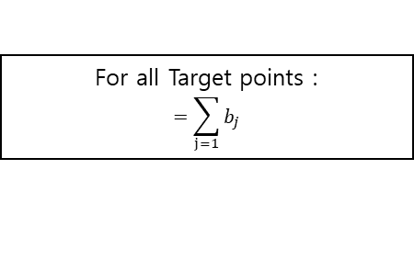


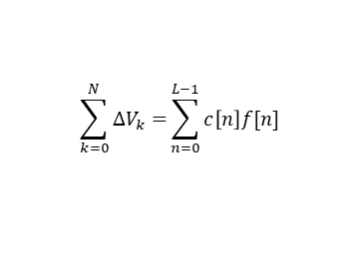


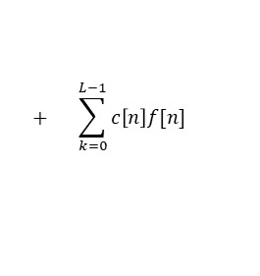

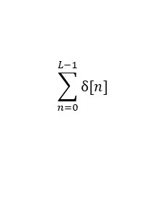

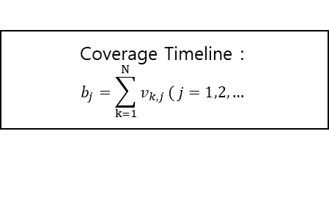







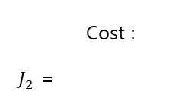
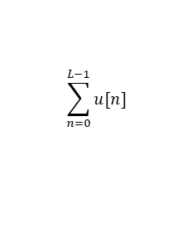
BILP(MILP) 설계기법 flowchart
Flowchart
Input
$N$ , , $n$ , $L, z, \text{œ}$
For all Target points :
$$=\sum_{j=1}{b_{j}}$$
$$v_{k,j}=0$$
No
Satellite invisible
Coverage :
$J_{1}$ = $−\frac{100}{L}$
Cost :
$J_{2}$ =
Yes
$$\sum_{n=0}^{L−1}{δ[n]}$$
$$\sum_{k=0}^{N}{∆V_{k}=}\sum_{n=0}^{L−1}{c\left[n\right]f[n]}$$
$v_{k,j}=1$ :
Access profile Saved
Multiple
Target
points
Single
Target
point
$J≜ω_{1}J_{1}+ω_{2}J_{2}$
Yes
$v_{0,j}$ :
Seed Satellite
No
$$k=0$$
$$(x=0)$$
No
$$\sum_{n=0}^{L−1}{u[n]}$$
$$+ \sum_{k=0}^{L−1}{c\left[n\right]f[n]}$$
$$J=−ω_{1}\frac{100}{L}$$
$v_{k,j}(k=1, 2, … , N)$ :
Normal Satellite
$$ω_{2}$$
$$x=1$$
Yes
Coverage Timeline :
$$b_{j}=\sum_{k=1}^{N}{v_{k,j}}( j=1,2, …$$
$$)$$
$$f=0$$
No
$$f=1$$
No
$f$-fold
($f$ = 2, 3, … $n_{k−1}$)
Yes
Yes
Satellite invisible
(at the $n$)
Single fold

Slide 16
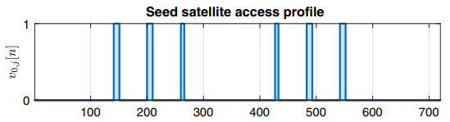
연구 결과
참고문헌 예시(Example 1) APC Decomposition 검증 과정
1. Access profile
논문의 figure
Coding으로 얻은 figure
출처 : Hang Woon Lee, Seiichi Shimizu, Shoji Yoshikawa, and Koki Ho, “Satellite Constellation Pattern Optimization for Complex Regional Coverage”, 2020 Journal of Spacecraft and Rockets 57:6, 1309-1327

Slide 17
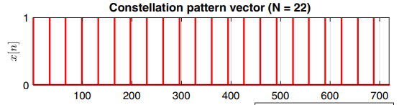
연구 결과
참고문헌 예시(Example 1) APC Decomposition 검증 과정
2. Constellation Pattern vector
논문의 figure
Coding으로 얻은 figure
출처 : Hang Woon Lee, Seiichi Shimizu, Shoji Yoshikawa, and Koki Ho, “Satellite Constellation Pattern Optimization for Complex Regional Coverage”, 2020 Journal of Spacecraft and Rockets 57:6, 1309-1327

Slide 18
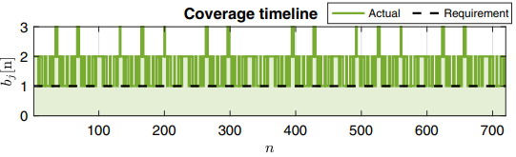
연구 결과
참고문헌 예시(Example 1) APC Decomposition 검증 과정
3. Coverage timeline
22대의 위성으로도 Coverage 100% 달성
논문의 figure
Coding으로 얻은 figure
출처 : Hang Woon Lee, Seiichi Shimizu, Shoji Yoshikawa, and Koki Ho, “Satellite Constellation Pattern Optimization for Complex Regional Coverage”, 2020 Journal of Spacecraft and Rockets 57:6, 1309-1327

Slide 19
연구 결과
참고문헌 예시(Example 1) APC Composition 검증 과정
3. Coverage timeline
21대의 위성으로는 Coverage 100% 달성 불가
N = 21인 경우
Cov 98.056%
N = 22인 경우
Cov 100%
출처 : Hang Woon Lee, Seiichi Shimizu, Shoji Yoshikawa, and Koki Ho, “Satellite Constellation Pattern Optimization for Complex Regional Coverage”, 2020 Journal of Spacecraft and Rockets 57:6, 1309-1327

Slide 20
결론

Slide 21
결론
결론
논문의 이론을 바탕으로 Example을 검증하기 위해 직접 코딩 작성
Quasi-symmetric method를 이용한 APC 과정 검증 완료
직접 작성한 flowchart를 참고하여 BILP method를 이용한 최적화 방법 적용 예정

Slide 22
경청해 주셔서 감사합니다.
질의응답
발표자: 이진진
이메일: jj95lee@yonsei.acl.kr

