Slide 1
Electrical Power System
EPS Budget
Latch
channel
Consumption Power
Channel Distribution
3.3V
5.5V
V-bat

Slide 2
Level 1: Electrical Power System
Level 2 | Level 3 | DAYS
Electrical Power Budget | Latch | 0
 | channel | 0
 | Consumption Power | 0
Channel Distribution | 3.3V | 0
 | 5V | 0
 | V-bat | 0

Slide 3
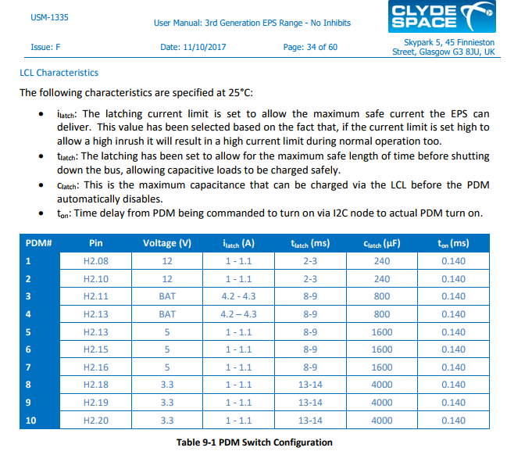

Slide 4
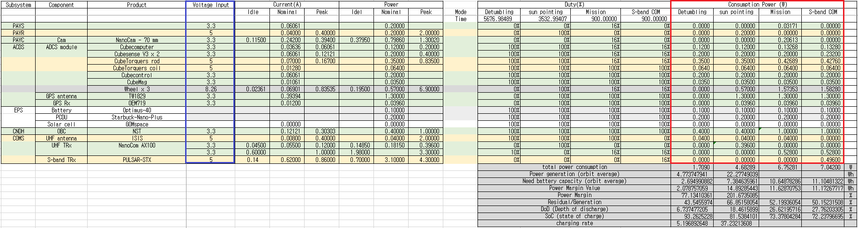
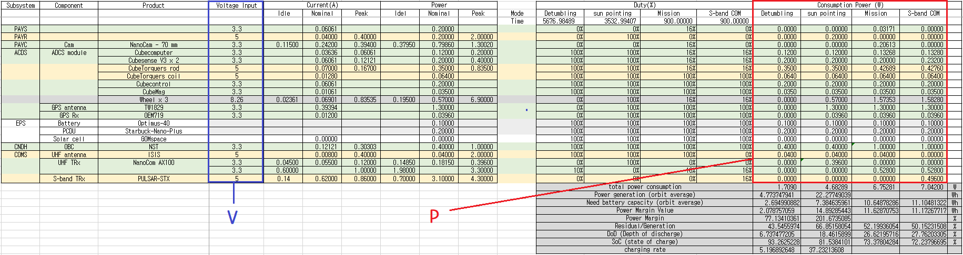
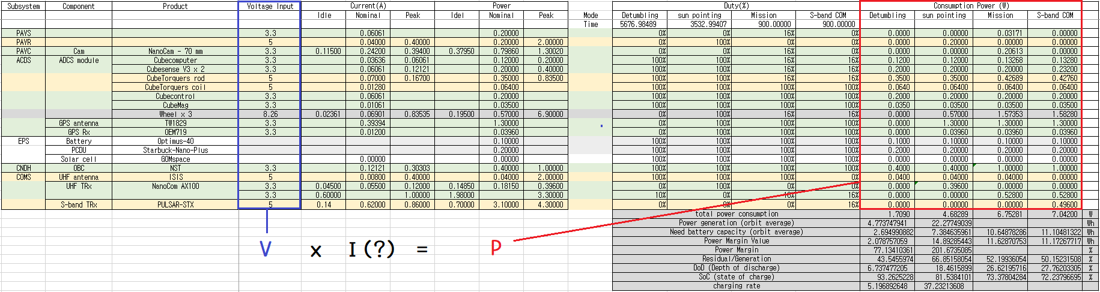

Slide 5
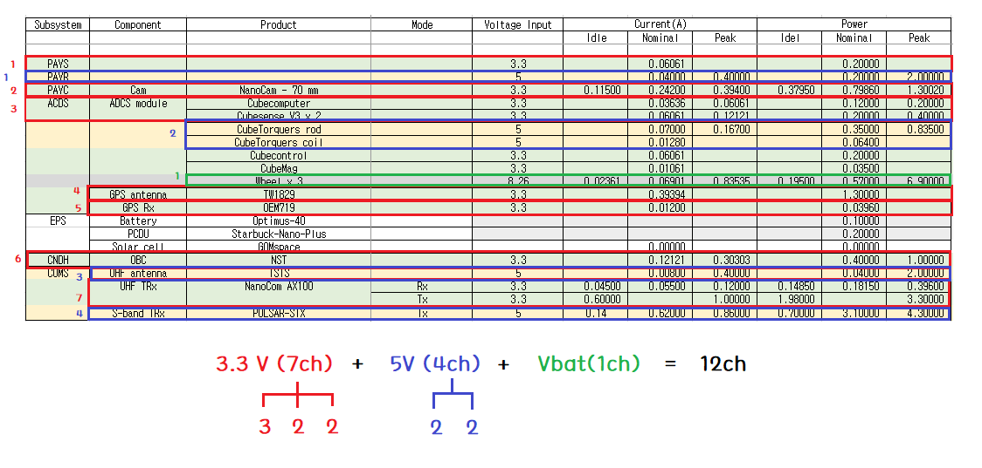
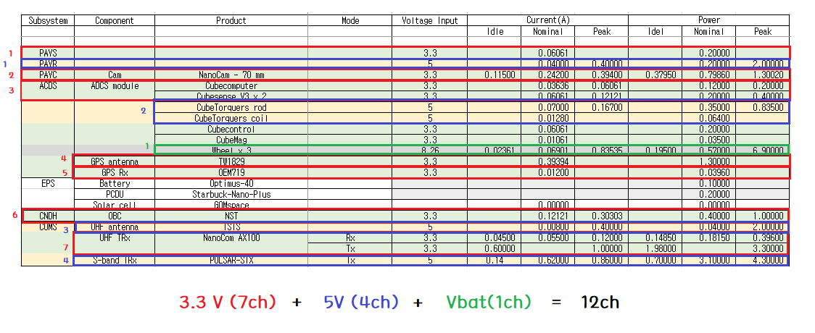
Notes:
.

Slide 6
