Slide 1
Electrical Power System
Basic Plan
Week 1 - Channel distribution
Week 2 - Power generation
Week 3 - Calculation DOD
Week 4 – Operation Scenario
Channel Distribution (Week 1)
3.3V - 1~8, 9, 10
5.5V - 11~13, 14
V-bat - 15
Power generation (Week2)

Slide 2
Level 1: Electrical Power System
Level 2 | Level 3 | DAYS
Electrical Power Budget | Week1 - Channel distribution | 0
 | Week2 – Calculate Power generation | 0
 | Week3 - Calculation DOD & Peak load | 0
 | Week4 - Operation Scenario
Channel Distribution Power Generation | 3.3V | 0
 | 5V | 0
 | V-bat | 0
 | Electrical model of battery
 | ADCS code
 | Orientation Scenario

Slide 3
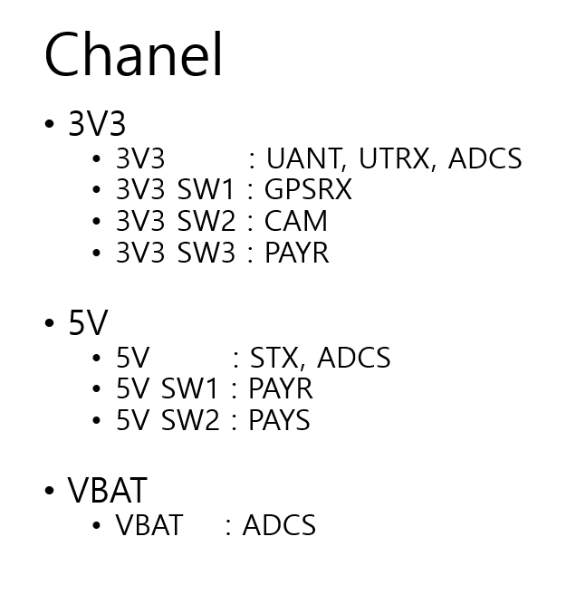

Slide 4
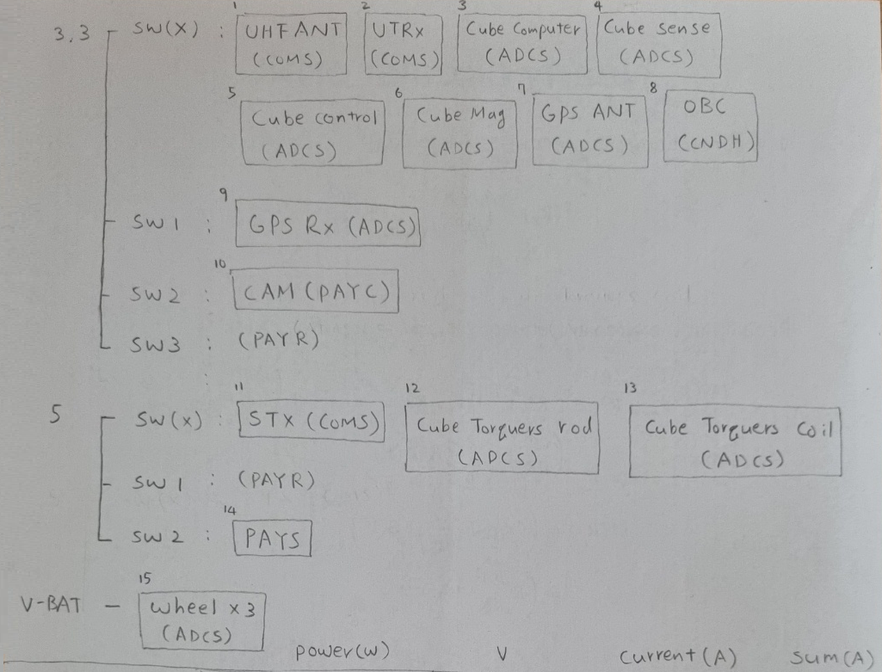

Slide 5
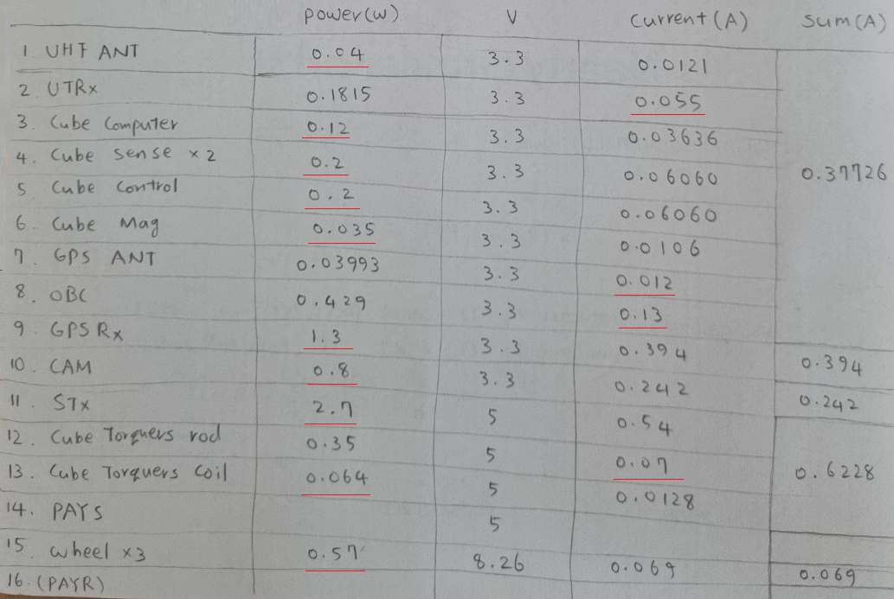

Slide 6
Level 1: Electrical Power System
Level 2 | Level 3 | DAYS
Electrical Power Budget | Week1 - Channel distribution | 0
 | Week2 – Calculate Power generation | 0
 | Week3 - Calculation DOD & Peak load | 0
 | Week4 - Operation Scenario
Channel Distribution Power Generation | 3.3V | 0
 | 5V | 0
 | V-bat | 0
 | Electrical model of battery
 | ADCS code
 | Orientation Scenario

Slide 7

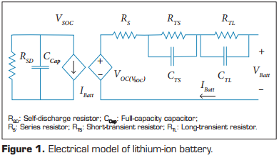
Ref1. Comparison of the Incident Solar Energy and Battery Storage in a 3U CubeSat Satellite for Different Orientation Scenarios
(Sancchez-Sanjuan, 2016)

Slide 8
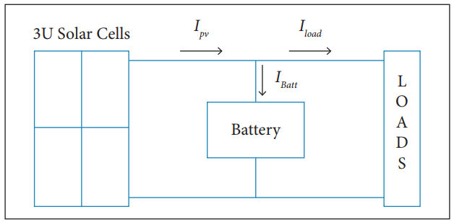
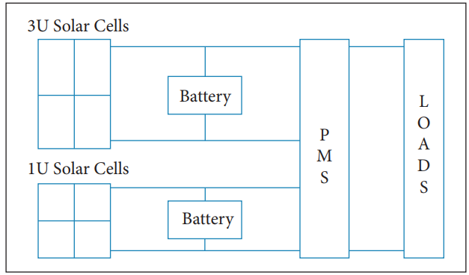
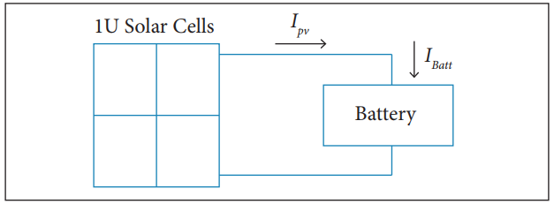

Slide 9
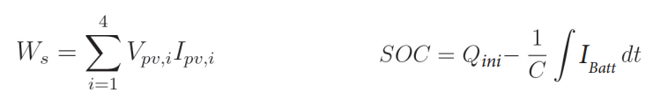

Slide 10
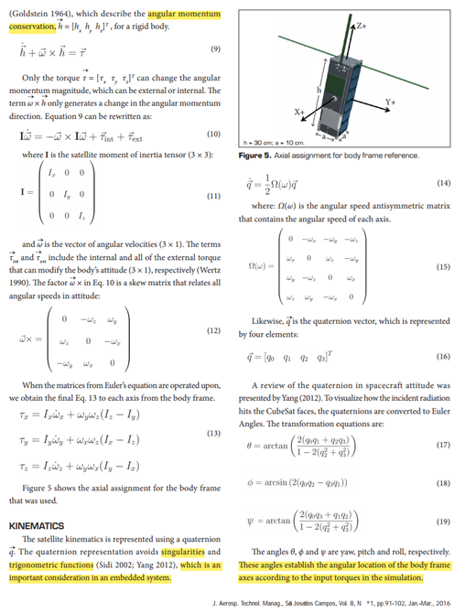

Slide 11
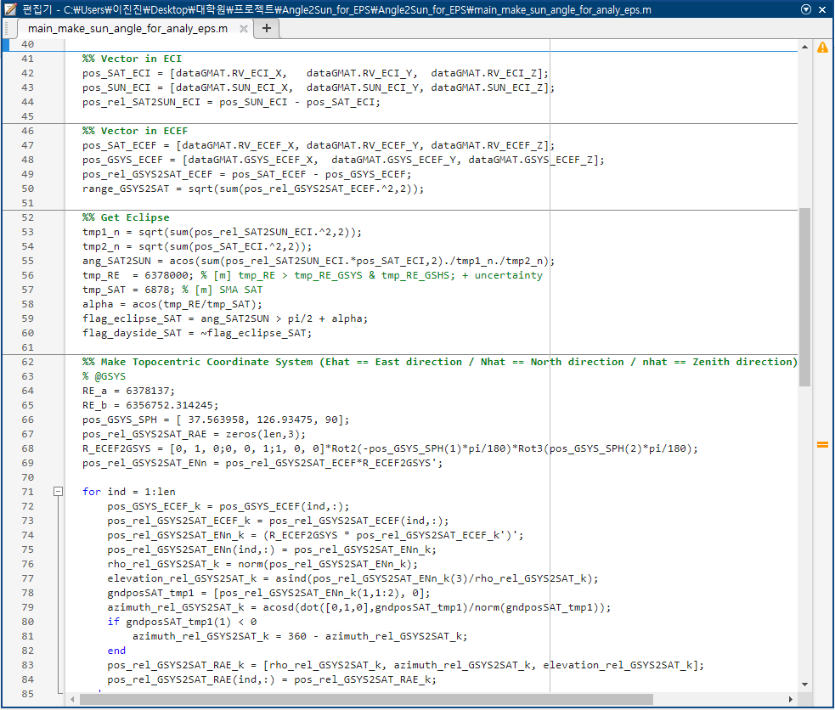

Slide 12
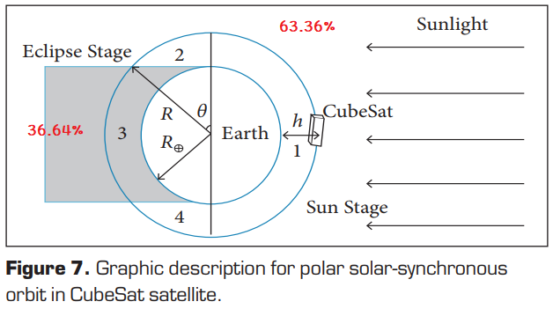
3597s
2080s

Slide 13
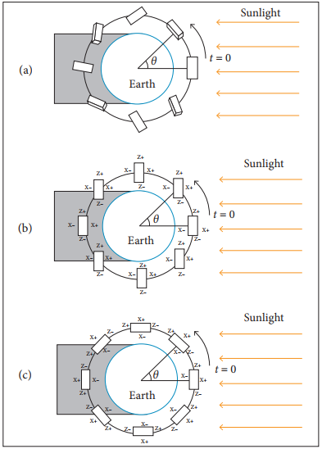
Sun stage – Sun pointing
Eclipse stage - Nadir pointing

Slide 14
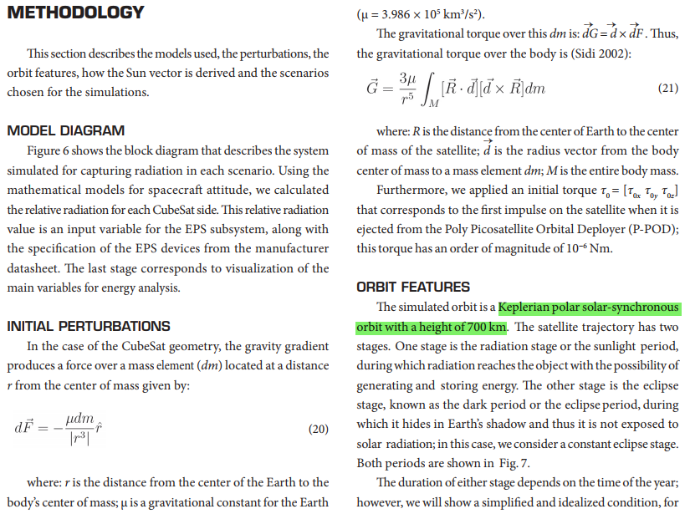

Slide 15
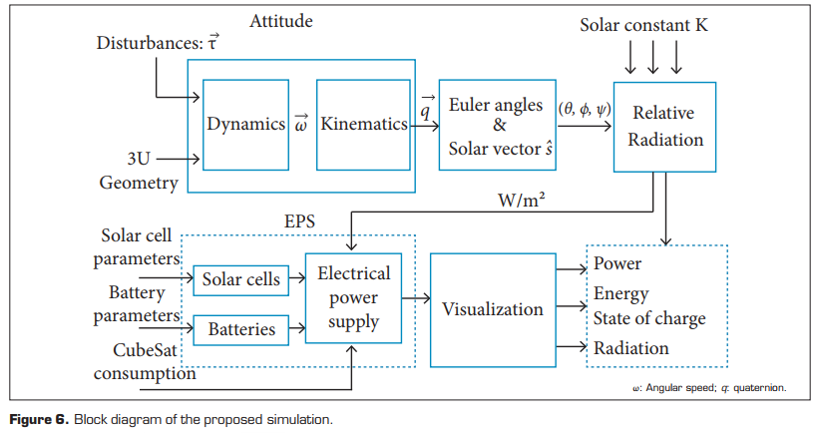

Slide 16
