Slide 1
Electrical Power System
Basic Plan
Week 1 - Channel distribution
Week 2 - Power generation
Week 3 - Calculation DOD
Week 4 – Operation Scenario
Power generation

Slide 2
Level 1: Electrical Power System
Level 2 | Level 3 | DAYS
Electrical Power Budget | Week1 - Channel distribution | 0
 | Week2 – Calculate Power generation | 0
 | Week3 - Calculation DOD & Peak load | 0
 | Week4 - Operation Scenario
Channel Distribution Power Generation | 3.3V | 0
 | 5V | 0
 | V-bat | 0
 | Electrical model of battery
 | ADCS code
 | Orientation Scenario

Slide 3
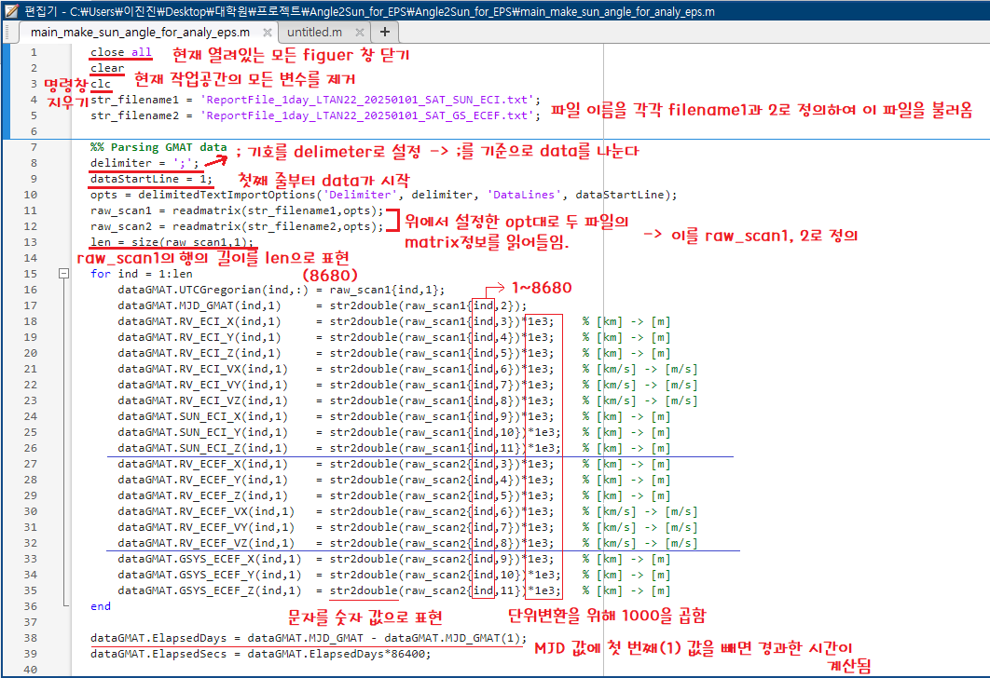

Slide 4
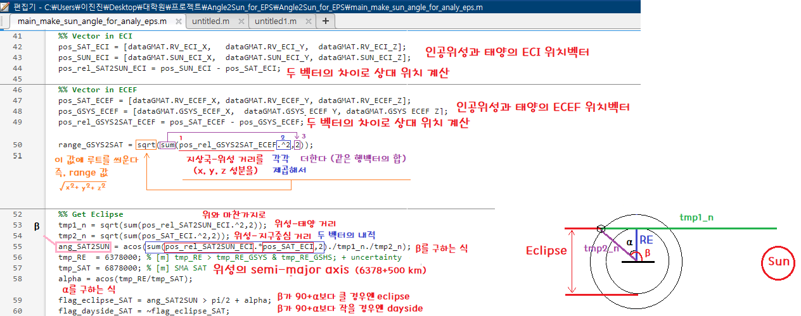

Slide 5
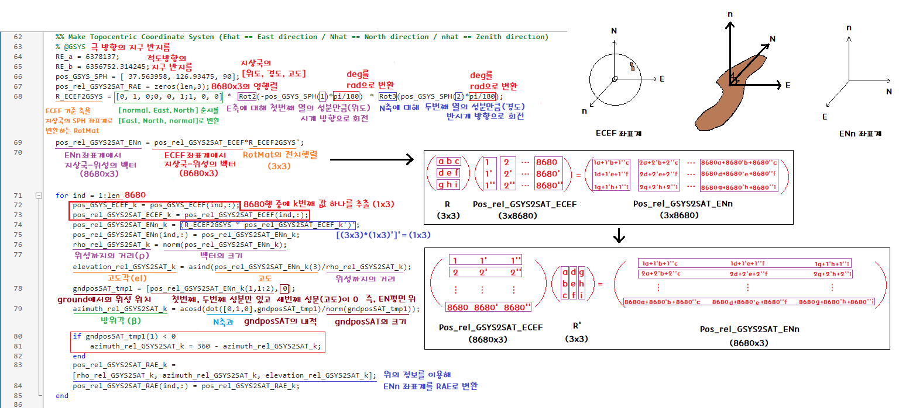

Slide 6
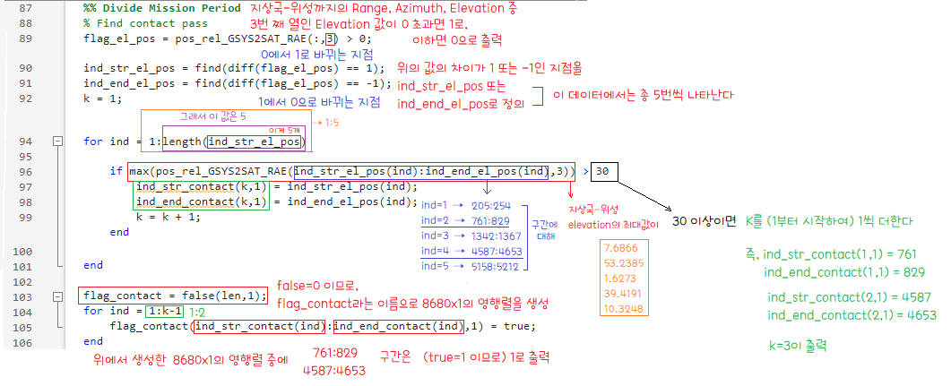

Slide 7
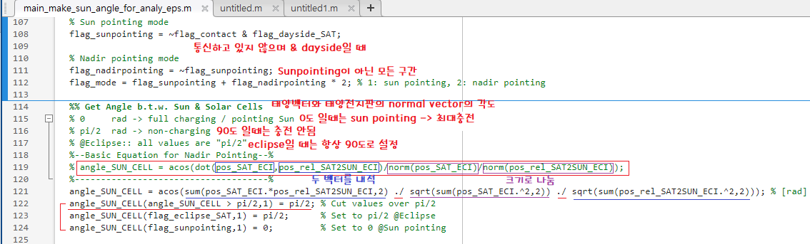

Slide 8
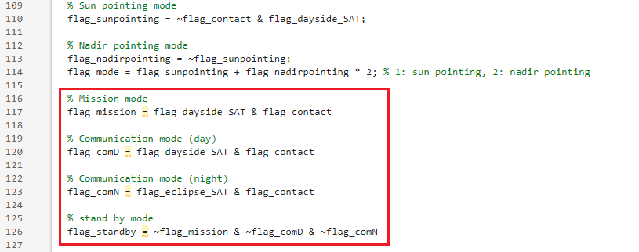
1.

Slide 9
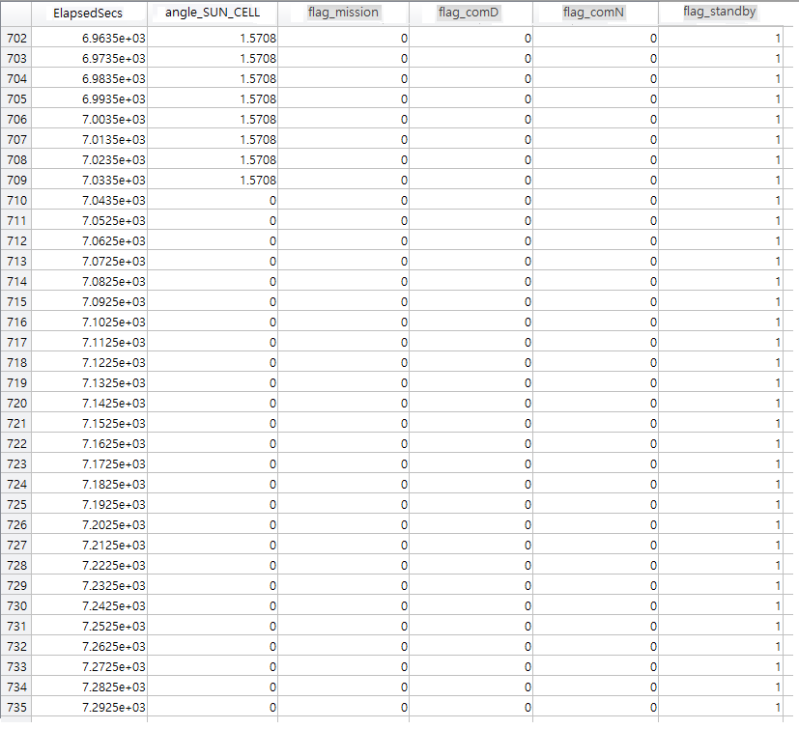
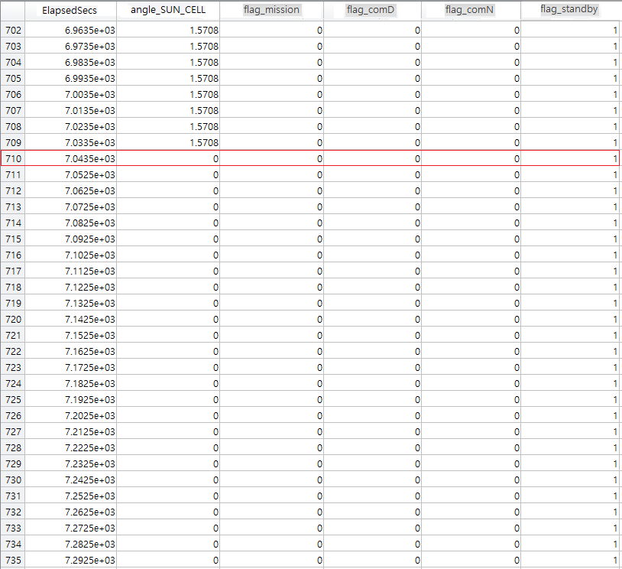

Slide 10
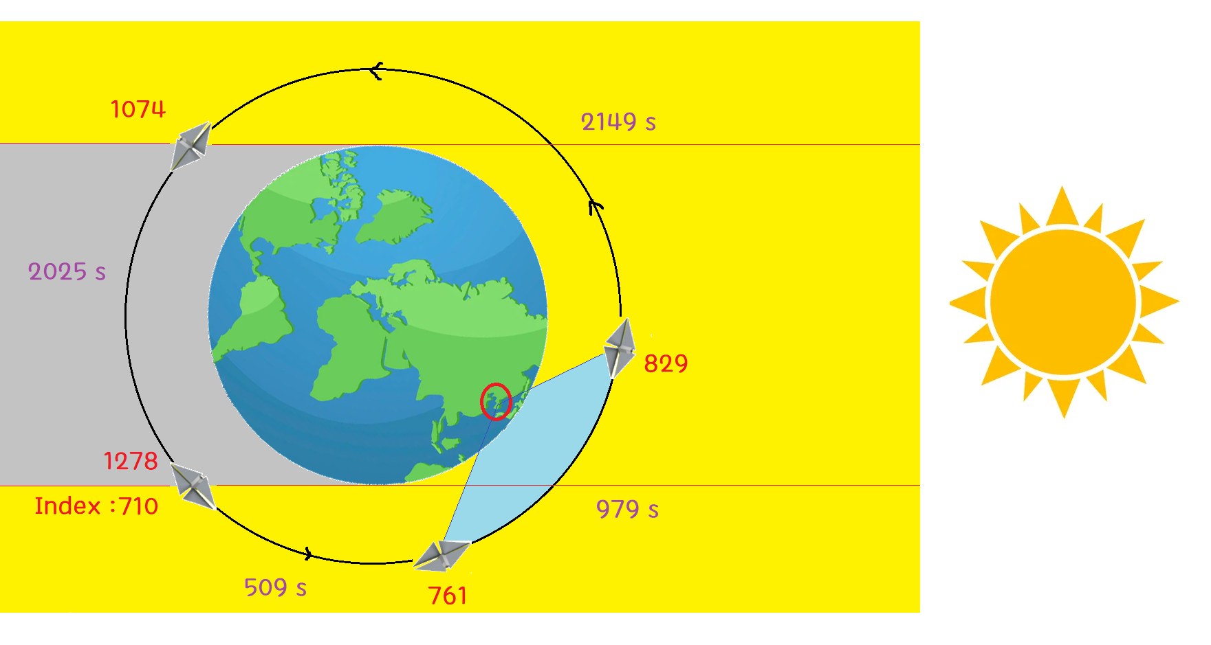
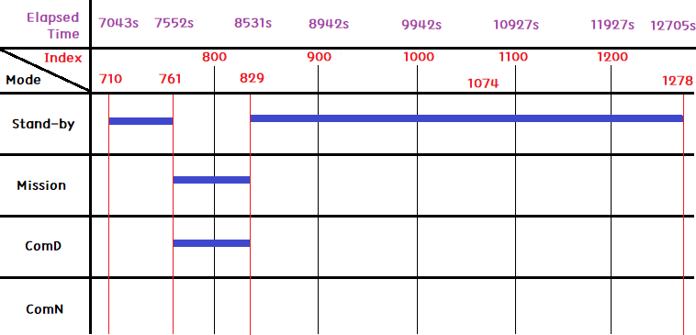
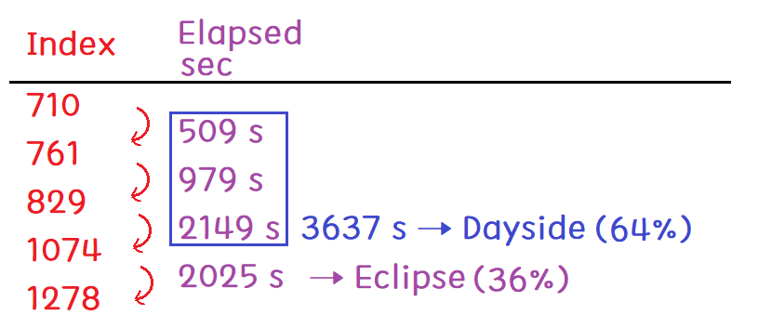
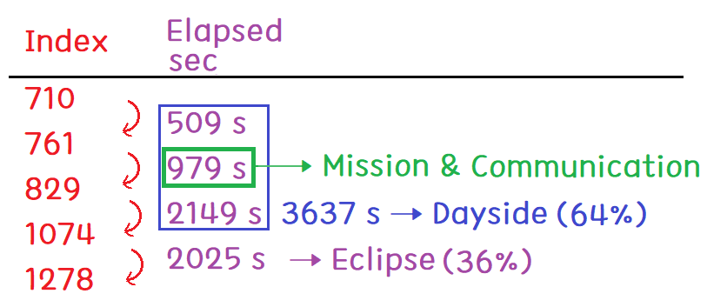

Slide 11
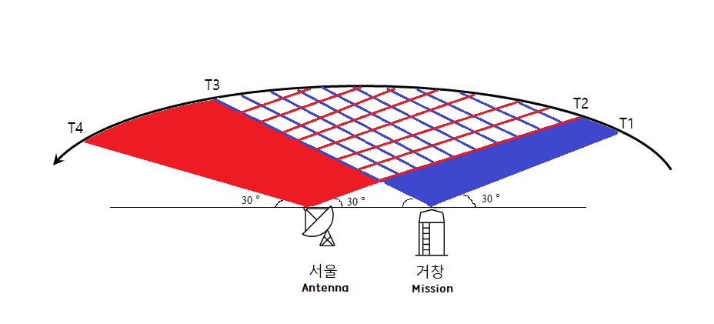
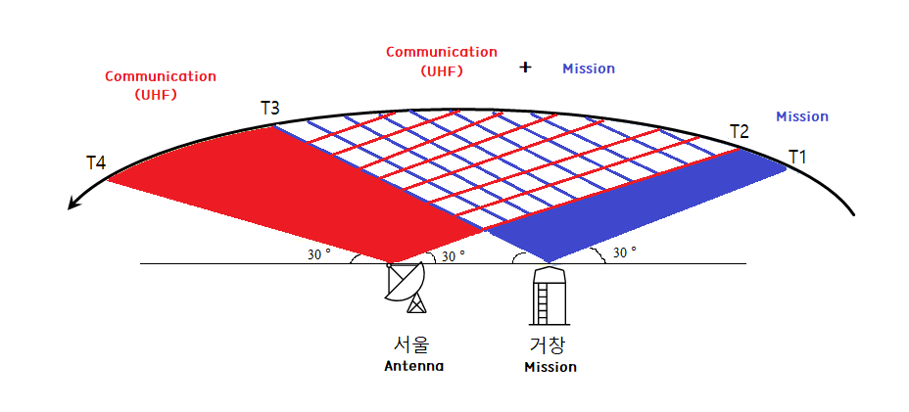
(Index : 829)
(Index : 761)

Slide 12

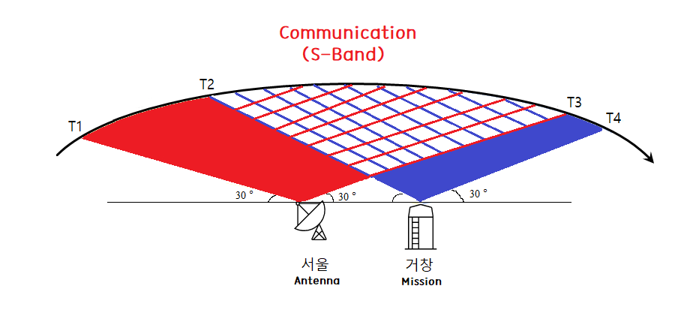

Slide 14
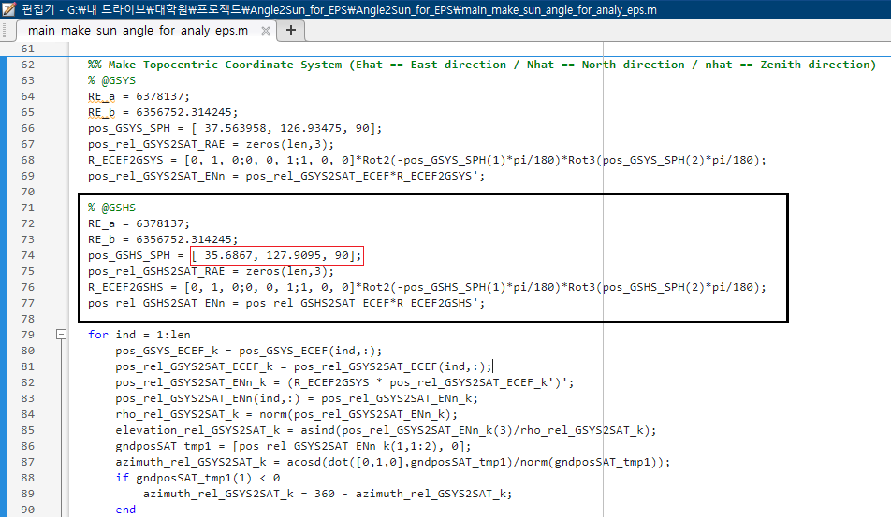

Slide 15
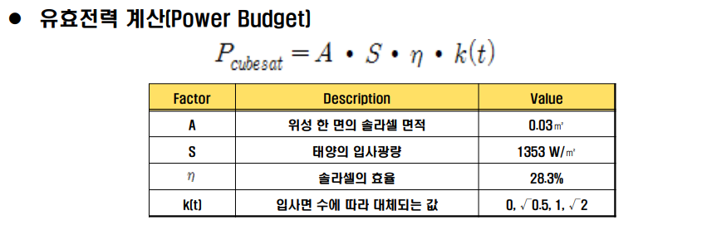
P = 0.03m^2 x 1353W/m^2 x 0.283 x 20(4x2+6x2)
= 11.5 W
Stand-by mode : 82.7%
Mission & Communication mode : 17.3%

