Slide 1
Electrical Power System
Basic Plan
Week 1 - Channel distribution
Week 2 - Power generation
Week 3 - Calculation DOD
Week 4 – Operation Scenario
Power generation

Slide 2
Level 1: Electrical Power System
Level 2 | Level 3 | DAYS
Electrical Power Budget | Week1 - Channel distribution | 0
 | Week2 – Calculate Power generation | 0
 | Week3 - Calculation DOD & Peak load | 0
 | Week4 - Operation Scenario
Channel Distribution Power Generation | 3.3V | 0
 | 5V | 0
 | V-bat | 0
 | Electrical model of battery
 | ADCS code
 | Orientation Scenario

Slide 3
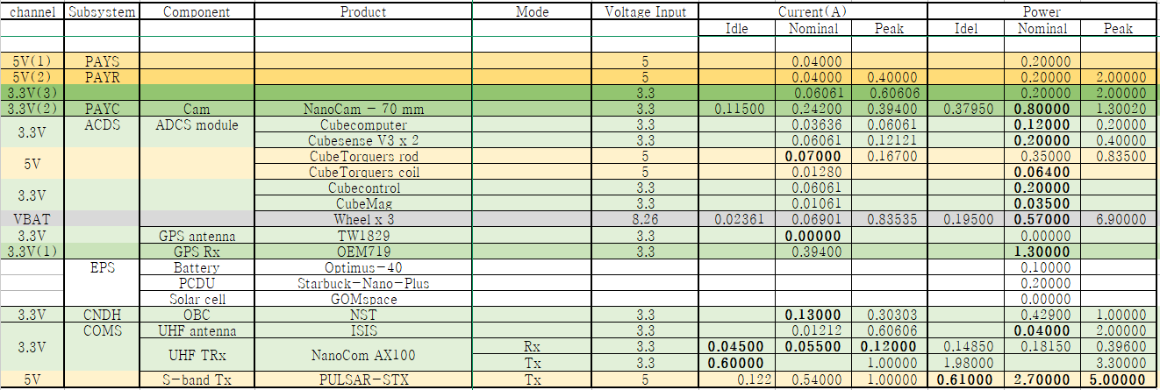
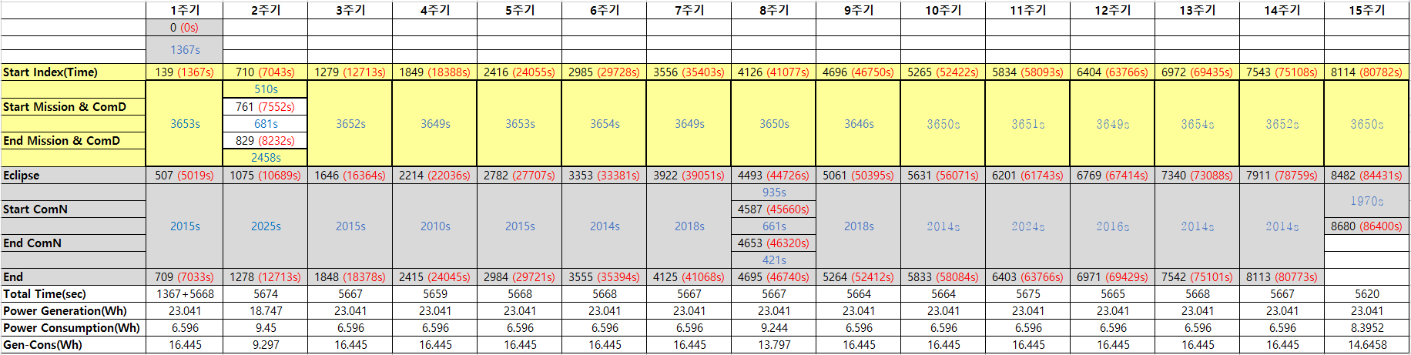

Slide 4
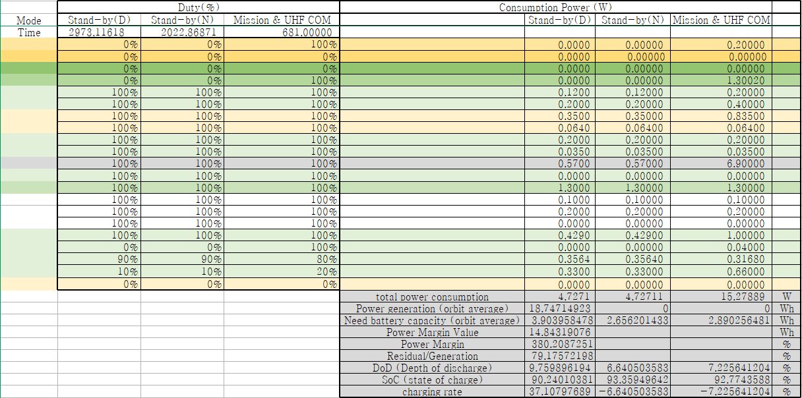
1. Mission & UHF COM (2번째 주기)

Slide 5
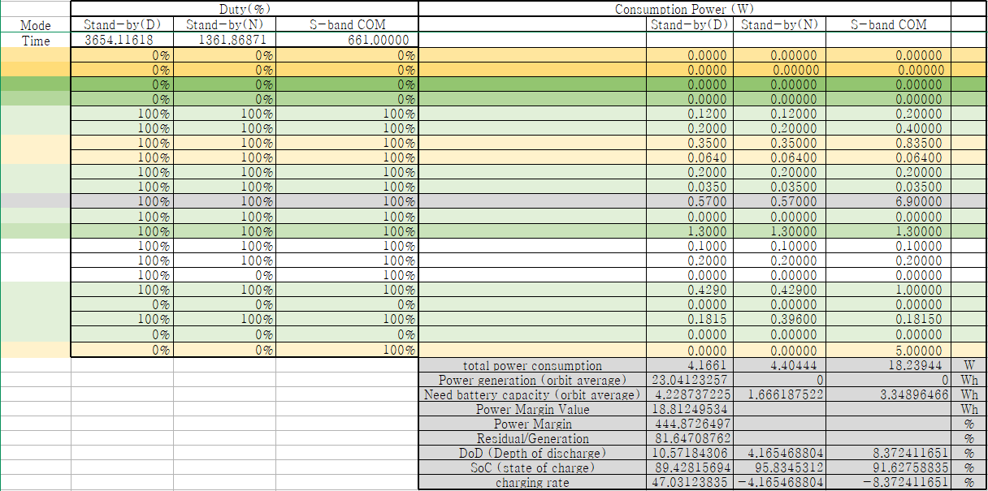
2. S-band COM_Night (8번째 주기)

Slide 6

3. S-band COM_Day (2번째 주기)

Slide 7
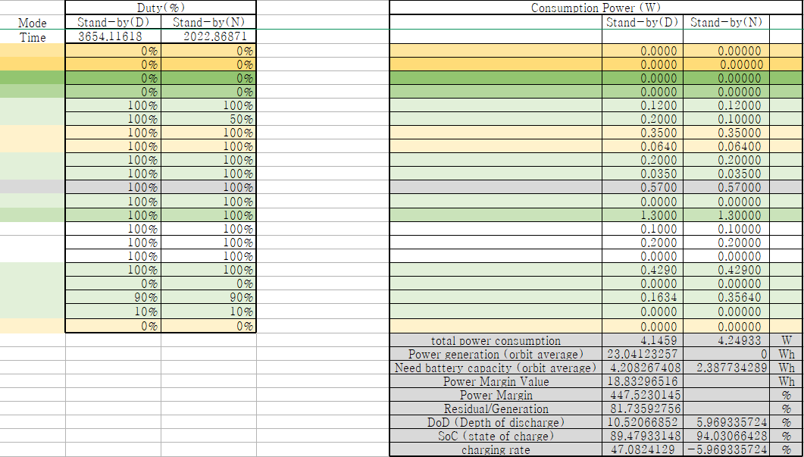
4. 그 외

Slide 8
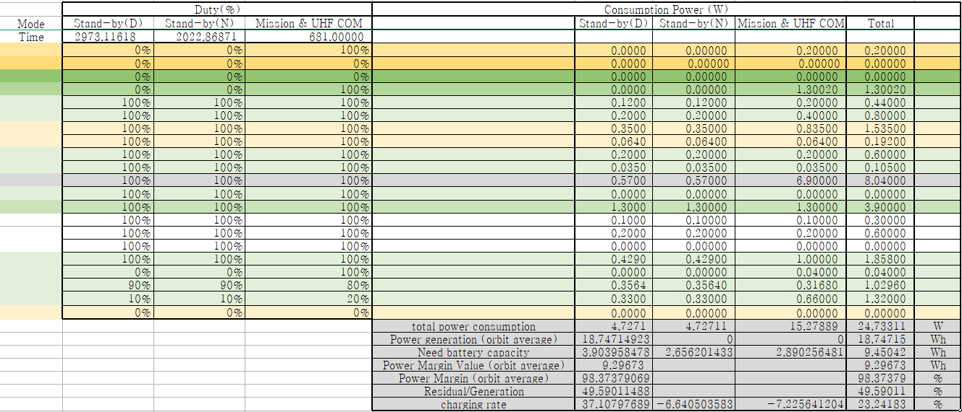
1.

Slide 9
1.

Slide 10
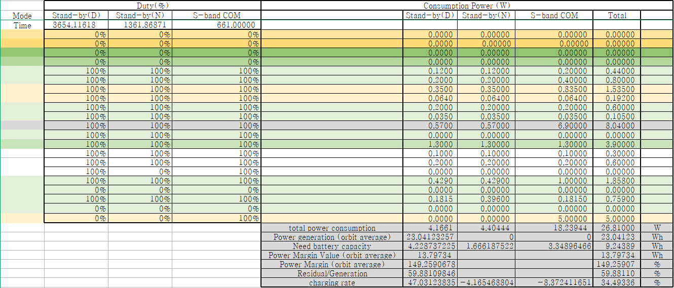
2.

Slide 11
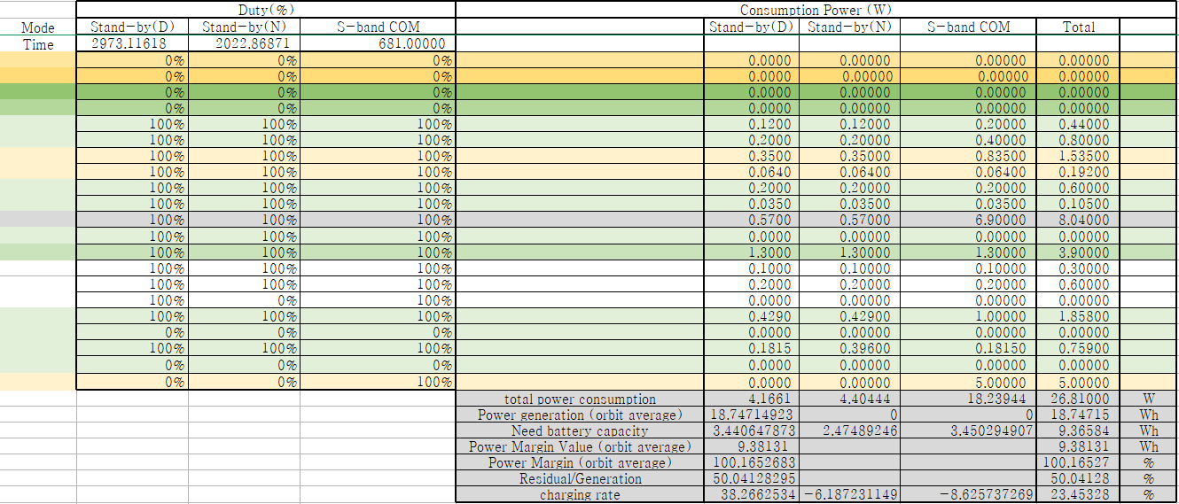
3.

Slide 12
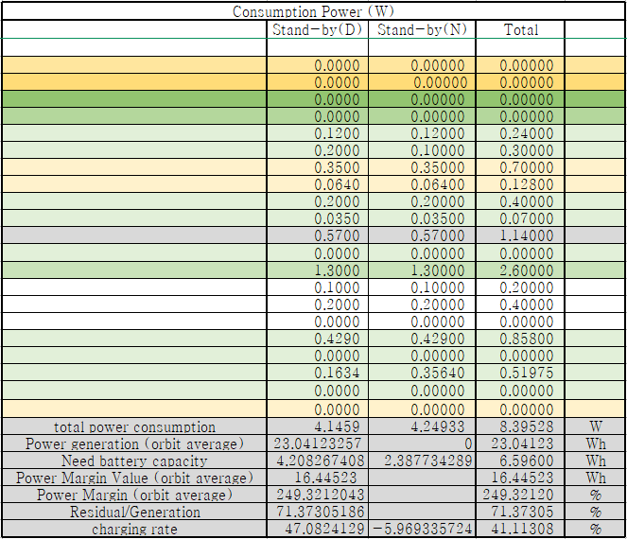
4.

Slide 13
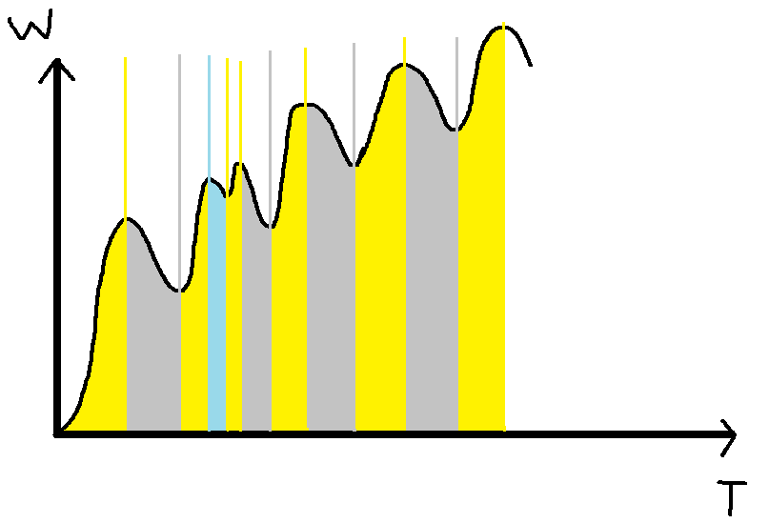

Slide 14
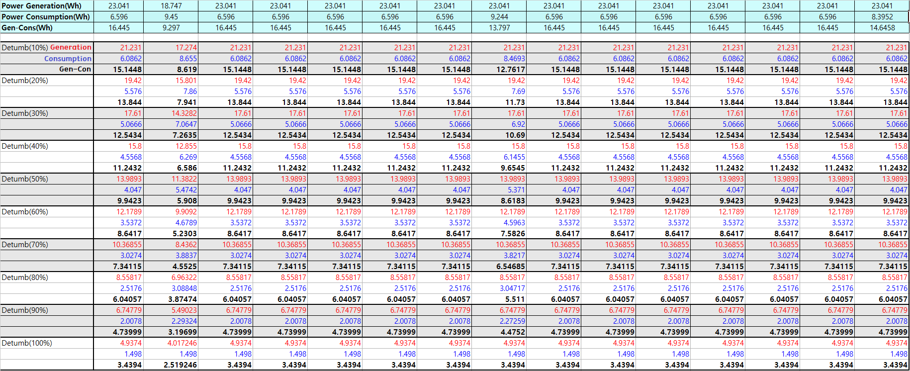

Slide 15
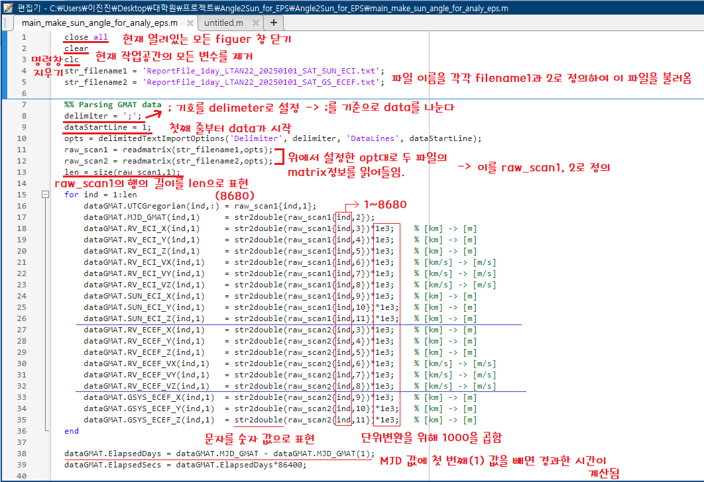

Slide 16
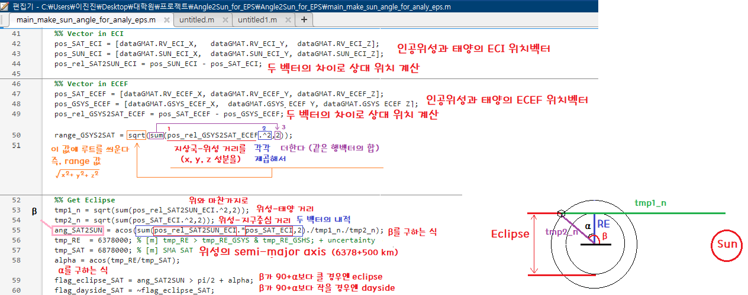

Slide 17
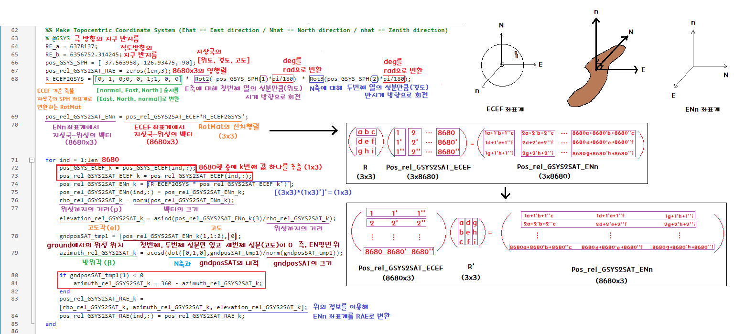

Slide 18
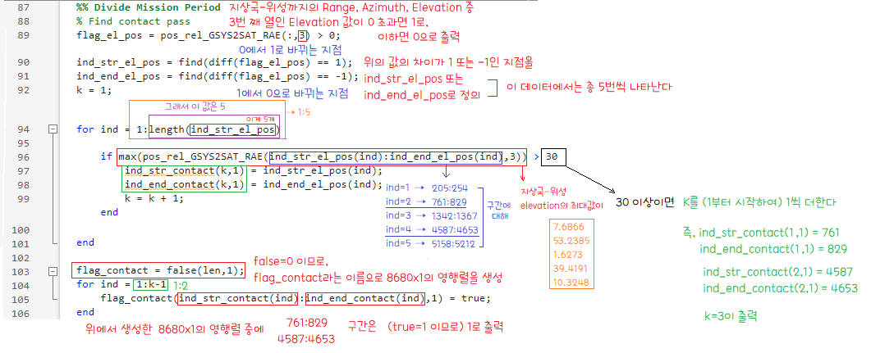

Slide 19
