Slide 1
Electrical Power System
Basic Plan
Week 1 - Channel distribution
Week 2 - Power generation
Week 3 - Calculation DOD
Week 4 – Operation Scenario
PDR (2022.11)
Power generation (~9/28)
Generating Time rate Calculation
(Dayside time x 0~100%)
Power generation (~10/12)
Simulink -> Visualization (graph)

Slide 2
Level 1: Electrical Power System
Level 2 | Level 3 | DAYS
Electrical Power Budget | Week1 - Channel distribution | 0
 | Week2 – Calculate Power generation | 0
 | Week3 - Calculation DOD & Peak load | 0
 | Week4 - Operation Scenario
Power Generation | Generating Time rate Calculation (Dayside time x 0~100%) | 0
 |  | 0
 |  | 0

Slide 3
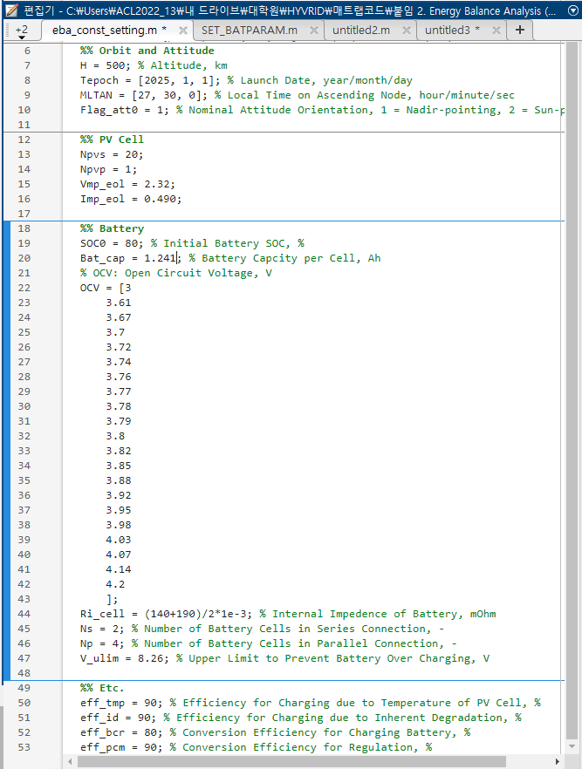
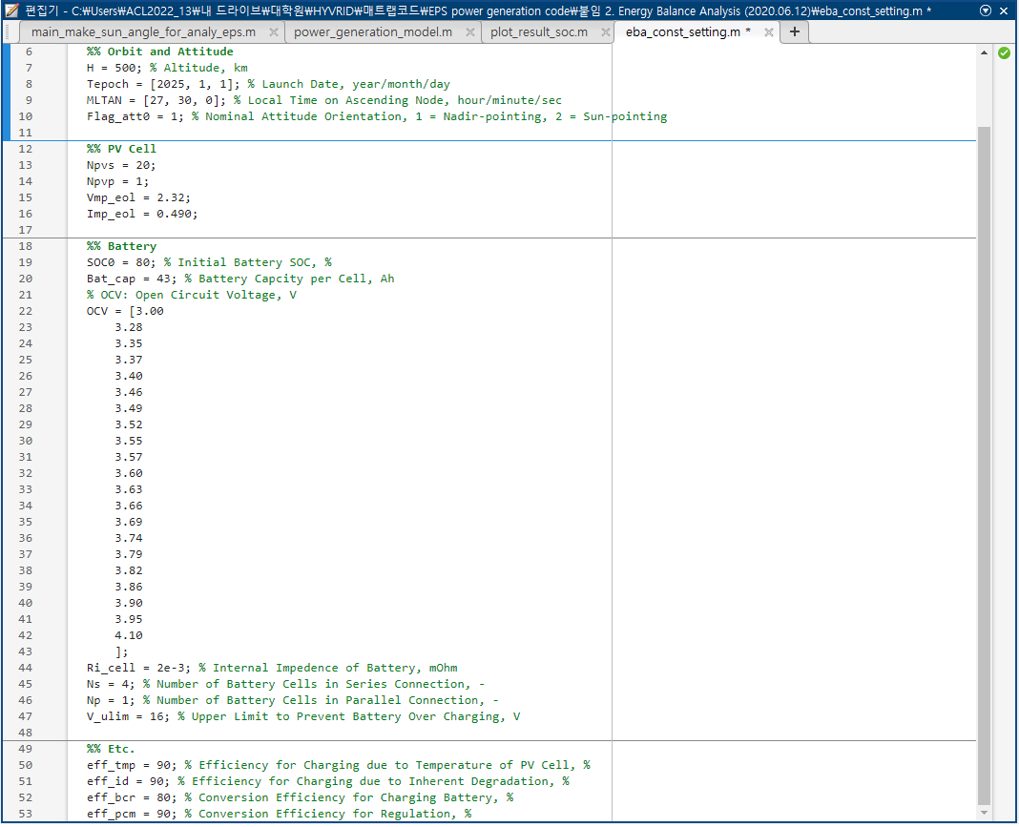

Slide 4
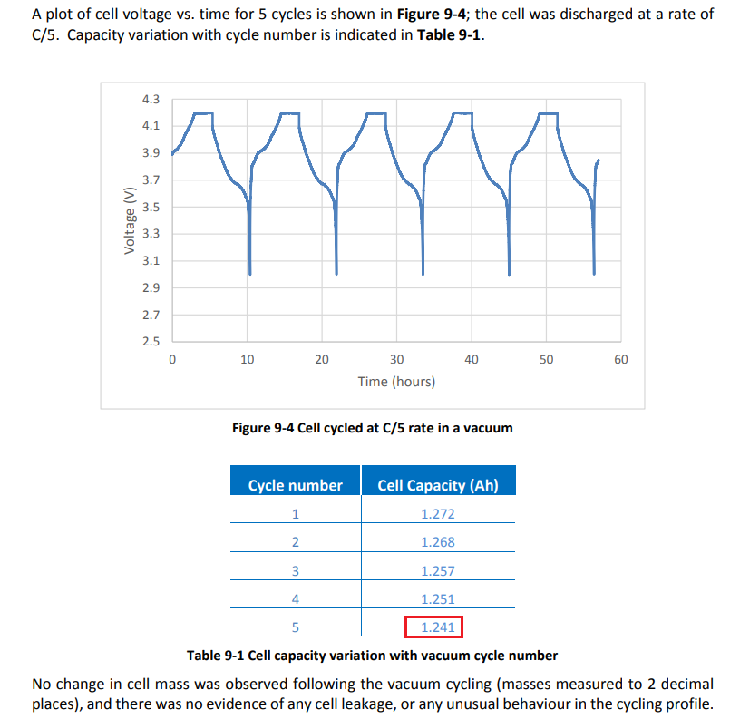

Slide 5
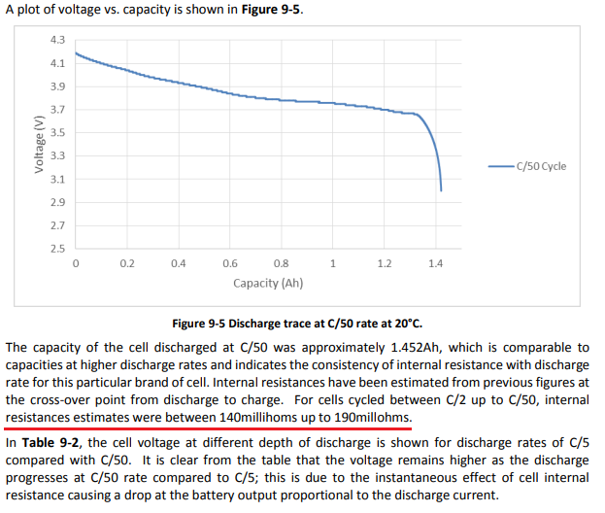

Slide 6
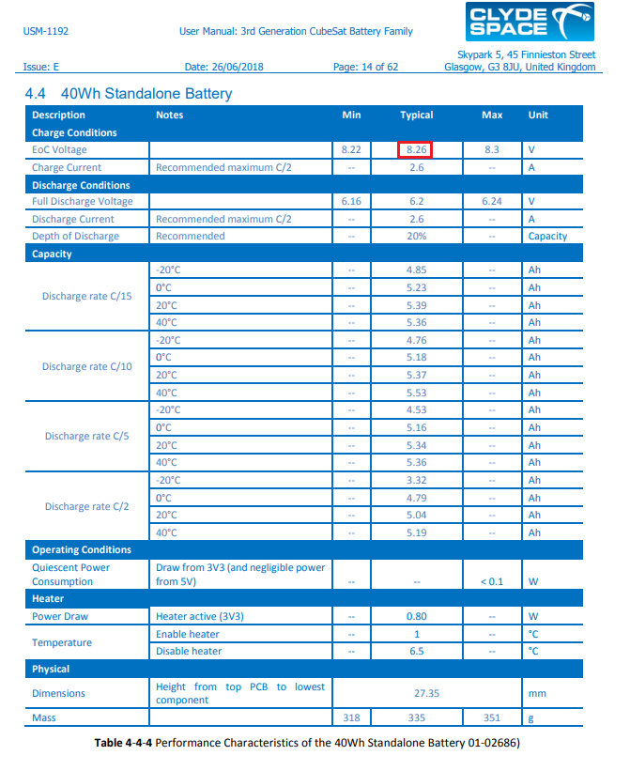

Slide 7
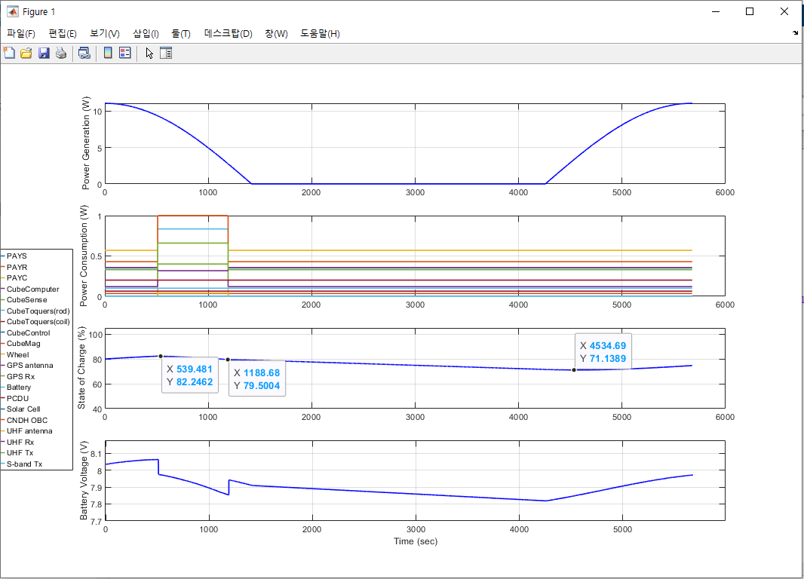

Slide 8
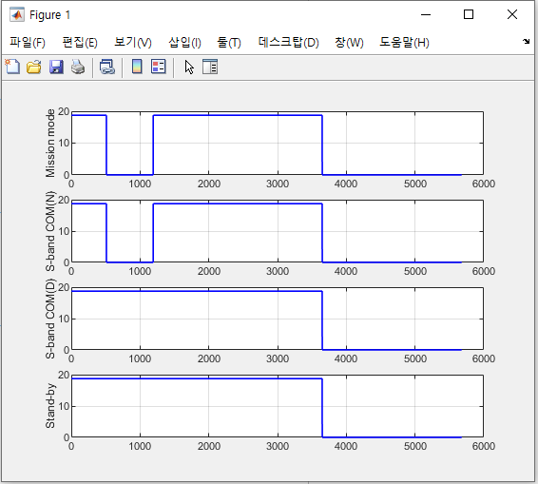

Slide 9
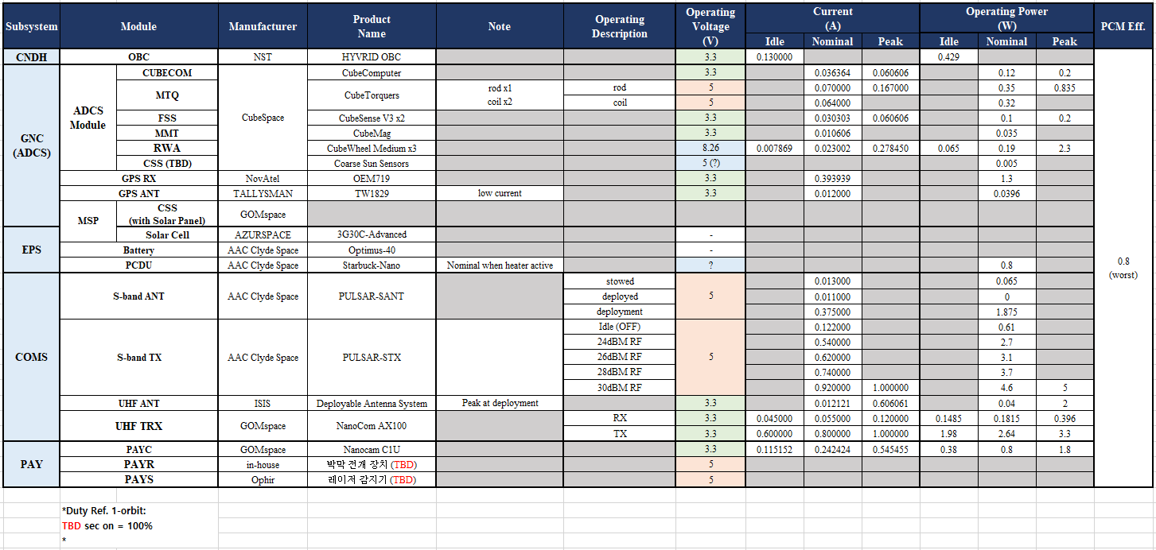

Slide 10
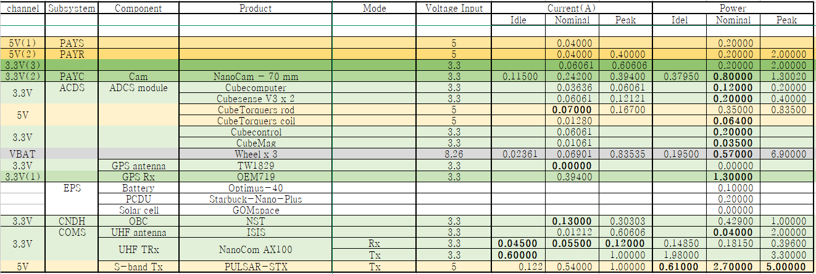
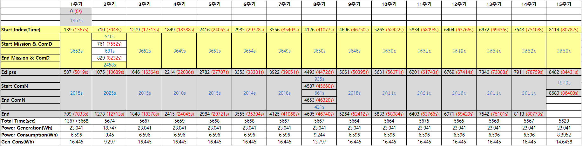
Component - Voltage, Current, Power

Slide 11
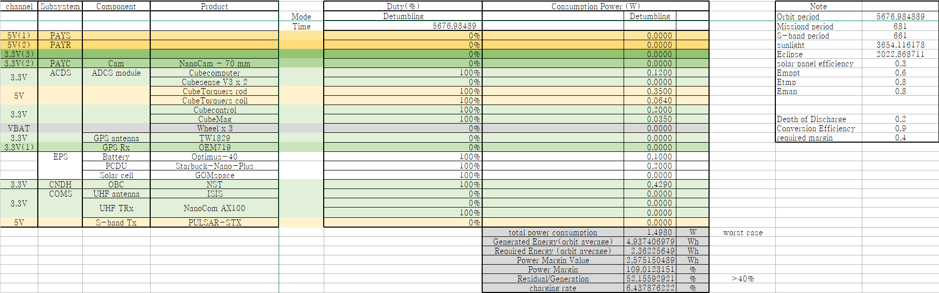
0. Detumbling

Slide 12
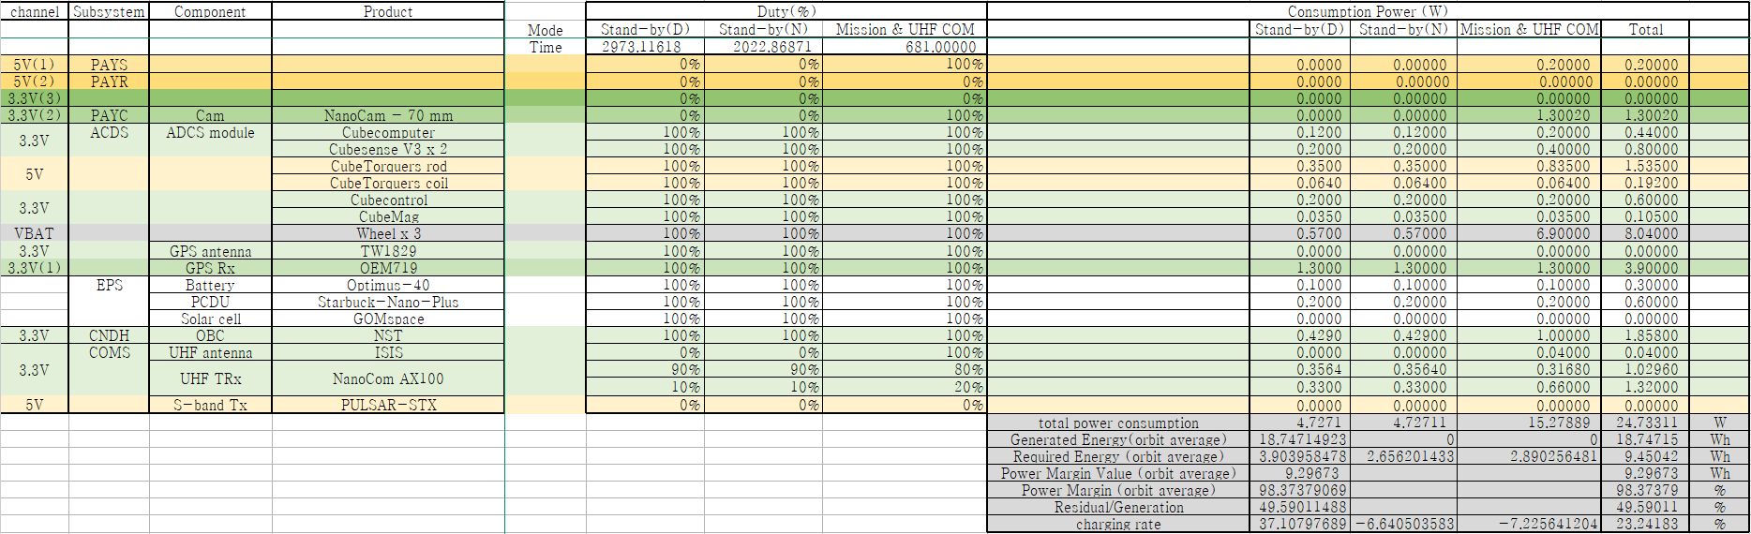
1. Mission & UHF COM (2번째 주기)

Slide 13
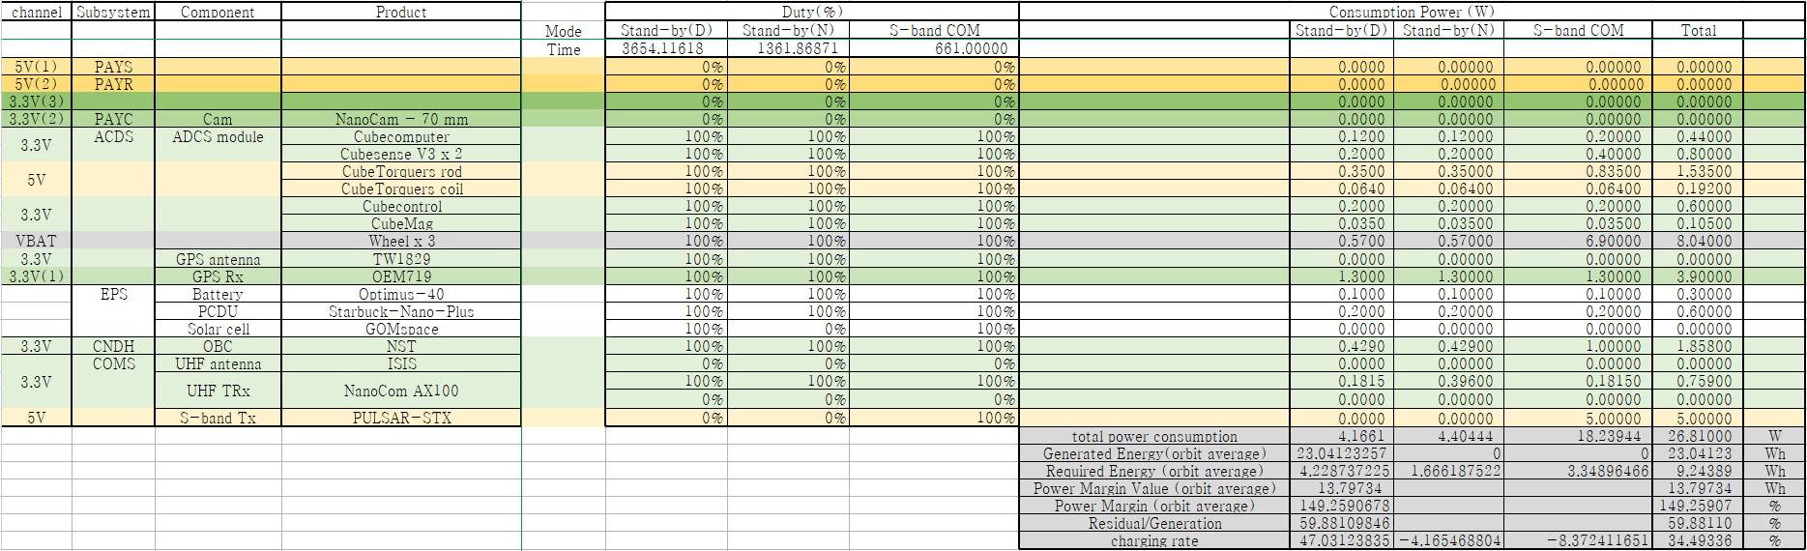
2. S-Band COM (8번째 주기)

Slide 14

3. S-Band COM (2번째 주기)

Slide 15
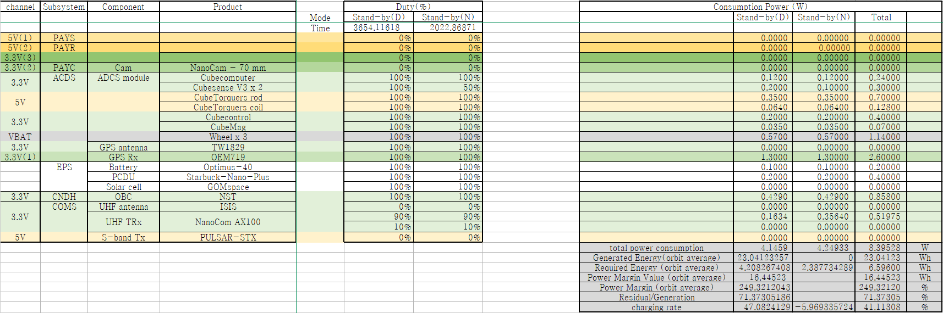
4. 그 외

Slide 16
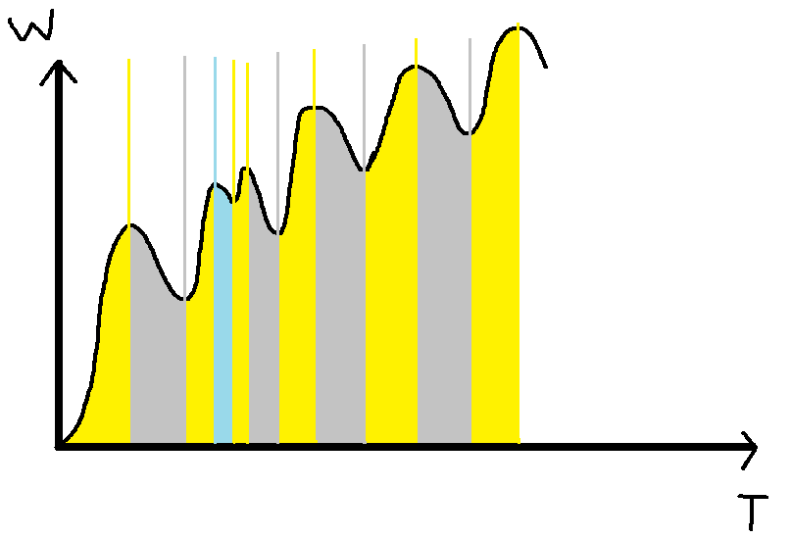
Energy generation, consumption (Orbit)

Slide 17
