Slide 1
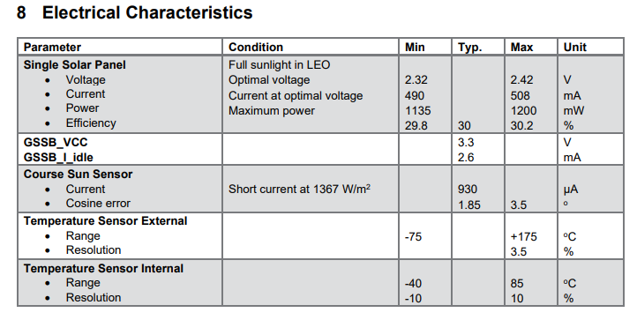
MSP

Slide 2
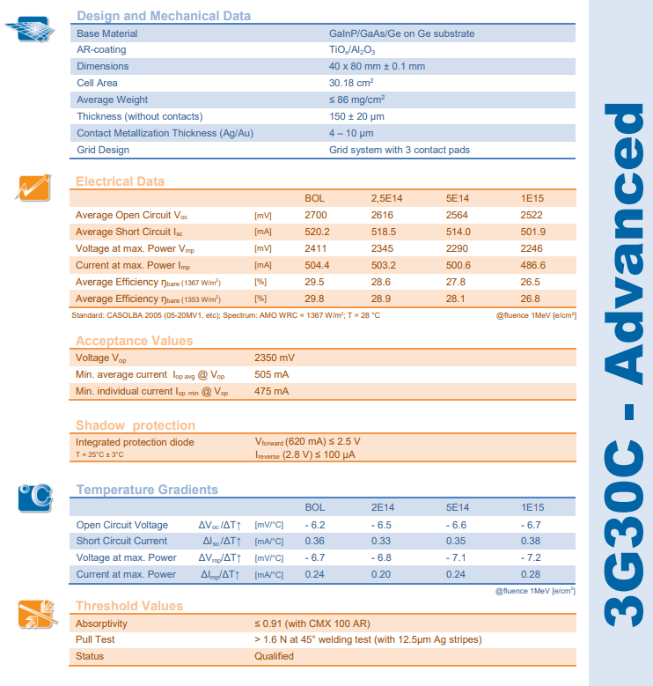
Solar cell (AZURSPACE)

Slide 3
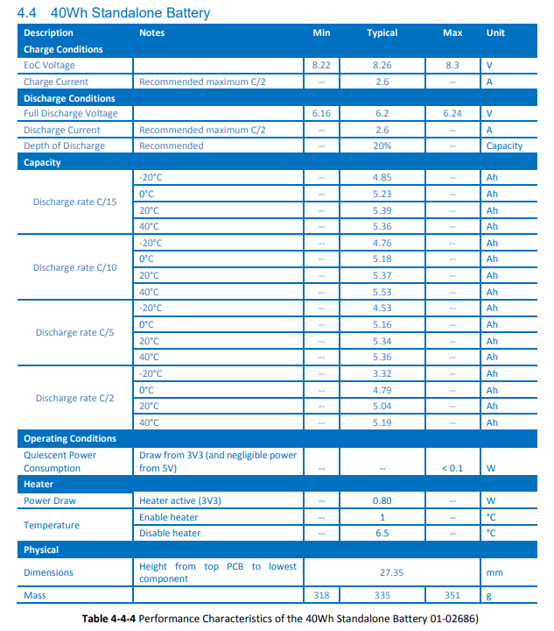
Battery (AAC Clyde)
Optimus 40?

Slide 4
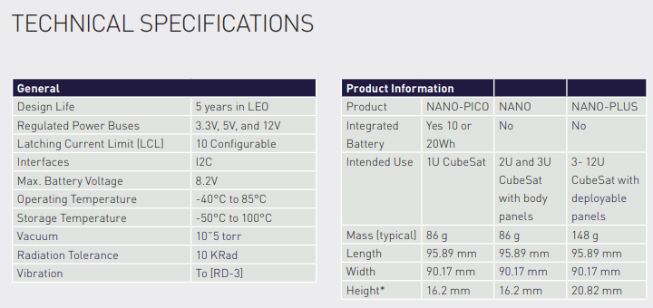
PCDU (AAC Clyde)
Nano?
Nano-plus?

Slide 5
S-band ANT

Slide 6
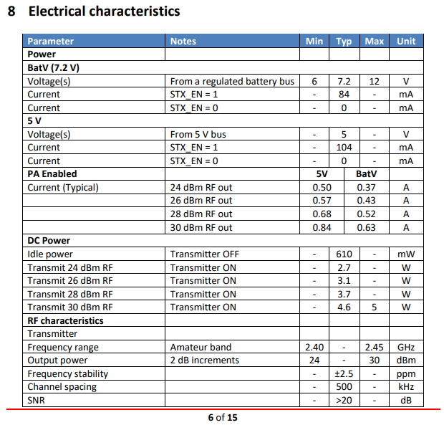
S-band Tx
24 dBm, 30 dBm

Slide 7
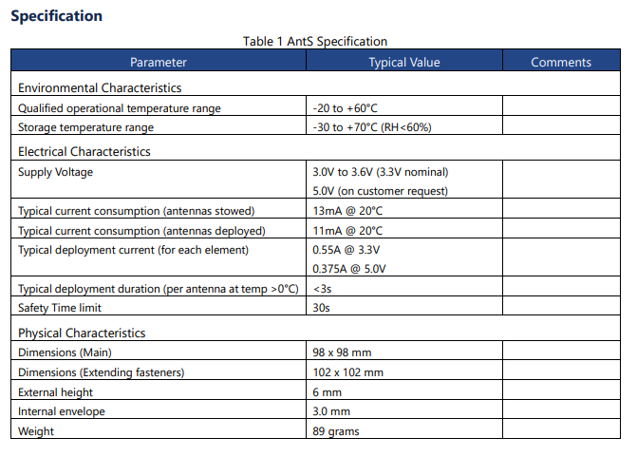
UHF ANT
Deployed – 0?
deployment
0.429

Slide 8
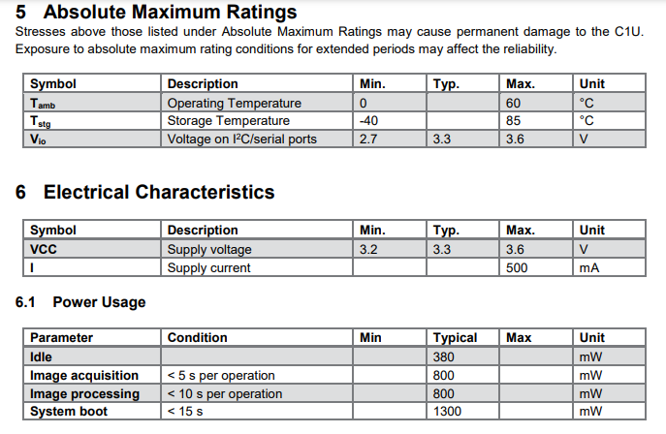
PAYC
Peak 1.8

