Slide 1
Electrical Power System
Basic Plan
1 - Channel distribution
2 - Power generation
3 - Calculation DOD
4 – Operation Scenario
PDR (2022.11)
Power generation (~9/28)
Generating Time rate Calculation
(Dayside time x 0~100%)
Power generation (~10/19)
Simulink -> Visualization (graph)

Slide 2
Level 1: Electrical Power System
Level 2 | Level 3 | DAYS
Electrical Power Budget | 1 - Channel distribution | 0
 | 2 – Calculate Power generation | 0
 | 3 - Calculation DOD & Peak load | 0
 | 4 - Operation Scenario
Power Generation | Generating Time rate Calculation (Dayside time x 0~100%) | 0
 |  | 0
 |  | 0

Slide 3
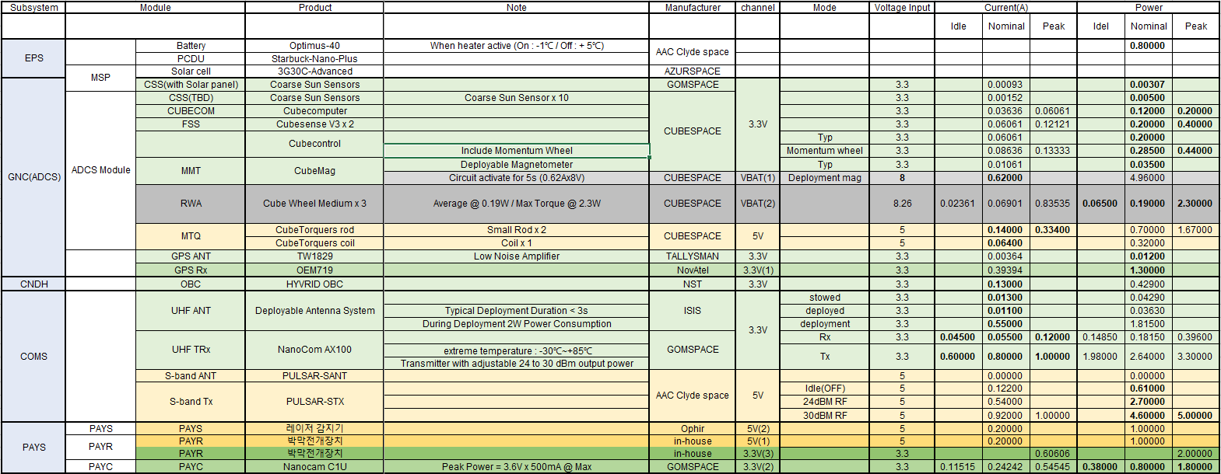
Level 1: Electrical Power System

Slide 4
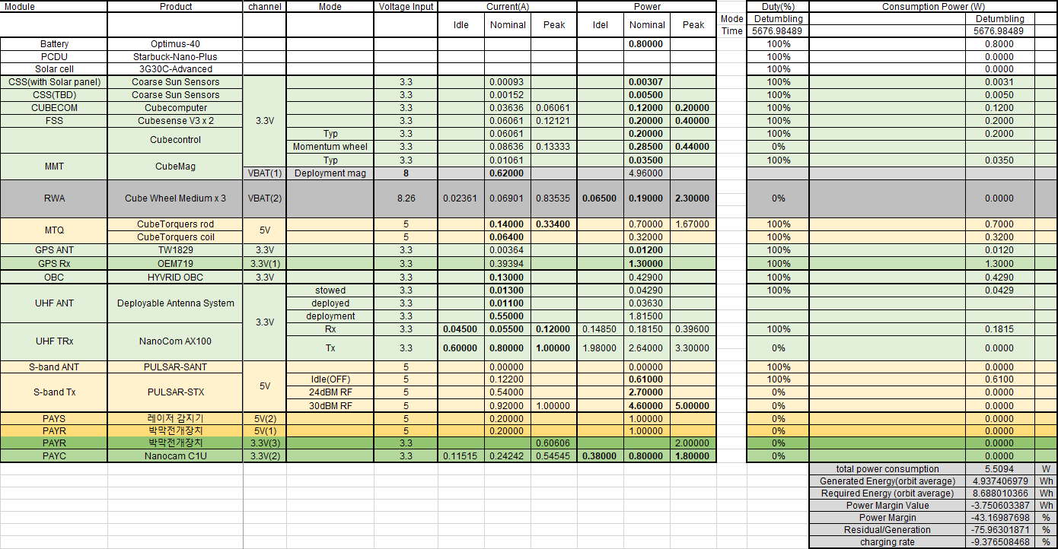
0. Detumbling mode

Slide 5
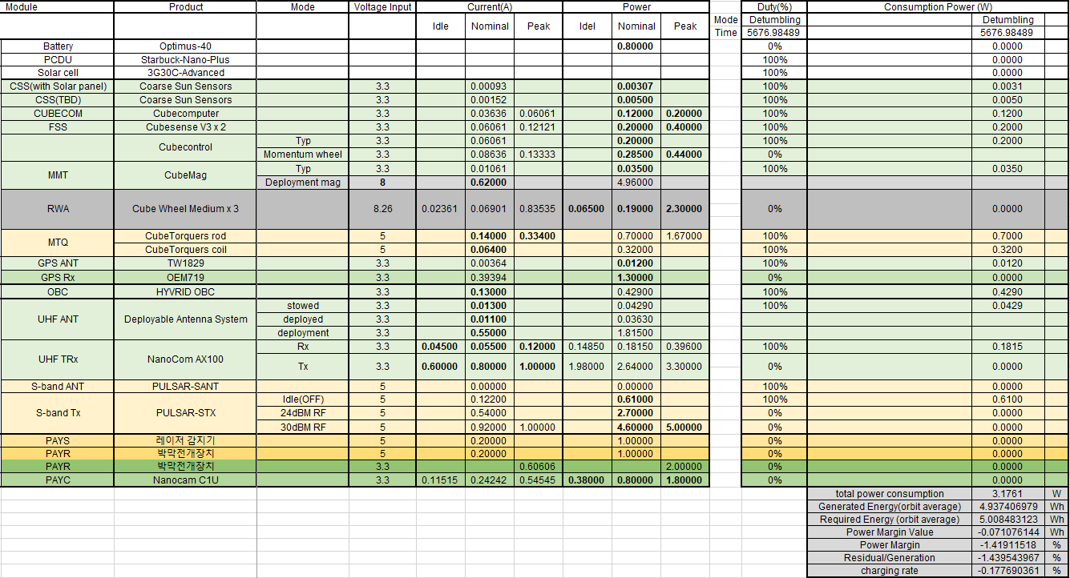
0. Detumbling mode

Slide 6
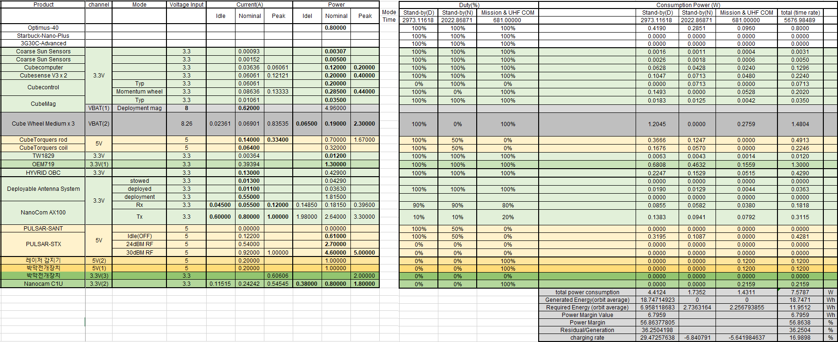
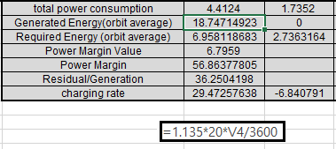
1. Mission & UHF COM mode

Slide 7
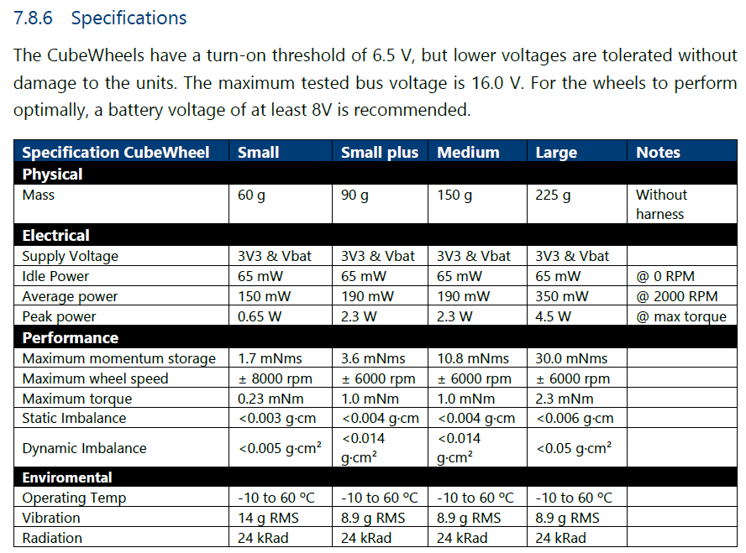
1. Mission & UHF COM mode

Slide 8
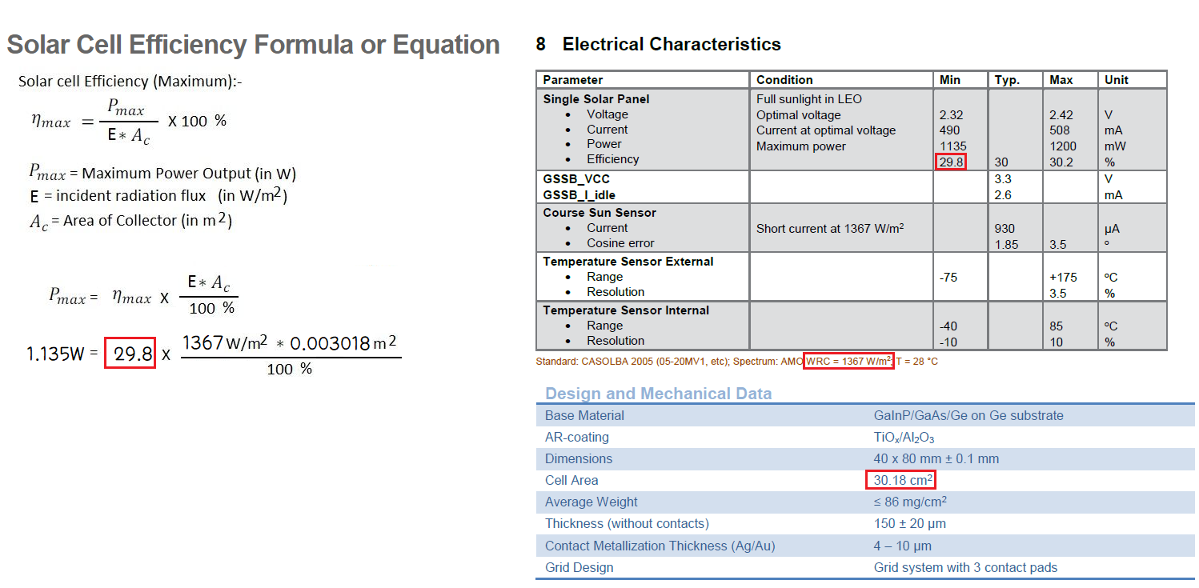
1. Mission & UHF COM mode

Slide 9
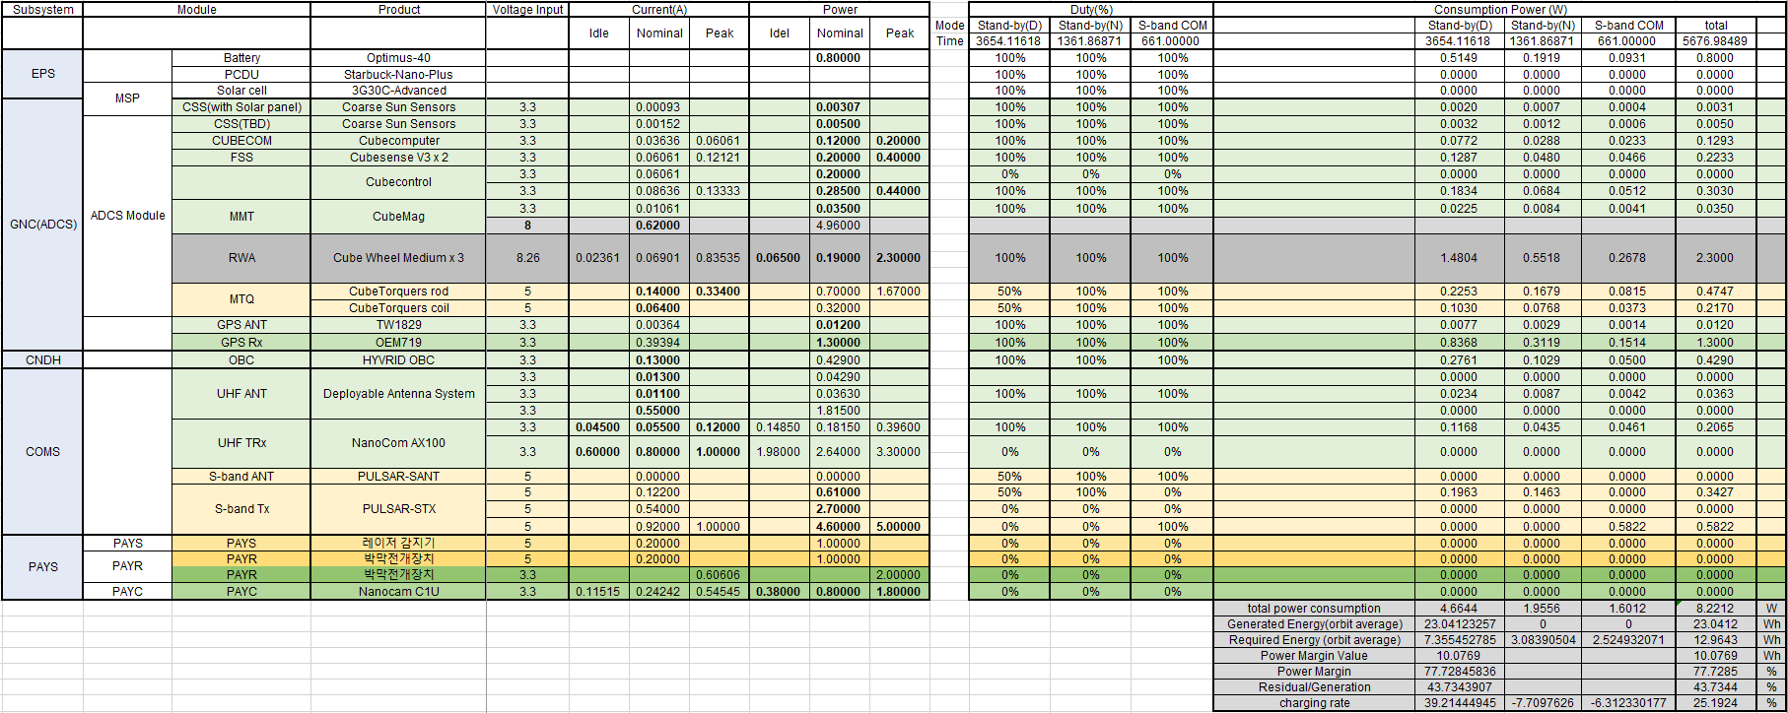
2. S-band COM mode(@Night)

Slide 10

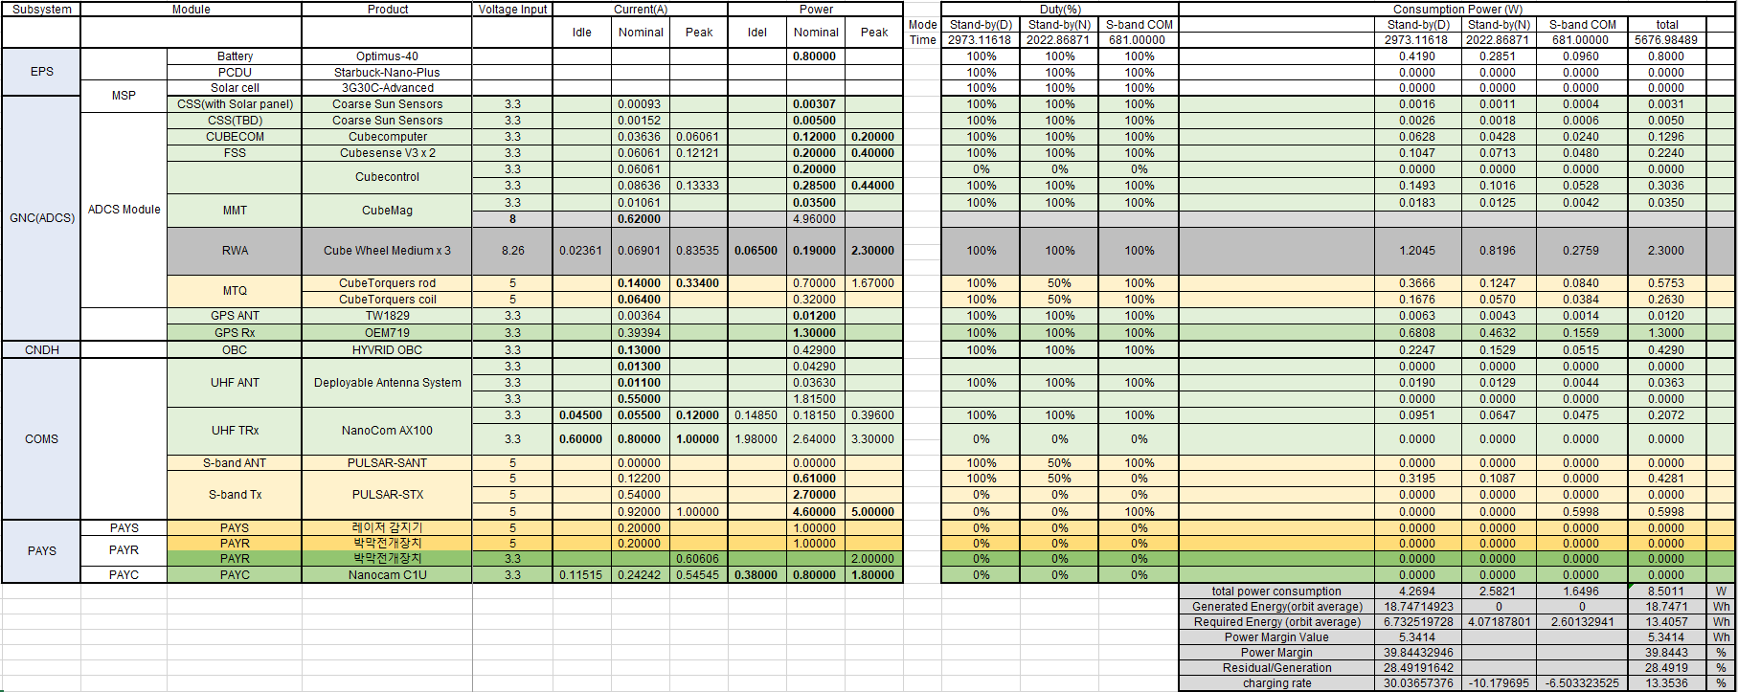
3. S-band COM mode(@Day)

Slide 11
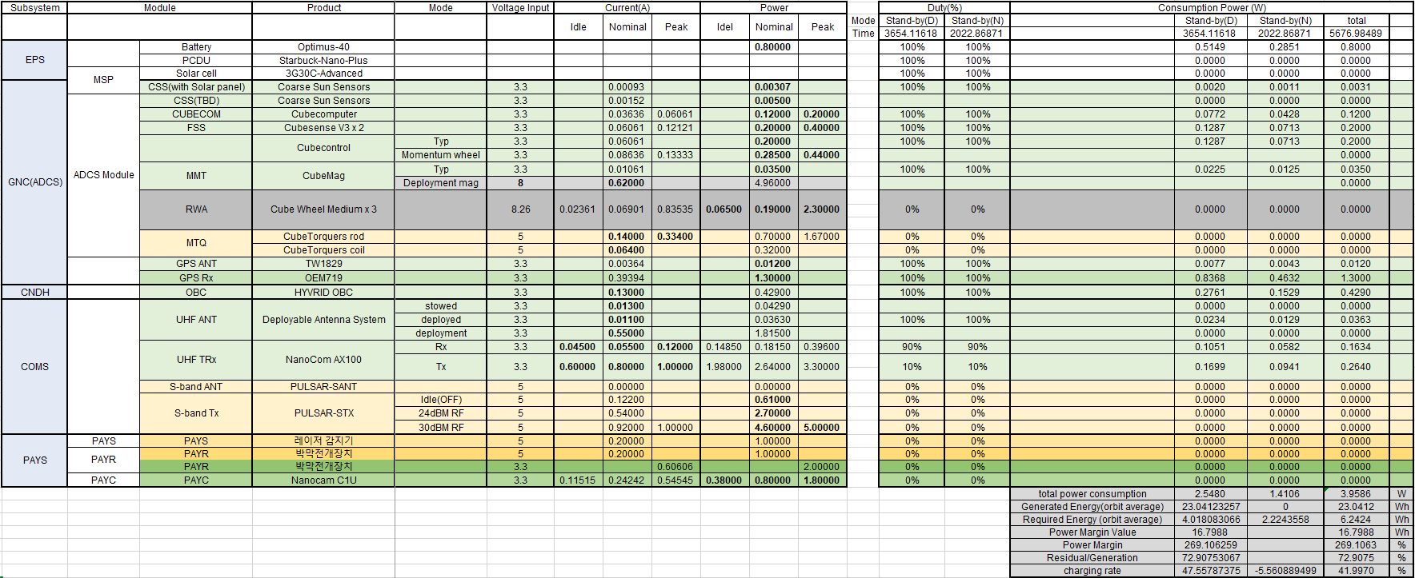
4. Stand-by mode

Slide 12
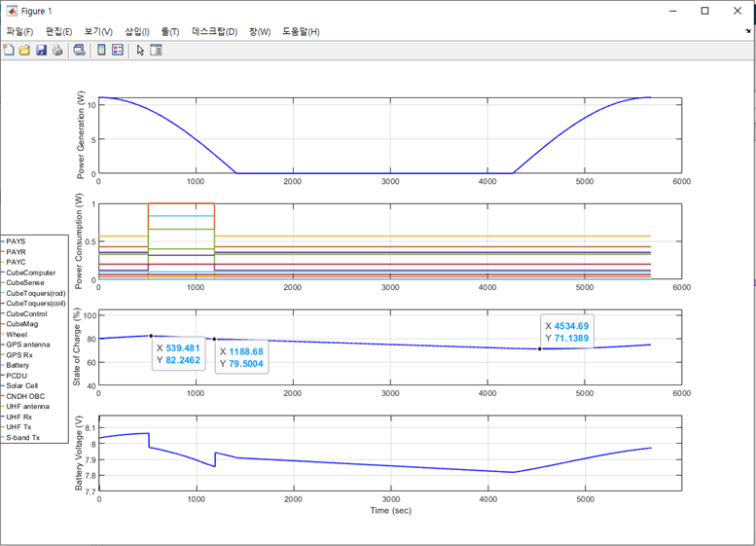

Slide 13
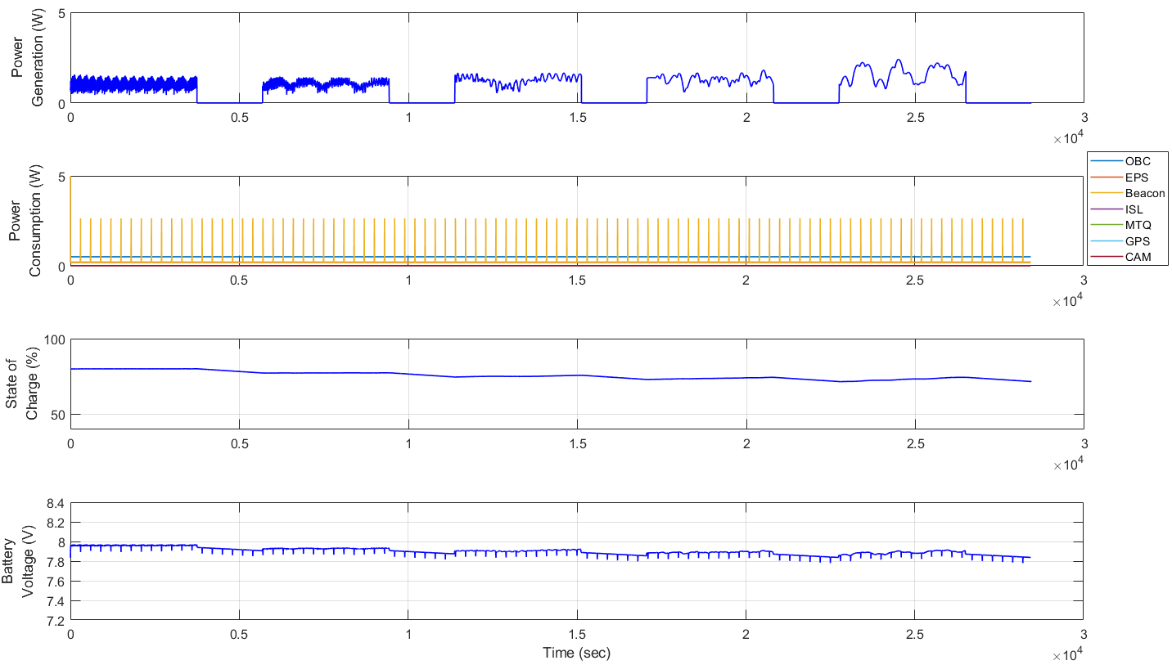

Slide 14
