Slide 1




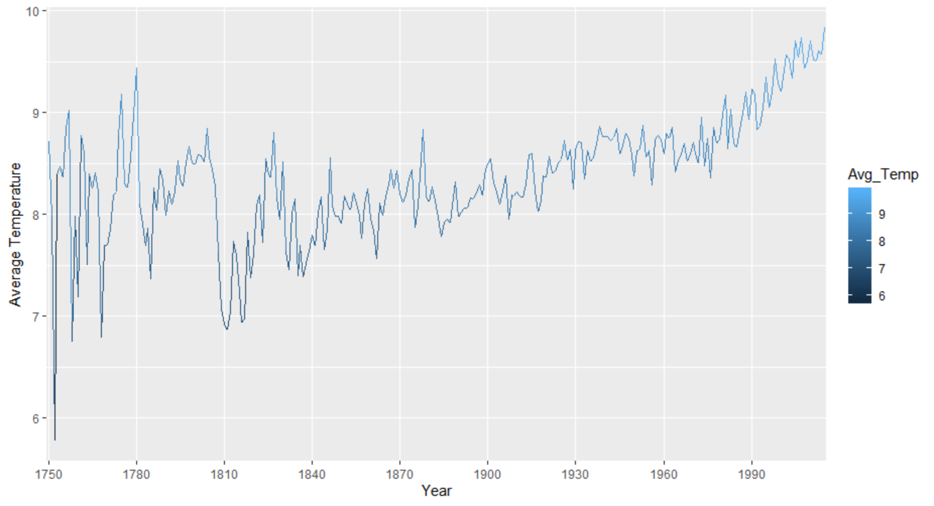
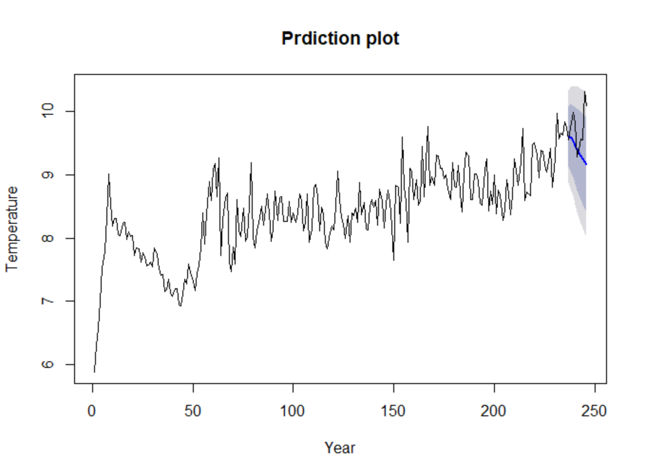
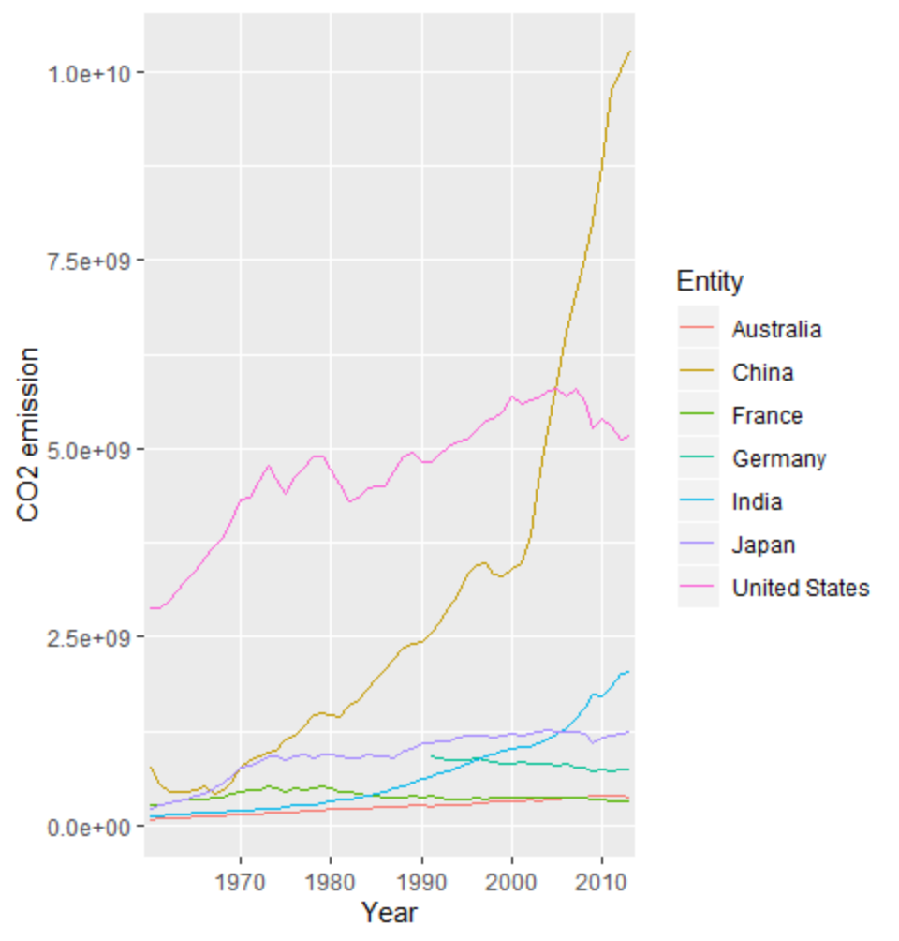
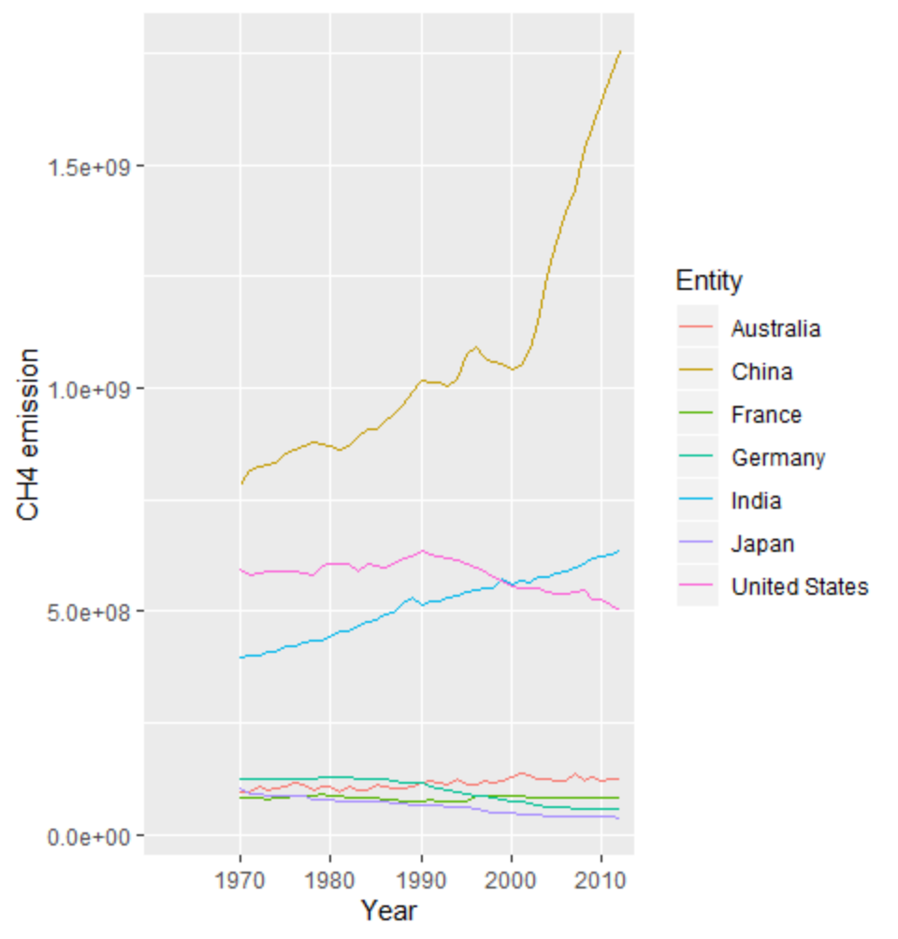
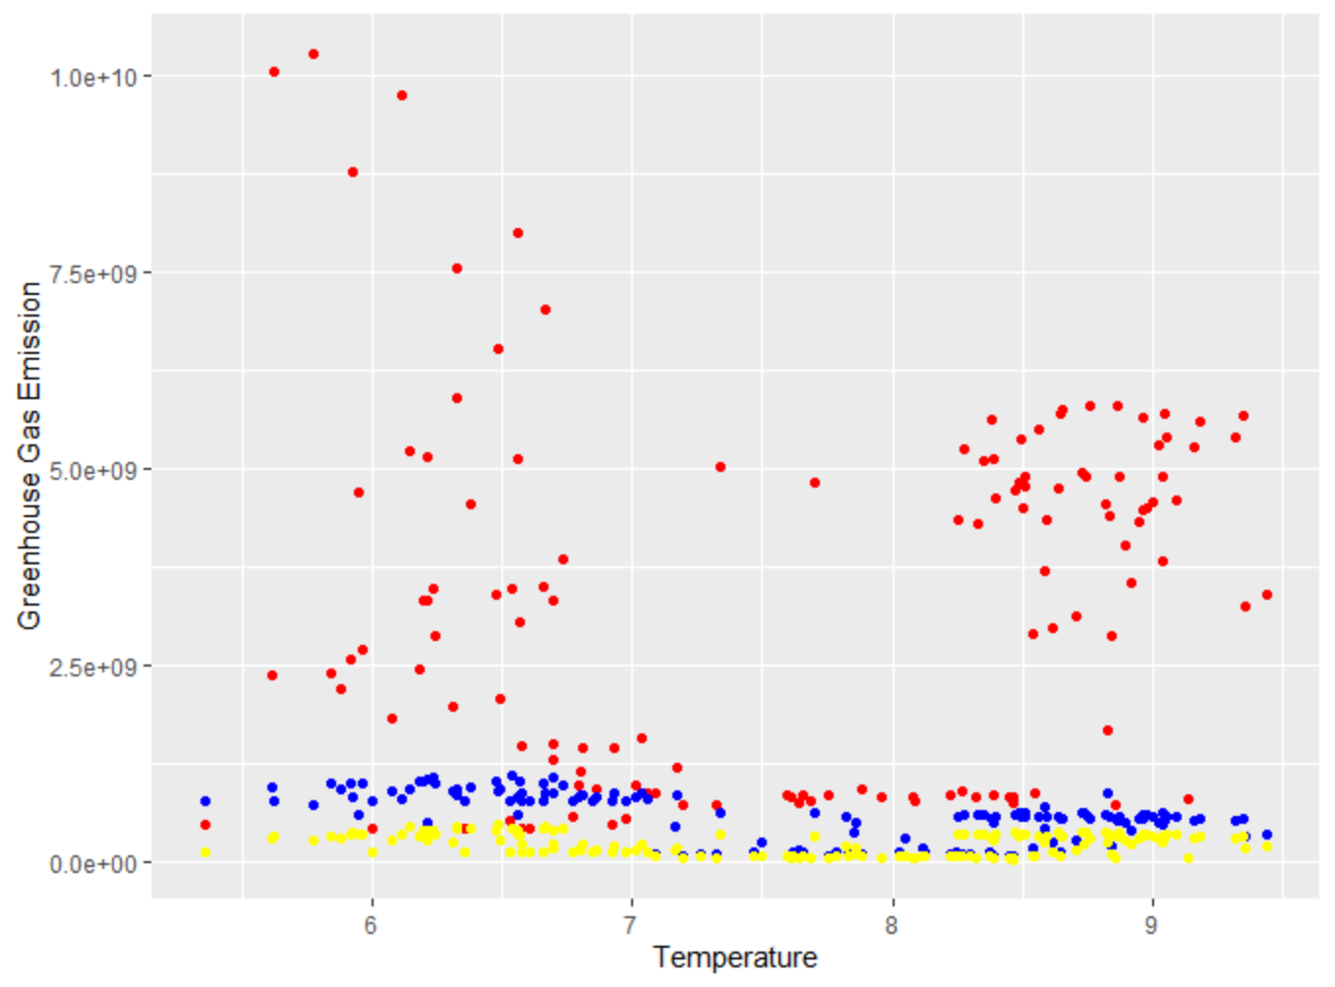
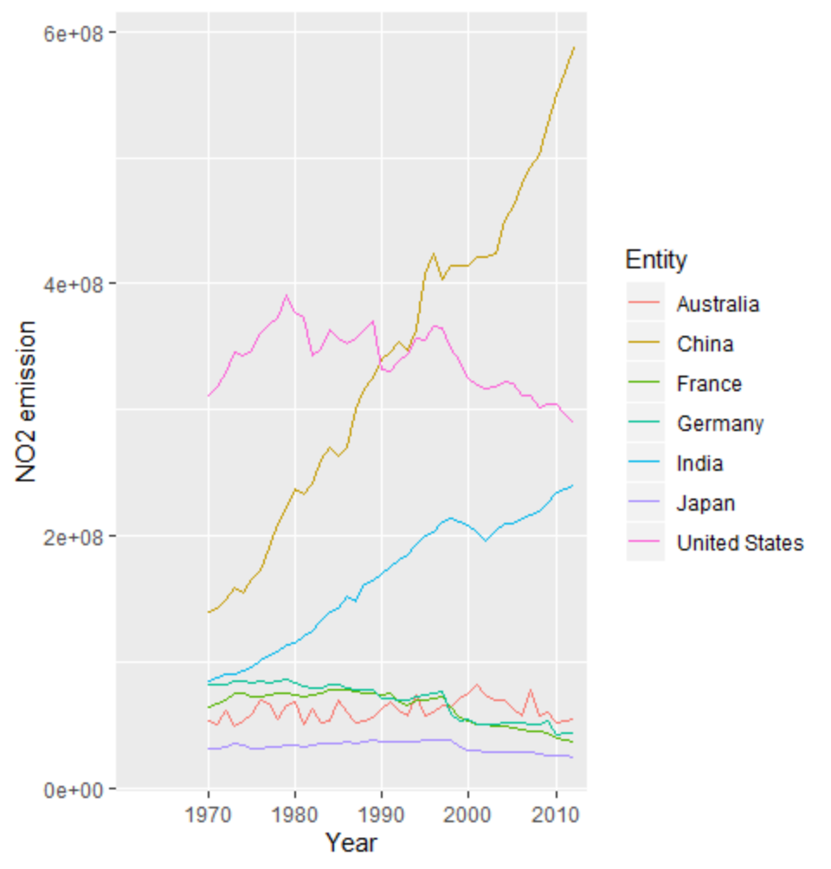
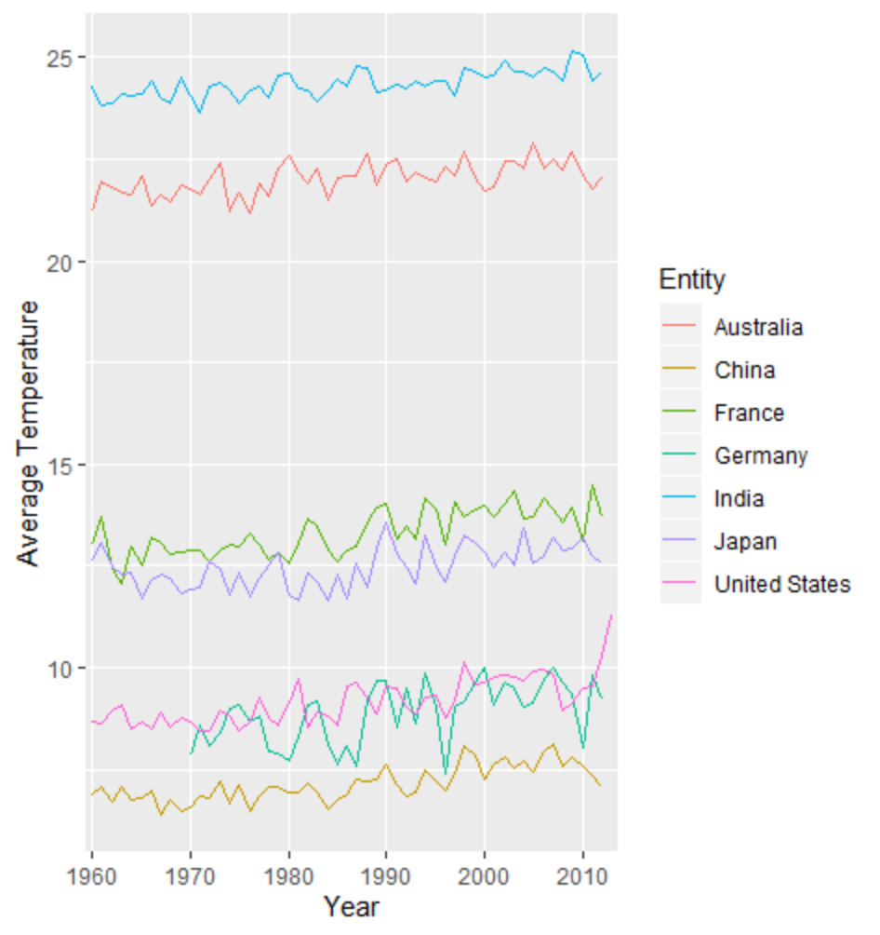
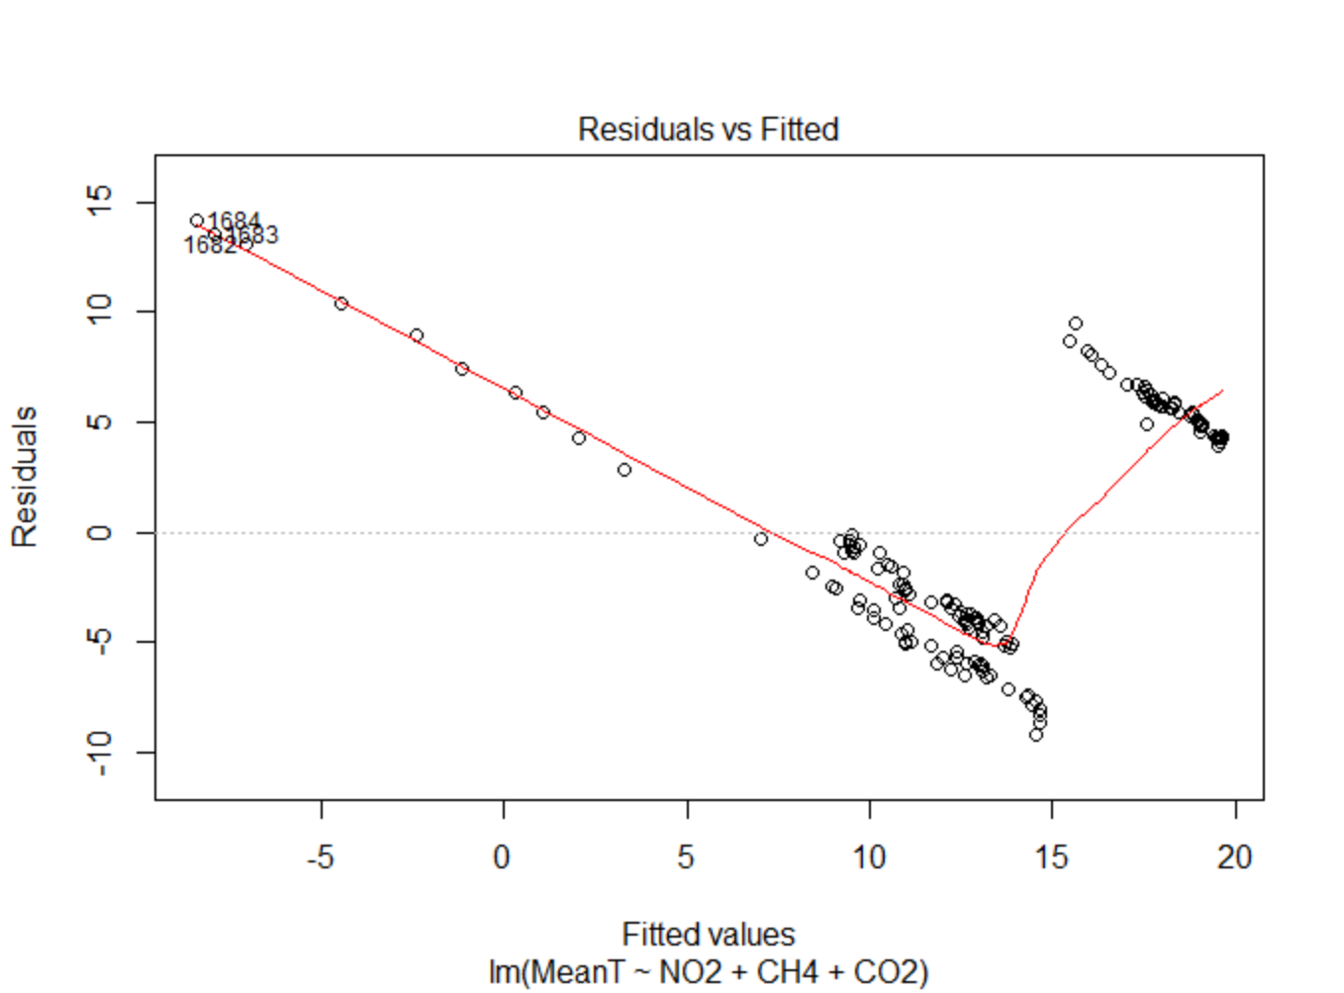
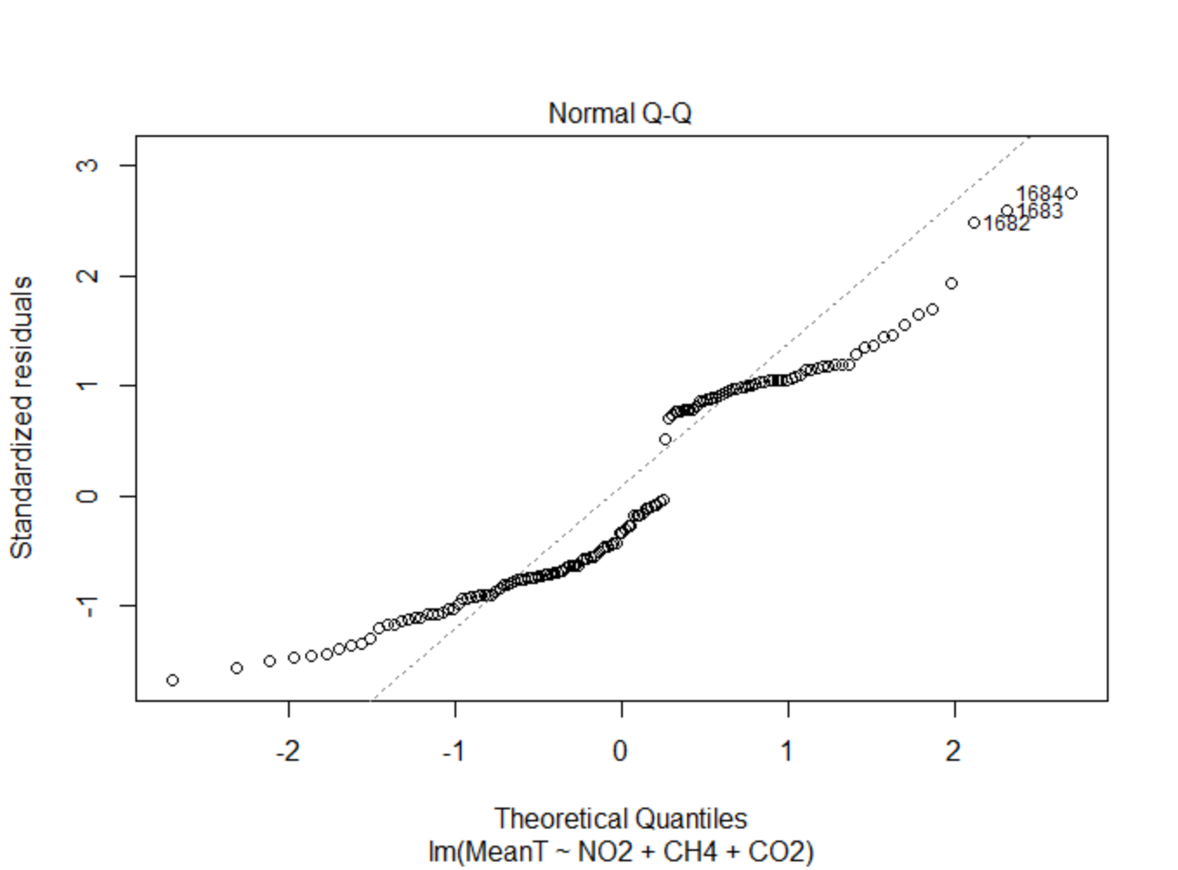
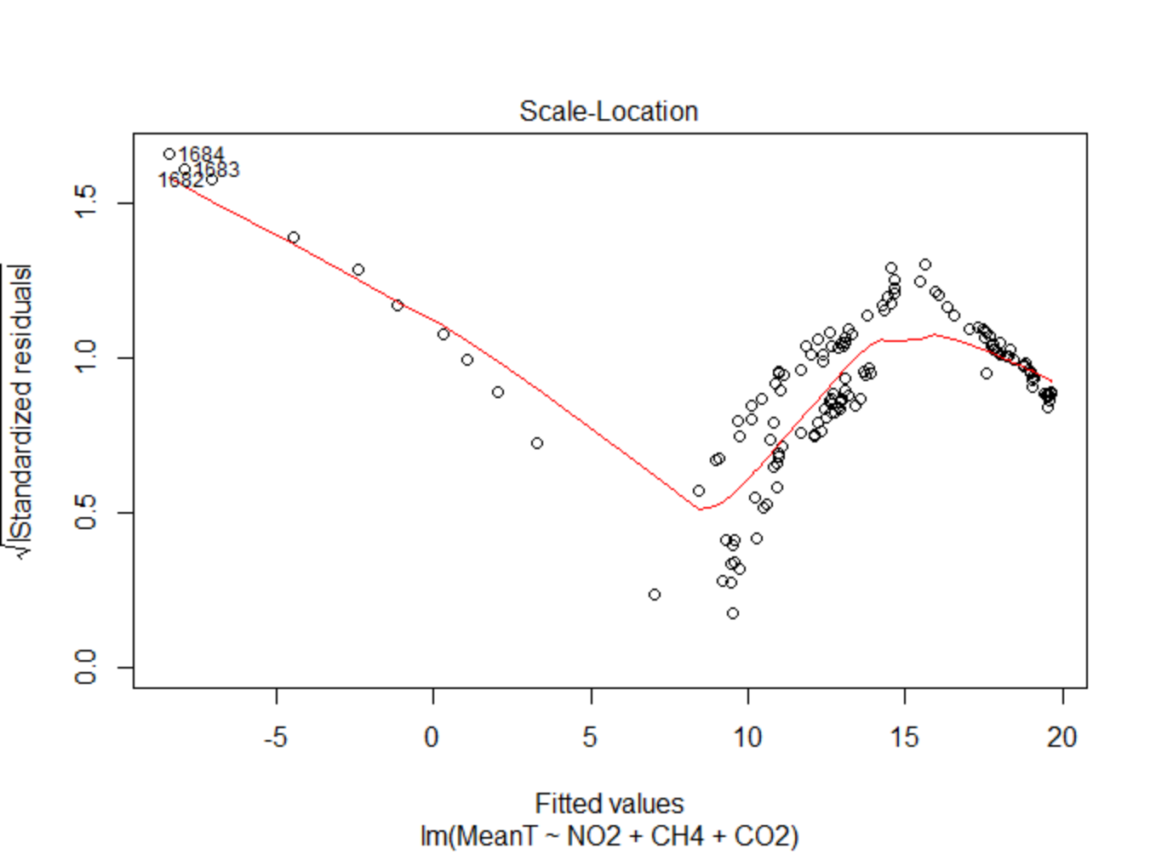
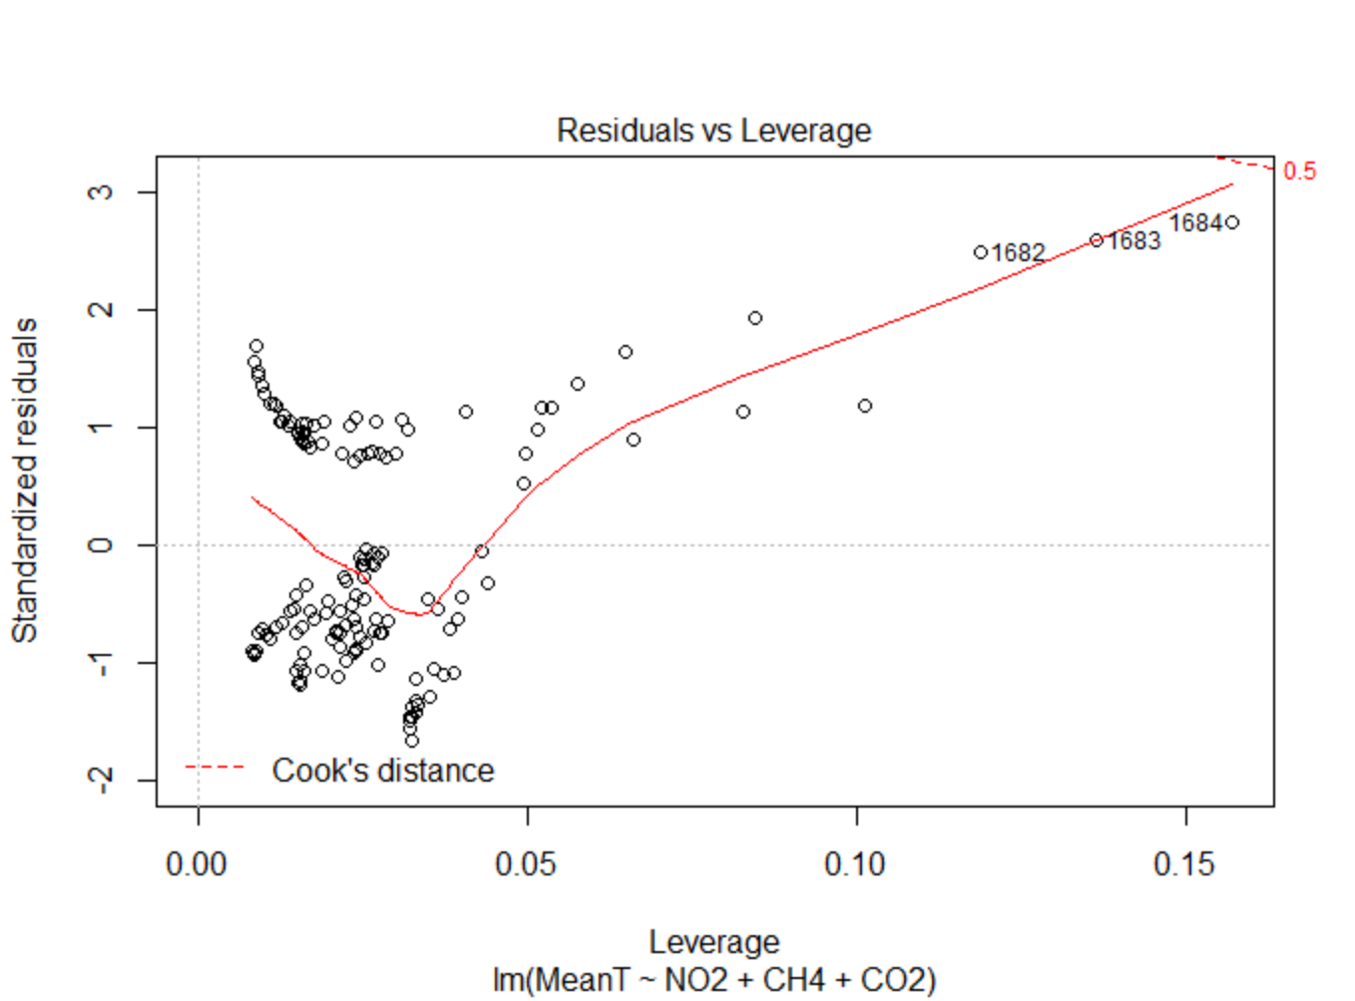
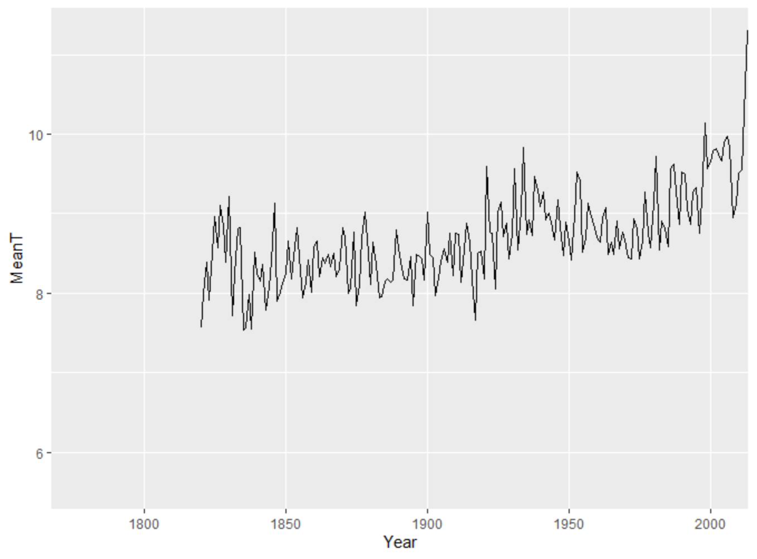
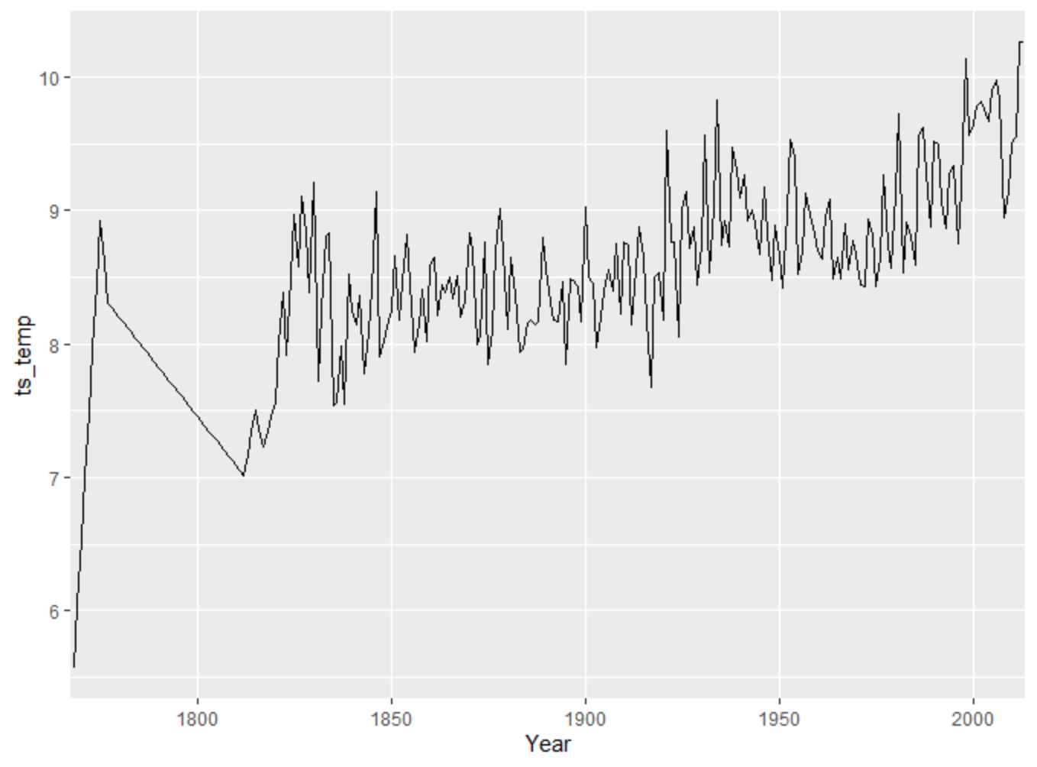
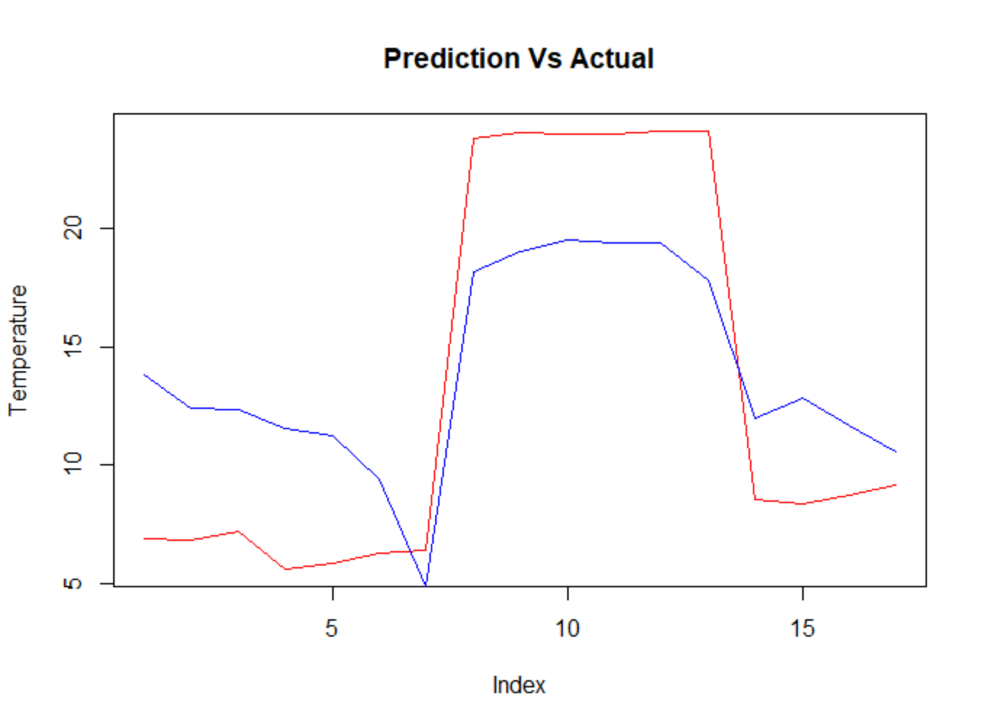
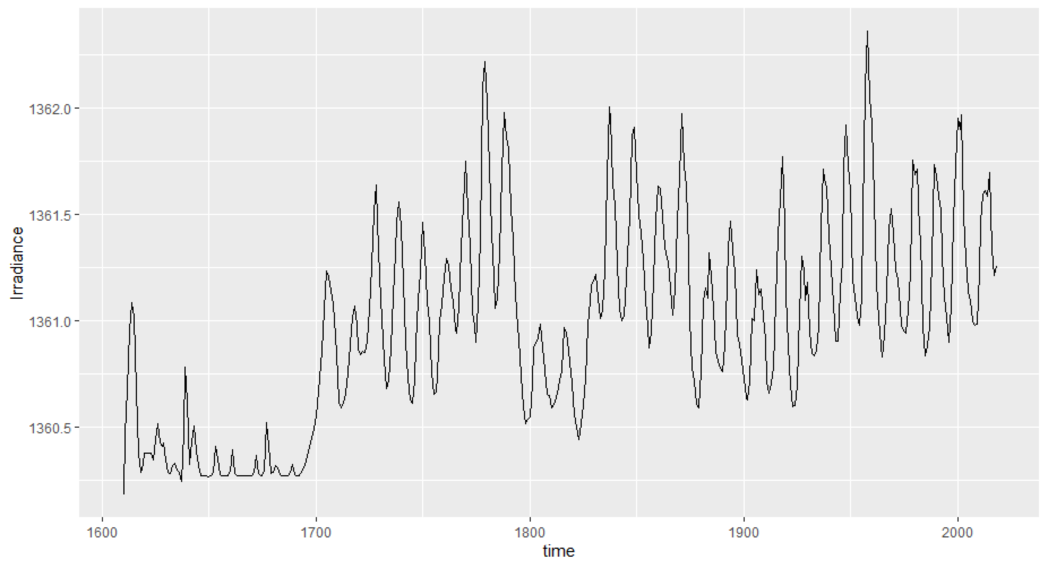
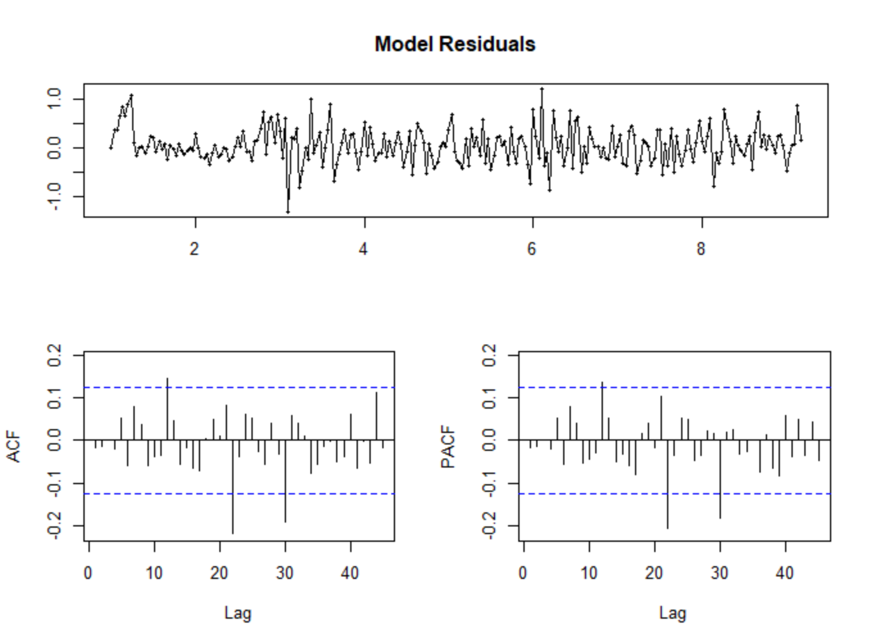
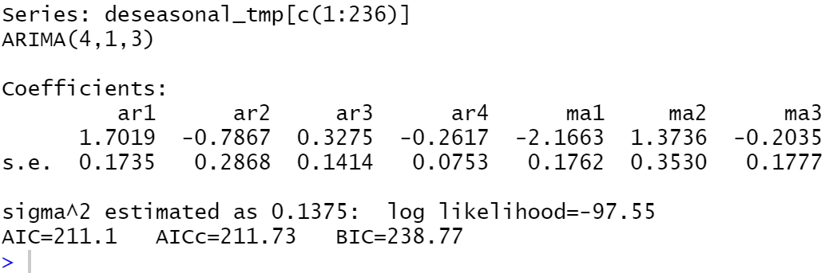
Data Analysis On Global Warming
Junjie Ding dingj4@rpi.edu
¹Rensselaer Polytechnic Institute, Tetherless World Constellation, Troy, NY, United States,
Abstract
Figure 2
Figure 1: solar irradiance since 1600
Figure 2: global average temperature since 1750
Figure 9: model diagnostics and model parameters
Figure 8: coefficients of models
Australia suffered from massive bushfires in the early of this year, and experts estimated that Australia's bush fires will become more frequent and more intense as climate change worsens. Therefore, global concerns about global warming start to rise.
Global warming is the rise of the average temperature of Earth’s climate system. It is believed that the average global temperature has increased at the fastest rate in the past 50 years, but there are some opinions argue that the global warming is not as serious as the public believes.
This poster will discuss how to use data analytics techniques to visualize the climate change and predict the future temperature.
Predication:
Figure 11
Figure 11: Predictions is the blue line in and grey parts are confidence bounds
Conclusion:
From Figure 11, we can see that the predicted future temperature will decrease and predictions are not very accurate.
2. Linear regression model:
Problem Area
Data cleaning:
This poster will explore if the global average temperature increased in the past 200 years. In addition, the poster will explore what will our future temperature be based on the historical data to know if we will experience global warming. There are some existing climate models that can predict the temperature in the next few days accurately (e.g. Weather forecasting), but it is difficult to get accurate predictions of the future temperature in long-term. However, we need to have long-term predictions of the average temperature in order to study the impact of global warming. This poster will use ARIMA model and Linear regression model to make predictions of the future temperature.
Figure 3
Figure 4
Figure 12
Figure 5
Figure 6
Figure 12:plot of the data after cleaning data
Model fitting:
Figure 3,4,5: three major greenhouse gas emission since 1960
Figure 6: land average temperature of selected countries since 1960
From Figure 1, the solar irradiance fluctuates, but there is not a clear trend shows that the solar irradiance level increased since 1700.
From Figure 2, it is clear that the global temperature has increased for last 200 years and it increased rapidly in the past 50 years.
Datasets
1. Data description:
One of the purposes of this project is to see whether the global average temperature is increasing, so I need to find a dataset that contains the historical data of average temperature. The first dataset I use in this project is land surface temperature dataset from Berkeley Earth. This dataset contains monthly average temperature of major cities across the world since 1750. Since according to the scientists, global warming happens when carbon dioxide and other greenhouses gases gathered in the atmosphere and absorbed solar radiation that have bounced off the earth’s temperature, I also use the historical total solar irradiance reconstruction dataset and three major greenhouse gases emission dataset in this project. The source of historical total solar irradiance reconstruction dataset is LASP interactive solar irradiance datacenter of University of Colorado.
2. Data analysis:
Figure 13
Figure 14
Models
1. ARIMA model:
Data cleaning:
Figure 15
Figure 16
Figure 13,,14,15,16: plots of the parameters and coefficients of fitted model
Predication:
Figure 7
Figure 8
Figure 7: plot of data before replacing outliers and removing NAs
Figure 8: plot of data after replacing outliers and removing NAs
Model fitting:
Figure 17
Figure 17: plots of the prediction values Vs actual value
Prediction value is blue line, actual value is red line
Conclusion:
Although there are differences between predicted values and actual values, the trend of the temperature changes is similar for predicted values and actual values. In addition, I use the estimates of greenhouse gas emission of 2025 to predict the temperature of 2025. The predicted average temperature of United States is 9.009 degree which is higher than the temperature of 2012 and 2013.
Figure 1
Figure 9
Figure 10
Resources:
Land temperature Data: http://berkeleyearth.org/data/
Solar Irradiance Dataset https://lasp.colorado.edu/lisird/data/historical_tsi/
How to use ARIMA model in R: https://blogs.oracle.com/datascience/introduction-to-forecasting-with-arima-in-r
Linear regression model in R: http://r-statistics.co/Linear-Regression.html
R visualization: https://www.analyticsvidhya.com/blog/2015/07/guide-data-visualization-r/

