Slide 1


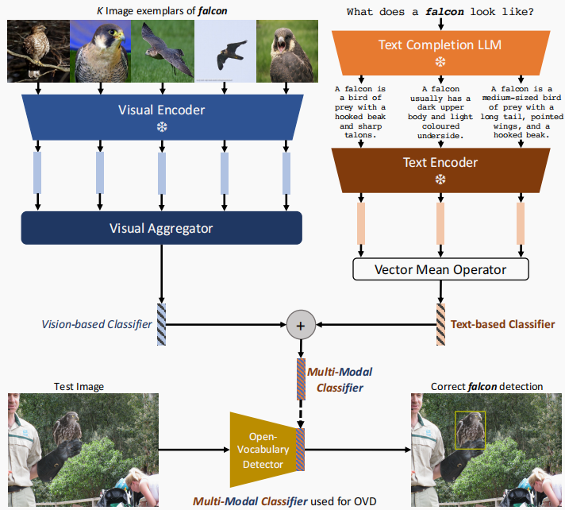
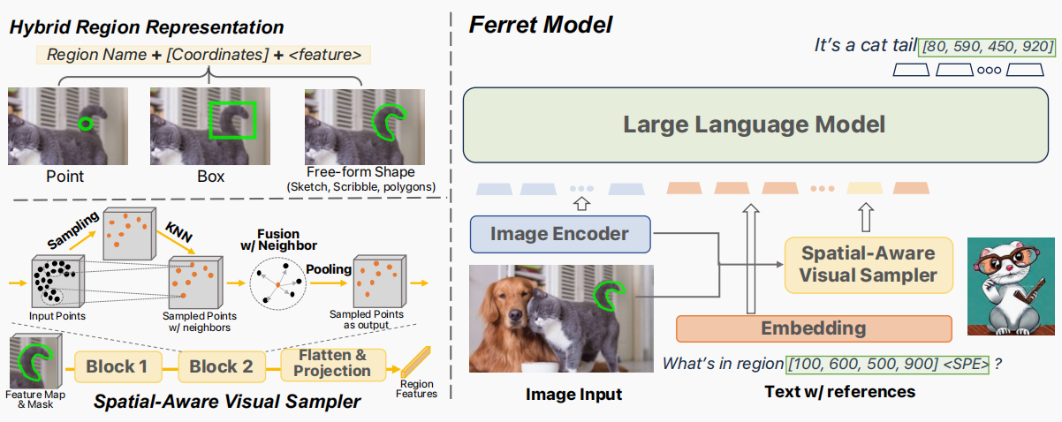
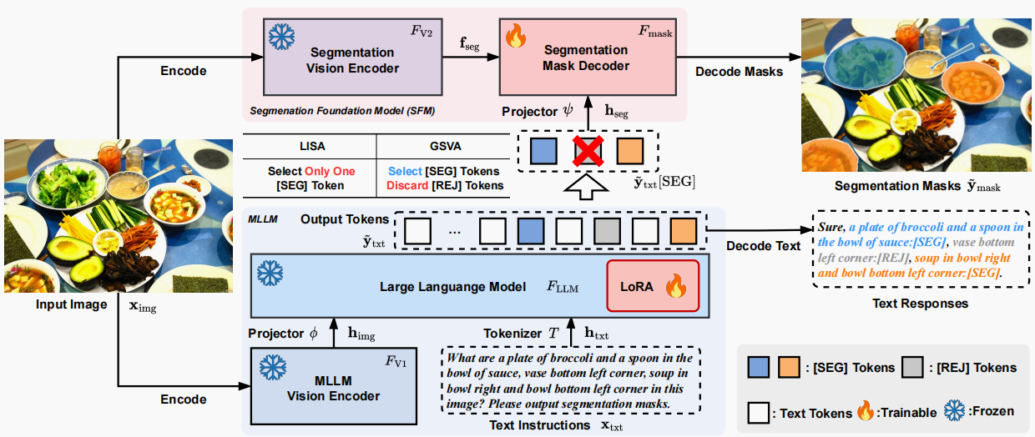
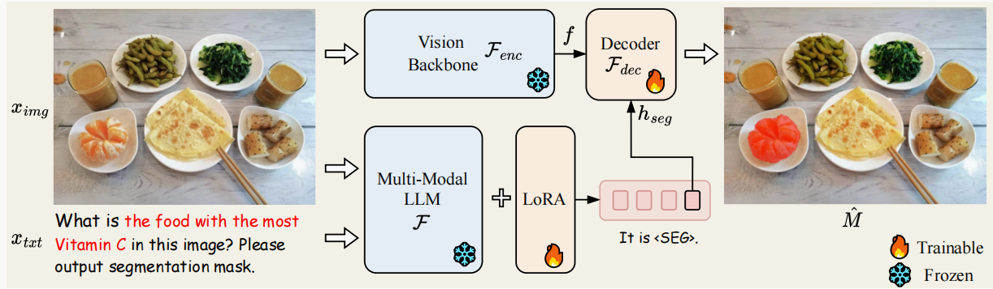
A Review of Open-Vocabulary Perception Driven by Multimodal Large Models
JunJie Liu, Sun Yat-sen University, Guangzhou, China, liujj255@mail2.sysu.edu.cn
INTRODUCTION
RESULTS
This review covers six key papers, providing a detailed overview of OVP driven by MLLMs, including background, motivation, technical details, experimental results, related work, and future prospects.
Figure 1. Overview of the proposed Ferret model architecture.
Ferret
Use a multimodal Transformer architecture that integrates image and text features by multiple layers of attention mechanisms to accomplish referring and grounding tasks.
Introducing new tokens and decoding the hidden embeddings generated by the language model into segmentation masks, achieving multimodal segmentation.
Figure 2. Overview of GSVA.
GSVA
Kosmos-2
Enabling new capabilities of perceiving object descriptions and grounding text to the visual world, integrates the grounding capability into downstream applications.
LISA
Large Language Instructed Segmentation Assistant, which inherits LLMs while also possessing the ability to produce segmentation masks.
REFERENCES
Figure 3..The pipeline of LISA.
[1] Ferret: Refer and Ground Anything Anywhere at Any Granularity.
[2] GSVA: Generalized Segmentation via Multimodal Large Language Models.
[3] Kosmos-2: Grounding Multimodal Large Language Models to the World.
[4] LISA: Reasoning Segmentation via Large Language Model.
[5] Multi-Modal Classifiers for Open-Vocabulary Object Detection.
Multi-Modal Classifiers
It uses large language models to generate textual descriptions and visual aggregators to process image samples, forming multimodal classifiers.

