Slide 1
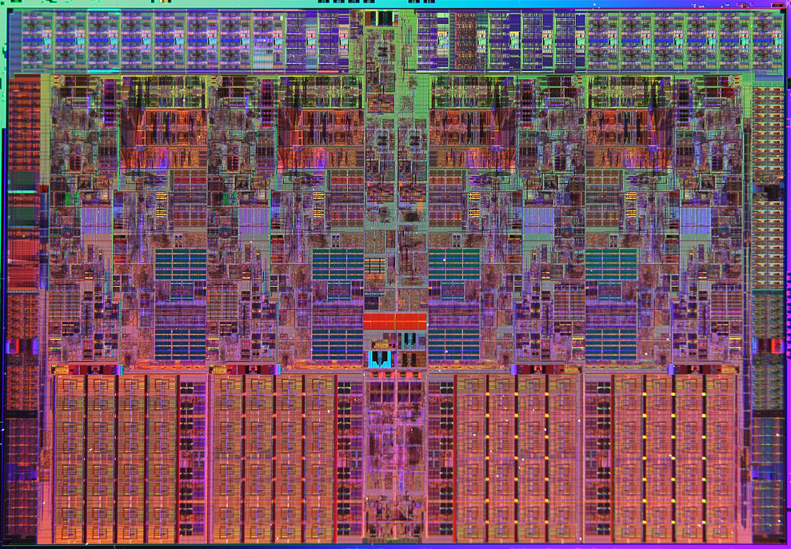
超大规模集成电路设计基础
Very Large Scale Integration Circuit (VLSI) Design

Slide 2
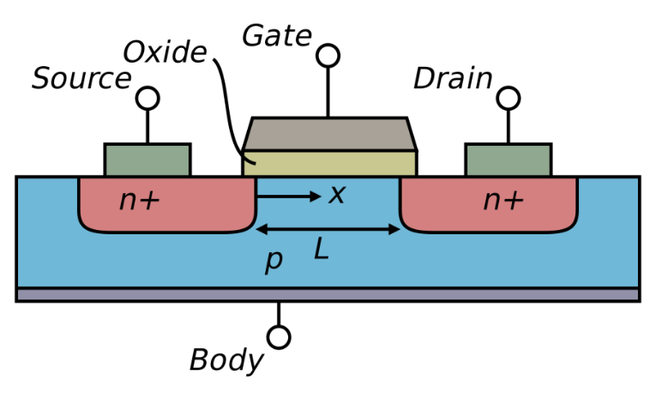
Lecture 2: Metal-Oxide-Semiconductor Field-Effect Transistor
金属氧化物半导体场效应管
Notes:
金属氧化物半导体场效型管
顾名思义，它是由Gate上的金属板，加上下面黄色的氧化绝缘层，以及最下层的半导体组成，
场效应管是说这个器件是通过电场来控制载流子的移动，从而实现开关的

Slide 3
Outline
Metal-Oxide-Semiconductor Field-Effect Transistor (MOSFET) Operating Principle
Operation Modes: Accumulation, Depletion, Inversion
Threshold Voltage*
MOSFET I-V Model
Gradual Channel Approximation
Current Saturation
Nanoscale MOSFET I-V Model
Velocity Saturation
Channel Length Modulation
Unified MOSFET I-V Model for Circuit Design
Notes:
1、定性讨论MOSFET的工作原理
2、定量讨论MOSFET中电流与电压的关系
3、纳米尺度新增的效应及修正后的IV模型
4、用统一模型描述MOSFET器件
这一节我们主要分析MOSFET的工作模式，以及在工作模式切换中非常重要的一个指标，阈值电压

Slide 4
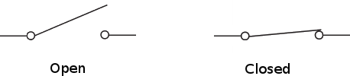
Review: Switch Properties
Information Processing Based on 0 and 1
1 0
Key features of a switch
On/Off
ON ⬄ Short circuit ⬄ a piece of conducting wire. OFF ⬄ Open circuit ⬄ an open gap in the circuit.
Control
On and off states of a switch can be controlled.
Notes:
之前说到MOSFET是用来控制电路开关的，这里我们先简要回顾一下开关的特性
开关主要是有开启和关断两个状态，对应1和0
开启状态对应短路，即此时开关相当于一根导线
关断状态对应开路，即此时电路断开
我们希望开关的这两个状态是可控的，从而实现对1和0的信息处理

Slide 5
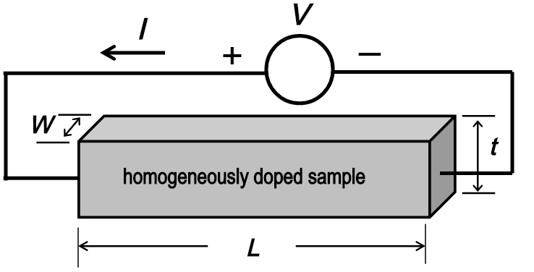
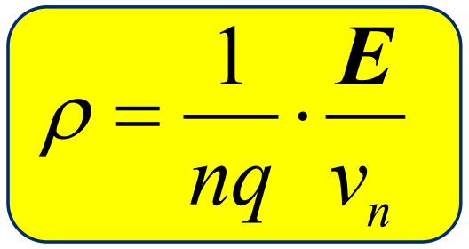
Resistance of Semiconductor
Ohm’s Law
L ₎
V = I*R
E ⋅ L = (J ⋅W ⋅ t) ⋅ (ρ ⋅
W ⋅ t
n = N_{D}
E = J ⋅ ρ
J = nqv_{n}
Drift Current
v_{n} = μ_{n}⋅E
For n-type semiconductors
1
nqμ_{n}
L
Wt N_{D} μ_{n}q ⋅Wt
Electric field (V/cm)
ρ =
R = ρ ^{L} =
Drift Velocity (cm/s)
Mobility (cm²/Vs)
KEY: The resistance of semiconductor can be accurately controlled by carrier density!
Notes:
欧姆定律微观尺寸化简即可求得电阻率，而后根据迁移速度与电场的关系可将电阻率化简，最后求得电阻值
对于尺寸确定的半导体材料而言，电阻完全受载流子浓度决定
-> 通过控制载流子浓度即可控制电阻 -> 控制半导体流经电流 -> 控制开关
E：电场 J：电流密度 ρ：电阻率 v：电子迁移速度 μ：电子迁移率 n：自由电子密度 q：电子电量 L：长 W：宽 t：高

Slide 6
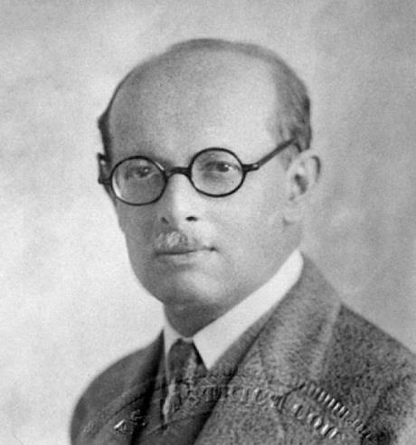
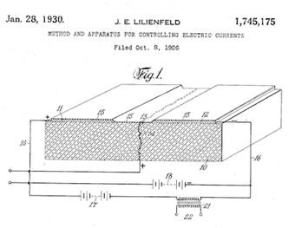
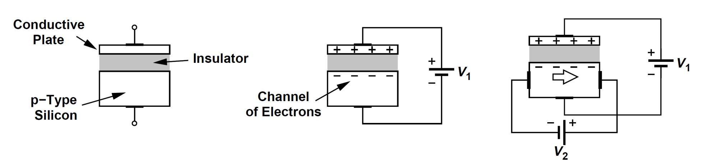
Field-Effect Transistor
J.E Lilienfeld
+Q
Use induced charge to modulate the carrier density.
-Q
Capacitor
Q = V₁⋅C
Channel Resistance can be modulated, yet the device cannot be turned off.
Notes:
上世纪30年代 加拿大人Lilienfeld申请专利：半导体材料+电容 构建MOSCAP
电容两边施加电压->等大反型电荷->调整载流子浓度->调控电阻
缺点：很难关断，除非把所有载流子都消耗掉

Slide 7
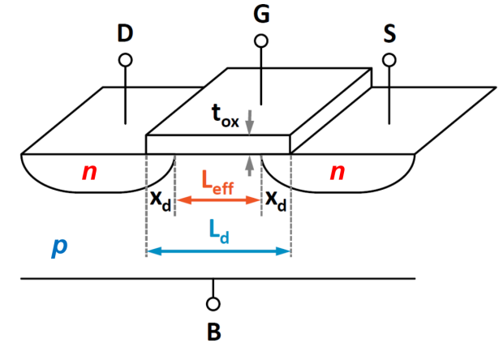
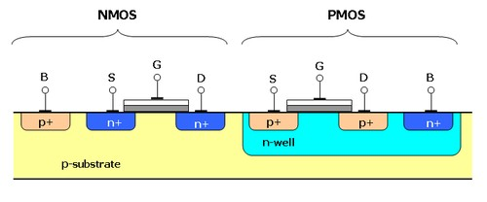
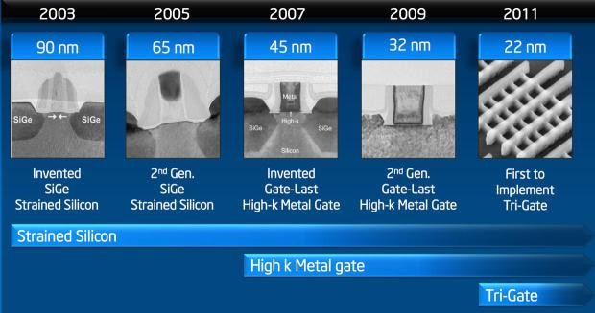
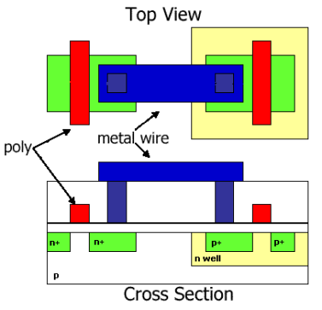
MOSFET Structure
Notes:
MOSFET在MOSCAP的基础上增加source/drain来实现开关可控
NMOS：电子 多数载流子
PMOS：空穴 多数载流子
MOSFET的俯视图与截面图示意
进入22nm后，传统平面MOSFET结构将由FinFET结构代替，但是其工作原理还是基于场效应管

Slide 8
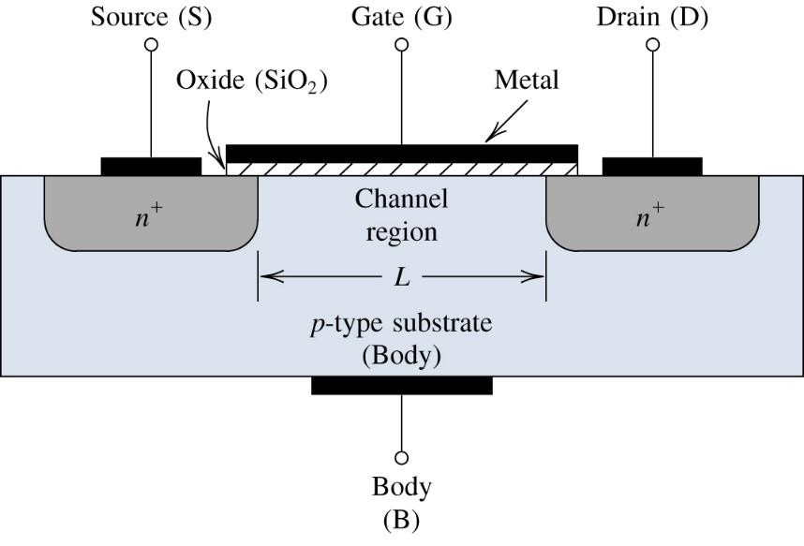
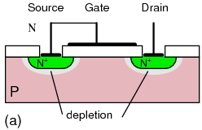

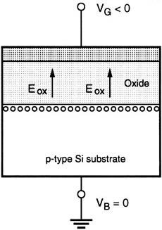
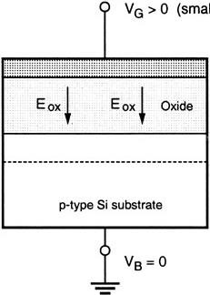
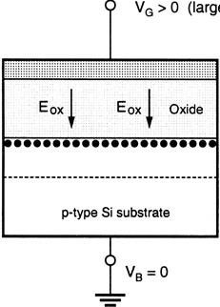




MOSFET as a Switch
At equilibrium
n
p
n
OFF STATE
V_{G} < 0
V_{G} > 0
Small
V_{G} > 0
Large
y
x
- - - - - - - -
depletion
Electron inversion!
Hole accumulation
- - - - - - - -
ON STATE
Notes:
两个反型PN节->两个反型二极管->严格意义关断
在栅极GATE施加反型电压：空穴堆积在channel上方，仍然是两个反型PN结
正向电压：
1、小电压时，电子中和channel上方空穴，留下不可移动的负电中心，不参与导电
2、大电压时，电子堆积在channel上方，相当于一整块N型半导体，因此导通

Slide 9
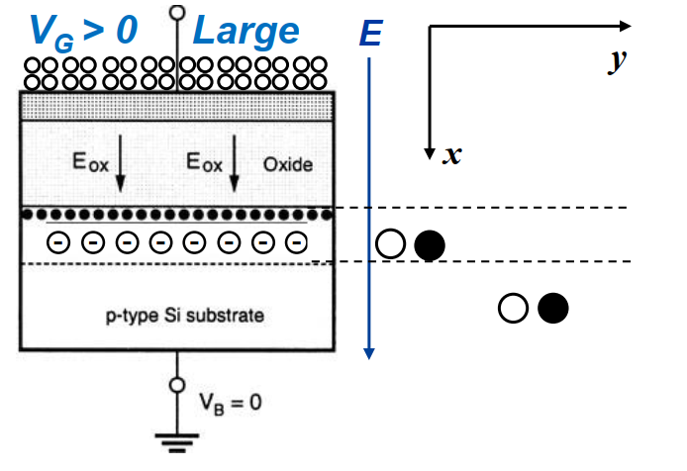
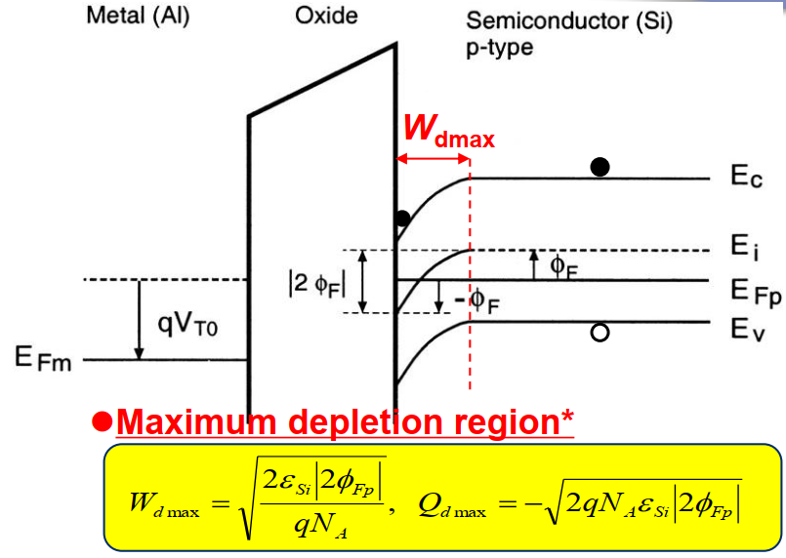
Is Inversion Layer Robust?
When V_{G} > 0 is applied, electric field is along +x-direction. As a result, electrons in the channel will move towards and “stick” at the Si/SiO₂ interface while holes will be “expelled” into the substrate.
However, due to screening effect, carriers in the substrate region (i.e., away from the Debye length), do not “feel” the applied electric field, therefore remaining stationary.
Consequently, a well-defined electron conduction channel is formed at the Si/SiO₂ interface.
Notes:
施加正电压时，电场沿x方向。channel中的电子将吸附在channel上部，而空穴将被排斥到衬底中。
由于屏蔽效应，衬底区域的载流子不会“感受到”外加电场，因此保持静止，所以导电沟道可以保持稳定。
由能带图可以看到，在界面附近的电子会受到强内建电场的影响而被局限在界面上，而远处的电子和空穴由于所处能带平滑，不会受到电场影响进行移动
具体可以通过计算得到导电沟道的宽度，在电压增加到一定程度后，由于屏蔽效应，导电沟道宽度将不会再发生变化

Slide 10
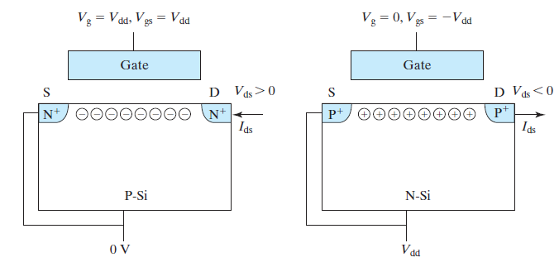
Threshold Voltage of MOSFET
SiO₂
SiO₂
NMOS
PMOS
The threshold voltage is the required gate voltage V_{GS} = V_{T} to form the conduction channel between S/D.
In this course, we can approximately assume V_{GS} < V_{T}, there is no free charge in the channel*; while as long as V_{GS} > V_{T}, the extra voltage will turn into free charge Q_{inv}=A⋅C_{ox}⋅(V_{GS} - V_{T}) that contributes to the channel’s drift current. (here A is the area and the unit of C_{ox} is F/m²)
For NMOS (electron conduction channel is n-type), V_{T} > 0; while for PMOS (hole conduction channel is p-type), V_{T} < 0
S/D provide the needed inversion charge for channel conduction!
Notes:
阈值电压是源/漏极间形成导电沟道需要的栅极电压
本门课我们可以假设栅极电压小于阈值电压时没有自由电荷，而大于阈值电压时，额外的电压将转化为自由电荷，并构成导电沟道的迁移电流
NMOS：栅极施加正电压，形成电子主导的导电沟道
PMOS：栅极施加负电压，形成空穴主导的导电沟道
形成导电沟道的电子/空穴其实是由源S/漏D极提供的

Slide 11
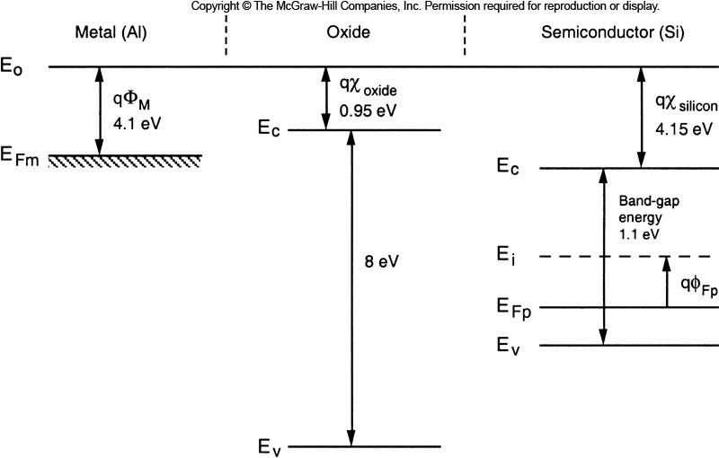

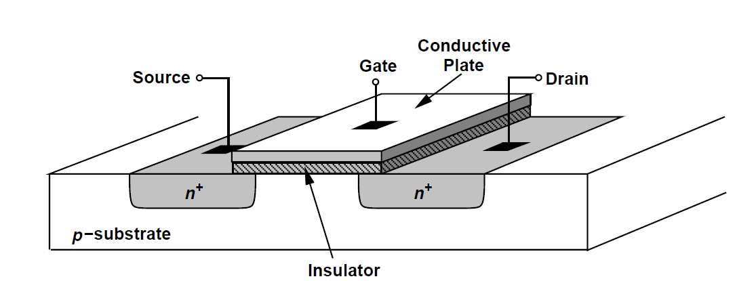
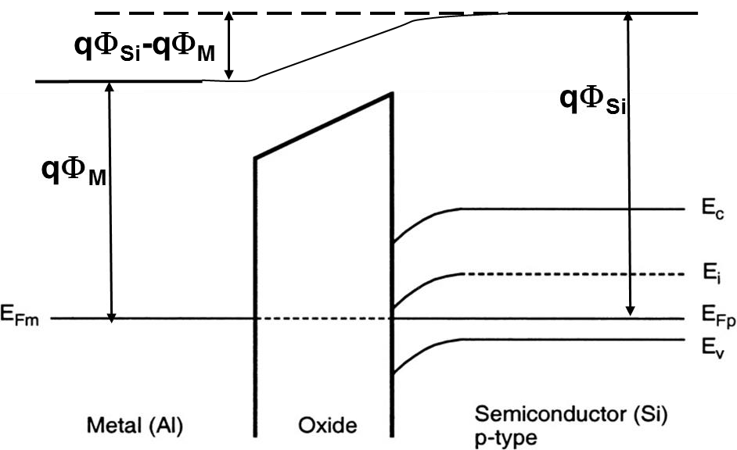
Flat Band Voltage*
z
x
y
qΦ_{Si}
Flat Band Voltage:It is the voltage applied externally between the gate and the substrate, so that the energy bands become "flat.”
V_{FB} = −φ_{bi}
= Φ_{M} − Φ_{Si}
Notes:
由于栅极、氧化层、P型衬底的电子亲和能不同，将它们结合在一起时在平衡状态下需要将三种材料的费米能级保持一致
由于栅极金属与P型衬底电子亲和能不同，当他们结合在一起后，当费米能级水平后会有一个能带弯曲，针对能带弯曲的程度可以定义一个平带电压
平带电压：施加外接栅压来抵消由于不同材料电子亲和能不同产生的能带弯曲
抵消栅极金属与P型衬底的电子亲和能的差距

Slide 12
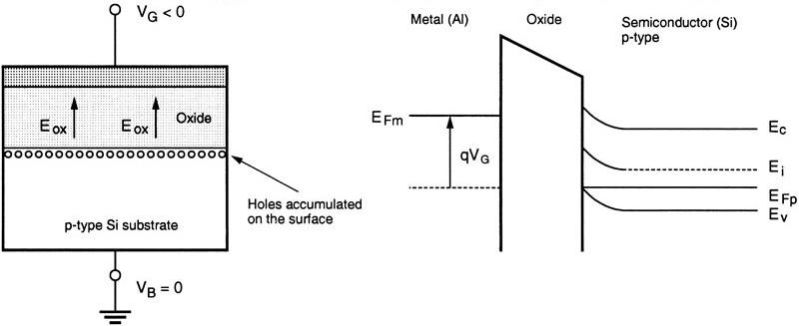


Accumulation Condition*
Accumulation: If a negative voltage V_{GS} <0 is applied to the gate electrode, the holes in the p-type substrate are attracted to the semiconductor-oxide interface, resulting in the majority carrier (hole) accumulation at the interface.
y
x
Q_{a} = +Q
x
-Q
Notes:
Accumulation：在栅极施加负电压可以在氧化层与沟道的界面形成空穴的积累

Slide 13
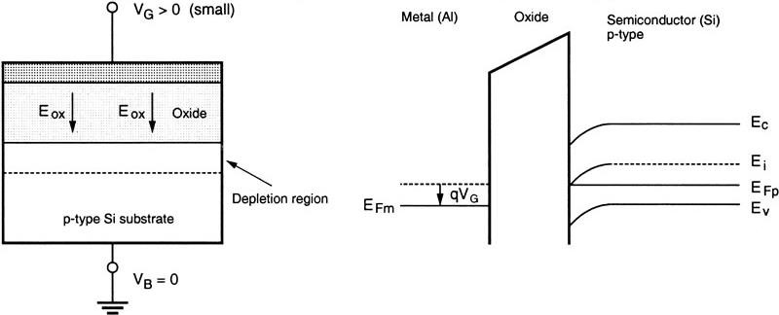






Depletion Condition*
Depletion: A small positive gate bias V_{GS} is applied to the gate electrode, the majority carriers (holes) will be repelled back into the substrate, thus leaving negatively charged fixed acceptor ions in the depletion region near the surface.
y
x
- - - - - - - -
qφ_{Fp}
W_{d}
+Q
x
2ε _{Si} φ_{s} −φ_{Fp}
W_{d} =
Q = -Q
d
qN _{A}
Notes:
Depletion：施加小的正电压可以将多数载流子，即空穴排斥到衬底，在氧化层与沟道的界面留下不可移动的负电中心
可以利用PN结中学到的depletion approximation公式计算depletion region的宽度

Slide 14
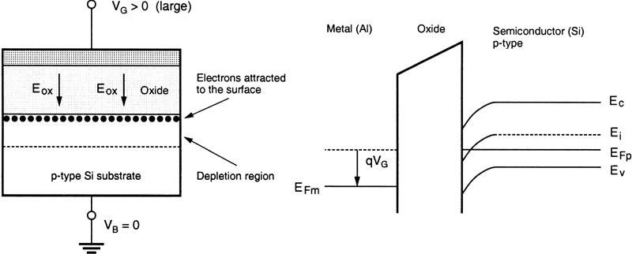


Inversion Condition*
Inversion: If the positive gate bias is V_{G} further increased, E_{i} becomes lower than the Fermi level on the surface, which means that the substrate semiconductor at the interface becomes n-type. This corresponds to the onset of inversion.
y
x
^{W}dm
+Q = (Q_{d} + Q_{inv})
+Q
x
-Q_{d}
^{-Q}inv
Notes:
Inversion：施加大的正电压可以在氧化层与沟道的界面形成电子的积累，因此界面处的衬底半导体反型变成N型导通
在栅极处的电荷需要等于在P型衬底中形成耗尽层需要的电荷Qd，加上形成反型需要的电荷Qinv

Slide 15
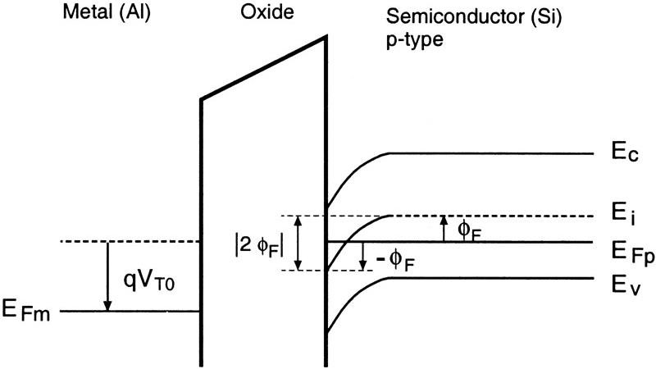
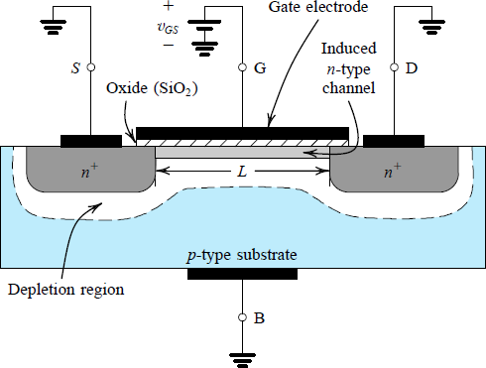
Strong Inversion Condition*
The surface is said to be strongly inverted when the density of mobile electrons at the interface becomes equal to the density of holes in the bulk (p-type) substrate.
n ~ |N_{A}|
Maximum depletion region*
2ε _{Si} 2φ_{Fp}
The corresponding applied “turn-on” gate voltage
^{W}d max ⁼
,
^{Q}d max ⁼ ⁻
2qN _{A}ε _{Si} 2φ_{Fp}
V = V is the threshold voltage
qN
A
GS T0
Notes:
强反型：当沟道处的移动电子密度与P型衬底中的空穴密度相等时，导电沟道完全形成，开始导电，称为强反型，对应栅极电压为阈值电压，此时进一步增加电压会进一步增加电流

Slide 16
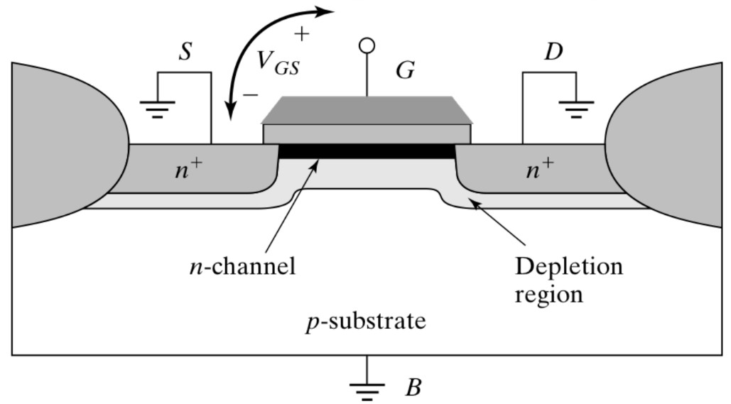
Threshold Voltage*
Threshold Voltage
1.Work function difference between the gate and the channel (i.e., Flat Band voltage - V_{FB}.
3. Offset the depletion region charge
- Q_{d}/C_{ox}
V = V + | 2φ | + ^{Qd}
^{Q}ox
T 0 FB Fp
C C
ox ox
2. Change the surface potential at inversion - |2φ_{Fp}|
4. Offset the fixed positive charges Q_{ox} (due to imperfections) in the gate oxide and in the silicon- oxide interface - Q_{ox}/C_{ox}.
Notes:
阈值电压的组成：
1、抵消栅极金属与P型衬底的电子亲和能不同产生的频带电压
2、界面开始反型所需要的势能
3、抵消耗尽区的电荷
4、抵消氧化层中本身的电荷

Slide 17
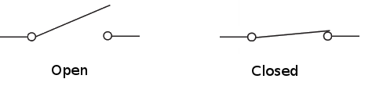

Summary: MOSFET Operation
0
1
V_{G} > V_{T}
V_{G} < V_{T}
y
x
- - - - - - - -
- - - - - - - -
Notes:
MOSFET的结构可以在栅极施加电压形成导电沟道
对于NMOS，只有栅极电压大于阈值电压时可以在Source和drain之间形成电子为主导的反型层，从而将MOSFET导通
因此MOSFET是一个由电压控制的电流源

