Slide 1
Lecture 6: Logical Efforts
Notes:
上一节传统方法，本节用logic effort方法计算延时与优化设计

Slide 2
Outline
Computing the Propagation Delay of a Given Circuit
Conventional Method
Logical Efforts Method
Optimize the Propagation Delay of Logic Circuit
Optimize the INV Chain
Optimize a Multi-Stage Combinational Logic Circuit
Notes:
上一节：传统方法分析传播时延
本节：使用Logical EffortsF方法
想要提出一个简单的方法来进行时延的估计，让计算机也能执行

Slide 3
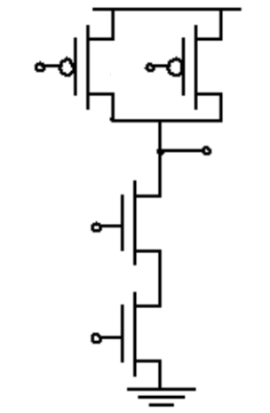
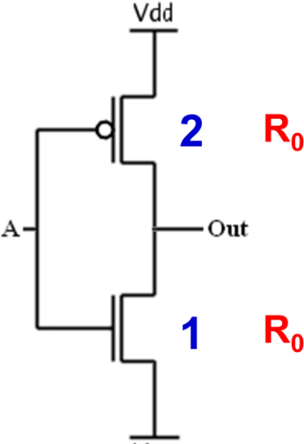
Example: NAND-2 versus INV.
2-Input NAND
Standard INV.
Standard INV.
t = t = 0.69R ⋅[3C
C ]
V
p 0 p, INV 0
par ,0
L
B
DD
A
2 2
2-Input NAND
^{t}p, NAND
= 0.69R₀ ⋅[6C_{par ,0} + C_{L} ]
In
Out
A
2
C_{g,0} and C_{par,0} are unit-width gate and parasitic capacitance
B
2
These differences represent the fact that, for a given load, complex gates have to work harder than an inverter to produce a similar response.
Notes:
回顾：单个门的时延受到什么因素影响
对于任一有特定功能的逻辑门，都可以通过合理的sizing使得等效电阻与标准的INV一致。
在等效电阻一致的情况下：影响主要在寄生电容。

Slide 4
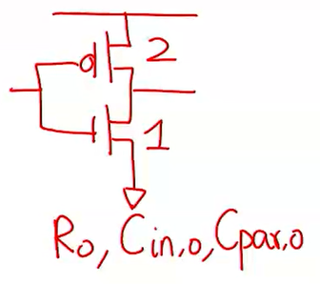









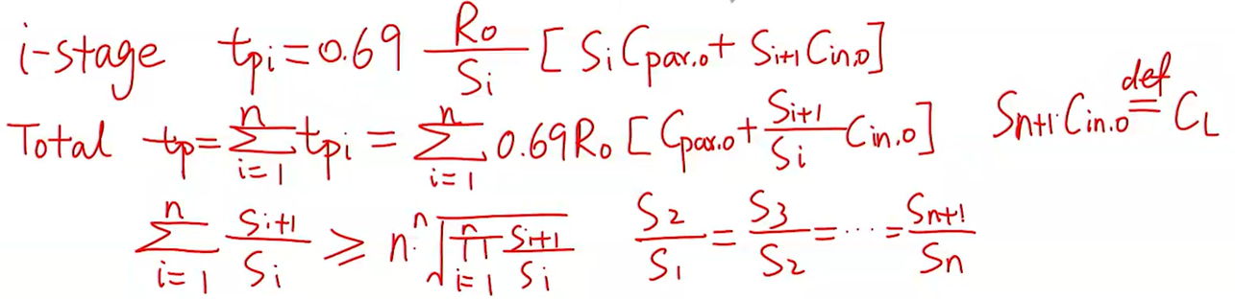
Example: Delay of Inverter Chain
^{R}on
= 0.69R_{on} ⋅ C_{par} + 0.69 ⋅ C
是否已对反相器的构造了然于胸？
^{t}p ^{= t}p,int ^{+ t}
p,ext
L
S
^{R}on,1
^{R}on,2
^{R}on,3
S₁
S₂
S₃
^{C}in,1
^{C}par,1
^{C}in,2
^{C}par,2
^{C}in,3
^{C}par,3
Notes:
由于每一级的门都是反相器，因此总的时延就变成了各级门的Size的函数。
也就是说分析反相器链的时延，我们只需要知道各级的门的sizing参数就可以。

Slide 5
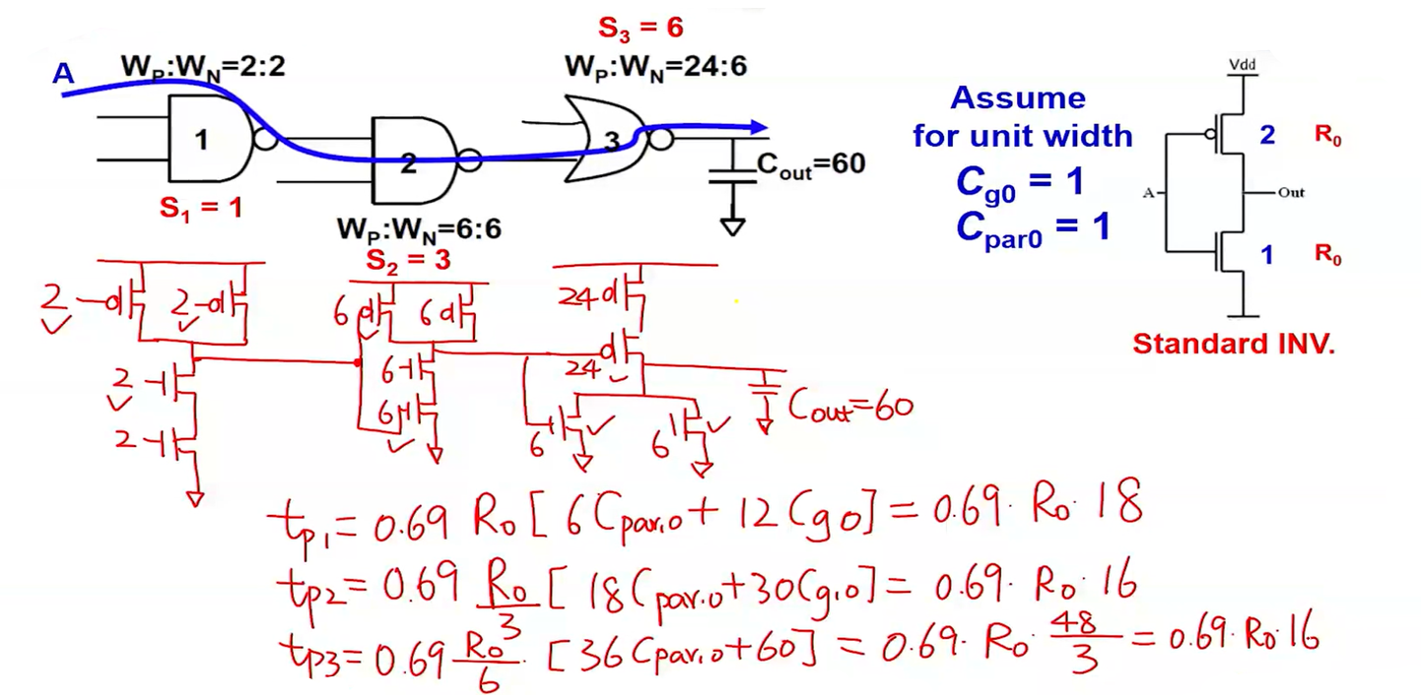
Example: Delay of Multi-Stage Network
哪一步最为困难？
Notes:
对于一个组合逻辑门组成的链，该如何分析它的时延？
我们需要先画出它们具体的构造图，之后查看影响时延的晶体管的sizing，最后才能得到计算公式。
可以说，一个组合逻辑链的时延的分析，我们需要知道门的逻辑功能以及sizing

Slide 6
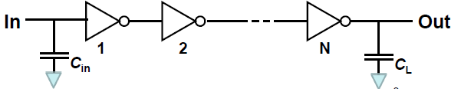
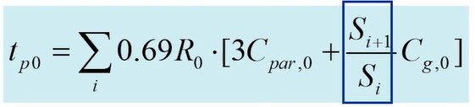
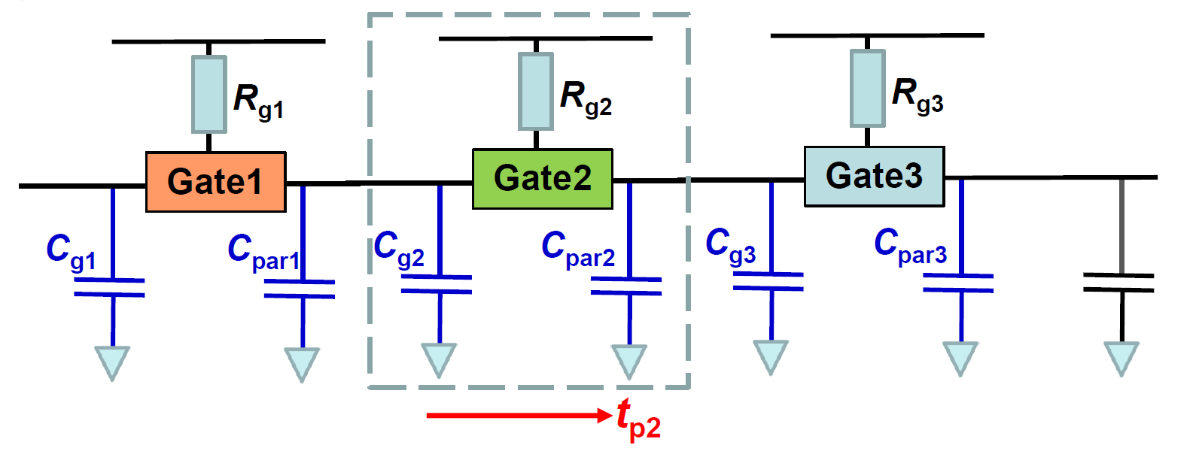
t_{p} = ∑0.69R_{g ,i} ⋅[C_{par ,i}
Multi-Stage Network vs. INV. Chain
Only depend on gate sizing
^{+ C}g ,i +1 ]
i
Depend on specific logic gate function
思考：如何写一个程序来计算这两条链的时延？难点在哪里？
Notes:
一个多级的任意逻辑电路，对照INV chain。INV链有着很不错的性质。
得到计算公式，发现INV chain的计算公式内，总的时延仅取决与前后两级的sizing。
要写程序计算组合电路门的时延，发现不知道门的具体的电容，而电容取决于门的构造，之前的方法我们通过门的逻辑功能画出了构造，这一步骤对于机器而言应该是较难实现的。

Slide 7
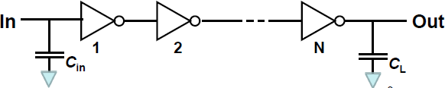

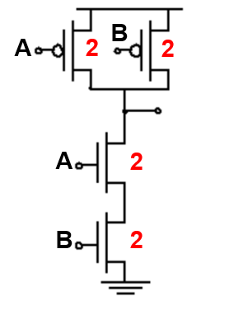
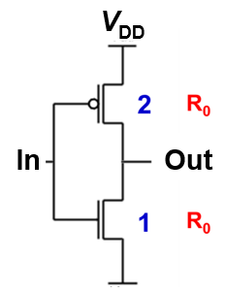



The Concept of Logical Effort
Grand Mission: Simplify any multi-stage logic gate circuit into the inverter chain.
A=2
B=4A
C=3A+4B
C=？
尝试把组合逻辑门与反相器进行比较
Notes:
通过某方法将任意多级电路转化为INV chain。将INV替换为其他门之后的变化。
以反相器作为一个参照物，获取所需的信息。

Slide 8
The Concept of Logical Effort
Grand Mission: Simplify any multi-stage logic gate circuit into the inverter chain.
Logical Effort: the logical effort of a logic gate is defined as the number of times worse it is at delivering output current than would be an inverter with identical input capacitance.
逻辑努力：逻辑努力代表了这样的事实，即对于给定负载，复合门必须比反相器更“努力”工作才能得到类似的响应。换言之，一个逻辑门的逻辑努力告诉我们，当假定这个逻辑门的每一个输入只代表一个反相器相同的输入电容时，在产生输出电流方面它与这个反相器差多少。逻辑努力只与电路的拓扑结构有关。
Notes:
通过某方法将任意多级电路转化为INV chain。将INV替换为其他门之后的变化。

Slide 9
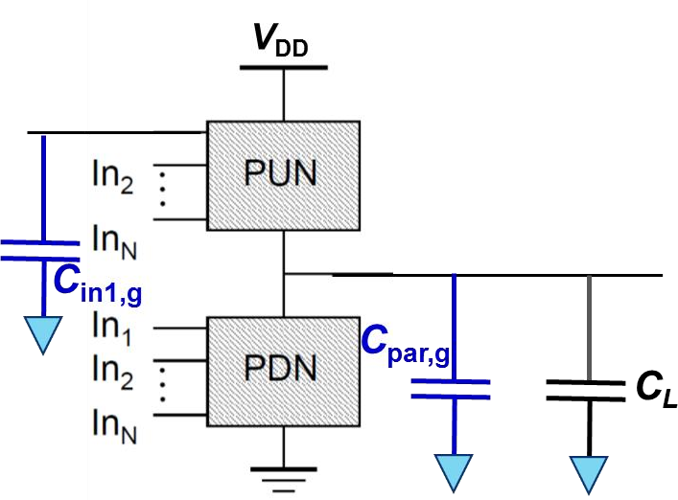

The Logical Effort Way of Thinking
Another way to write this
_{⋅ (}^{C}par , gate
C_{L}
^{t}p, gate ^{= 0.69 ⋅ R}gate ^{⋅ C}in, gate
+ )
C
C
in, gate
in, gate
^{τ}gate
^{γ}gate
Fan-Out
Strategy: normalize to a time constant of an INV.
^{t}p, gate ₌ ^{τ} gate _{(γ}
+
^{C}load , gate ₎
def.
τ τ
gate
C
^{τ}INV ^{= 0.69} ^{⋅ R}INV ^{⋅ C}in,INV
^{t}p,in1 ^{= 0.69R}on,in1 ^{⋅[C}par , gate
C_{L} ]
INV INV
in, gate
Assume all inputs are identical
^{t}p, gate ^{= t}p,in1
Notes:
进行理论推导，将受到逻辑功能影响的部分提取出来。从根本上进行分析。
放大S倍，tao RC不随size变化。
Gamma也不随S变化而变化
Fan-out会发生变化

Slide 10
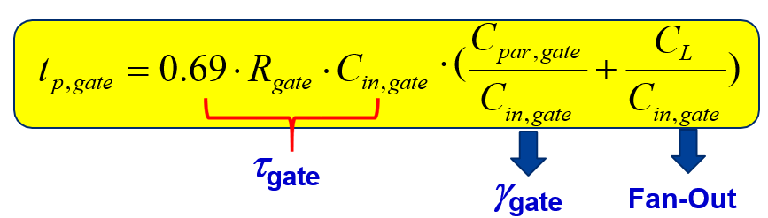
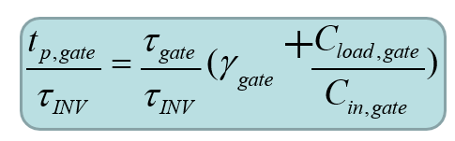

The Logical Effort Definition
τ
INV ^{= R}INV
⋅
^{C}in,INV
Define the normalized delay:
General Form
Logical effort (g) | Electrical Fan-Out (h) | Parasitic delay (p)
_{g =} ^{R}gate ^{⋅ C}in, gate ^{R}INV ^{⋅ C}in,INV | _{h =} ^{C}load ^{C}in, gate | _{p =} ^{R}gate ^{⋅ C}par,gate _{⋅γ} _{R ⋅ C} INV INV par,INV
γ
₌ ^{C}par , INV
in, INV
INV
C
g & p – Internal contribution
h – Load contribution
目的：提取出与逻辑功能相关的部分
Notes:
将公式中各部分进行简单的表示，可以得到logic effort的表达式
H实际表示了前后两级的input capasitance的比例。
G是Input，p是output，与标准INV的比较，h是前后两级，load

Slide 11
The Meaning of Logical Effort
Logical effort (g) | Electrical Fan-Out (h) | Parasitic delay (p)
_{g =} ^{R}gate ^{⋅ C}in, gate ^{R}INV ^{⋅ C}in,INV | _{h =} ^{C}load ^{C}in, gate | _{p =} ^{R}gate ^{⋅ C}par,gate _{⋅γ} _{R ⋅ C} INV INV par,INV
^{*R}gate ^{= R}INV _{g =} ^{C}in,gate ^{C}in,INV | _{h =} ^{C}load ^{C}in, gate | _{p =} ^{C}par,gate _{⋅γ} _{C} INV par,INV
Logical effort (g)
- Independent of gate size!
D = ∑ d_{i} = ∑ g_{i} ⋅ h_{i} + ∑ p_{i}
- Normally, we match R_{gate} = R_{INV} after proper gate sizing
Parasitic delay (p)
Independent of gate size!
Electrical Fan-out (h)
Dependent of gate size!
Notes:
D：可以由此得到，相对一个同级数的标准反相器链，任意的一个多级逻辑链路相应的时延比值
G和p不受size影响
H会受影响

Slide 12
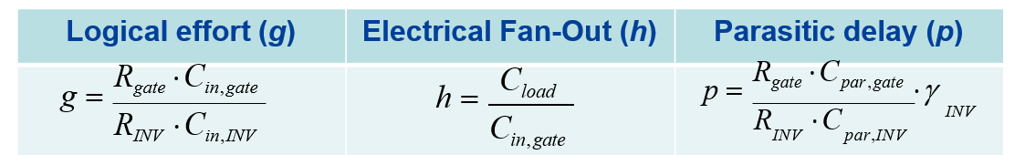
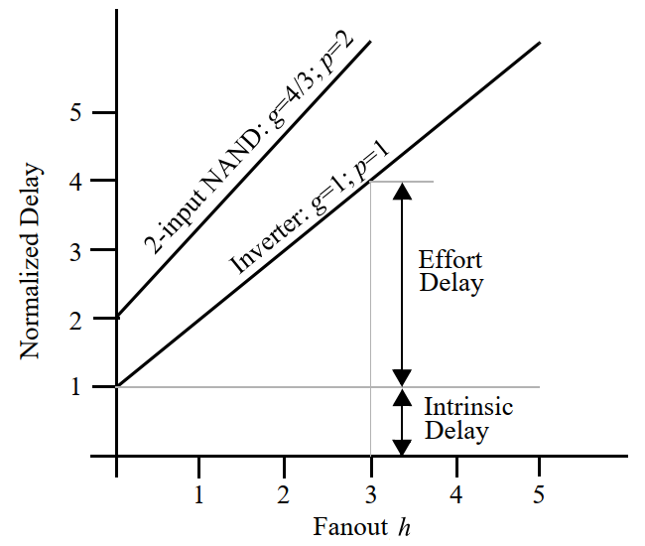
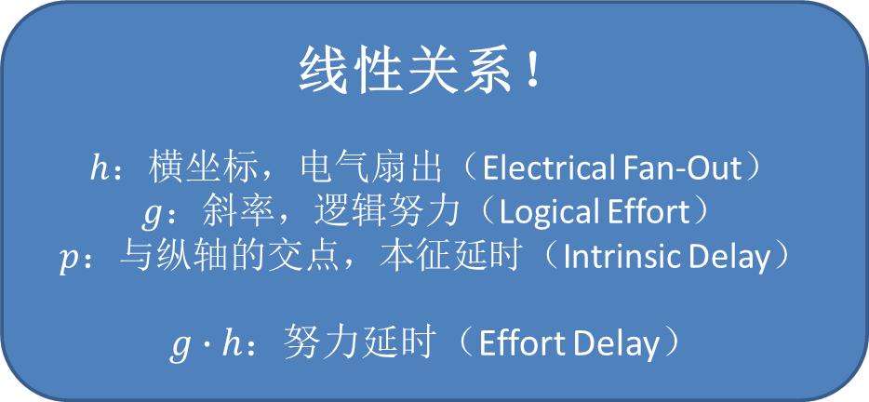
The Meaning of Logical Effort
线性关系！
$h$：横坐标，电气扇出（Electrical Fan-Out）
$g$：斜率，逻辑努力（Logical Effort）
$p$：与纵轴的交点，本征延时（Intrinsic Delay）
$g∙h$：努力延时（Effort Delay）
可以通过调整等效扇出（即调整晶体管尺寸）或通过选择具有不同逻辑努力的逻辑门来调整延时。
可以发现，扇出和逻辑努力以类似的方式影响延时，称两者的积为门努力（gate effort）。
Notes:
D：可以由此得到，相对一个同级数的标准反相器链，任意的一个多级逻辑链路相应的时延比值
G和p不受size影响
H会受影响

Slide 13
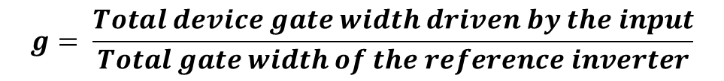
Computing Logical Effort: g
g is an unit-less inherent characteristic of the logic gate
Not a function of size of the gate
It is a function of the construction of the gate (connection and relative size between transistors)
An indication of the “cost” of implementing the function
If the logic gate is sized so that the PUN and PDN have equal strength, then
- For a given logic gate, g may vary for different inputs (we have to specify the input first!)
Such unit-less property of the logical effort allows us to postpone detailed calculations of CMOS sizes until the logical effort analysis is completed.
Notes:
Unit-less：无量纲，无单位
Postpone：推迟
G为无单位的固有特性
指示功能的实现成本
对于给定的逻辑门，随着input不同g可能也不同，需要先确定是哪个输入

Slide 14
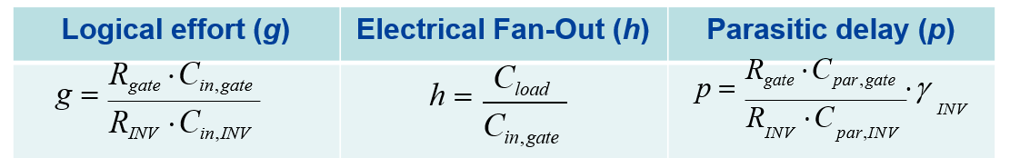
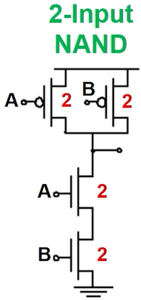
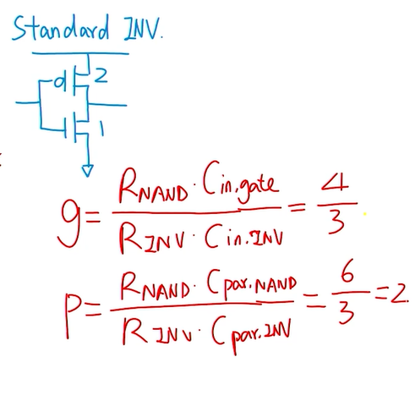
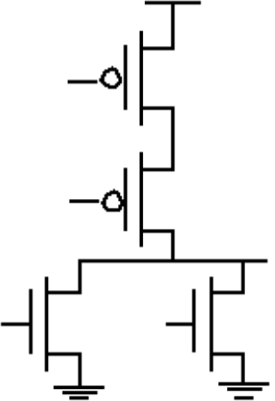
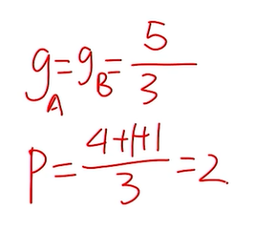
Example: NAND-2 and NOR-2
2-Input NOR
A
4
B
4
A
1 B
1
Notes:
计算不同门的g与p
等效电阻和标准INV一致
g和p是不随gate整体大小变化而变化的

Slide 15
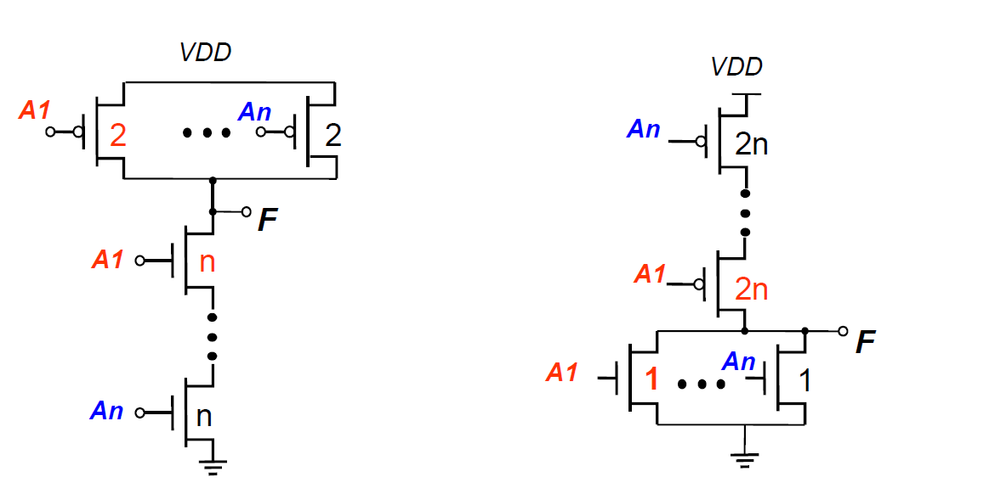
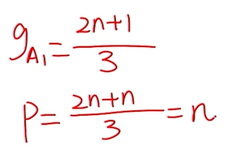
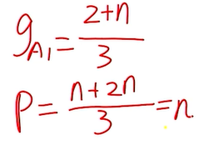
Logical Effort for n-input Gates
NAND-n
NOR-n
Notes:
Input，output连接

Slide 16
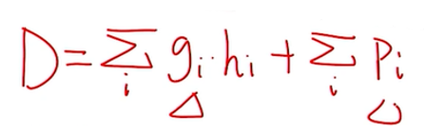
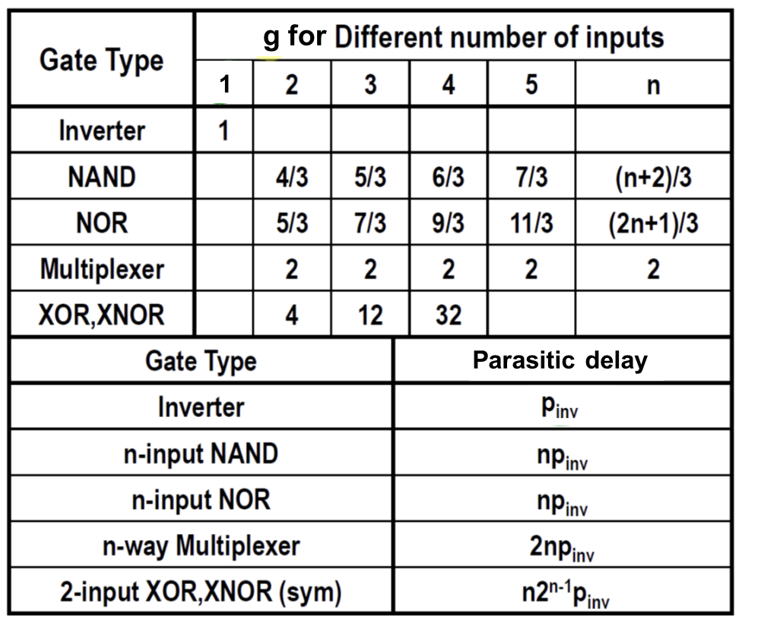
Look-Up Table for Logic Gates
β = 2
p_{INV} = γ_{INV}~ 1
p_{gate} in this table does not include intermediate nodes.
Notes:
建表，将常见的门加入。
其中gi和pi可查

Slide 17
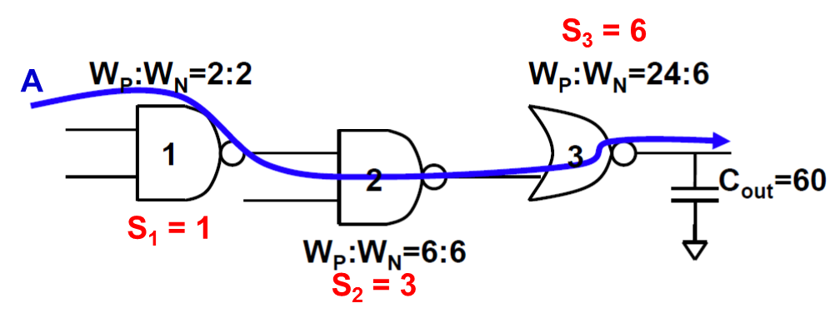

A Random Multi-Stage Network
Delay of a multi-stage network = sum of stage delays
Path Effort Delay
Path Parasitic Delay
Total Path Delay
F = ∑ f_{i} = ∑ g_{i} ⋅ h_{i}
P = ∑ p_{i}
D = ∑d_{i} = F + P
$$g, p ,h$$
Notes:
进行Delay的计算，将Effort Delay与Parasitic Delay加和
即利用变化后的公式，计算出g、p和h，之后再求出时延

Slide 18
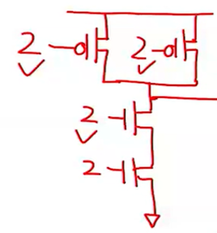
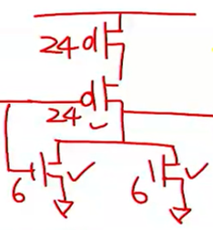
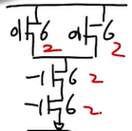
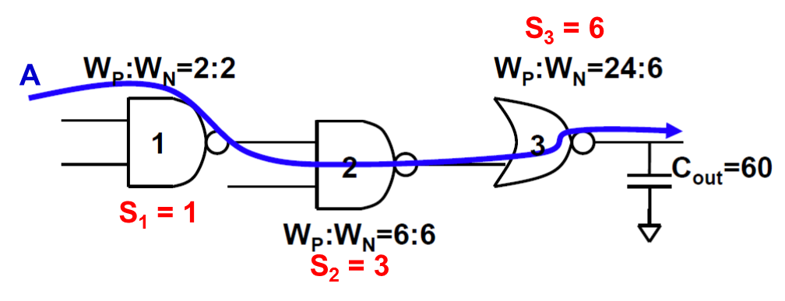
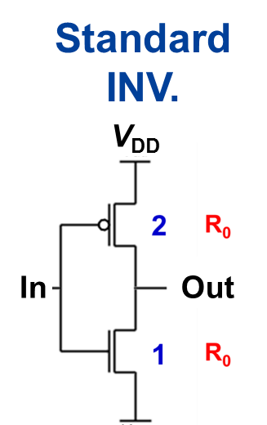
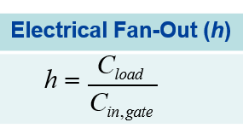
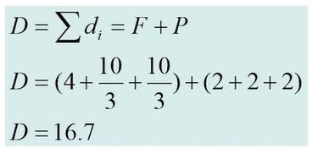
A Random Multi-Stage Network
 | Stage 1 | Stage 2 | Stage 3
Gate | 2-NAND | 2-NAND | 2-NOR
g | 4/3 | 4/3 | 5/3
p | 2 | 2 | 2
h | (6+6)/(2+2)=3 | (24+6)/(6+6)=5/2 | 60/(24+6)=2
Given τ_{INV} = 0.69⋅R₀⋅3C₀
Total delay = D⋅τ_{INV} = 0.69⋅R₀⋅50
Same as conventional method!
Notes:
这时候，g与p都可以通过查表获得，需要推导的只有h

Slide 19
Summary of Logical Efforts Method
Delay and/or power of a logic network depend significantly on the relative sizes of logic gates
To generalize analysis of a delay, we use logical effort
Delay normalized by inverter delay, d = f + p
g and p are characteristics of a logic gate that depend on its structure and does not depend on gate size.
Once a table of g’s and p’s are created for the catalog of gates, delay can be calculated quickly and easily.
Next, we will look at how to size a network instead of just analyzing it!

Slide 20

希望大家给五星满分好评！

