Slide 1
Lecture 6: Logic Circuit Delay Analysis
- Logical Efforts Method

Slide 2
Outline
Computing the Propagation Delay of a Given Circuit
Conventional Method
Logical Efforts Method
Optimize the Propagation Delay of Logic Circuit
Optimize the INV Chain
Optimize a Multi-Stage Combinational Logic Circuit
Notes:
上一节介绍logic effor。
本节不止分析，也用于优化size获得最小延时
本节:
考虑如何对多级组合逻辑电路进行优化
将逻辑努力的计算扩展到具有分支的情况
使用逻辑努力方法分析优化策略

Slide 3

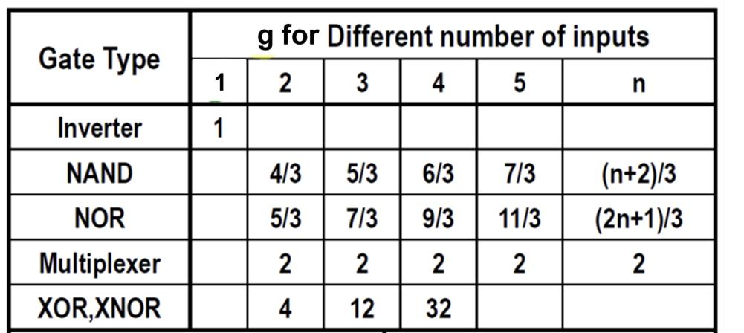
Review: Logical Efforts
General Form
Logical effort (g) | Electrical Fan-Out (h) | Parasitic delay (p)
_{g =} ^{R}gate ^{⋅ C}in, gate ^{R}INV ^{⋅ C}in,INV | _{h =} ^{C}load ^{C}in, gate | _{p =} ^{R}gate ^{⋅ C}par,gate _{⋅γ} _{R ⋅ C} INV INV par,INV
γ
₌ ^{C}par , INV
in, INV
INV
C
Size Ratio Independent
Size Ratio Independent
Notes:
分析g和p，事实上是逻辑门与标准INV相关信息的比，可知它们只受逻辑功能的影响，与sizing无关
可见表，比值比较

Slide 4
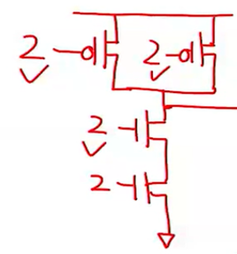
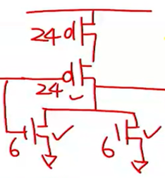
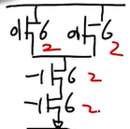
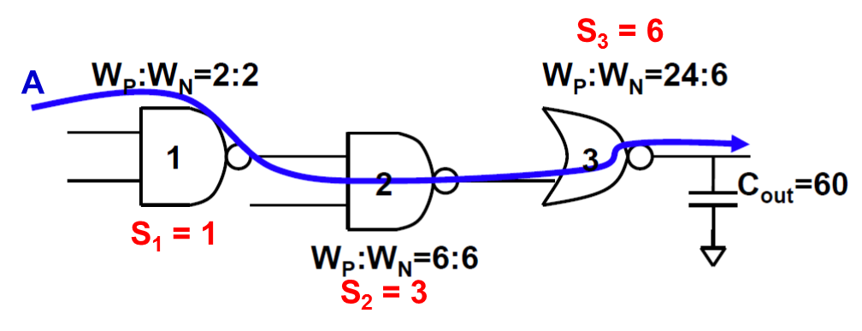
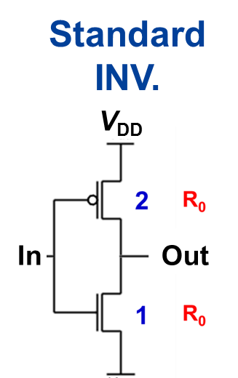
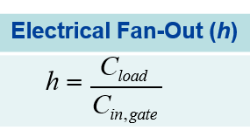
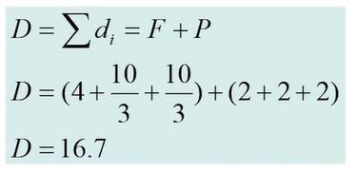
Review: A Random Multi-Stage Network
 | Stage 1 | Stage 2 | Stage 3
Gate | 2-NAND | 2-NAND | 2-NOR
g | 4/3 | 4/3 | 5/3
p | 2 | 2 | 2
h | (6+6)/(2+2)=3 | (24+6)/(6+6)=5/2 | 60/(24+6)=2
Given τ_{INV} = 0.69⋅R₀⋅3C₀
Total delay = D⋅τ_{INV} = 0.69⋅R₀⋅50
Same as conventional method!
Notes:
这时候，g与p都可以通过查表获得，需要推导的只有h

Slide 5
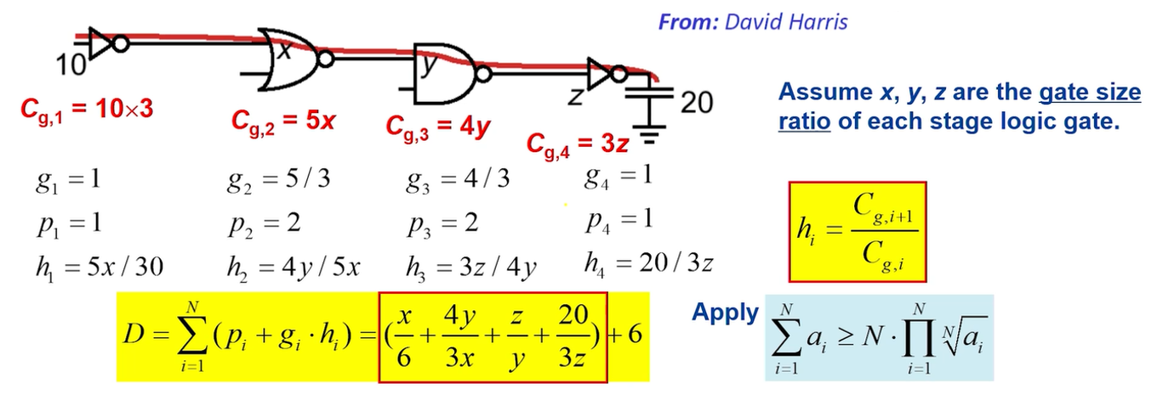
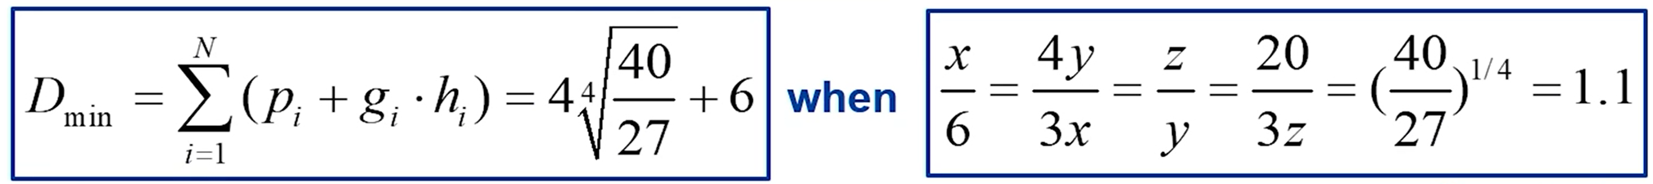
Optimize a Multi-Stage Network
Notes:
问题：给出了功能，没有给出sizing，如何优化size。
第一个10*3的意义：指相对标准的为10，标准的10*3（标准反相器系数为3,10代表为其10倍）
设未知数，假设sizing的大小，可以代入得到相应的公式
使用均值不等式，获得其最小值，等号条件也是4个分数相等

Slide 6
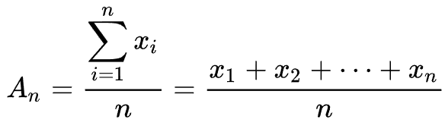
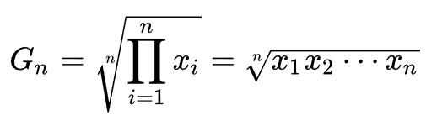
均值不等式
均值不等式可以看成是“对于若干个非负实数，它们的算术平均不小于几何平均”的推论。
算术平均数
几何平均数
可使用数学归纳法，柯西不等式法等方法证明
Notes:
补充均值不等式相关内容，内容抄自百度百科

Slide 7
General Method for Multi-Stage Network
N
D = ∑( p_{i} + g_{i} ⋅ h_{i} ) =
i =1
N
N
g_{i} ⋅ h_{i} + ∑ p
Unit-less
No need to optimize
∑
i
i =1 i =1
Need Optimization
Minimum value is achieved when f₁ = g₁h₁ = g₂h₂ = … = g_{N}h_{N} = f_{N}
Stage Effort:
Path Electrical Effort: Path Logical Effort:
f_{i} = g_{i}⋅h_{i}
H_{path} = h₁⋅h₂…h_{N} = C_{L}/C_{in} G_{path} = g₁⋅g₂…g_{N}
^{(G}path^{⋅H}path⁾min
Notes:
Pi是常数，不需要优化。
Hi需要优化，事实上可以视为是优化gi*hi。
求和的值最小当且仅当每一个值最小，可以使用编程方法来使其变得最小。

Slide 8
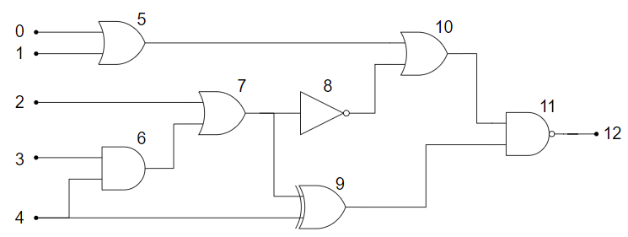
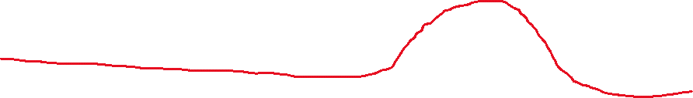
Multi-Stage Network with Branching
Logical effort (g) | Electrical Fan-Out (h) | Parasitic delay (p)
_{g =} ^{R}gate ^{⋅ C}in, gate ^{R}INV ^{⋅ C}in,INV | _{h =} ^{C}load ^{C}in, gate | _{p =} ^{R}gate ^{⋅ C}par,gate _{⋅γ} _{R ⋅ C} INV INV par,INV
Notes:
输出可能与多个输入相连接。多两个的gate 电容会影响第二级的门
可分为在critical path和不在上的门
使用branching来区分。这个b用于确定braching的影响。事实上可以把h和b一起讨论

Slide 9
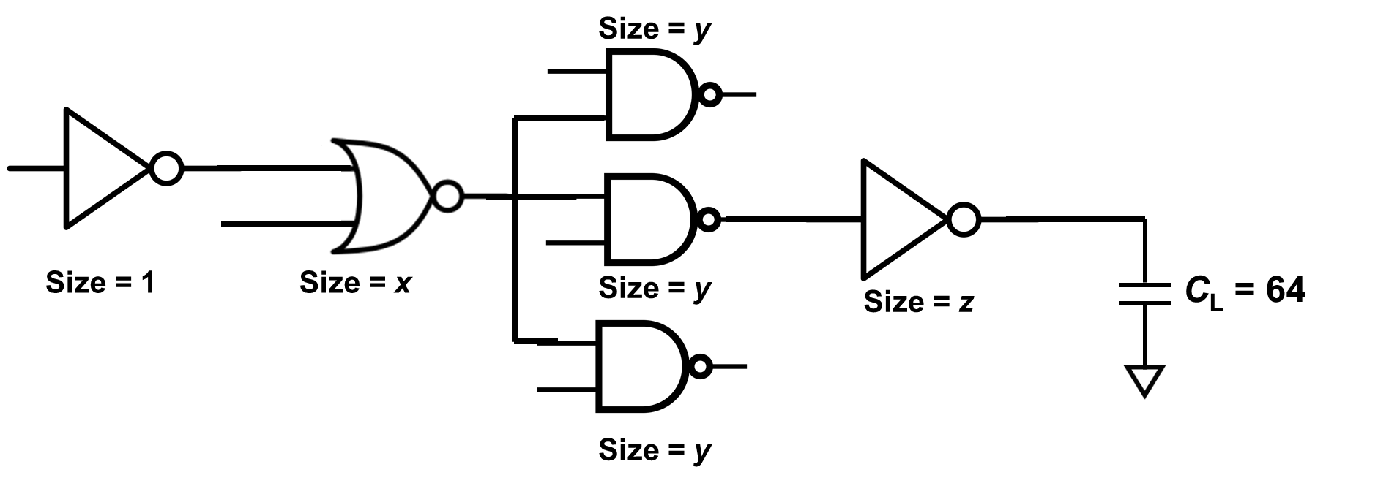
Multi-Stage Network with Branching
_{b =} ^{C}on− path ^{+ C}off − path
Branching effort
i
C
on− path
C_{g,1} = 3
g₁ = 1
p₁ = 1
h₁ = 5x / 3
C_{g,2} = 5x
g₂ = 5 / 3
p₂ = 2
C_{g,4} = 3z
g = 1
4
p = 1
D = ∑( p_{i} + g_{i} ⋅ h_{i} ⋅ b_{i} )
i =1
= (^{5x} + 3 ^{4 y} + ^{z} + ⁶⁴) + 6
4
N
h = 4 y / 5x
C_{g,3} = 4y
h = 64 / 3z
2
g = 4 / 3
4
b = 1
_{b =} 4 y + 8 y ₌ ₃
3
p₃ = 2
b = 1
1
4
2
4 y
3 3x y 3z
h = 3z / 4 y
3
b₃ = 1
Notes:
输出可能与多个输入相连接。多两个的gate 电容会影响第二级的门
可分为在critical path和不在上的门
使用branching来区分。这个b用于确定braching的影响。事实上可以把h和b一起讨论

Slide 10
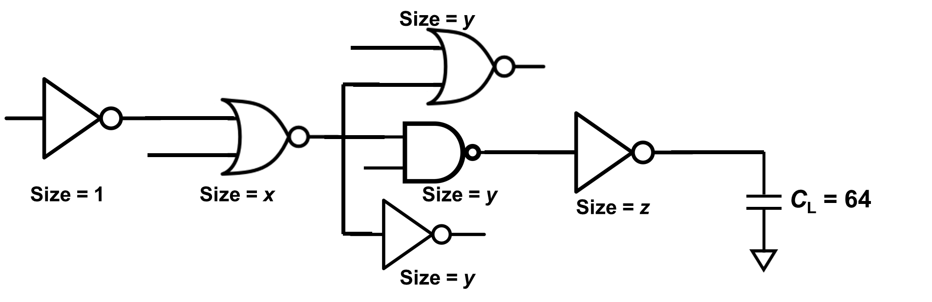
Multi-Stage Network with Branching
/2
/2
_{b =} ^{C}on− path ^{+ C}off − path
₌ 4 y + 2.5 y +1.5 y ₌ ₂
4 y
Branching effort
2
C
on− path
Notes:
分支努力的计算：根据size来区分
因为各分支会影响当前门输出的负载电容以及寄生电容

Slide 11
D = ∑( p_{i} + g_{i} ⋅ h_{i} ⋅ b_{i} ) = ∑ g_{i} ⋅ h_{i} ⋅ b_{i} + ∑ p_{i}
Generalization for Multi-Stage Network
N N N
i =1 i =1 i =1
KEY: Minimum delay is achieved when each stage bears the same effort:
N
= ∏ g_{i} ⋅ h_{i} ⋅ b_{i} = G_{path}
f
⋅ H _{path} ⋅ B_{path} = Path Effort
opt
^{f}opt ^{= N G}path ^{⋅ H} path ^{⋅ B}path
Fan-out of each stage: h_{i} = f_{opt}/(b_{i}⋅g_{i})
Complex gates should drive smaller load!
D_{min} = ∑(g_{i} ⋅ h_{i} ⋅ b_{i} + p_{i} ) = N ⋅ f_{opt} + P
Minimum path delay
Notes:
所以需要考虑branching情况进行修正
可以依据原始的方法进行，也可以将hi和bi放在一起。
计算时使用均值不等式可进行求解

Slide 12
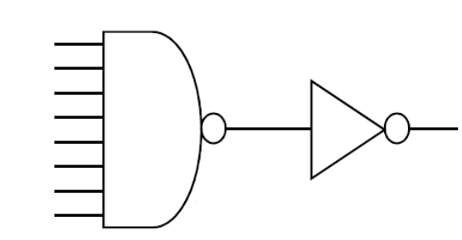
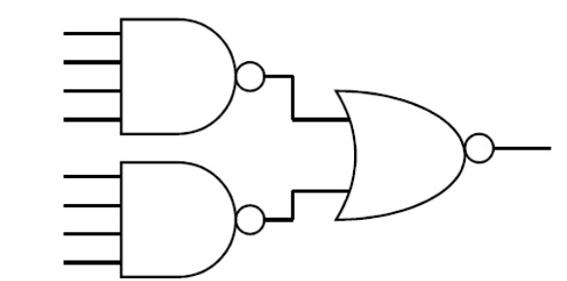

Fast Gate Design
Assume C_{L} = 10
1
1
1
1
1
g₁ = 2
p₁ = 4
h₁ = 5 / 6
g₁ = 10 / 3
p₁ = 8
h₁ = 3 / 10
g₂ = 1
p₂ = 1
h₂ = 10 / 3
g₂ = 5 / 3
p₂ = 2
h₂ = 2
>
D₁ = 13.3
D₂ = 11
t_{p} = 135.7 ps t_{p} = 67.1 ps
Normally, we need to choose the logic gate with Fan-In ≤ 4
Logical efforts method can only provide approximate values.
Notes:
尽可能多使用fan-in小的门。使用LE来验证。（定性和定量）
负载CL=10.
N位的NAND,P为n。
延时的值(仿真获得）和Logic effots的值相差比较大。LE忽略了S CMOS电路中瞬时的电容。可以定性判断，但是不是很好的定量计算方法。

Slide 13
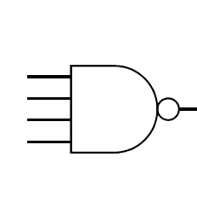
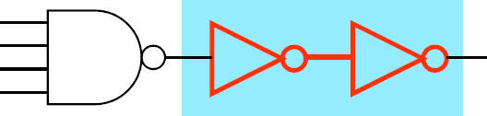

Fast Gate Design
Assume C_{L} = 64
1
1
1 1
1
4 16
Buffer Stage
Buffer Stage
g₁ = 2
p₁ = 4
h₁ = 32 / 3
g₁ = 2
p₁ = 4
h₁ = 1 / 2
g₂ = 1
p₂ = 1
h₂ = 1
g₃ = 1
p₃ = 1
h₃ = 64 / 3
Bad Sizing
g₁ = 2
p₁ = 4
h₁ = 2
g₂ = 1
p₂ = 1
h₂ = 4
g₃ = 1
p₃ = 1
h₃ = 4 / 3
D₁ = 25.3
D₂ = 29.3
D₂ = 15.3
By appropriately sizing the buffer stage, circuit delay can be greatly reduced!
Notes:
插入buffer来减少delay
插入一对INV,2个取反变自身。Buffer不做size优化，不好。
而优化buffer的size，优化后时延降低

Slide 14
Summary of Circuit Optimization
Choose proper logic gates to implement the logic function;
Identify the input pattern and critical path;
Compute the total path effort and optimized f_{opt};
Working from either end, determine gate sizes.
Logical efforts is a simplified model, can only guide your design!
Ref: Sutherland, Sproull, Harris, “Logical Effort” (Morgan-Kaufmann 1999)

Slide 15

希望大家给五星满分好评！

