Slide 1
Lecture 7: Pass Transistor Logic
Notes:
上一节：如何分析由静态CMOS构成的多级逻辑门的时延分析，在此基础上可以在给定了逻辑功能的基础上，优化每一级的实现以及gate sizing来获得整个系统的最小时延。
本节：学习另一种实现逻辑功能的方法，即Pass Transistor Logic

Slide 2
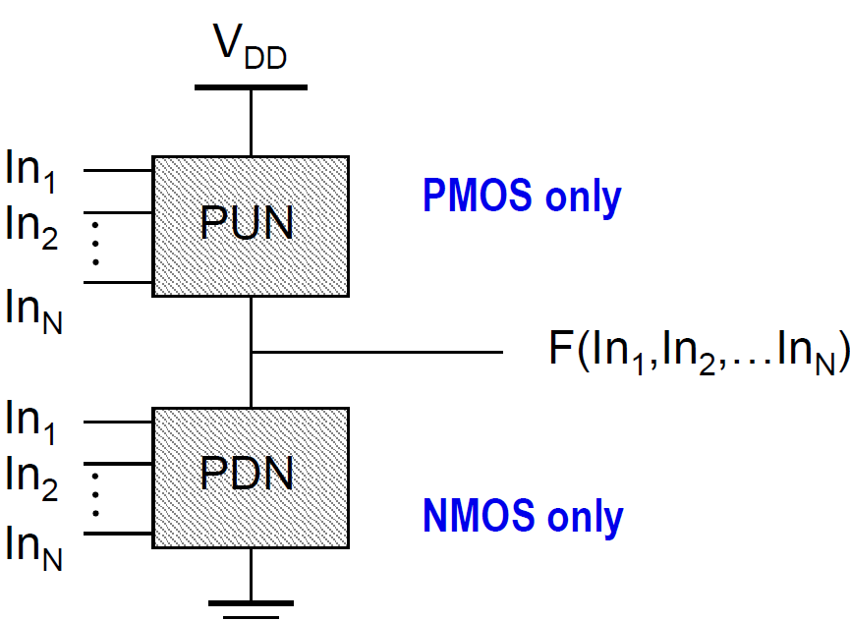
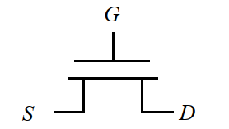
Review of Static CMOS Logic Gates
静态电路：在静态电路中，每一时刻每个门的输出通过一个低阻路径连到VDD或GND上。同时在任何时候该门的输出即为该电路实现的布尔函数值（忽略在切换期间的瞬态效应）。
不同的静态电路类型：
Complementary CMOS（互补CMOS，最常用的逻辑类型之一）
Pass Transistor Logic (传输管逻辑）
PMOS only
NMOS only
NMOS
Notes:
回顾静态CMOS相关内容，并结合和本章内容的关联
互补CMOS方法即之前介绍的方法，如无特殊标识，课件中提到的static CMOS类型都指此类型
之后回顾一下MOSFET的构造，方便后续内容讲解

Slide 3
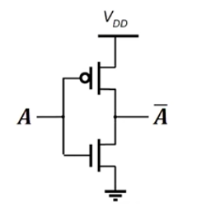
Review of Static CMOS Logic Gates
互补CMOS的部分设计原则：
Logic inputs connect to the Gate terminal of MOSFETs.
The pull-up network (PUN) is made of PMOS transistors ONLY while the pull-down network (PDN) is made of NMOS transistors ONLY.
PMOS only
Static CMOS logic gate - the output is
connected to V_{DD} or GND via a low-resistive path at every point in time (except during the switching transients).
NMOS only
NMOS in series & PMOS in parallel → NAND
NMOS in parallel & PMOS in series → NOR
问题：Limited Logic Functions
Notes:
依顺序讲解
什么是static CMOS?（之前的设计限制）
1.输入信号只接到MOSFET的gate端口
2.为何PDN与PUN要时延NMOS与PMOS（由于阈值电压的影响）
3.为了使得输出稳定，保证输出通过一条低电阻的路径与VDD或者GND相连
4.如何通过排列组合实现，实现了NAND和NOR，通过完备性知道其可实现任意功能的逻辑功能
问题：Limitied Logic Function：虽然可以实现任意功能，但是本质是先实现NAND和NOR，要实现这之外的门，哪怕只有2输入，也要付出较大的代价

Slide 4
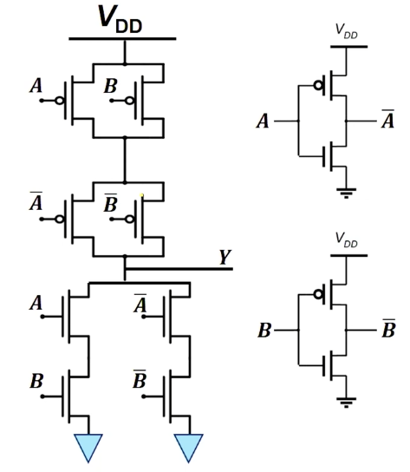

Example: Constructing XOR Gate
Static 2-input XOR Gate
A | B | Y | Y
0 | 0 | 0 | 1
0 | 1 | 1 | 0
1 | 0 | 1 | 0
1 | 1 | 0 | 1
12 Transistors in Total
Notes:
问题：Limitied Logic Function：例子
实现2输入的XOR需要12个Transistor
Static CMOS可以实现这样的设计，但是如果不是NAND和NOR类似的功能，就有可能要付出较大的代价（电路结构比较复杂）

Slide 5
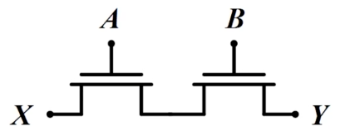
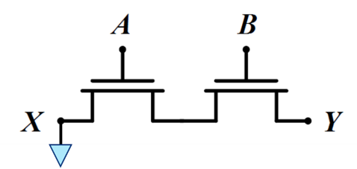
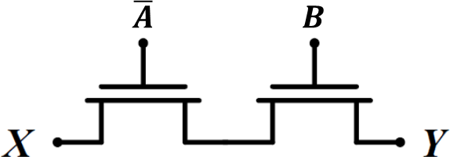
Review: NMOS in Series
What if X is connected to another input signal?
In static CMOS configuration X = GND
A | B | Y
1 | 1 | X
𝒀 = 𝑿 when 𝑨 AND 𝑩
𝒀 = 𝑨 ∙ 𝑩
A | B | Y
0 | 1 | X
The two NMOS act as the pass-or-not switches.
Notes:
从本质上梳理：
两个NMOS串联，实现的是AND的功能。但是由于我们在static CMOS的设计中，考虑到NMOS适合构建PDN，所以将NMOS接地(X端口)，导致其实现的功能为INV(AB)。
现在放宽这个范围，让static CMOS的input除了能和transistor的tgate相连，还可以连到source和drain，
现在考虑X可以接入到任意的输入，这时候发现本质上串联NMOS的功能就变成了一个2输入控制的开关，这样可以使用新的方式来构造电路

Slide 6
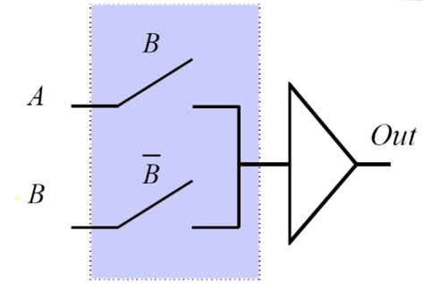
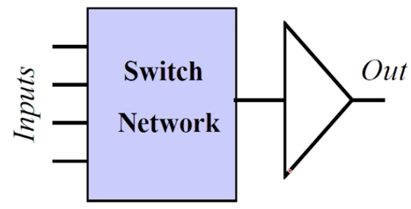
Pass Transistor Logic (PTL)
传输管逻辑
Allows logic inputs to drive the S and D terminals of transistors.
Then N inputs are divided into two parts
(N-1) as the gate control signals
The N^{th} signal as the transmitted signal
(N-1) transistors in series represent one of the 2^{N-1} input patterns.
Notes:
PTL：传输管逻辑
这就是Pass Transistor的设计思路：即回归到晶体管最本质的开关功能，控制开则信号通过
比起原本的设计，部分的输入可能会变成传输信号，不比原本都接到gate。

Slide 7
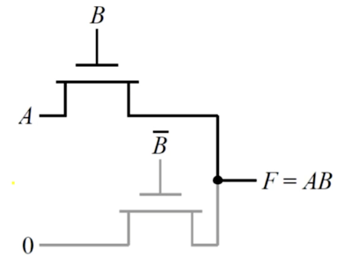
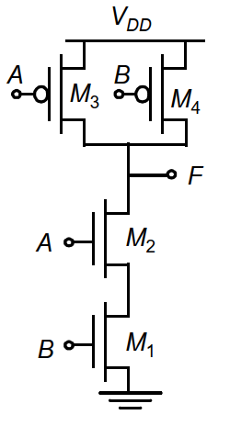
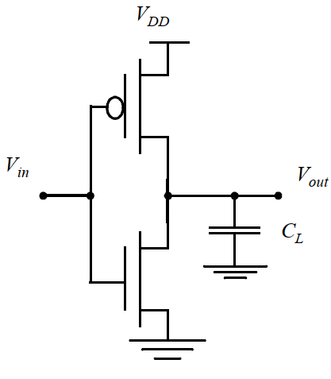
Example: 2-Input AND Gate
PTL 2-input AND Gate
0
A
4 Transistors in Total
A | B | F
0 | 0 | 0
1 | 0 | 0
0 | 1 | 0
1 | 1 | 1
练习：使用互补CMOS方法设计需要多少个Transistor？
B controls A
2输入的NAND+反相器，6个
观察不同情况下输出F与输入的关系：
B=0：F恒为0
B=1：F=A
+
Notes:
设计一个2输入的AND:
使用static CMOS：一个NAND，再加反相器
4个transistor：2个NMOS，加上产生~B的2个
练习：使用static CMOS需要4+2=6个

Slide 8
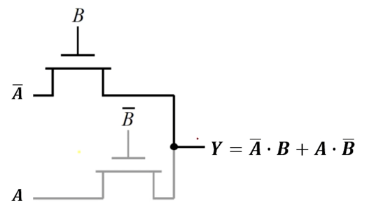
Example: 2-Input XOR Gate
PTL 2-input XOR Gate
A | B | F
0 | 0 | 0
1 | 0 | 1
0 | 1 | 1
1 | 1 | 0
Still 4 Transistors in Total!
A
A
B controls A
分析：输出和输入之间的关系？
使用互补CMOS方法需要多少Transistor？
Such circuit design strategy can be easily expand to any N-input logic gates.

Slide 9
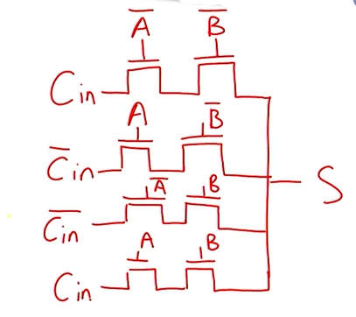


Example: 3-Input Logic Gate
PTL Full-Adder Sum Logic
A | B | ^{C}in | S
0 | 0 | 0 | 0
0 | 0 | 1 | 1
1 | 0 | 0 | 1
1 | 0 | 1 | 0
0 | 1 | 0 | 1
0 | 1 | 1 | 0
1 | 1 | 0 | 0
1 | 1 | 1 | 1
C
in
C
in
A and B control C_{in}
对比：对比互补CMOS的设计方法，孰快孰慢？
Notes:
那如何扩展到多输入情况？
根据控制信号分析情况，结合输入的关系。选择A、B进行控制，2*2有4种情况。

Slide 10
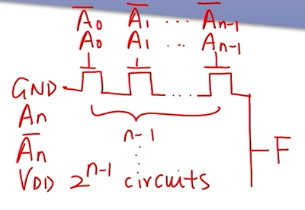
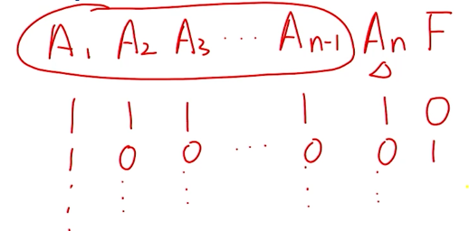
Static CMOS vs. PTL
N-input NAND
With the increase of input signals, PTL needs (N-1)×(1+2^{N-1}) transistors while static CMOS logic gates need 2N transistors for NAND/NOR functions.
Notes:
这种情况下使用互补CMOS只需要2N个Transistor。
可以发现各自的优势与逻辑功能息息相关

Slide 11


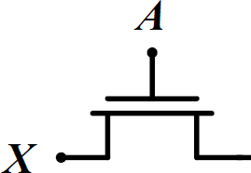

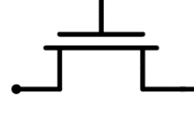
NMOS-Only Switch Issue
𝑨 = 𝑽_{𝑫𝑫}
D
S
𝒀
0 → V_{DD} - V_{TN}
Output voltage does not pull up to V_{DD}, but to V_{DD} - V_{TN}
𝑿: 𝟎→𝑽_{𝑫𝑫}
0 → V_{DD} - V_{TN} - V_{TN}
𝒀
PTL should never be cascaded due to reduced voltage swing
Notes:
要形成通道，需要保证V(GS)>V(T)
问题：如果把某个NMOS的输出作为下一个NMOS的控制信号（接到G），则会导致相应的输出电压不断下降
因此不能出现这种情况
Swing：摆幅

Slide 12
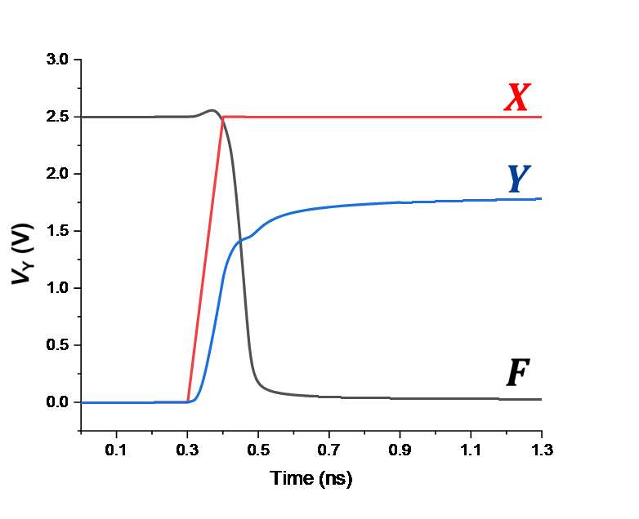
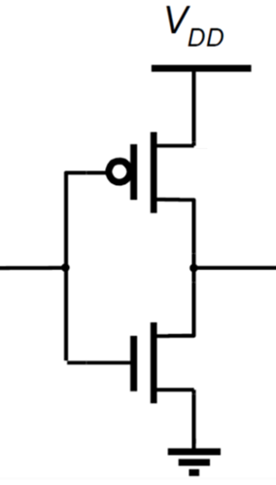
NMOS-Only Switch Issue
𝑨 = 𝑽_{𝑫𝑫}
M₂
D
S
𝒀
𝑭
𝑿: 𝟎→𝑽_{𝑫𝑫}
M₁
The voltage at Y can only be pulled-up to V_{DD} – V_{TN}
If |V_{TP}| of M₂ is smaller than V_{TN}, then M₂ cannot be turned off. → Static power consumption
Also the smaller V_{GS} of M₁ reduces the discharge current. → Longer discharge time
Notes:
电压摆幅减少可能的影响场景：不同级的门可能使用不同的设计方式
分析
对PUN：无法关闭PMOS，不断工作，产生功耗
对PDN：V(GS)减小，放电电流减少，放电时间增多
图：仿真结果

Slide 13
Summary of PTL
PTL Gate is Static – a low-impedance path exists to both supply rails under all circumstances.
PTL Gate is Ratio-less – logic function does not depend on the transistor’s size.
PTL Gate is Easy to implement – (N-1) inputs control the transmission of the N^{th} input signal.
PTL Gate design is Modular – all circuits use the same topology, only inputs are permuted.
For small fan-in logic gates, for instance the XOR, PTL is more attractive than static CMOS.
For large fan-in logic gates, PTL will bring additional routing overhead.
NMOS-only PTL Gate has potential static power dissipation issue.
Notes:
是static的，在所有情况下，两个电源轨均存在低阻抗路径
起到的都是开关功能，size不影响功能
容易实现，知道真值表后就可以将N-1个输入作为控制
如果只用NMOS或PMOS设计，则会导致静态功耗问题以及输出无法实现0-VDD的摆幅

Slide 14
补充：静态电路与动态电路
The complementary CMOS circuit style falls under a broad class of logic circuits called static circuits in which at every point in time (except during the switching transients), each gate output is connected to either VDD or Vss via a low-resistance path.
Also,the outputs of the gates assume at all times the value of the Boolean function implemented by the circuit (ignoring, once again, the transient effects during switching periods).
This is in contrast to the dynamic circuit class, which relies on temporary storage of signal values on the capacitance of high-impedance circuit nodes. The latter approach has the advantage that the resulting gate is simpler and faster. Its design and operation are however more involved and prone to failure due to an increased sensitivity to noise.

Slide 15

希望大家给五星满分好评！

