Slide 1
Lecture 7: From Pass Transistor Logic to Transmission Gate
Notes:
上一节：如何利用晶体管作为switch的性质来传输信号
仅用一个NMOS来作信号传输的问题：pull up时摆幅无法从0-VDD
针对单个NMOS或单个PMOS组成的缺点，如何解决

Slide 2
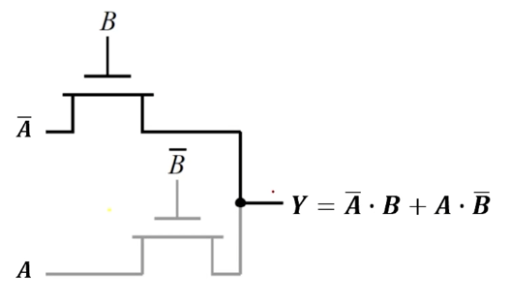
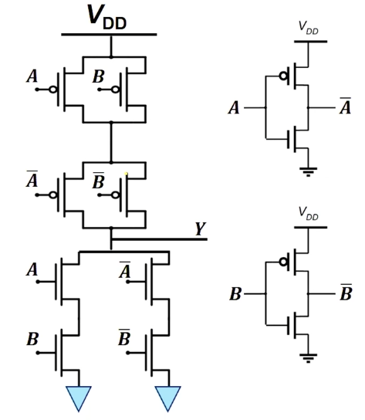
Review: 2-Input XOR Gate
PTL 2-input XOR Gate
A | B | F
0 | 0 | 0
1 | 0 | 1
0 | 1 | 1
1 | 1 | 0
Still 4 Transistors in Total!
A
A
B controls A
PTL相比互补CMOS在实现某些功能的电路更加方便，使用晶体管的数量更少。
——但也会带来其他问题。
Such circuit design strategy can be easily expand to any N-input logic gates.

Slide 3
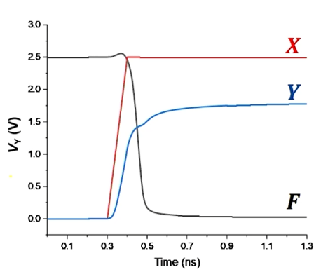
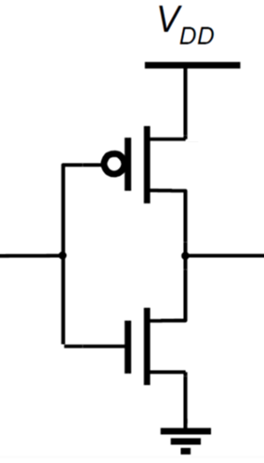



Review: NMOS-Only Switch Issue
𝑨 = 𝑽
𝑫𝑫
M₂
D
S
𝒀
𝑭
𝑿: 𝟎→𝑽_{𝑫𝑫}
M₁
The voltage at Y can only be pulled-up to V_{DD} – V_{TN}
If |V_{TP}| of M₂ is smaller than V_{TN}, then M₂ cannot be turned off. → Static power consumption
Also the smaller V_{GS} of M₁ reduces the discharge current.
→ Longer discharge time
Notes:
PTL的弊端，后考虑如何解决
如果设计不好，Y不够大，无法把M2关断

Slide 4
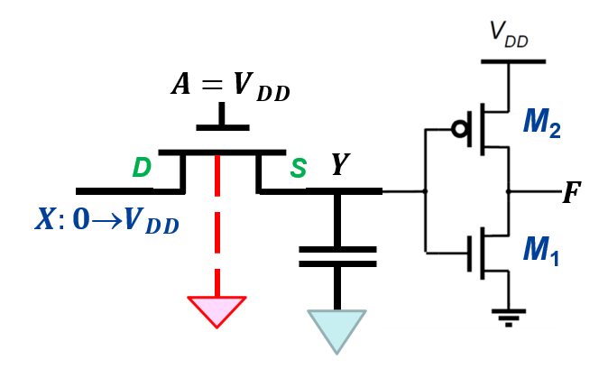
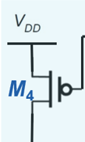
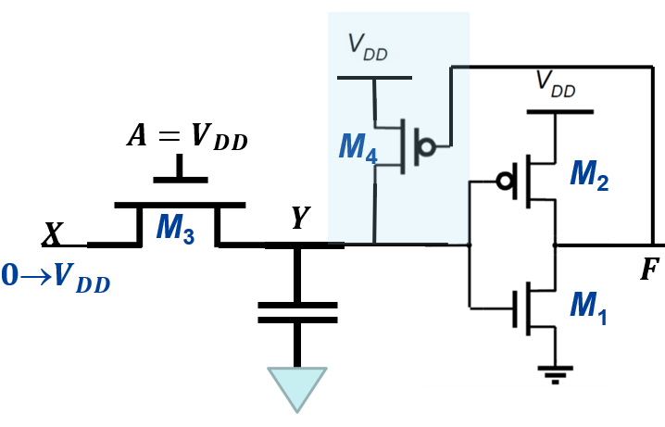
Improvement Strategy #1
电平恢复器
The level restoring PMOS transistor forms
a positive feedback.
𝑿: 𝟎→𝑽_{𝑫𝑫}
𝒀: 𝟎→𝑽_{𝑫𝑫} − 𝑽_{𝑻𝑵}
M Turn ON
1
M₄
Turn ON
𝒀: 𝑽_{𝑫𝑫} − 𝑽_{𝑻𝑵} → 𝑽_{𝑫𝑫}
𝑭: 𝑽_{𝑫𝑫}→𝟎
Realize Full Voltage Swing
Notes:
方法1：电平恢复
使用一个PMOS作为电平恢复器；优点：所有电平不是GND就是VDD，没有静态功耗
Y受到了两路电路，从M4所在支路，Y可以被上拉到VDD
正反馈，将M2彻底关闭，M1打开
接下来看其会不会导致什么其他影响

Slide 5

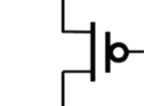

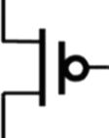
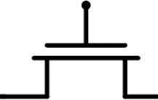


Racing Issue at Point Y
At t = 0
Y = V_{DD}, F = 0
M₁, M₄ ON, M₂ , M₃ OFF
t>0，M₁,M₃ ,M₄ ON, M₂ OFF
At t > 0, equivalent circuit
𝑨 = 𝑽_{𝑫𝑫}
M
4
M
2
𝑿
𝑽_{𝑫𝑫}→𝟎
M₃
𝒀
𝑭
M₁
^{R}on,M
M₄
𝑭 V =
3
V
Y
^{R}on,M ^{+ R}on,M
3 4
DD
If W_{M4} is too large (R_{on,M4} is too small), V_{Y} cannot be pulled below V_{TN}* (i.e., M₁ turned OFF)*, the logic function cannot be operated correctly.
M₃
𝒀
Notes:
此时M1，M4导通，对于M3，由于X,Y,A都是VDD，因此是处于关断状态
当X->0后，M3导通，这时候Y也降
此时Y的电压就受到M3和M4电阻影响，V(Y)就会变大

Slide 6
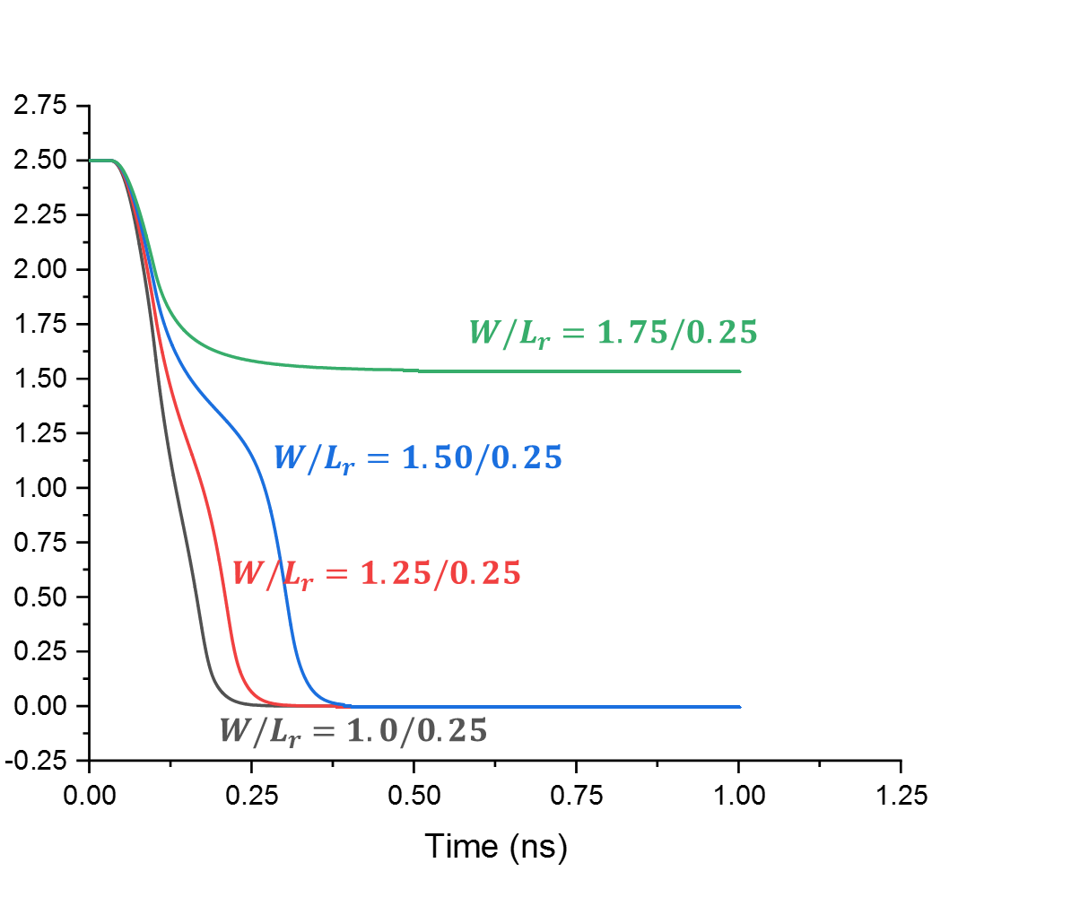
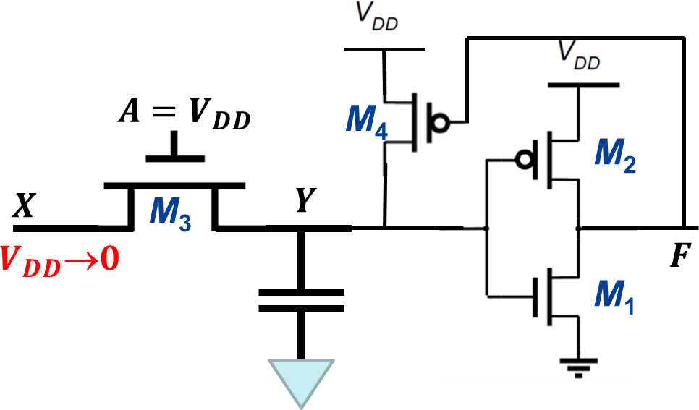

M₄ PMOS Sizing Effect
Node Y stops discharging and the inverter never switches any more.
Logic function can be implemented, yet with longer time. → need to avoid.
Desired fast switching
Level restoring method has speed and power impacts: increases the capacitance at Y, and slows down the propagation delay.
Notes:
会丧失应有的性能，如：无法快速放电
具体看会有什么影响，M4的W很小，理想
但是很大时，无法下拉，功能受影响

Slide 7
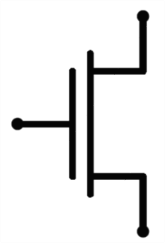
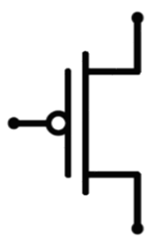



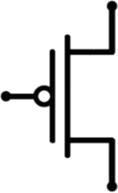

Weak and Strong PUN & PDN
V_{DD} → 0
^{V}SG ^{≥ V}Tp
S
V_{DD} → |V_{Tp}|
D
NMOS passes a STRONG 0 in pull- down network (PDN)
C
PMOS passes a WEAK 0 in pull- down network (PDN)
V
C_{L}
L
DD
S
D
^{V}DD
D
0 → V_{DD}
^{V}DD
D
0 → V_{DD} - V_{Tn}
^{V}DD
NMOS passes a WEAK 1 in pull-up network (PUN)
S
PMOS passes a STRONG 1 in pull- up network (PUN)
S
C
C_{L}
^{V}GS ^{≥ V}Tn
L
Notes:
方法2：使用PMOS来进行pull-up
之前不行，原因是NMOS无法强上拉

Slide 8
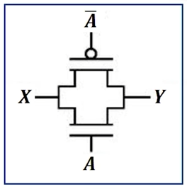
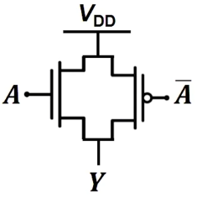
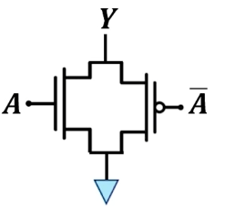
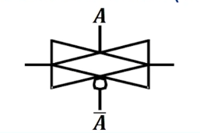
Improvement Strategy #2
解决电压损失问题最广泛使用的方法是使用传输门（Transmission Gate ，TG）
NMOS and PMOS in parallel
When A: 0 → V_{DD}
PMOS helps to pull-up Y to V_{DD}
Transmission Gate (TG)
When A: 0 → V_{DD}
NMOS helps to pull-down Y to GND
Symbol
TG enables bi-directional rail-to-rail switching.
TG requires two transistors with more control signals than PTL.
Notes:
核心思想依旧是PTL
实现功能需要更多的晶体管
X与Y是对偶的

Slide 9
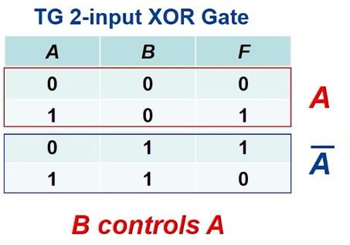
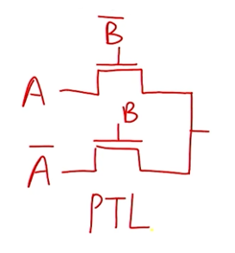
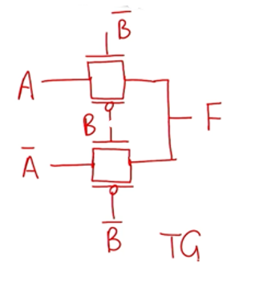
Example: TG-Based XOR
将NMOS替换为TG
各需要多少个晶体管？
Notes:
遇到单个NMOS就将其补全为TG

Slide 10
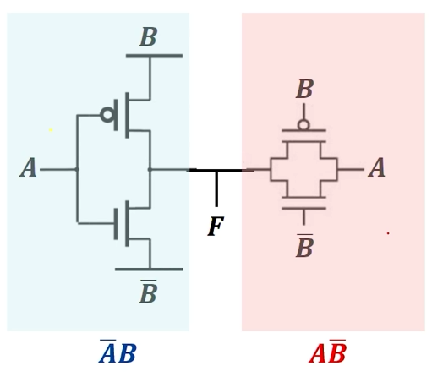
Example: TG-Based XOR
Simplest version – Make use of the bi-directional feature of TG
TG 2-input XOR Gate
A | B | F
0 | 0 | 0
1 | 0 | 1
0 | 1 | 1
1 | 1 | 0
A
A
B controls A
各需要多少个晶体管？如果使用互补CMOS设计，需要多少个晶体管？
Notes:
6个晶体管（互补CMOS需要12个）
解决了问题，同时总体需要增加的晶体管数也减少了

Slide 11
Example: TG-Based XOR
各需要多少个晶体管？如果使用互补CMOS设计，需要多少个晶体管？
Notes:
6个晶体管（互补CMOS需要12个）
解决了问题，同时总体需要增加的晶体管数也减少了

Slide 12
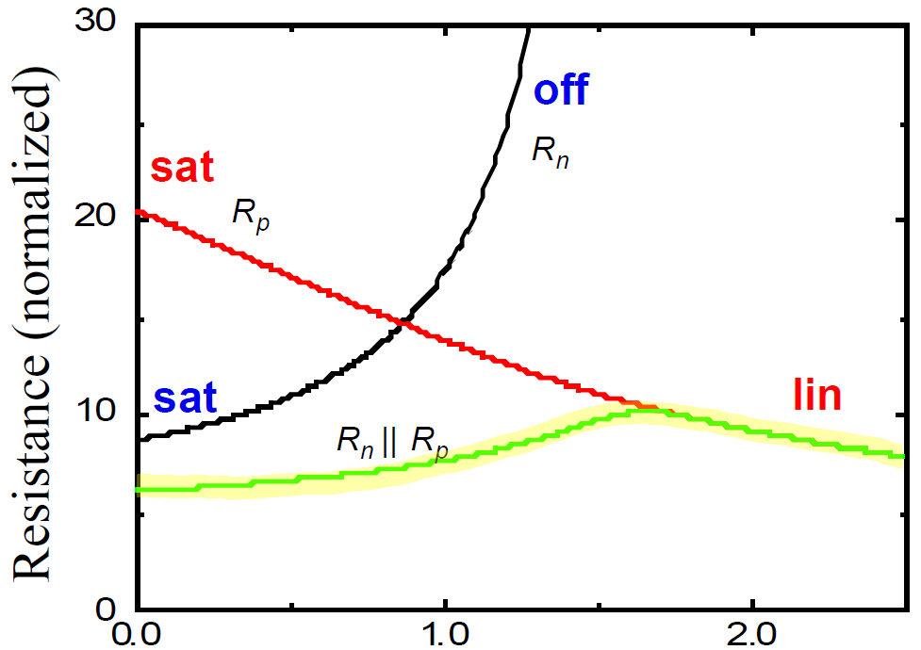
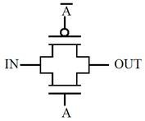
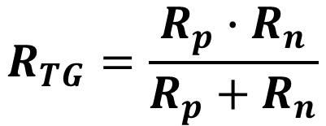
Equivalent Resistance of TG
I
0
|V_{GSp}| = V_{DD}
S_{p}
D_{p}
^{𝑽}𝑫𝑫
𝒀
D_{n}
S_{n}
^{V}GSn ^{= V}DD ^{- V}Y
^{𝑽}𝑫𝑫
Transmission Gate (TG)
V_{Y} (V)
$$R_{TG}=\frac{R_{p}∙R_{n}}{R_{p}+R_{n}}$$
考虑当TG用于上拉时的等效电阻
Notes:
等效电阻的大小
电流分析：电流方向为正电子（即空穴）的方向
虽然S，D相反，但是电流方向相同
电阻分析：

Slide 13
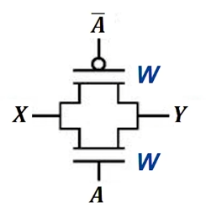
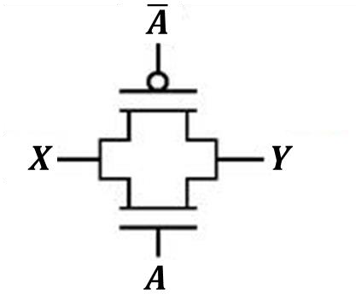
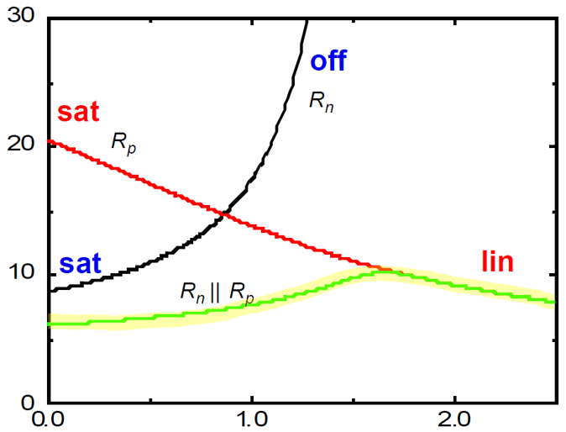
Equivalent Resistance of TG
KEY: We need to consider the penalty for weak transition: NMOS-PUN & PMOS-PDN
*In this course, we assume penalty factor is α = 2
由于在这些情况下，相应的等效电阻都会更大，所以加入α来模拟
PUN
Strong PMOS, Weak NMOS
PDN
Strong NMOS, Weak PMOS
TG with equal PMOS and NMOS
W – 2R₀
W – α⋅2R₀
W – αR₀
W – R₀
Equal Strength
^{R}ON,PDN ^{= 0.8R}0 (α=2)
^{R}ON,PUN ^{= R}0
(α=2)
R_{ON} ~ R₀
粗略地近似，将其视为相等
Notes:
当α=2时

Slide 14
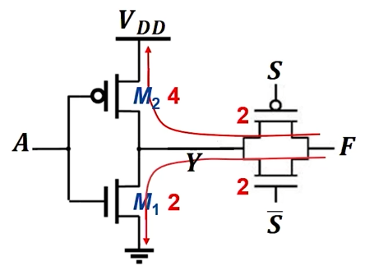
Logical Efforts of a TG Gate
KEY: ALWAYS trace back to V_{DD} (PUN) or GND(PDN) to form a complete charge/discharge path!
PUN Gate Sizing
^{R}ON,M2 ^{+ R}ON,TG ^{= R}0 ^{→ R}ON,TG ^{= R}0^{/2 & R}ON,TG ^{= R}0^{/2}
PDN Gate Sizing
^{R}ON,M1 ^{+ R}ON,TG ^{= R}0 ^{→ R}ON,TG ^{= R}0^{/2 & R}ON,TG ^{= R}0^{/2}
g_{A} = 6/3 = 2
g_{S} = 2/3
Drawbacks: Neglecting the parasitic capacitance at Y.
通常计算PDN或者PUN的传播延时时都以VDD或者GND作为基准
Notes:
从传播延时的定义出发一般将其视为一级的电路。
作为一级电路时的问题：充电时，V(Y)未知
误差，Y的电容被忽略

Slide 15
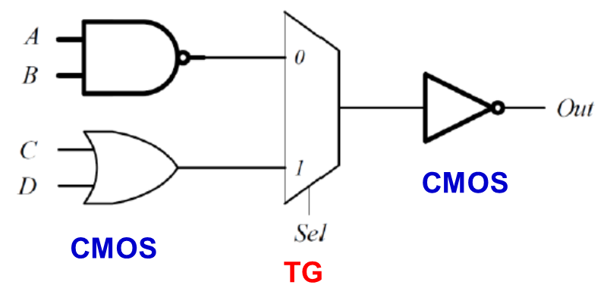
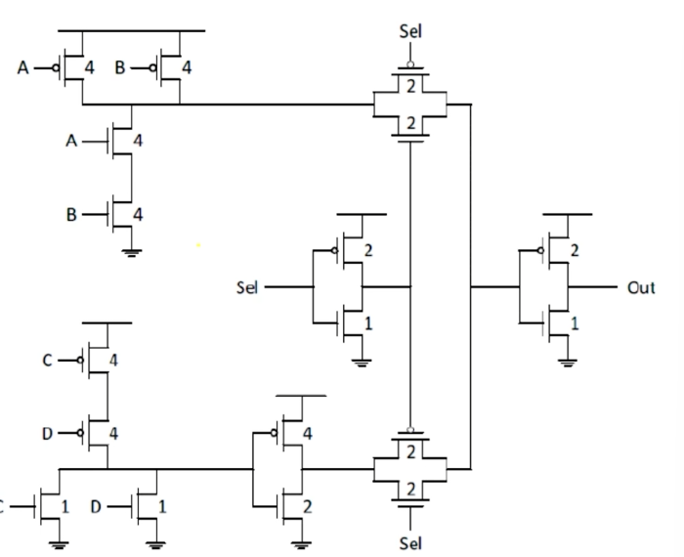

Example: TG-Based Logic Circuit
Calculate the worst-case delay of this circuit.
1
1
1
1
若应用Logical Effort方法分析，
该如何对此电路进行分级？
Notes:
依照前面的例子，将TG与前一个门视为同一级

Slide 16
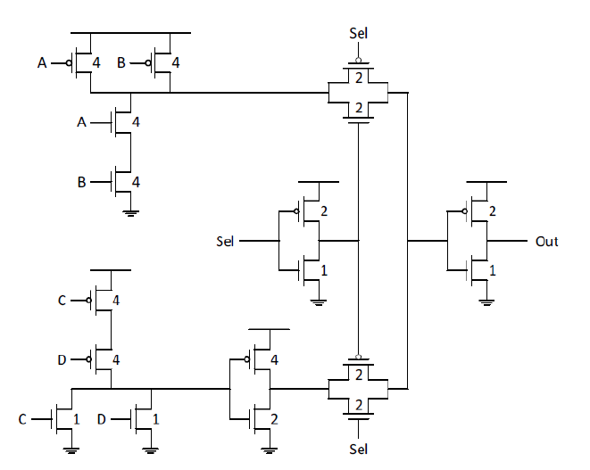
Example: TG-Based Logic Circuit
1
1
1
Stage 3
1
CMOS
CMOS
Stage 1
Stage 2
g₂ = 2
g₃ = 1
g₁ = 5/3
Notes:
可以根据新得到的分级计算Logic effort

Slide 17

希望大家给五星满分好评！

