Slide 1
Lecture 7: Pass Transistor Logic Power and Delay Analysis
Notes:
之前：PTL的思想以及如何实现，与静态CMOS比较，有优势，也有缺陷
以例子对之前的知识进行巩固，并学习如何分析

Slide 2
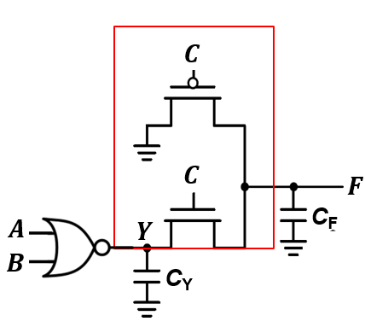
PTL Circuit Analysis
Step 1: Determine the logic function
𝒀 = 𝑨 + 𝑩
Y | C | F
0 | 0 | 0
1 | 0 | 0
0 | 1 | 0
1 | 1 | 1
𝑭 = 𝒀 ∙ 𝑪 = (𝑨 + 𝑩) ∙ 𝑪
Notes:
首要：确定逻辑功能，先得到Y
可以发现C是作为控制信号，因此很快能够得到表达式

Slide 3
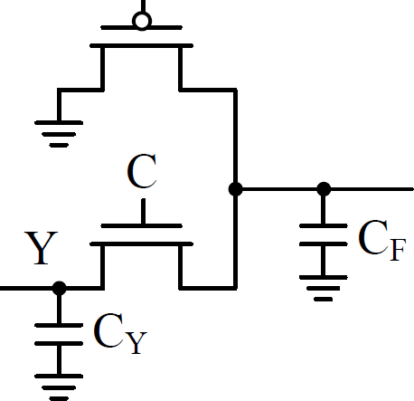

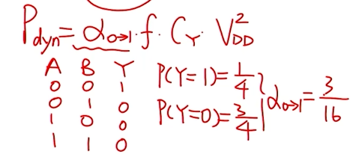
PTL Circuit Analysis
𝑪
Step 2: Calculate the dynamic power consumption
KEY: M₁ cannot be pulled-up to V_{DD}
M₂
𝑪
𝑭
C_{F}
= α_{0→1} ⋅ C_{L} ⋅V_{DD} ⋅ (V_{OH}
𝑨
𝑩
𝒀
^{P}avg ^{−V}OL ^{) ⋅ f}clock
M₁
C_{Y}
KEY: M₂ cannot be pulled-down to 0
Y | C | F | V_{F}
0 | 0 | 0 | |VTP|
1 | 0 | 0 | |VTP|
0 | 1 | 0 | 0
1 | 1 | 1 | VDD - VTN
NOR门的动态功耗分析
Notes:
动态功耗评估
第一级：可以快速写出，
第二级：不能swing到VDD，因此为VOH-VOL（out-high，out-low）
因为不是从0-VDD，因此要判断出每个输入对应的输出电压

Slide 4

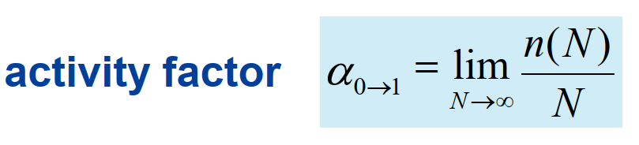
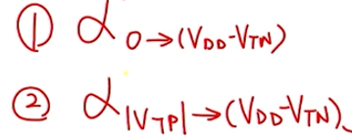

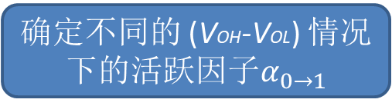
PTL Circuit Analysis
Step 2: Calculate the dynamic power consumption
𝑪
M₂
𝑪
𝑭
输出电压的摆幅会影响功耗
确定不同的 (VOH-VOL) 情况下的活跃$因子α_{0→1}$
𝑨
𝑩
𝒀
C_{F}
M₁
C_{Y}
Y | C | F | V_{F}
0 | 0 | 0 | |VTP|
1 | 0 | 0 | |VTP|
0 | 1 | 0 | 0
1 | 1 | 1 | VDD - VTN
n(N): the number of 0->1 transitions in N clock cycles
$$α_{0→1}$$
Notes:
都用绝对值表示
需要确定最后每一个input，output的具体电压值是多少

Slide 5
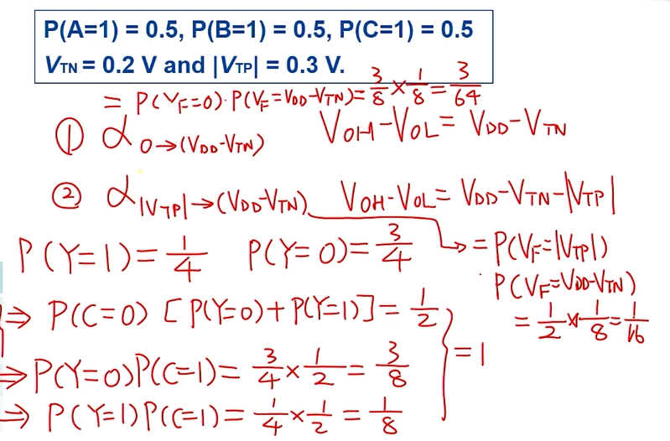
PTL Circuit Analysis
Step 2: Calculate the dynamic power consumption
𝑪
M₂
𝑪
𝑭
𝑨
𝑩
𝒀
C_{F}
M₁
C_{Y}
Y | C | F | V_{F}
0 | 0 | 0 | |VTP|
1 | 0 | 0 | |VTP|
0 | 1 | 0 | 0
1 | 1 | 1 | VDD - VTN
Notes:
都用绝对值表示
需要确定最后每一个input，output的具体电压值是多少

Slide 6
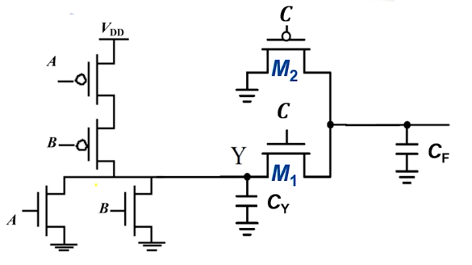
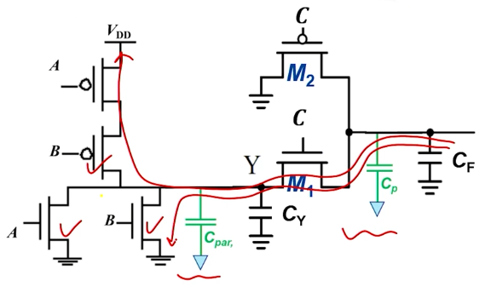
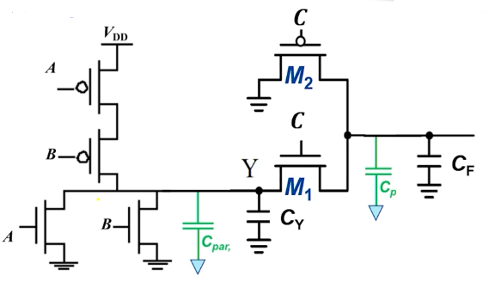
PTL Circuit Analysis
Step 3: Calculate the propagation delay
𝑪
M₂
𝑪
𝑭
𝑨
𝑩
𝒀
C
F
M
1
C_{Y}
若用传统方法求解，需考虑中间的电容
追溯到VDD与GND

Slide 7
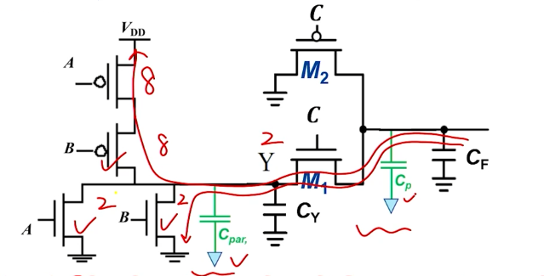
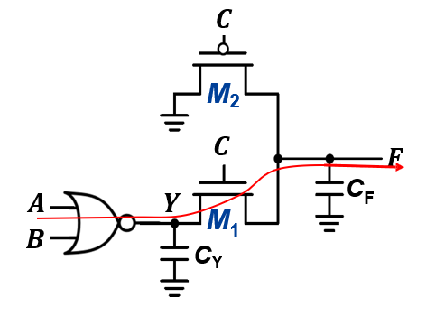
PTL Circuit Analysis
Step 3: Calculate the propagation delay
KEY: Single-stage circuit for worst-case!
A = 0→1, B = 0, C = 1
Notes:
假设M1的size为2，前后电阻均分，可以先给晶体管分配size，而后R和C都可确定。
对于worse case，需要保证路径可以接到VDD或者GND
分析较为复杂

Slide 8
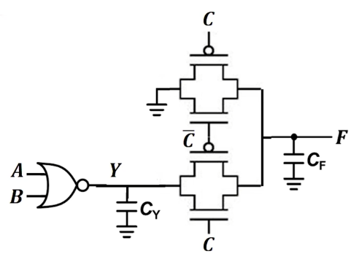
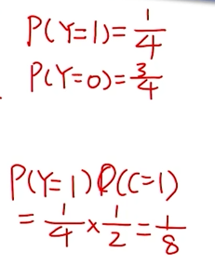

TG Circuit Analysis
Y | C | F | V_{F}
0 | 0 | 0 | 0
1 | 0 | 0 | 0
0 | 1 | 0 | 0
1 | 1 | 1 | VDD
增加了晶体管数目，但是分析变得简单
Notes:
更换后摆幅可以达到0-VDD
虽然增加了晶体管数，但是使得电路的分析更加简单

Slide 9
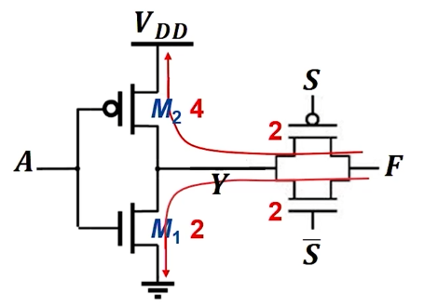
Logical Efforts of a TG Gate
KEY: ALWAYS trace back to V_{DD} (PUN) or GND(PDN) to form a complete charge/discharge path!
PUN Gate Sizing
^{R}ON,M2 ^{+ R}ON,TG ^{= R}0 ^{→ R}ON,TG ^{= R}0^{/2 & R}ON,TG ^{= R}0^{/2}
PDN Gate Sizing
^{R}ON,M1 ^{+ R}ON,TG ^{= R}0 ^{→ R}ON,TG ^{= R}0^{/2 & R}ON,TG ^{= R}0^{/2}
g_{A} = 6/3 = 2
Drawbacks: Neglecting the parasitic capacitance at Y.
使用Logical Effort方法分析时TG不作为单独的一级，误差较大
Notes:
从传播延时的定义出发一般将其视为一级的电路。
作为一级电路时的问题：充电时，V(Y)未知
误差，Y的电容被忽略

Slide 10
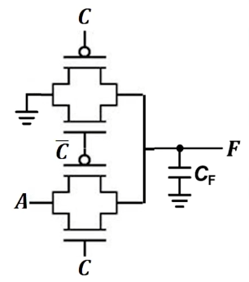
Summary of PTL/TG Circuit
PTL/TG logic gates use S/D terminal as the input.
The essence of PTL/TG is to make the (N-1) input signals control the transmission of the N^{th} input.
PTL/TG circuits are easy to implement, yet the circuit analysis is more difficult.
For specific small fan-in logic gates, including XOR/XNOR and Multiplexer, PTL/TG has clear advantage than static CMOS.
In general, logical efforts method can be applied to PTL/TG, yet with less accuracy than static CMOS.
In real IC design, make the best use of PTL/TG and static CMOS.
Notes:
TG本身不能作为一级，因此分析误差较大
将其单独当做一级进行logic effort等方法进行分析，则中间电容会被忽略。因此误差会较大

Slide 11

希望大家给五星满分好评！

