Slide 1
Lecture 8: Adders Introduction of Adders
Notes:
前文：了解实现具有特定功能的逻辑门的实现方法
现介绍电路中重要的组合电路器件：加法器

Slide 2
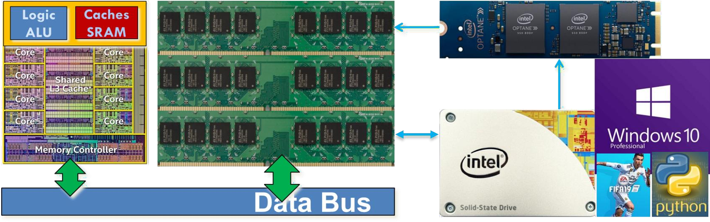
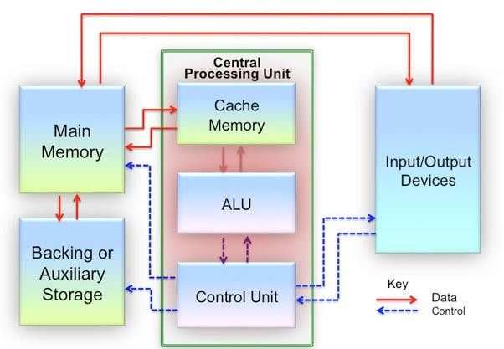
Overview of CPU
CPU Schematics
CPU is the core of the computer.
The CPU processor mainly has five components: Program Counter (PC), Control Unit, Instruction Memory, Data Memory, Register File, and Arithmetic Logic Unit (ALU).
The ALU unit determines the computing capability.
Notes:
什么是加法器？其地位：
CPU中有计算，存储等功能，其中ALU主要处理计算部分。
联系计组内容。

Slide 3
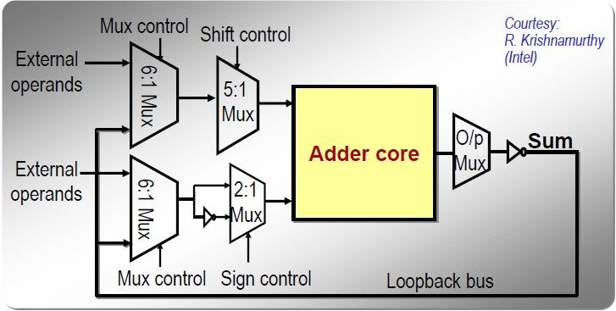
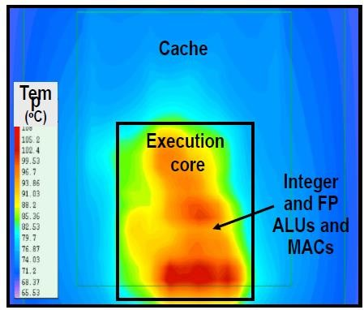
Arithmetic Logic Unit (ALU)
32-Bit ALU Architecture
Processor Thermal Map
ALU a variety of mathematical and logical operations into a single unit.
Multiple ALUs clustered together in the execution core → High Power Density
GOAL: High-Performance Energy-Efficient Design
Notes:
ALU处理数值和逻辑的计算。
逻辑计算在之前已经介绍，与或非等。
而数值计算在CPU中实现的核心就是加法器。

Slide 4
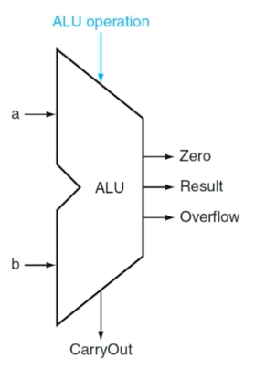
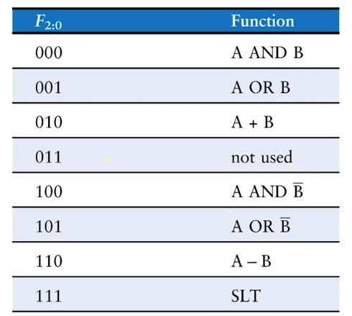
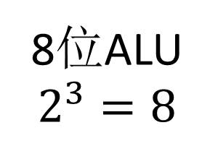
Arithmetic Logic Unit (ALU)
8位ALU
$$2^{3}=8$$
ALU Control Line Example
数值加减法该如何实现？

Slide 5
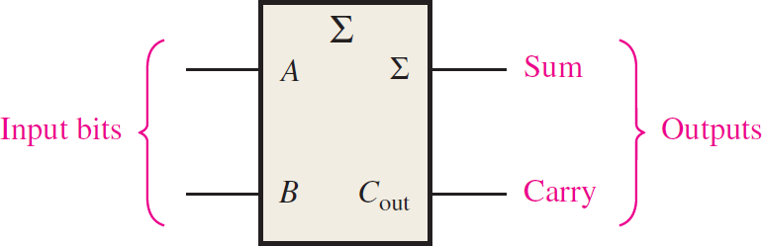
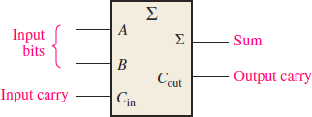
Binary Addition
MSB
LSB
There are two output states: Sum & Carry-out
LSB Addition, only two inputs: A₀ & B₀
1
A₄₁
+^{B4}1
1 1
1 0 1 1 1
+ 1 1 1 0 0
0 0 1 1
1
1 0 1 1 1
+ 1 1 1 0 0
0 1 1
 | 1 | 0 0
 | 0 | 1 1 | 1
 | 1 | 1 0 | 0
 | 0 | 0 1 | 1
1 0 1 1 1
+ 1 1 1 0 0
1 0 1 1 1
+ 1 1 1 0 0
1
1 0 1 1 1
+ 1 1 1 0 0
1 1
A₀
Half Adder (HA)
B₀
1 1
Other Bit Addition, three inputs: A_{n} & B_{n} & C_{in,n}
Full Adder (FA)
MSB(Most Significant Bit)：最高有效位
^{C}out,n-1 ^{= C}in,n
设计与优化的关键
LSB(Least Significant Bit)：最低有效位

Slide 6
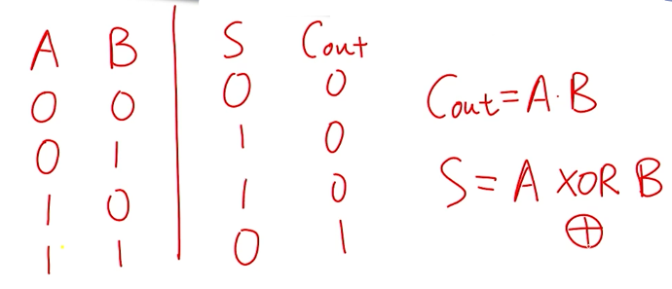
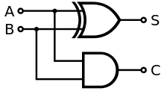
Half Adder Logic Function
Logic diagram
结合之前所学的知识，这样的电路该使用互补CMOS方法还是PTL方法实现？
不同的方法适合于实现哪些功能？

Slide 7
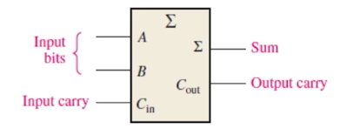
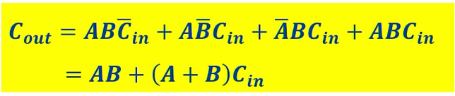
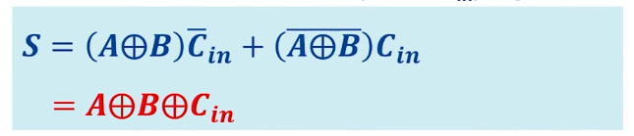
Full Adder Logic Function
Inputs |  |  | Outputs
A | B | ^{C}in | ^{C}out | S
0 | 0 | 0 | 0 | 0
1 | 0 | 0 | 0 | 1
0 | 1 | 0 | 0 | 1
1 | 1 | 0 | 1 | 0
0 | 0 | 1 | 0 | 1
1 | 0 | 1 | 1 | 0
0 | 1 | 1 | 1 | 0
1 | 1 | 1 | 1 | 1
C_{out} = 1: at least 2 out 3 of the (A, B, C_{in}) inputs are Logic 1
S = 1: odd number of the (A, B, C_{in}) inputs are Logic 1

Slide 8
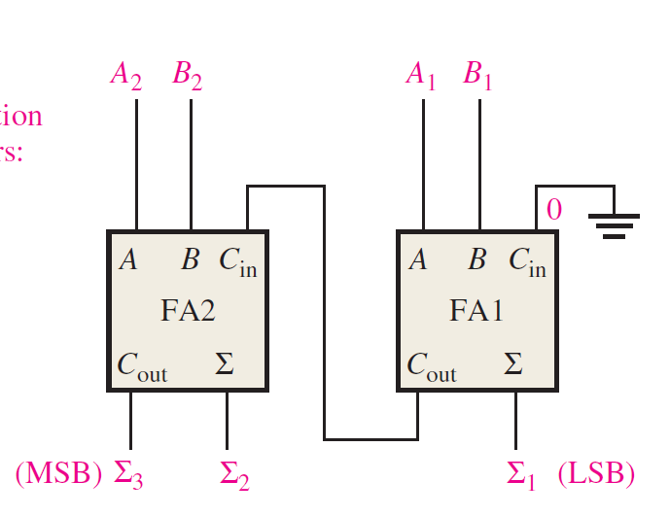
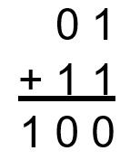
Multi-Bit Binary Addition
2-bit addition
Carry: 1 0
The general worst-case path is to obtain S₂ & C_{out,3}.
The carry-out/carry-in is the most important information.
A good design needs to minimize the overall propagation delay.

Slide 9
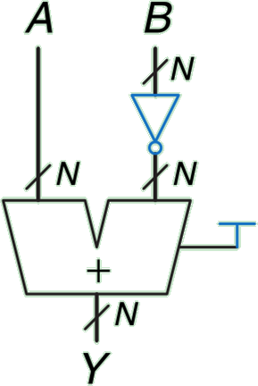

Binary Subtraction
KEY: 15 - 5 = 15 + (-5) → Convert to Addition
The computer use Two’s Complement Numbers to represent negative number.
Inverter all bits and then add 1 to the LSB
1 1 1
(carry)
1 1 1 1
+ 1 0 1 1
1 0 1 0 ⁼ ¹⁰10
补码=原码按位取反+1
FA

Slide 10
One Bit Multiplication
𝑷 = 𝑨 × 𝑩
A | B | P
0 | 0 | 0
0 | 1 | 0
1 | 0 | 0
1 | 1 | 1
Just an AND gate

Slide 11
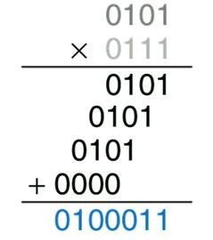
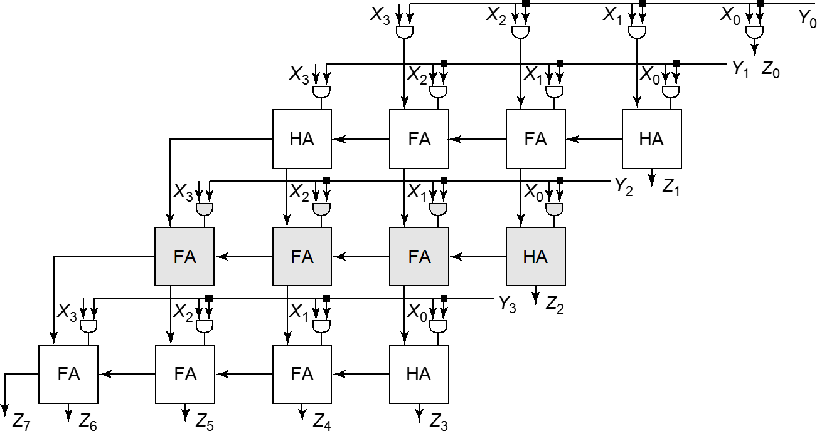
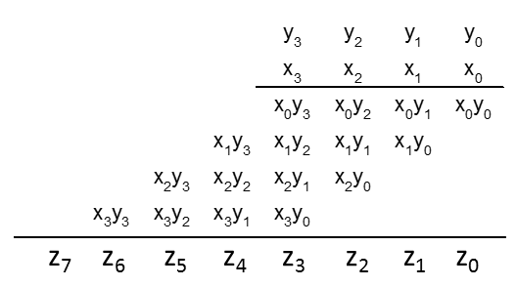
Multi-Bit Multiplication
The 4 × 4 Array Multiplier
Notes:
核心都是Adder

Slide 12

希望大家给五星满分好评！

