Slide 1
Lecture 8: Adders
Circuit Implementation 1
Notes:
介绍了加法器——CPU中的核心部件
如何使用加法器构建出二进制加法、减法、乘法功能

Slide 2
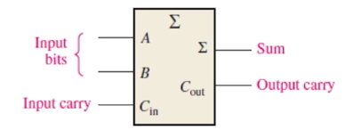
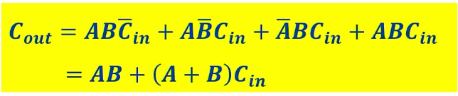
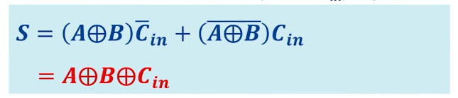
Full Adder Logic Function
Inputs |  |  | Outputs
A | B | ^{C}in | ^{C}out | S
0 | 0 | 0 | 0 | 0
1 | 0 | 0 | 0 | 1
0 | 1 | 0 | 0 | 1
1 | 1 | 0 | 1 | 0
0 | 0 | 1 | 0 | 1
1 | 0 | 1 | 1 | 0
0 | 1 | 1 | 1 | 0
1 | 1 | 1 | 1 | 1
C_{out} = 1: at least 2 out 3 of the (A, B, C_{in}) inputs are Logic 1
S = 1: odd number of the (A, B, C_{in}) inputs are Logic 1
Notes:
半加器和全加器，半加器可以作为全加器的特殊情况。
输入3，输出2，sum和carry

Slide 3
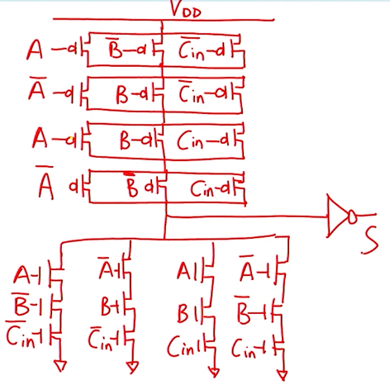
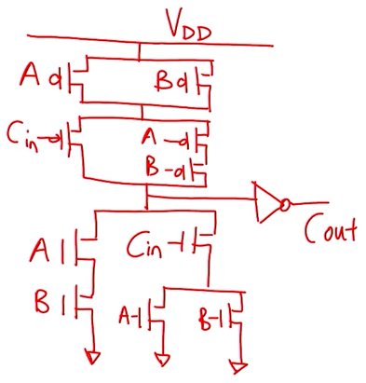
Static CMOS Adder Version 1
𝑪_{𝒐𝒖𝒕} = 𝑨𝑩 + 𝑨 + 𝑩 𝑪_{𝒊𝒏}
如何使用静态CMOS方法将其分别实现？
使用该方法实现的全加器，需要多少个晶体管？
44

Slide 4

Full Adder – Another Look
It’s all about carry, so re-define terms for more efficient design.
使用A，B控制Cin
Carry status
Delete (D)
Propagate (P)
Generate (G)
Full Adder
Internally generates P, G, (D)
A | B | ^{C}in | ^{C}out | ^{C}out Status
0 | 0 | 0 | 0 | D
0 | 0 | 1 | 0 | D
0 | 1 | 0 | 0 | P
0 | 1 | 1 | 1 | P
1 | 0 | 0 | 0 | P
1 | 0 | 1 | 1 | P
1 | 1 | 0 | 1 | G
1 | 1 | 1 | 1 | G
𝑷 = 𝑨⨁𝑩
𝑪_{𝒐𝒖𝒕} = 𝑫 ∙ 𝟎 + 𝑷 ∙ 𝑪_{𝒊𝒏} + 𝑮 ∙ 𝟏
𝑪_{𝒐𝒖𝒕} = 𝑷 ∙ 𝑪_{𝒊𝒏} + 𝑮
𝑮 = 𝑨 ∙ 𝑩

Slide 5


Full Adder – Another Look
A | B | ^{C}in | ^{C}out | S
0 | 0 | 0 | 0 | 0
0 | 0 | 1 | 0 | 1
0 | 1 | 0 | 0 | 1
0 | 1 | 1 | 1 | 0
1 | 0 | 0 | 0 | 1
1 | 0 | 1 | 1 | 0
1 | 1 | 0 | 1 | 0
1 | 1 | 1 | 1 | 1
We can also derive expressions for S based on D and P
Delete
Propagate
Generate

Slide 6
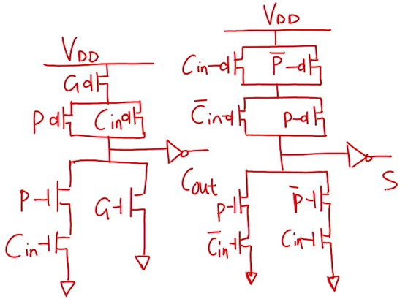
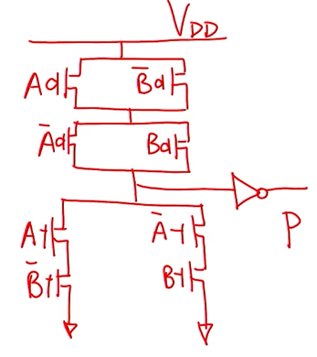
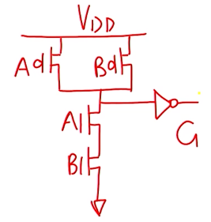
Static CMOS Adder Version 2
𝑷 = 𝑨⨁𝑩
𝑮 = 𝑨 ∙ 𝑩
𝑪_{𝒐𝒖𝒕} = 𝑷 ∙ 𝑪_{𝒊𝒏} + 𝑮
𝑺 = 𝑷⨁𝑪_{𝒊𝒏}
Preparation Stage
需要使用多少个晶体管？（38）

Slide 7
Full Adder – A Third Look
A | B | ^{C}in | ^{C}out | S
0 | 0 | 0 | 0 | 0
0 | 0 | 1 | 0 | 1
0 | 1 | 0 | 0 | 1
1 | 0 | 0 | 0 | 1
0 | 1 | 1 | 1 | 0
1 | 0 | 1 | 1 | 0
1 | 1 | 0 | 1 | 0
1 | 1 | 1 | 1 | 1
𝑪_{𝒐𝒖𝒕} = 𝑮 + 𝑷 ∙ 𝑪_{𝒊𝒏} = 𝑨𝑩 +
𝑨⨁𝑩
^{𝑪}𝒊𝒏
𝑪_{𝒐𝒖𝒕} = 𝑨𝑩 +
𝑨 + 𝑩
^{𝑪}𝒊𝒏
Most Brief Expression
C_{out} = 0, S = A + B + C_{in}
Eliminate XOR Gate
Integrate C and S
out
C_{out} = 1, S = A ⋅ B ⋅ C_{in}
C_{out} controls A & B
Notes:
之前的设计需要很多晶体管，因为异或太多

Slide 8

希望大家给五星满分好评！

