Slide 1
Lecture 8: Adders
Circuit Implementation 2
Notes:
前：如何使用静态CMOS实现一个全加器

Slide 2
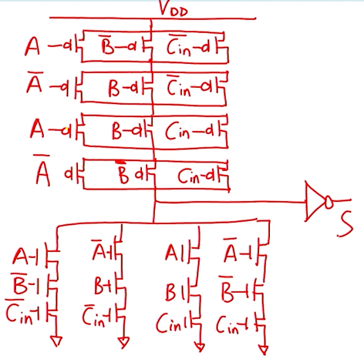
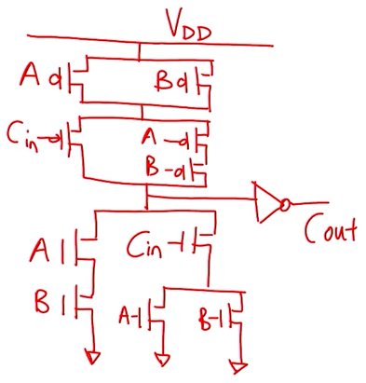
Static CMOS Adder Version 1
𝑪_{𝒐𝒖𝒕} = 𝑨𝑩 + 𝑨 + 𝑩 𝑪_{𝒊𝒏}
使用该方法实现的全加器，需要多少个晶体管？
44

Slide 3
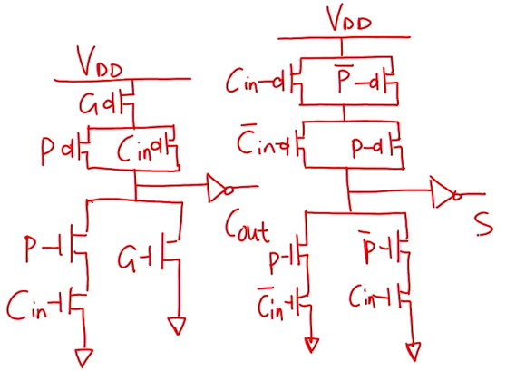
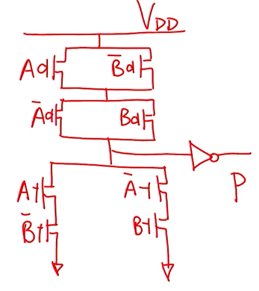
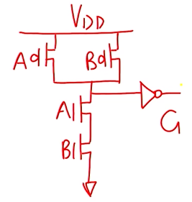
Static CMOS Adder Version 2
𝑷 = 𝑨⨁𝑩
𝑮 = 𝑨 ∙ 𝑩
𝑪_{𝒐𝒖𝒕} = 𝑷 ∙ 𝑪_{𝒊𝒏} + 𝑮
𝑺 = 𝑷⨁𝑪_{𝒊𝒏}
Preparation Stage
需要使用多少个晶体管？（38）

Slide 4
Review: Full Adder – A Third Look
𝑷 = 𝑨⨁𝑩
𝑮 = 𝑨 ∙ 𝑩
Preparation Stage
A | B | ^{C}in | ^{C}out | S
0 | 0 | 0 | 0 | 0
0 | 0 | 1 | 0 | 1
0 | 1 | 0 | 0 | 1
1 | 0 | 0 | 0 | 1
0 | 1 | 1 | 1 | 0
1 | 0 | 1 | 1 | 0
1 | 1 | 0 | 1 | 0
1 | 1 | 1 | 1 | 1
𝑪_{𝒐𝒖𝒕} = 𝑮 + 𝑷 ∙ 𝑪_{𝒊𝒏} = 𝑨𝑩 +
𝑨⨁𝑩
^{𝑪}𝒊𝒏
𝑪_{𝒐𝒖𝒕} = 𝑨𝑩 +
𝑨 + 𝑩
^{𝑪}𝒊𝒏
Most Brief Expression
C_{out} = 0, S = A + B + C_{in}
Eliminate XOR Gate
Integrate C and S
out
C_{out} = 1, S = A ⋅ B ⋅ C_{in}
C_{out} controls A & B
尽可能消除异或门
Notes:
之前的设计需要很多晶体管，因为异或太多

Slide 5
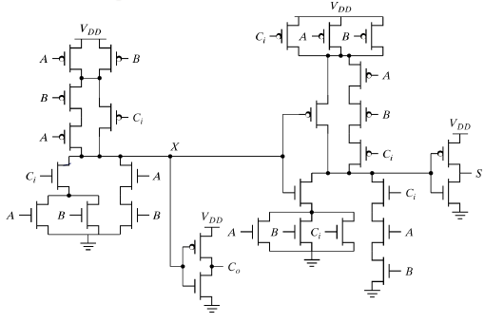
Static CMOS Adder Version 3
𝑪_{𝒐𝒖𝒕} = 𝑨𝑩 + 𝑨 + 𝑩 𝑪_{𝒊𝒏}= 𝑨𝑩 + 𝑨⨁𝑩 𝑪_{𝒊𝒏}
C_{out} = 0, S = A + B + C_{in}
C_{out} = 1, S = A ⋅ B ⋅ C_{in}
G
C₀ = 0
P*
𝑷* = 𝑨+𝑩
28 Transistors
𝑷 = 𝑨⨁𝑩
𝑮 = 𝑨 ∙ 𝑩
C₀ = 1
Notes:
因为在这里引入了C，进行了优化，电路看着不对称

Slide 6
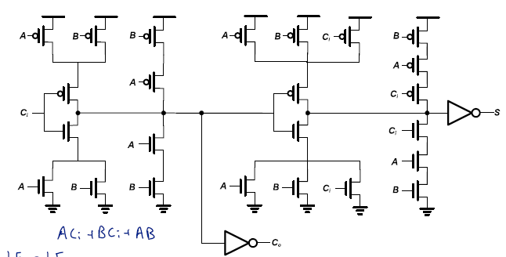
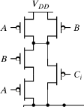
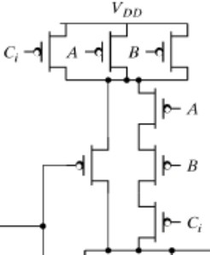
Static CMOS Adder Version 3.1
P* | D
 |  | G
C₀ = 0
C₀ = 1
28 Transistors with Symmetric Topology
Notes:
方便美观，使其对称，有助于版图设计

Slide 7
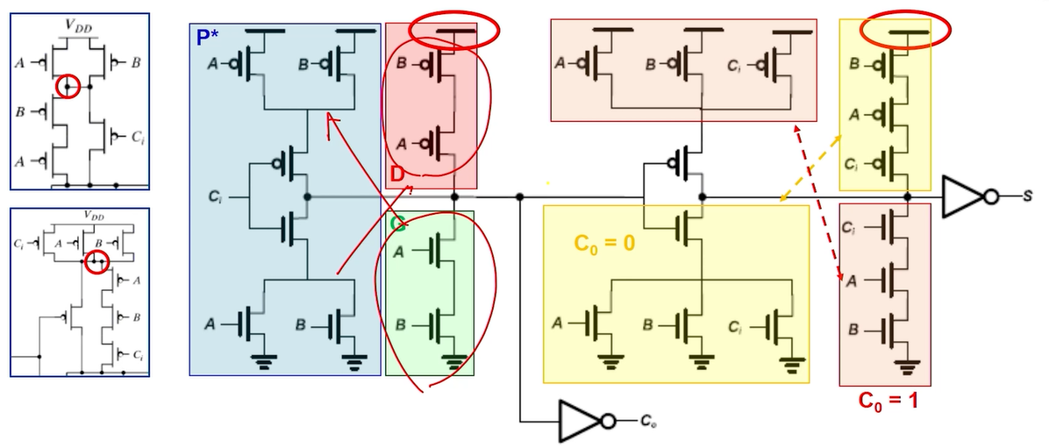
Static CMOS Adder Version 3.1
Critical Path上存在反相器，能否将其消除？
28 Transistors with Symmetric Topology
Notes:
方便美观，使其对称，有助于版图设计

Slide 8
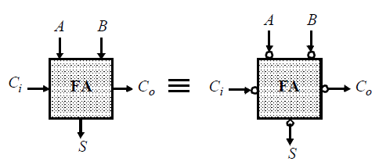
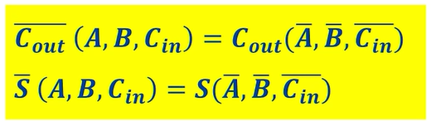
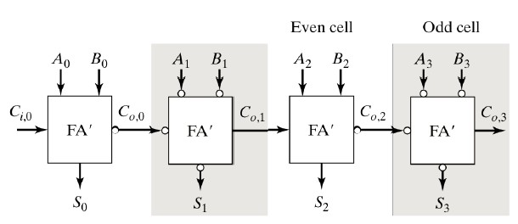
Inversion Property of Adder
Minimize Critical Path by Reducing Inverting Stages
Critical Path上存在反相器，能否将其消除？
Notes:
如何消除电路中的反相器。
讨论性能时是指关键路径上的delay，这种做法将反相器移动到非CP上。(C0到A10,A20)
0,2,4..上的输出是inv的，1,3,5等输入为正的

Slide 9
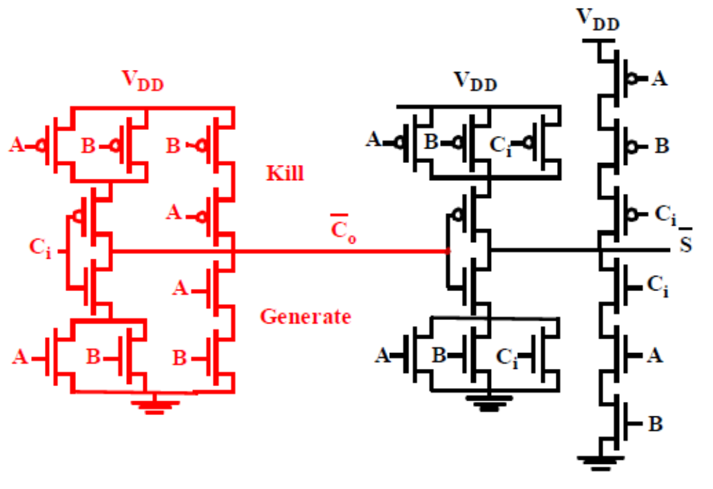
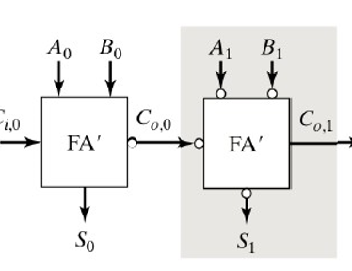
Best Static CMOS Adder Structure
Static CMOS Mirror Adder
24 Transistors with Least Number
Notes:
版图是对称的
使用静态CMOS方法应该不会有比此更少的

Slide 10
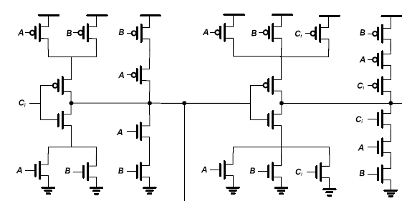
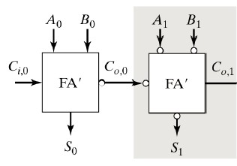
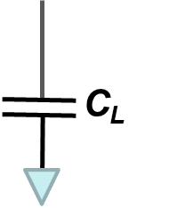
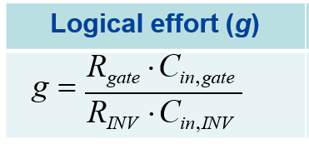
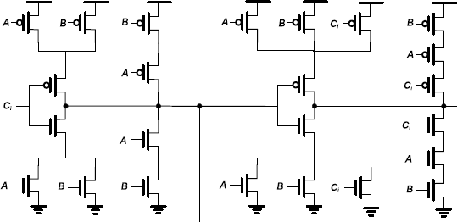
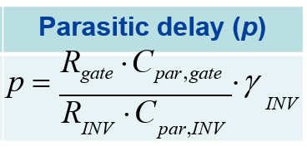
Logical Efforts of Mirror Adder
4
4
4
4
4
^{C}o,0
2
2
2
2
2
KEY: Find C_{L}
^{C}o,0：
S₀: 1 NMOS + 1 PMOS
C_{o,1}: 1 NMOS+1 PMOS
S₁: 2 NMOS+2 PMOS
g_{Ci} = (4+2)/3 = 2
p_{Ci} = (4+2+4+2)/3 = 4

Slide 11
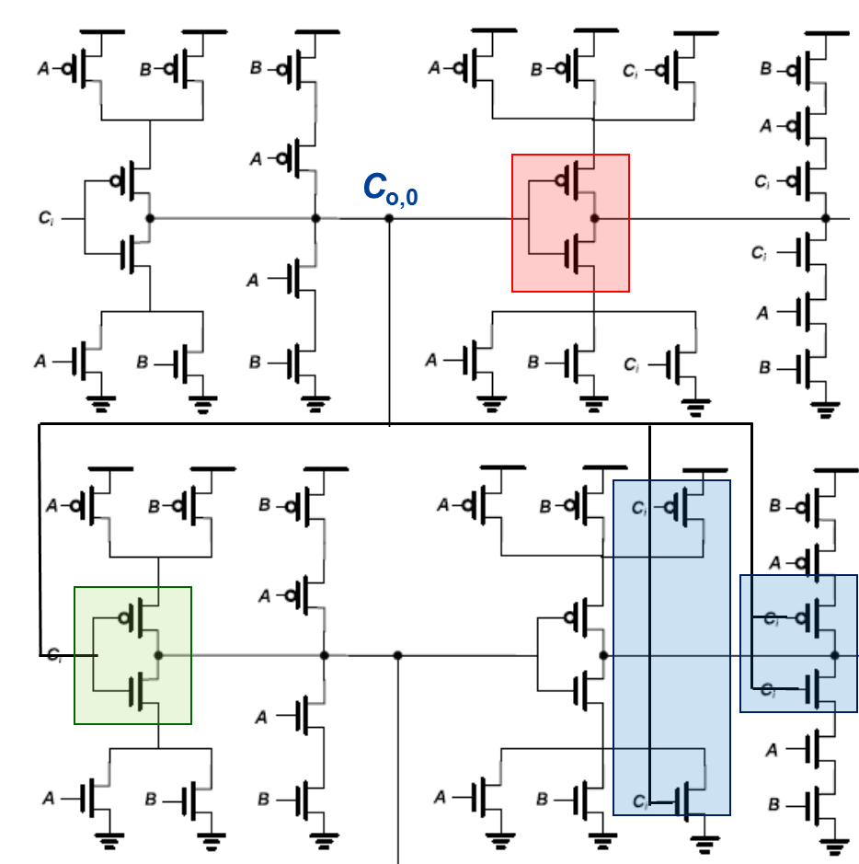
Sizing the Mirror Adder
4x
4x
4x
4
4
4
6
6
6
Use minimum size sum gates to reduce load on carry.
4x
4x
4
2
Since g of carry gate is 2, we need to have
Ci
a optimal h=C_{load}/C_{ci}=2 to get the minimal
f_{opt}=g⋅h~4
Total load on carry gate is:
C_{load} = C_{ci} + (6+6+9) = 21 + 6x
₆ h = C_{load}/C_{ci} = (21+6x)/6x
6  Therefore, we need to increase the size of
6 the carry stage x = 3.5 to maintains h~2
2x
3
3
3
2x
2x
2x
2x
2
2
2
4x
4x
4x
4
4
4
4x
4x
4
2
2x
3
3
3
2x
2x
2x
2x
2
2
2
Notes:
Y一般加法器都是多位的，如32位。64位。
一般从版图的角度讲可能需要输入一致
一般Sum不在Critical Path上，通过输入电容影响时延。

Slide 12
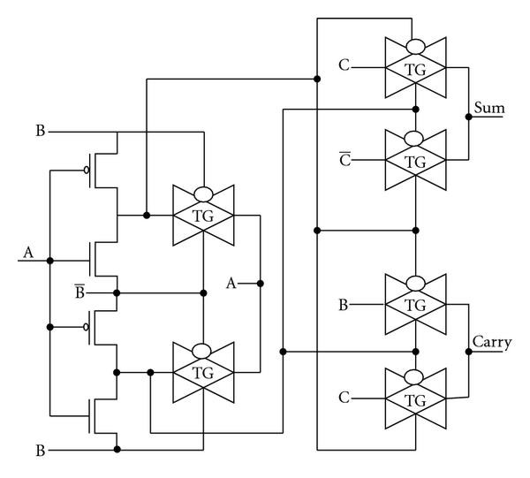




TG-Based Full Adder
20 transistors
Notes:
24个晶体管是因为将其中的一个输出作为输入，一般不会这么做。
要使得output和input完全分开，可以使用PTL方法实现

Slide 13
Summary of Full Adder
A | B | ^{C}in | ^{C}out | ^{C}out Status
0 | 0 | 0 | 0 | D
0 | 0 | 1 | 0 | D
0 | 1 | 0 | 0 | P
0 | 1 | 1 | 1 | P
1 | 0 | 0 | 0 | P
1 | 0 | 1 | 1 | P
1 | 1 | 0 | 1 | G
1 | 1 | 1 | 1 | G
The most critical signal is the carry information, so we can divide the truth table of full adder depending on whether C_{out} = 1 or not.
The meaning of Propagate (P) and Generate (G) is extremely important for fast multi-bit FA circuit design.
The NMOS and PMOS chains are completely symmetrical in the mirror adder circuit, yet the logic function of each branch is different.
Only the transistors in the (propagate) carry chain have to be optimized for speed. All transistor in the sum stage (except the MSB) can be of minimal size
Notes:
这些含义的划分对于多位的加法器意义重大。

Slide 14

希望大家给五星满分好评！

