Slide 1
Interconnection Network

Slide 2
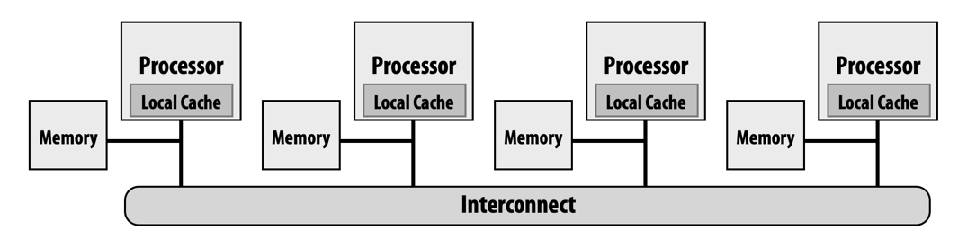
Interconnection Networks[互连网络]
An Interconnection Network (ICN) is a programmable system that transports data between terminals
To hold our parallel machines together
at the core of parallel computer architecture
Share basic concept with LAN/WAN
but very different trade-offs due to very different time scale/requirements

Slide 3
Interconnection Networks[互连网络]
Interconnection networks can be grouped into four domains
Depending on number and proximity of devices to be
Wide-Area Networks[广域网]
Local-Area Networks[局域网]
System-Area Networks[系统区域网络]
On-Chip Networks[片上网络]

Slide 4
Wide-Area Networks
Interconnect systems distributed across the globe
Internetworking support is required
Millions of devices interconnected
Maximum interconnect distance
many thousands of kilometers

Slide 5
Local-Area Networks
Interconnect autonomous computer systems
Machine room or throughout a building or campus
Hundreds of devices interconnected
Maximum interconnect distance
Few meters to tens of kilometers
Example (most popular):
Ethernet, with 10 Gbps over 40Km

Slide 6
System-Area Networks
Interconnects within one “machine”
Interconnect in a multi-processor system
Interconnect in a supercomputer
Hundreds to thousands of devices interconnected
Tianhe-2 supercomputer (16K nodes)
Maximum interconnect distance
Fraction to tens of meters (typical)
A few hundred meters (some)
InfiniBand: 120 Gbps over a distance of 300m
Notes:
InfiniBand is a high-speed, low-latency interconnect technology primarily used in high-performance computing (HPC) environments, such as supercomputers, data centers, and high-speed networks. 1. High Bandwidth: InfiniBand offers high data transfer rates, ranging from gigabits per second (Gbps) to terabits per second (Tbps), depending on the generation and configuration.
Low Latency: InfiniBand provides low-latency communication, which is crucial for applications requiring real-time data processing and high-performance computing tasks.
Scalability: InfiniBand supports large-scale deployments and can scale to thousands of nodes in a single fabric, making it suitable for demanding workloads and distributed computing environments.
Reliability: InfiniBand offers features such as error detection, correction, and fault tolerance mechanisms to ensure data integrity and reliability.
Remote Direct Memory Access (RDMA): One of the key features of InfiniBand is RDMA, which allows data to be transferred directly between the memory of one computer and another without involving the CPU. This can significantly reduce latency and CPU overhead, improving overall system performance.

Slide 7
System-Area Networks
Notes:
APM (Application Performance Management)

Slide 8
On-Chip Networks
Interconnect within a single chip
Devices are micro-architectural elements
Caches, directories, processor cores
Currently, designs with tens of devices are common
Ex: IBM Cell, Intel multicores, Tile processors
Proximity: millimeters
We are concerned with On-Chip and System-Area Networks

Slide 9
Why Study Interconnects?
Provide external connectivity from system to outside world
Also, connectivity within a single computer system at many levels
Interconnection networks should be well designed
To transfer the maximum amount of information
Within the least amount of time (and cost, power constraints)
Application:
managing communication can be critical to performance

Slide 10
Why Study Interconnects? (cont.)
Trends: high demand on communication bandwidth
increased computing power and storage capacity
switched networks are replacing buses
Computer architects/engineers must understand interconnect problems and solutions
in order to effectively design and evaluate systems
Notes:
https://zhuanlan.zhihu.com/p/346426970
In traditional bus-based network architectures, such as Ethernet networks using hubs, all devices on the network share the same communication medium (the bus). When a device sends data, it broadcasts it to all other devices on the network, and only the intended recipient processes the data, while others ignore it. This approach can lead to network congestion and reduced efficiency, especially as the number of devices on the network increases.
Switched networks, on the other hand, use network switches to facilitate communication between devices. Each device is connected to a switch, and the switch forwards data packets only to their intended destination based on the destination address. This approach reduces network congestion and improves efficiency by minimizing unnecessary broadcasts.

Slide 11
Interconnection network
Characteristics of communication
Latency must be low
Bandwidth must be high
Message characteristics
Many small messages with several fixed sizes
The largest message is one cache block size (64 or 128 bytes)
Implications
Only two layers are sufficient: link level and node level
Communication protocol must be simple
no packet dropping, no elaborate flow control

Slide 12
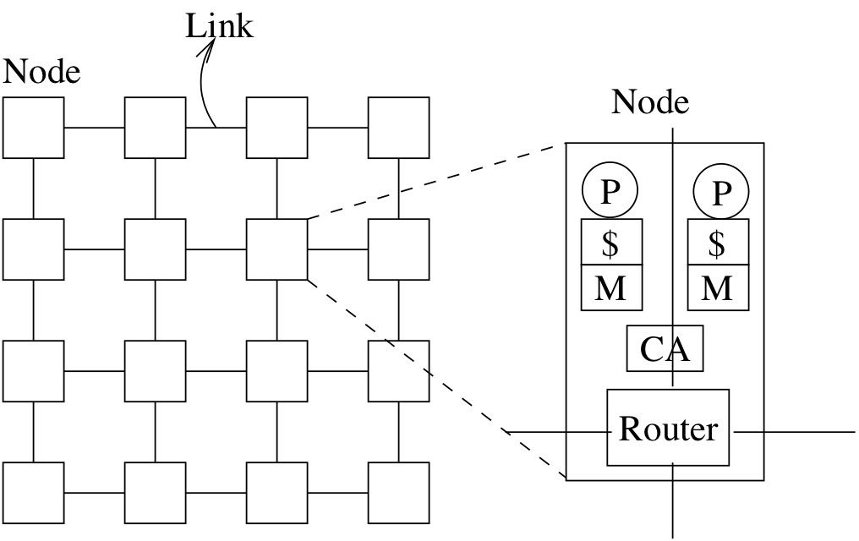
Nodes and Links
A node encapsulates
one or more processors
communication controller/assist (CA)
router
Routers are connected by links
Links may be unidirectional or bidirectional

Slide 13
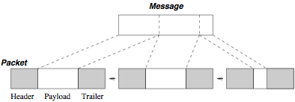
Link and Channel
Link = set of wires interconnecting a pair of nodes
Link can be unidirectional or bidirectional
Unit of transfer determined by flow control protocol (flit)
Flit size determined by link latency and amount of buffering available
Channel = link + sender + receiver
A message transmitted over a channel is broken into packets
A packet has a header, trailer, and payload

Slide 14
Design Considerations
Application requirements
Number of terminals or ports to support
Peak bandwidth of each terminal
Average bandwidth of each terminal
Latency requirements
Message size distribution
Expected traffic patterns
Required quality of service
Required reliability and availability

Slide 15
Design Considerations
Job of an interconnection network:
to transfer information from source node to dest. node
support network transactions that realize application
Latency as small as possible
As many concurrent transfers as possible
Cost as low as possible

Slide 16
Example Requirements
Example requirements for a coherent processor-memory interconnect
Processor ports 1-2048
Memory ports 1-4096
Peak BW 8 GB/s
Average BW 400 MB/s
Message Latency 100 ns
Message size 64 or 576 bits
Traffic pattern arbitrary
Quality of service none
Reliability no message loss
Availability 0.999 to 0.99999

Slide 17
Technology constraints
Technology constraints
Signaling rate
Chip pin count (if off-chip networking)
Area constraints (typically for on-chip networking)
Chip cost
Circuit board cost (if backplane boards needed)
Signals per circuit board
Signals per cable
Cable cost
Cable length
Channel and switch power constraints

Slide 18
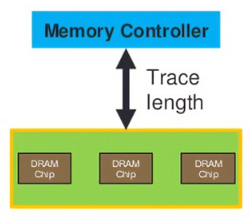
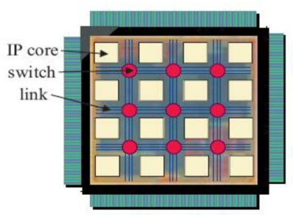
Off-chip vs. On-chip ICNs
Off-chip: I/O bottlenecks
Pin-limited bandwidth
Inherent overheads of off-chip I/O transmission
On-chip
Wiring constraints
Horizontal and vertical layout
Short, fixed length
Power
Consume 10-15% or more of die power budget
Latency
Different order of magnitude

Slide 19
Main Aspects of an ICN
Topology
Static arrangement of channels and nodes in a network
Routing
Determines the set of paths a packet can follow
Flow control[流控]
Allocating network resources (channels, buffers, etc.) to packets and managing contention

Slide 20
Main Aspects of an ICN
Switch microarchitecture
Internal architecture of a network switch
Network interface
How to interface a terminal with a switch
Link architecture
Signaling technology and data representation on the channel

Slide 21
1. Network Topology

Slide 22
Network Topology
Network topology = shape of the network
Determines the distance that a message needs to travel (in # links or network hops) from one node to another
Important characteristics
Diameter: largest distance
Average distance
Degree: how many links are connected to a switch

Slide 23
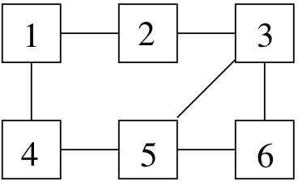
Example
For the shown network, compute diameter, avg distance, bisection bandwidth (assuming each link is bidirectional)
Diameter = 3
e.g. the distance between node 1 and 6
Avg distance:
d(1,2)=1, d(1,3)=2, d(1,4)=1, d(1,5)=2, d(1,6)=3
d(2,3)=1, d(2,4)=2, d(2,5)=2, d(2,6)=2
d(3,4)=2, d(3,5)=1, d(3,6)=1
d(4,5)=1, d(4,6)=2
d(5,6)=1
Sum of all distances = 24, number of node pairs = 15
Average distance = 24/15

Slide 24
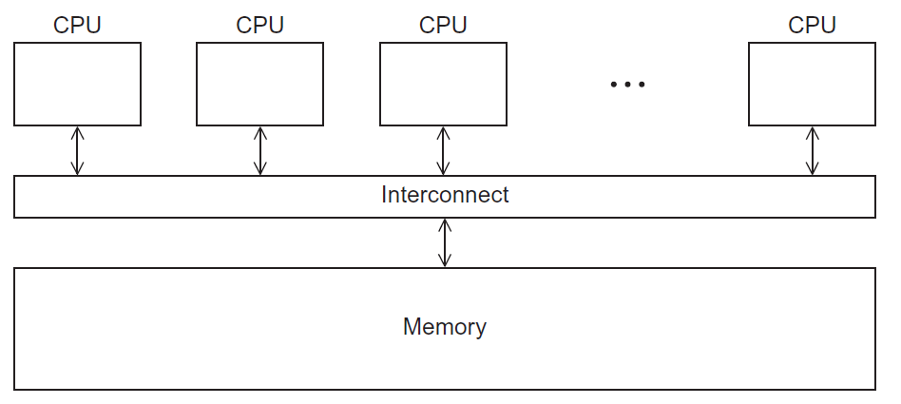
Recall: Shared Memory System

Slide 25
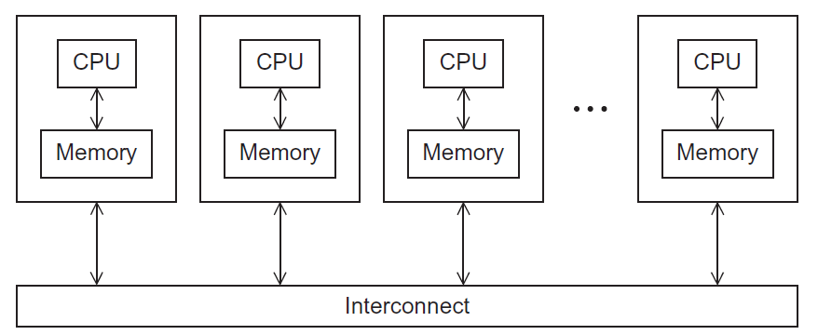
Recall: Distributed Memory System

Slide 26
Interconnection networks
Affects performance of both distributed and shared memory systems.
Two categories:
Shared memory interconnects
Distributed memory interconnects

Slide 27
1.1 Shared memory interconnects

Slide 28
Shared memory interconnects
Bus interconnect
A collection of parallel communication wires together with some hardware that controls access to the bus.
Communication wires are shared by the devices that are connected to it.
As the number of devices connected to the bus increases, contention for use of the bus increases, and performance decreases.

Slide 29
Shared memory interconnects
Switched interconnect
Uses switches to control the routing of data among the connected devices.
Crossbar –
Allows simultaneous communication among different devices.
Faster than buses.
But the cost of the switches and links is relatively high.

Slide 30
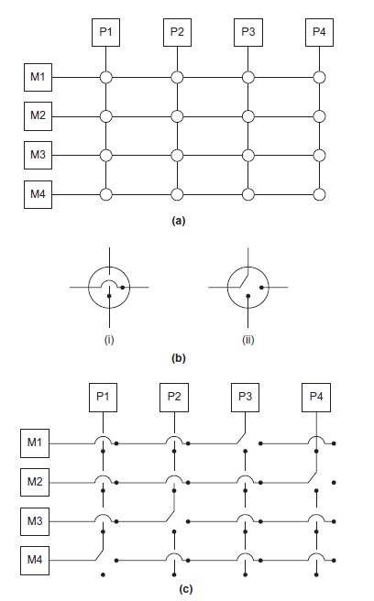
(a)
A crossbar switch connecting 4 processors (Pi) and 4 memory modules (Mj)
(b)
Configuration of internal switches in a crossbar
(c) Simultaneous memory accesses by the processors

Slide 31
1.2 Distributed memory interconnects

Slide 32
Distributed memory interconnects
Two groups
Direct interconnect
Each switch is directly connected to a processor memory pair, and the switches are connected to each other.
Indirect interconnect
Switches may not be directly connected to a processor.

Slide 33
（1）Direct interconnect

Slide 34
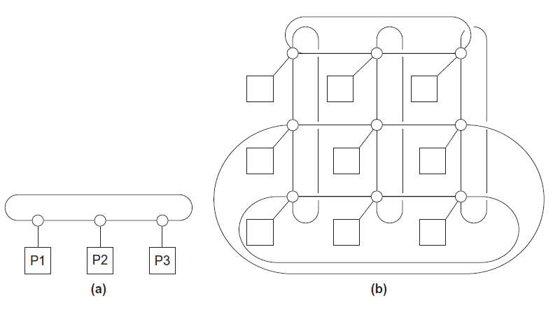
Direct interconnect
ring
toroidal mesh
（二维环面网格）
Notes:
toroidal mesh 二维环面网格

Slide 35

Bisection width（等分宽度）
A measure of “number of simultaneous communications” or “connectivity”.
How many simultaneous communications can take place “across the divide” between the halves?

Slide 36
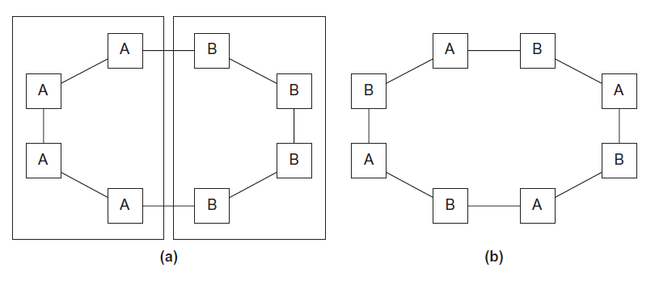
Two bisections of a ring
For toroidal mesh

Slide 37
Definitions
Bandwidth
The rate at which a link can transmit data.
Usually given in megabits or megabytes per second.
Bisection bandwidth
A measure of network quality.
Instead of counting the number of links joining the halves, it sums the bandwidth of the links.

Slide 38
Fully connected network
Each switch is directly connected to every other switch.
impractical
bisection width = p²/4
(p: # of nodes)
Notes:
P: # of nodes.

Slide 39
Hypercube
Highly connected direct interconnect.
Built inductively:
A one-dimensional hypercube is a fully-connected system with two processors.
A two-dimensional hypercube is built from two one-dimensional hypercubes by joining “corresponding” switches.
Similarly a three-dimensional hypercube is built from two two-dimensional hypercubes.

Slide 40
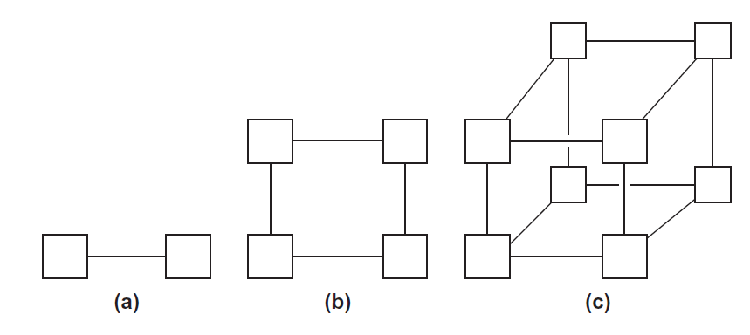
Hypercubes
one-
two-
three-dimensional

Slide 41
（2）Indirect interconnect

Slide 42
Indirect interconnects
Simple examples of indirect networks:
Crossbar
Omega network
Often shown with unidirectional links and a collection of processors
Each of which has an outgoing and an incoming link, and a switching network.

Slide 43
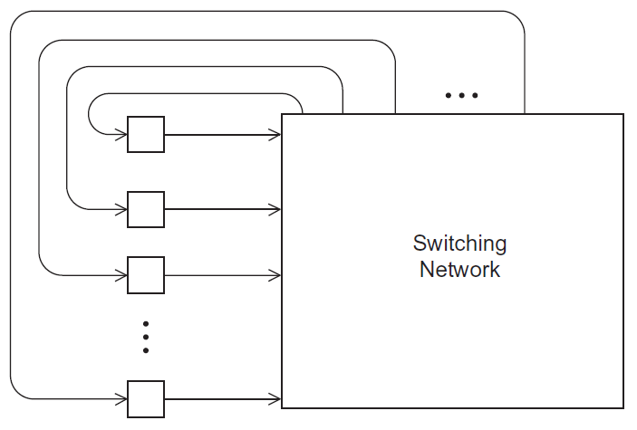
A generic indirect network

Slide 44
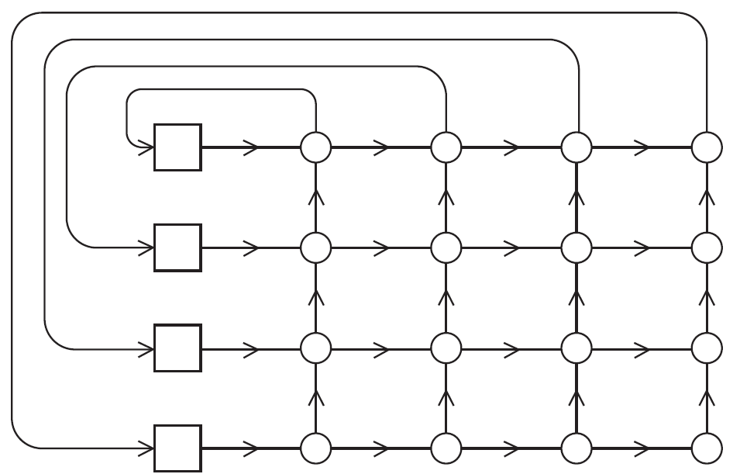
Crossbar interconnect for distributed memory

Slide 45
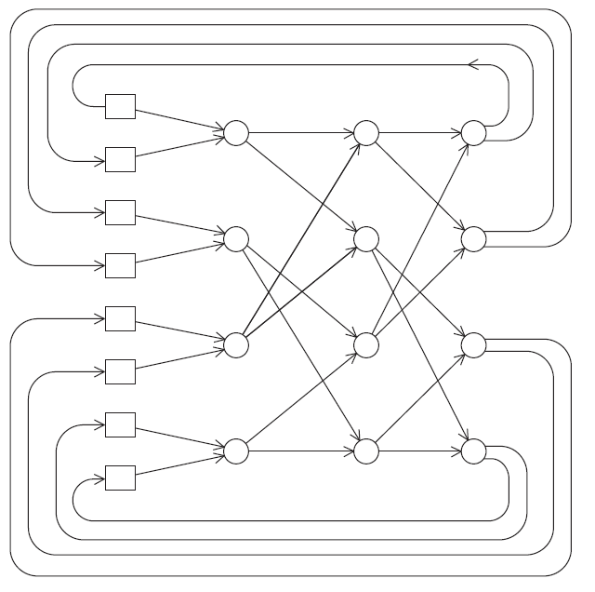
An omega network

Slide 46
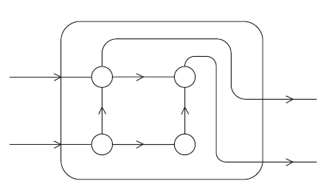
A switch in an omega network

Slide 47
More definitions
Any time data is transmitted, we’re interested in how long it will take for the data to reach its destination.
Latency
The time that elapses between the source’s beginning to transmit the data and the destination’s starting to receive the first byte.
Bandwidth
The rate at which the destination receives data after it has started to receive the first byte.

Slide 48
Message transmission time = l + n / b
latency (seconds)
length of message (bytes)
bandwidth (bytes per second)

Slide 49
2. Routing Policy

Slide 50
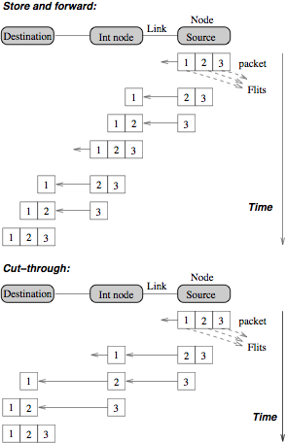
Routing policy
How to send a packet over the network?
Store & Forward:
Send all flits over a link, then over another, and so on
T = h * (Txmit + Tswitch)
Cut-through:
Send flits in pipeline over the links
T = h * Tswitch + Txmit
Implication:
cut-through routing reduces the importance of topology

Slide 51
Routing Policy
Minimal vs. non-minimal
Minimal = each packet travels the least number of hops
Deterministic vs. non-deterministic
Deterministic = each sender-dest pair uses a single path for all messages
Adaptive vs. non-adaptive
Adaptive = message can change path as it is being transmitted
Deadlock-free vs. Deadlock possible
Deadlock due to several messages mutually waiting for buffer space

Slide 52
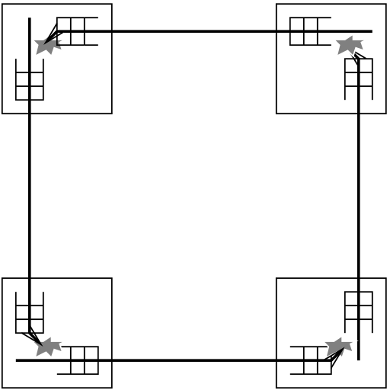
What is Deadlock?
Inability of the network to forward packets
Due to limited buffer space and cyclic dependence on buffer acquisition
Handling a deadlock
Detect and break: expensive
Drop packets: adverse effect in performance and complicates protocol
Avoid: restriction on routing
The figure shows four packets filling up the input buffer and need the next output buffer, but the output buffer is already full

Slide 53
3. Router Architecture

Slide 54
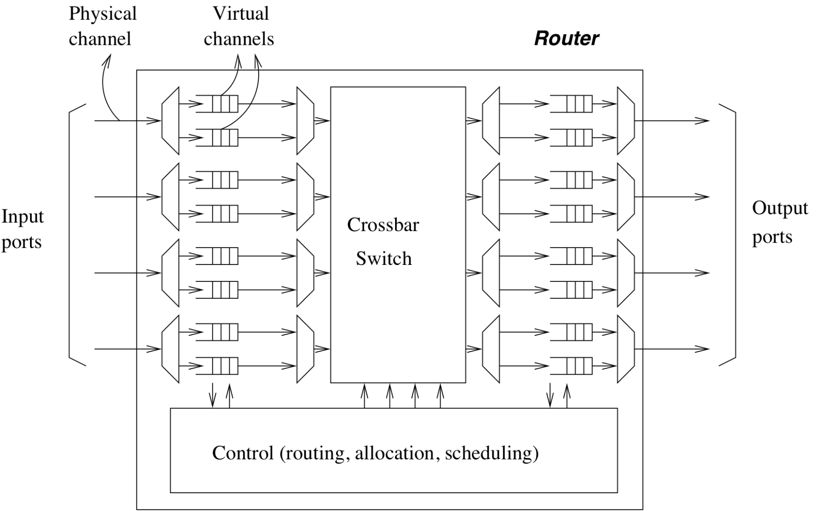
Router Architecture
Router has four input ports and four output ports
Each channel has two virtual channels (VCs), with separate buffers

Slide 55
Router Architecture
Arriving packet sent to the appropriate VC (buffer) based on its header
Control logic arbitrates among multiple input channels and allocates them to the input of the crossbar switch
It also allocates output VC to the output of the switch
It arbitrates multiple input ports that want to send packet to the same output port

Slide 56
Router Architecture
Switch typically implemented using a crossbar (to minimize latency and collision)
Multiple flits from different VCs can go on the switch as long as they go to different output VCs
Steps can also be pipelined to improve router throughput

Slide 57
Summary
Interconnection network
Basic concepts
Design consideration
Main aspects
Network Topology
Routing Policy
Router Architecture

Slide 58
Cache coherence

Slide 59
Recall that…
Caches are managed by system hardware
Out of a programmer’s direct control!
Any undesired consequence?

Slide 60
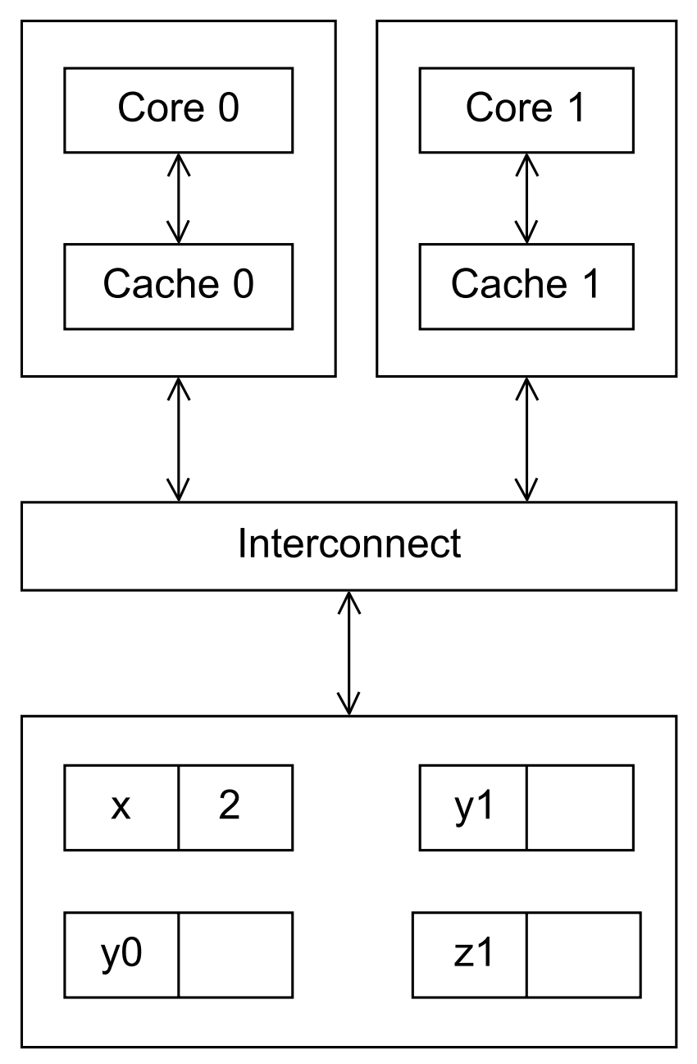
What would happen?

Slide 61
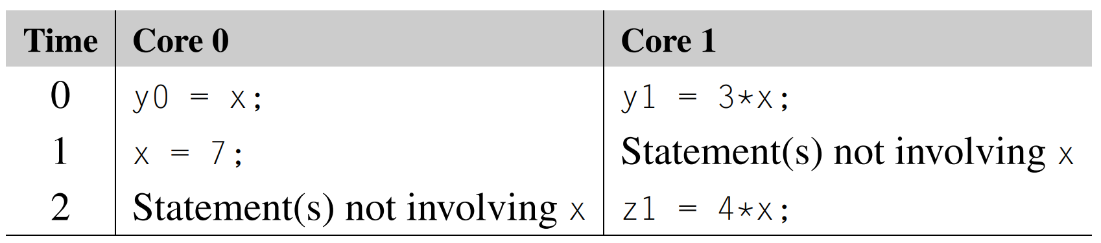
What would happen?
Suppose executed at the indicated times
What value z1 will get, 4*7=28 or 4*2=8?
Unpredictable! Whether write-through or write-back…

Slide 62
Cache Coherence Problem
When the caches of multiple processors store the same variable, an update by one processor to the cached variable, how to ensure the cached value stored by the other processors is also updated.
Snooping cache coherence
Directory-based cache coherence

Slide 63
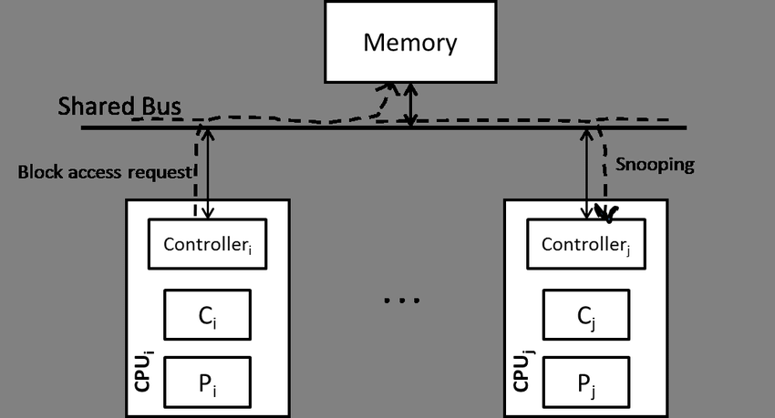
监听（Snooping）Cache Coherence
Notes:
Source: https://www.google.com/url?sa=i&url=https%3A%2F%2Fwww.researchgate.net%2Ffigure%2FSnooping-based-cache-coherence_fig2_324599927&psig=AOvVaw23rpj0jdC8768InYpwTM0u&ust=1709610752742000&source=images&cd=vfe&opi=89978449&ved=0CBMQjRxqFwoTCKiY5r_a2YQDFQAAAAAdAAAAABAJ

Slide 64
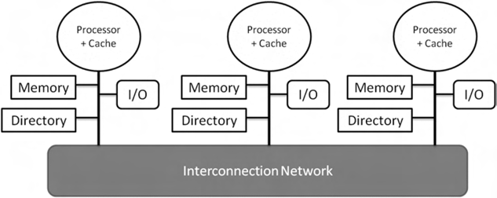
基于目录的(Directory-based) Cache Coherence
Directory (a data structure) stores the status of each cache line
Also support distributed-memory
Directory is maintained in a distributed way
Notes:
https://www.researchgate.net/publication/259821213/figure/fig4/AS:392548955770892@1470602372166/Organization-of-Directory-Based-Protocol.png

Slide 65
基于目录的(Directory-based) Cache Coherence
Pros: Substantial additional storage required for the directory
Cons: When a cache variable is updated, only the cores storing that variable need to be contacted

Slide 66
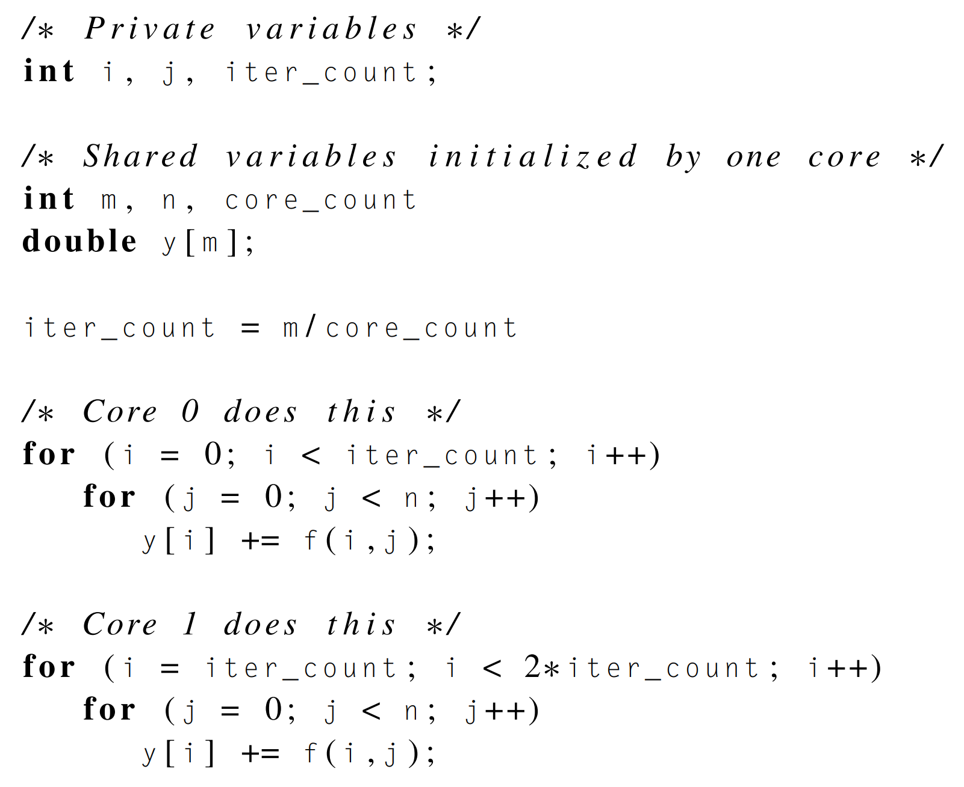

伪共享 (False Sharing)
Suppose $m=8$, core_count = 2, each cache line is 64 bytes!
The system is behaving as if the elements of y were being shared by the cores !

Slide 67
Supplementary materials

Slide 68
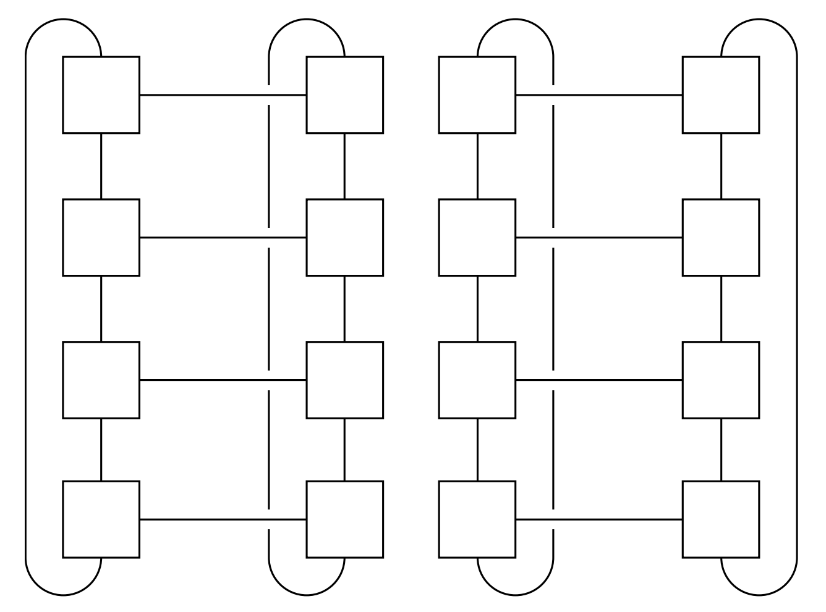
Computing bisection width
back

