Slide 1

Parallel software

Slide 2
The burden is on software
Hardware and compilers can keep up the pace needed.
From now on…
In shared memory programs:
Start a single process and fork threads.
Threads carry out tasks.
In distributed memory programs:
Start multiple processes.
Processes carry out tasks.

Slide 3

SPMD – single program multiple data
A SPMD programs consists of a single executable that can behave as if it were multiple different programs through the use of conditional branches.
if (I’m thread process i)
do this;
else
do that;

Slide 4
Writing Parallel Programs
double x[n], y[n];
…
for (i = 0; i < n; i++)
x[i] += y[i];
Divide the work among the processes/threads
so each process/thread gets roughly the same amount of work
and communication is minimized.
Arrange for the processes/threads to synchronize.
Arrange for communication among processes/threads.

Slide 5
Shared Memory
Dynamic threads
Master thread waits for work, forks new threads, and when threads are done, they terminate
Efficient use of resources, but thread creation and termination is time consuming.
Static threads
Pool of threads are created and allocated work, but do not terminate until cleanup.
Better performance, but potential waste of system resources.

Slide 6

Nondeterminism
. . .
printf ( "Thread %d > my_val = %d\n" , my_rank , my_x ) ;
. . .
Thread 0 > my_val = 7
Thread 1 > my_val = 19
Thread 1 > my_val = 19
Thread 0 > my_val = 7

Slide 7
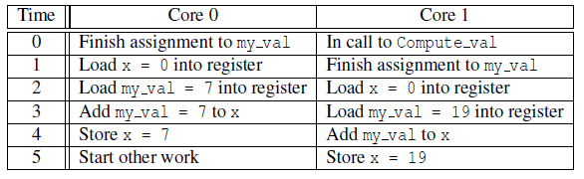
Nondeterminism
my_val = Compute_val ( my_rank ) ;
x += my_val ;

Slide 8
Nondeterminism
Race condition
Critical section
Mutually exclusive
Mutual exclusion lock (mutex, or simply lock)
my_val = Compute_val ( my_rank ) ;
Lock(&add_my_val_lock ) ;
x += my_val ;
Unlock(&add_my_val_lock ) ;

Slide 9
busy-waiting
my_val = Compute_val ( my_rank ) ;
if ( my_rank == 1)
while ( ! ok_for_1 ) ; /* Busy−wait loop */
x += my_val ; /* Critical section */
if ( my_rank == 0)
ok_for_1 = true ; /* Let thread 1 update x */

Slide 10
More mechanisms
Semaphores: similar to mutexes
Monitor: an object whose methods can only be executed in a mutually exclusive way

Slide 11
Thread safety
Parallel programs call functions developed for use in serial programs
If the called function uses static local variables?
- ordinary C local variable: allocated from the system stack
- static C local variable: persist from one call to the next, i.e., shared
- e.g., strtok(), it is NOT thread safe

Slide 12
message-passing
char message [ 1 0 0 ] ;
. . .
my_rank = Get_rank ( ) ;
if ( my_rank == 1) {
printf ( message , "Greetings from process 1" ) ;
Send ( message , MSG_CHAR , 100 , 0 ) ;
} elseif ( my_rank == 0) {
Receive ( message , MSG_CHAR , 100 , 1 ) ;
printf ( "Process 0 > Received: %s\n" , message ) ;
}

Slide 13
Partitioned Global Address Space Languages
shared int n = . . . ;
shared double x [ n ] , y [ n ] ;
private int i , my_first_element , my_last_element ;
my_first_element = . . . ;
my_last_element = . . . ;
/ * Initialize x and y */
. . .
f o r ( i = my_first_element ; i <= my_last_element ; i++)
x [ i ] += y [ i ] ;

Slide 14
Input and Output
In distributed memory programs, only process 0 will access stdin.
In shared memory programs, only the master thread or thread 0 will access stdin.
In both distributed memory and shared memory programs all the processes/threads can access stdout and stderr.

Slide 15
Input and Output
In most cases only a single process/thread will be used for all output to stdout other than debugging output.
because of the indeterminacy of the order of output to stdout
Debug output should always include the rank or id of the process/thread that’s generating the output.

Slide 16
Input and Output
Only a single process/thread will attempt to access any single file other than stdin, stdout, or stderr.
E.g., each process/thread can open its own, private file for reading or writing,
But no two processes/threads will open the same file.

Slide 17

Performance

Slide 18

Speedup
Number of cores = p
Serial run-time = T_{serial}
Parallel run-time = T_{parallel}
linear speedup
T_{parallel} = T_{serial} / p

Slide 19
Speedup of a parallel program
T_{serial}
S =
T_{parallel}

Slide 20
Efficiency of a parallel program
T_{serial}
T_{parallel}
S
T_{serial}
E =
=
=
.
p
p
p T_{parallel}

Slide 21

Speedups and efficiencies of a parallel program

Slide 22
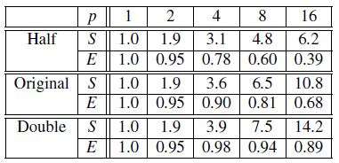
Speedups and efficiencies of parallel program on different problem sizes

Slide 23
Speedup

Slide 24
Efficiency

Slide 25
Effect of overhead
T_{parallel} = T_{serial} / p + T_{overhead}

Slide 26

Amdahl’s Law
Unless virtually all of a serial program is parallelized, the possible speedup is going to be very limited
— regardless of the number of cores available.

Slide 27
Example
We can parallelize 90% of a serial program.
Parallelization is “perfect” regardless of the number of cores p we use.
T_{serial} = 20 seconds
Runtime of parallelizable part is
0.9 x T_{serial} / p = 18 / p

Slide 28
Example (cont.)
Runtime of “unparallelizable” part is
Overall parallel run-time is
0.1 x T_{serial} = 2
T_{parallel} = 0.9 x T_{serial} / p + 0.1 x T_{serial} = 18 / p + 2

Slide 29
Example (cont.)
Speed up
T_{serial}
20
S =
=
0.9 x T_{serial} / p + 0.1 x T_{serial}
18 / p + 2

Slide 30
Scalability
In general, a problem is scalable if it can handle ever increasing problem sizes.
If we increase the number of processes/threads and keep the efficiency fixed without increasing problem size, the problem is strongly scalable.
If we keep the efficiency fixed by increasing the problem size at the same rate as we increase the number of processes/threads, the problem is weakly scalable.

Slide 31

Taking Timings
What is time?
Start to finish?
A program segment of interest?
CPU time?
Wall clock time?

Slide 32
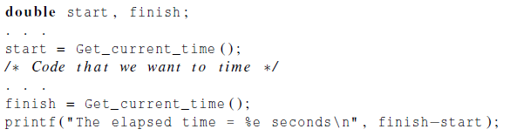
Taking Timings
theoretical
function
omp_get_wtime
MPI_Wtime

Slide 33
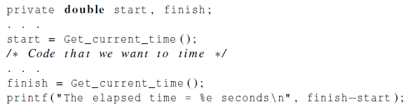
Taking Timings

Slide 34
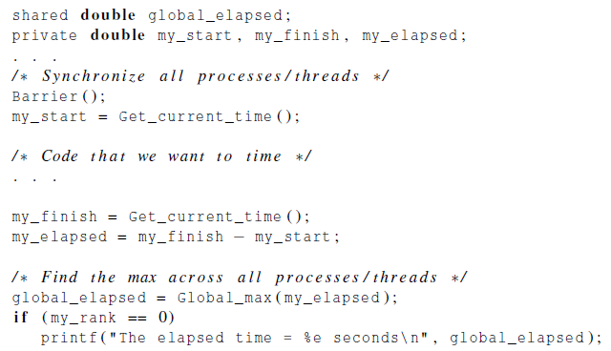
Taking Timings

Slide 35
Parallel program design

Slide 36
Foster’s methodology
Partitioning: divide the computation to be performed and the data operated on by the computation into small tasks. The focus here should be on identifying tasks that can be executed in parallel.

Slide 37

Foster’s methodology
Communication: determine what communication needs to be carried out among the tasks identified in the previous step.

Slide 38
Foster’s methodology
Agglomeration or aggregation: combine tasks and communications identified in the first step into larger tasks. For example, if task A must be executed before task B can be executed, it may make sense to aggregate them into a single composite task.
Notes:
agglomeration
英 [əˌglɒməˈreɪʃn] 美 [əˌglɑməˈreɪʃn]
n.成团，结块；

Slide 39
Foster’s methodology
Mapping: assign the composite tasks identified in the previous step to processes/threads. This should be done so that communication is minimized, and each process/thread gets roughly the same amount of work.

Slide 40
Example - histogram
1.3,2.9,0.4,0.3,1.3,4.4,1.7,0.4,3.2,0.3,4.9,2.4,3.1,4.4,3.9,0.4,4.2,4.5,4.9,0.9

Slide 41
Serial program - input
The number of measurements: data_count
An array of data_count floats: data
The minimum value for the bin containing the smallest values: min_meas
The maximum value for the bin containing the largest values: max_meas
The number of bins: bin_count

Slide 42
Serial program - output
bin_maxes : an array of bin_count floats
bin_counts : an array of bin_count ints

Slide 43
First two stages of Foster’s Methodology

Slide 44
Alternative definition of tasks and communication

Slide 45
Adding the local arrays

Slide 46
Concluding Remarks (1)
Serial systems
The standard model of computer hardware has been the von Neumann architecture.
Parallel hardware
Flynn’s taxonomy.
Parallel software
We focus on software for homogeneous MIMD systems, consisting of a single program that obtains parallelism by branching.
SPMD programs.

Slide 47
Concluding Remarks (2)
Input and Output
We’ll write programs in which one process or thread can access stdin, and all processes can access stdout and stderr.
However, because of nondeterminism, except for debug output we’ll usually have a single process or thread accessing stdout.

Slide 48
Concluding Remarks (3)
Performance
Speedup
Efficiency
Amdahl’s law
Scalability
Parallel Program Design
Foster’s methodology

