Slide 1


用Pthreads进行共享内存编程
任课教师：王桢

Slide 2
课程内容
参考资料：
并行程序设计导论，Peter S Pacheco, 机械工业出版社， 2016
Chapter 4 Shared-Memory Programming With Pthreads

Slide 3
Roadmap
Problems programming shared memory systems.
Controlling access to a critical section.
Thread synchronization.
Programming with POSIX threads.
Mutexes.
Producer-consumer synchronization and semaphores.
Barriers and condition variables.
Read-write locks.
Thread safety.

Slide 4
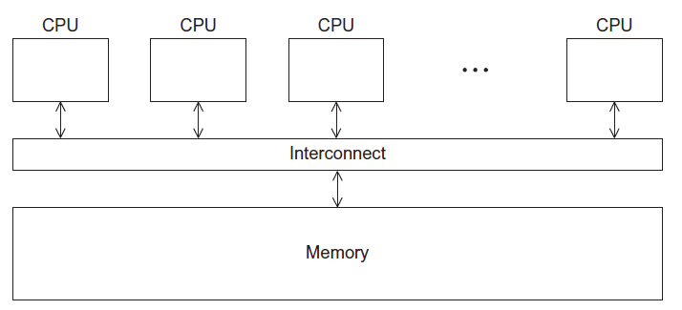
A Shared Memory System

Slide 5
Processes and Threads
A process is an instance of a running (or suspended) program.
Threads are analogous to a “light-weight” process.
In a shared memory program, a single process may have multiple threads of control.

Slide 6
POSIX® Threads
Portable Operating System Interface (POSIX)
Also known as Pthreads.
A standard for Unix-like operating systems.
A library that can be linked with C programs.
Specifies an application programming interface (API) for multi-threaded programming.
Notes:
Portable Operating System Interface (POSIX) for software compatibility between Unix-like operating systems

Slide 7

Caveat
The Pthreads API is only available on POSIXR systems — Linux, MacOS X, Solaris, HPUX, …
Notes:
Caveat 附加说明

Slide 8
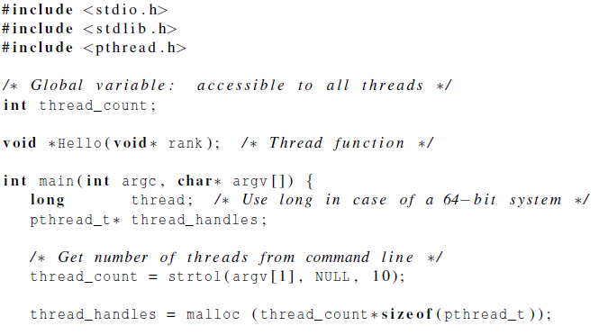
Hello World! (1)
declares the various Pthreads
functions, constants, types, etc.
Notes:
The first element argv[0] typically contains the name of the program itself, i.e., the name used to invoke the program from the command line. It's the path to the executable binary file of the program.
str: This is a pointer to the string that contains the representation of the number you want to convert.
endptr: This is a pointer to a character pointer. After calling strtol(), endptr will point to the first character that couldn't be converted to a number in the input string. If no such character exists, endptr will be set to the null terminator of the string.
base: This parameter specifies the base of the number system used in the string. It can be any integer from 2 to 36, inclusive. If base is 0, the conversion is performed using auto-detection: if the string starts with "0x" or "0X", it's treated as hexadecimal; if it starts with "0", it's treated as octal; otherwise, it's treated as decimal.

Slide 9
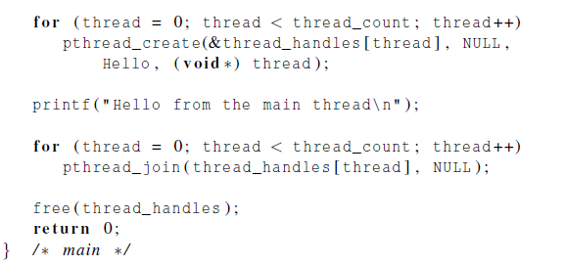
Hello World! (2)
Notes:
thread: A pointer to a variable of type pthread_t where the thread identifier for the newly created thread will be stored.
attr: An optional pointer to a pthread_attr_t structure that specifies various attributes for the new thread such as its stack size, scheduling policy, etc. If NULL is passed, default attributes are used.
start_routine: A pointer to the function that the new thread will execute. This function must return a void* and take a single void* argument.
arg: An argument that will be passed to the start_routine function when the new thread is created.
In C, the name of a function can be treated as a pointer to the function itself.
thread: The thread identifier (pthread_t) of the thread you want to wait for.
retval: A pointer to a pointer that will receive the exit status of the target thread. This exit status is typically passed to pthread_exit() by the terminating thread. If you don't need the exit status, you can pass NULL.

Slide 10
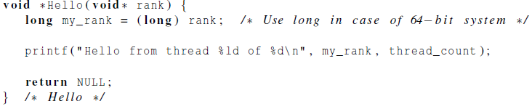
Hello World! (3)
Notes:
The data segment (数据段) holds initialized global and static variables. These variables have predefined values set during program compilation.
The data segment contains only global or static variable which have a predefined value and can be modified. Heap contains the dynamically allocated data that is stored in a memory section we refer that as heap section and this section typically starts where data segments ends.
You're pretty much correct, but threads share all segments except the stack. Threads have independent call stacks, however the memory in other thread stacks is still accessible and in theory you could hold a pointer to memory in some other thread's local stack frame (though you probably should find a better place to put that memory!).

Slide 11
Compiling a Pthread program
gcc −g −Wall −o pth_hello pth_hello . c −lpthread
link in the Pthreads library
Notes:
the -g option is used to generate debug information in the compiled executable. This debug information includes details such as symbol names, source code line numbers, and variable information. It's primarily used for debugging purposes, as it allows debuggers to map machine code back to the original source code.
The -Wall option in the gcc compiler command enables a set of warning messages.
The -l flag is a linker option used to specify a library to link with your program. In this case, -lpthread tells the linker to link your program with the pthread library.

Slide 12
Running a Pthreads program
. /pth_hello <number of threads>
. /pth_hello 1
Hello from the main thread
Hello from thread 0 of 1
. /pth_hello 4
Hello from the main thread
Hello from thread 0 of 4
Hello from thread 1 of 4
Hello from thread 2 of 4
Hello from thread 3 of 4

Slide 13

Global variables
Can introduce subtle and confusing bugs!
Limit use of global variables to situations in which they’re really needed.
Shared variables.

Slide 14
Starting the Threads
Processes in MPI are usually started by a script.
In Pthreads the threads are started by the program executable.

Slide 15
Starting the Threads
pthread.h
One object for each thread.
pthread_t
int pthread_create (
pthread_t* thread_p /* out */ ,
const pthread_attr_t* attr_p /* in */ ,
void* (*start_routine ) ( void ) /* in */ ,
void* arg_p /* in */ ) ;

Slide 16
pthread_t objects
Opaque
The actual data that they store is system-specific.
Their data members aren’t directly accessible to user code.
However, the Pthreads standard guarantees that a pthread_t object does store enough information
to uniquely identify the thread with which it’s associated.
Notes:
不透明的，体现在：

Slide 17
A closer look (1)
int pthread_create (
pthread_t* thread_p /* out */ ,
const pthread_attr_t* attr_p /* in */ ,
void* (*start_routine ) ( void ) /* in */ ,
void* arg_p /* in */ ) ;
We won’t be using, so we just pass NULL.
Allocate before calling.

Slide 18
A closer look (2)
int pthread_create (
pthread_t* thread_p /* out */ ,
const pthread_attr_t* attr_p /* in */ ,
void* (*start_routine ) ( void ) /* in */ ,
void* arg_p /* in */ ) ;
Pointer to the argument that should
be passed to the function start_routine.
The function that the thread is to run.

Slide 19
Function started by pthread_create
Prototype: void* thread_function ( void* args_p ) ;
Void* can be cast to any pointer type in C.
So args_p can point to a list containing one or more values needed by thread_function.
Similarly, the return value of thread_function can point to a list of one or more values.

Slide 20
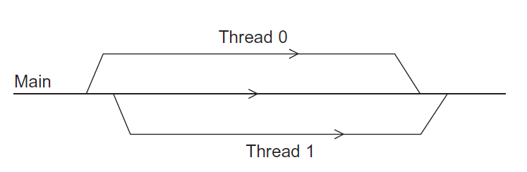
Running the Threads
Main thread forks and joins two threads.

Slide 21
Stopping the Threads
We call the function pthread_join once for each thread.
A single call to pthread_join will wait for the thread associated with the pthread_t object to complete.
More about returning a value.
Notes:
When you create a thread using pthread_create(), the function executed by the thread can return a value using pthread_exit().
1. Use the pthread_join() function: You can use pthread_join() to wait for the thread to exit and retrieve its return value. The return value of the function executed by the thread will be passed to pthread_join() via a void** argument. In pthread_join, If retval is not NULL, then pthread_join() copies the exit status of the target thread (i.e., the value that the target thread supplied to pthread_exit(3)) into the location pointed to by retval.
2. Allocate memory for the return value: Alternatively, you can allocate memory dynamically within the thread, store the return value there, and pass a pointer to this memory back to the calling thread.

Slide 22
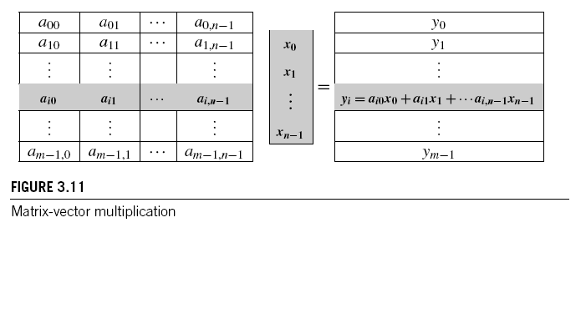
Matrix-Vector Multiplication in pthreads

Slide 23
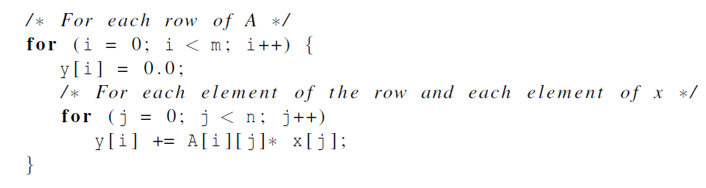
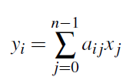
Serial pseudo-code

Slide 24
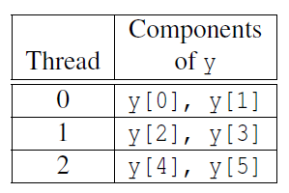
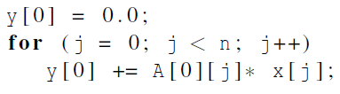
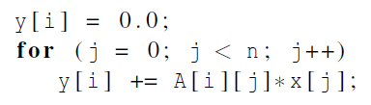
Using 3 Pthreads
thread 0
general case

Slide 25
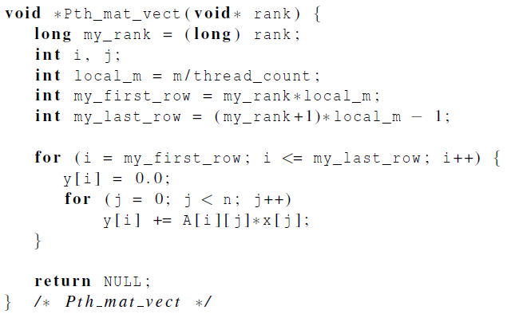
Pthreads matrix-vector multiplication

Slide 26

Critical sections

Slide 27
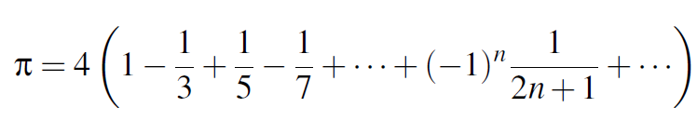
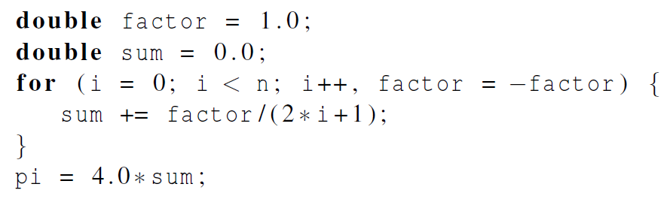
Estimating π

Slide 28
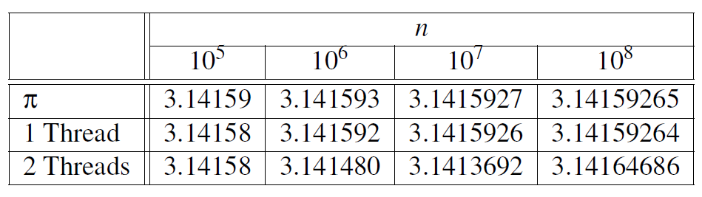
Using a dual core processor
Note that as we increase n, the estimate with one thread gets better and better.

Slide 29
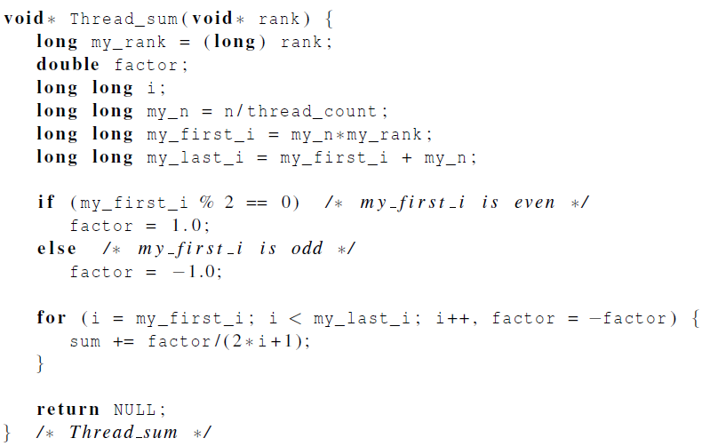
A thread function for computing π

Slide 30
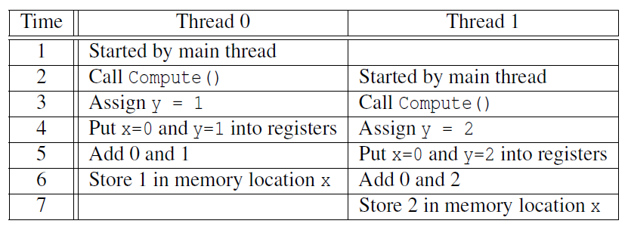

Possible race condition
y= compute()
x=x+y
x=1+2?
x=2?
Notes:
两个变量的相加要使用多条机器指令。 注意是register!

Slide 31
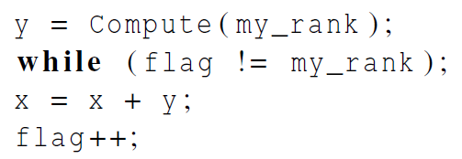
Busy-Waiting
A thread repeatedly tests a condition, but, effectively, does no useful work until the condition has the appropriate value.
Beware of optimizing compilers, though!
flag initialized to 0 by main thread

Slide 32
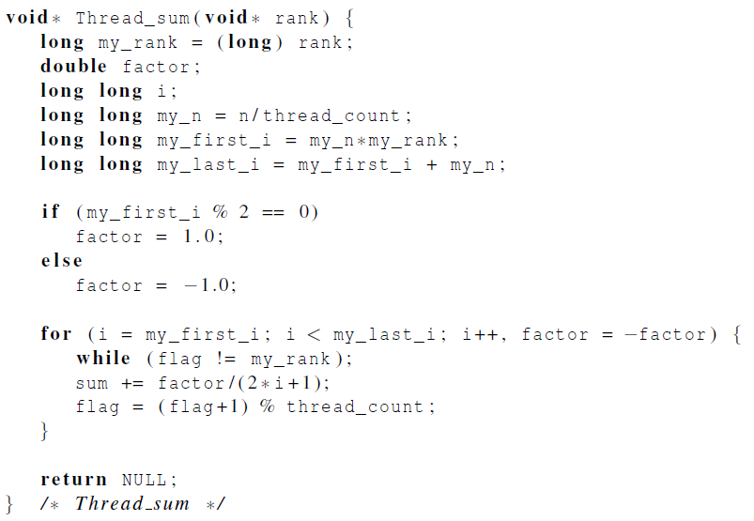
Pthreads global sum with busy-waiting

Slide 33
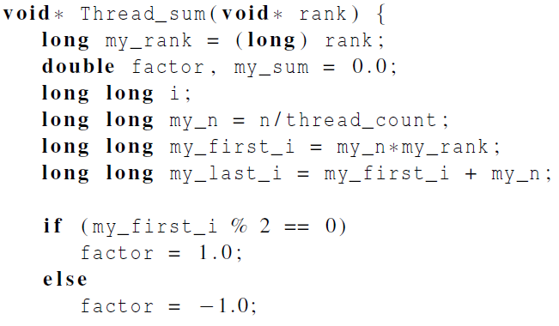
Global sum function with critical section after loop (1)

Slide 34
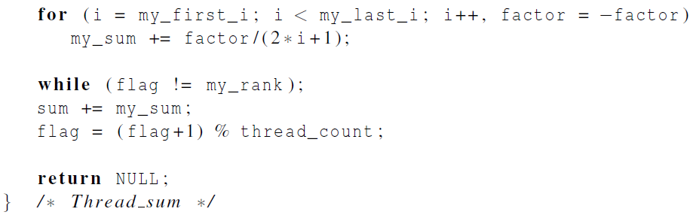
Global sum function with critical section after loop (2)

Slide 35
Mutexes
A thread that is busy-waiting may continually use the CPU accomplishing nothing.
Mutex (mutual exclusion) is a special type of variable that can be used to restrict access to a critical section to a single thread at a time.
Notes:
互斥量（互斥锁的简称）

Slide 36

Mutexes
Used to guarantee that one thread “excludes” all other threads while it executes the critical section.
The Pthreads standard includes a special type for mutexes: pthread_mutex_t.

Slide 37
Mutexes
In order to gain access to a critical section a thread calls
When a thread is finished executing the code in a critical section, it should call

Slide 38
Mutexes
When a Pthreads program finishes using a mutex, it should call

Slide 39
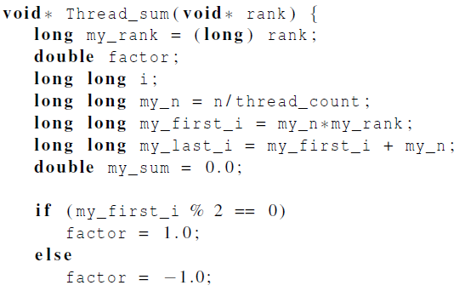
Global sum function that uses a mutex (1)

Slide 40
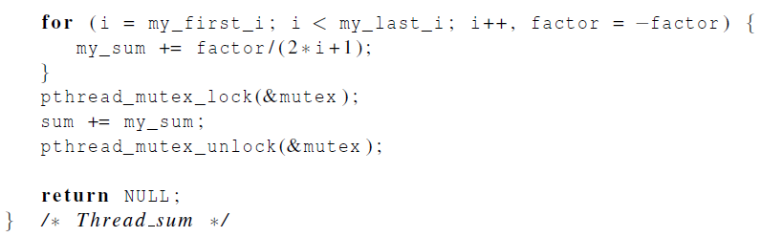
Global sum function that uses a mutex (2)
See a complete toy example

Slide 41
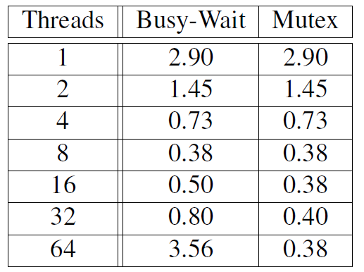
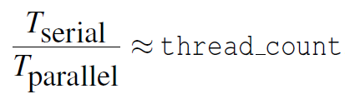
# of threads > # of cores
Run-times (in seconds) of π programs using n = 10⁸ terms on a system with two four-core processors.

Slide 42
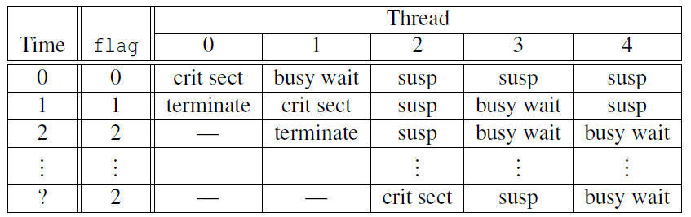
5 threads 2 cores
Possible sequence of events with busy-waiting and more threads than cores.

Slide 43
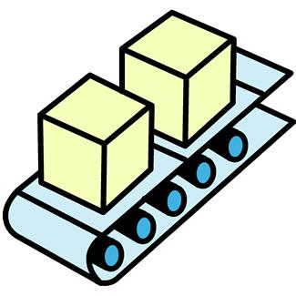
Producer-Consumer Synchronization and Semaphores
Notes:
信号量

Slide 44
Issues
Busy-waiting enforces the order threads access a critical section.
Using mutexes, the order is left to chance and the system.
There are applications where we need to control the order threads access the critical section.
Notes:
上例中标量加法可交换，顺序无所谓。矩阵乘法（每个线程生成一个矩阵乘起来）则需要按顺序

Slide 45
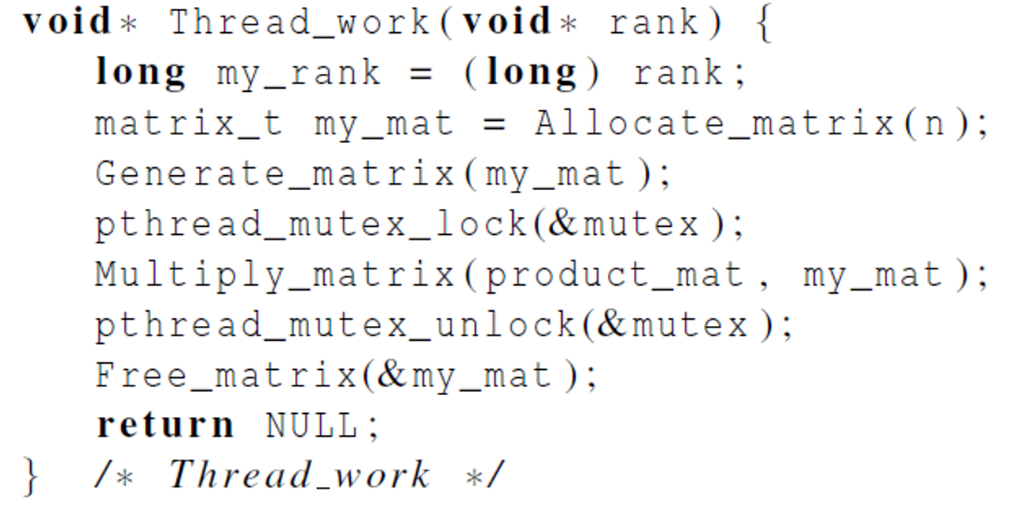
Problems with a mutex solution
Problem: matrix multiplication is not commutative
For example, A * B * C ≠ C * B * A
Notes:
每个线程生成一个n*n的matrix，其中n和product_mat是共享的

Slide 46
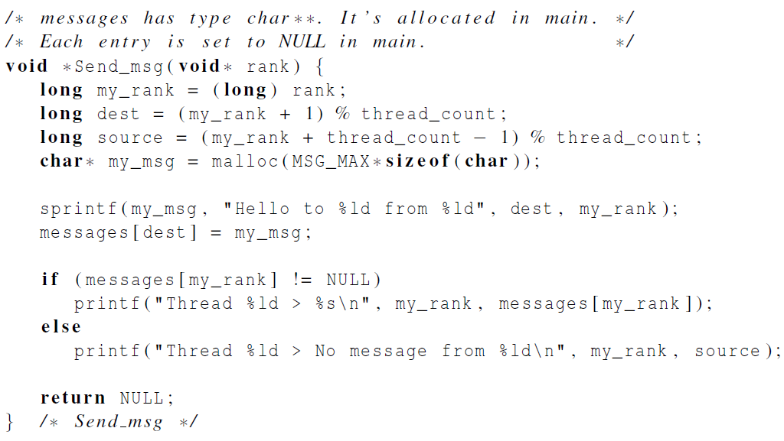
A first attempt at sending messages using pthreads
while (messages[my_rank] == NULL);
Problem: If running 2+ threads on a dual-core system, some of the messages are never received.
Notes:
Thread 0 will typically finish before thread t-1 has copied the message into the Messages array. We can replace if statement with a busy-wait while statement.
中文书p115还有用mutex的失败示例

Slide 47

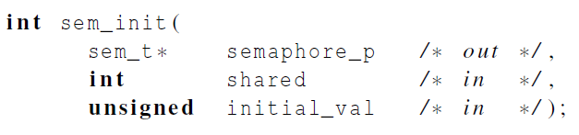
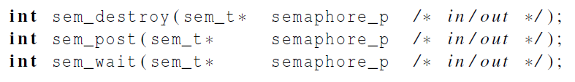
Syntax of the various semaphore functions
Semaphores are not part of Pthreads;
you need to add this.
Notes:
Part of POSIX protocol (not defining impl.)
一般考虑二元信号量，1对应可以获取的mutex, 0对应被占据了的mutex，sem_post给其+1使得别人能获取（不被阻塞），而sem_wait就是看若为0则阻塞，若为1则成功获取可以继续。

Slide 48
int sem_init(sem_t *sem,int pshared,unsigned int value);
pshared为0，表示信号在当前进程的多个线程之间共享
value表示初始化信号的值
int sem_wait(sem_t *sem);
sem_wait可以用来阻塞当前线程，直到信号量的值大于0，解除阻塞。
解除阻塞后，sem的值-1，表示公共资源被执行减少了
int sem_post(sem_t *sem);
sem_post用于增加信号量的值，信号量+1
当有线程阻塞在这个信号量上时，调用这个函数会使其中的一个线程不再阻塞，选择机制由线程的调度策略决定。

Slide 49
Using Semaphores to send msgs
/* semaphores are initialized to 0 (locked) */
void* Send_msg(void* rank) {
long my_rank = (long) rank;
long dest = (my_rank + 1) % thread_count;
char* my_msg = malloc(MSG_MAX*sizeof(char));
sprintf(my_msg, "Hello to %ld from %ld", dest, my_rank);
messages[dest] = my_msg;
sem_post(&semaphores[dest]); /*unlock the semaphore of dest*/
/*wait for our semaphore to be unlocked*/
sem_wait(&semaphores[my_rank]);
printf("Thread %ld > %s\n", my_rank, messages[my_rank]);
return NULL;
}
semaphores[thread_count]

Slide 50
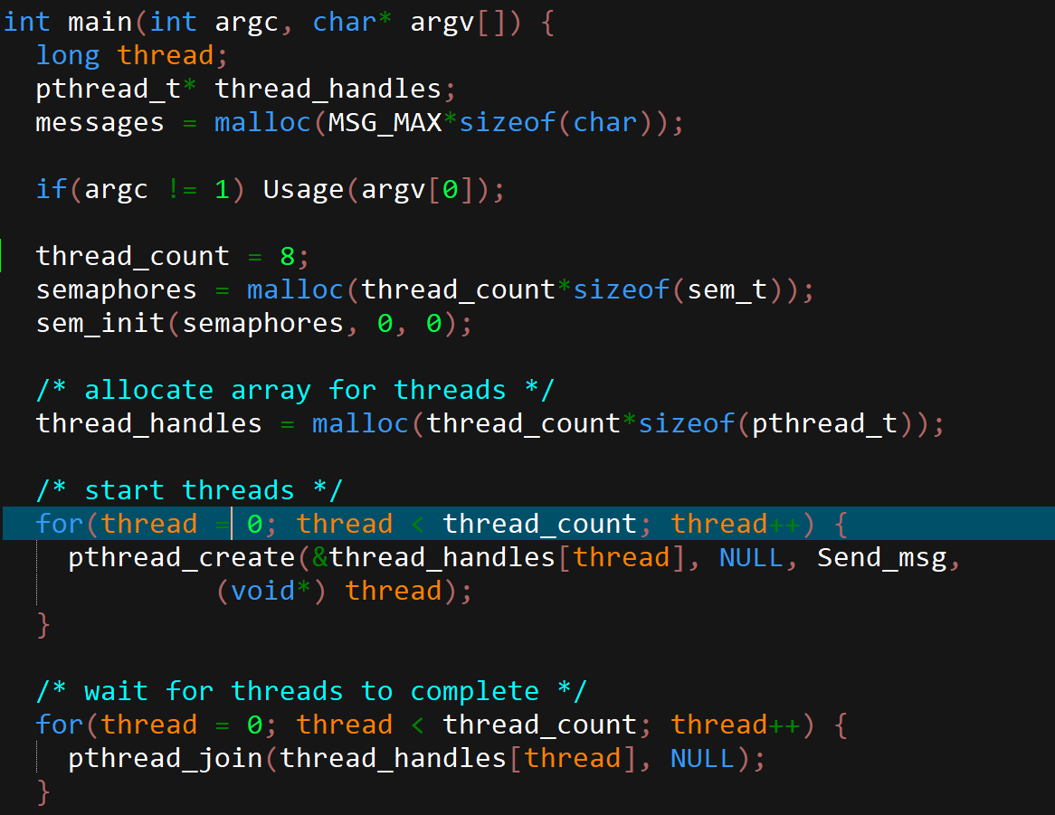

Slide 51
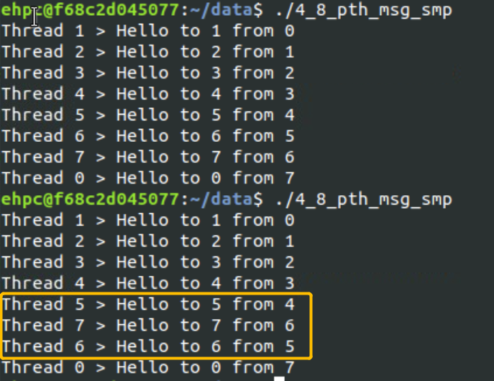
输出不一定严格有序，但是消息发送的顺序是有序的

Slide 52

Barriers and Condition Variables
Notes:
路障和条件变量

Slide 53
Barriers
Synchronizing the threads to make sure that they all are at the same point in a program is called a barrier.
No thread can cross the barrier until all the threads have reached it.

Slide 54
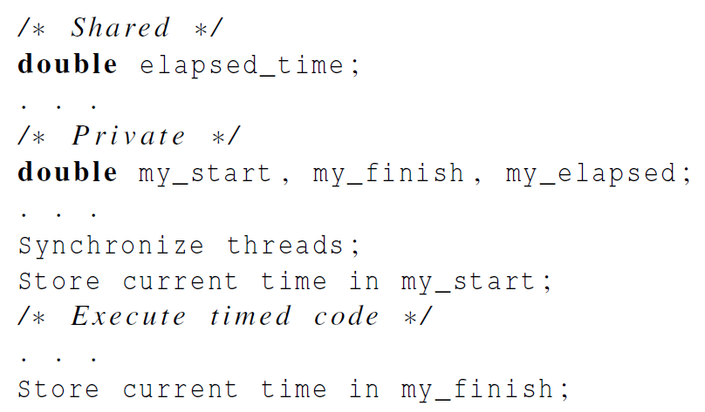
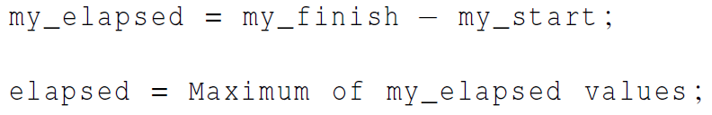
Using barriers to time the slowest thread

Slide 55
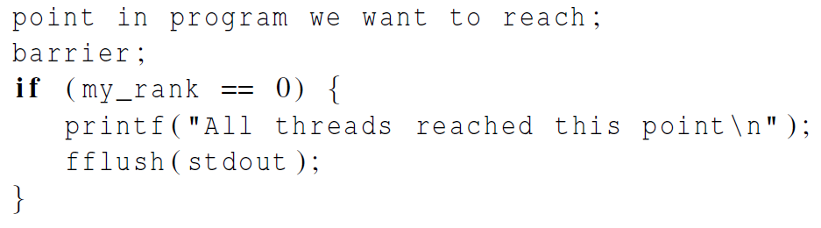

Using barriers for debugging
Notes:
fflush(stdout)：清空输出缓冲区，并把缓冲区内容输出。

Slide 56
Busy-waiting and a Mutex
Implementing a barrier using busy-waiting and a mutex is straightforward.
We use a shared counter protected by the mutex.
When the counter indicates that every thread has entered the critical section, threads can leave the critical section.

Slide 57
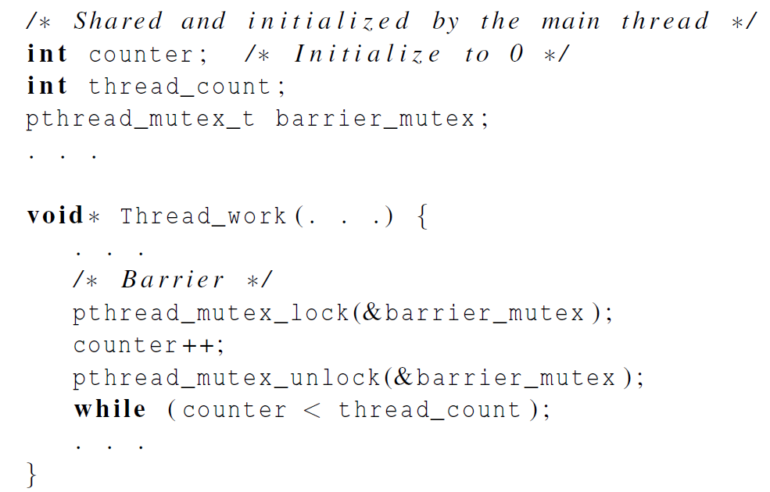
Busy-waiting and a Mutex
We need one counter
variable for each instance of the barrier, otherwise problems are likely to occur.

Slide 58
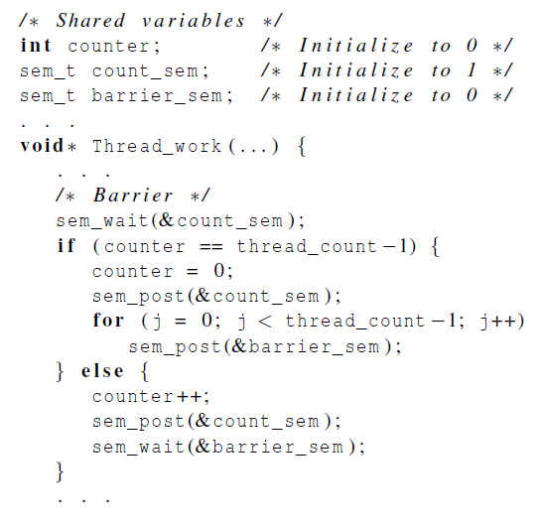
Implementing a barrier with semaphores
Notes:
信号量和互斥锁(mutex)的区别：互斥锁只允许一个线程进入临界区，而信号量允许多个线程同时进入临界区。
int sem_init(sem_t *sem, int pshared, unsigned int value);，其中sem是要初始化的信号量，pshared表示此信号量是在进程间共享还是线程间共享，value是信号量的初始值。
int sem_destroy(sem_t *sem);,其中sem是要销毁的信号量。只有用sem_init初始化的信号量才能用sem_destroy销毁。
int sem_wait(sem_t *sem);等待信号量，如果信号量的值大于0,将信号量的值减1,立即返回。如果信号量的值为0,则线程阻塞。相当于P操作。成功返回0,失败返回-1。
int sem_post(sem_t *sem); 释放信号量，让信号量的值加1。相当于V操作。
---------------------

Slide 59
int sem_wait(sem_t *sem);
sem_wait可以用来阻塞当前线程，直到信号量的值大于0，解除阻塞。
解除阻塞后，sem的值-1，表示公共资源被执行减少了
信号量和互斥锁(mutex)的区别：
互斥锁只允许一个线程进入临界区，
而信号量允许多个线程同时进入临界区。
先判断，如果大于0，解除阻塞，减去1；
如果等于0，保持阻塞

Slide 60
Condition Variables
A condition variable is a data object that allows a thread to suspend execution until a certain event or condition occurs.
When the event or condition occurs another thread can signal the thread to “wake up.”
A condition variable is always associated with a mutex.

Slide 61
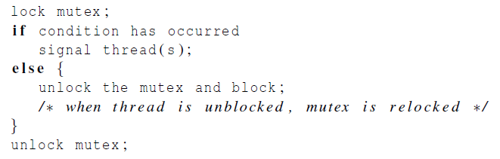
Condition Variables

Slide 62
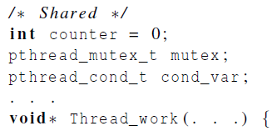
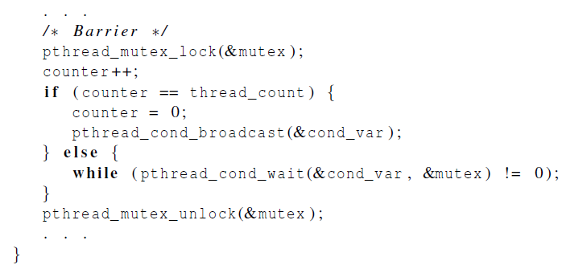
Implementing a barrier with condition variables
pthread_mutex_unlock(&mutex);
wait_on_signal(&cond_var);
pthread_mutex_lock(&mutex)
Notes:
通常的应用场景下，当前线程执行pthread_cond_wait时，处于临界区访问共享资源，存在一个mutex与该临界区相关联，这是理解pthread_cond_wait带有mutex参数的关键
当前线程执行pthread_cond_wait前，已经获得了和临界区相关联的mutex；执行pthread_cond_wait会阻塞，但是在进入阻塞状态前，必须释放已经获得的mutex，让其它线程能够进入临界区
当前线程执行pthread_cond_wait后，阻塞等待的条件满足，条件满足时会被唤醒；被唤醒后，仍然处于临界区，因此被唤醒后必须再次获得和临界区相关联的mutex
综上，调用pthread_cond_wait时，线程总是位于某个临界区，该临界区与mutex相关，pthread_cond_wait需要带有一个参数mutex，用于释放和再次获取mutex。
====== while，不是if的原因：
Pthread_cond_wait: Upon successful completion, a value of zero is returned. Otherwise, an error number is returned to indicate the error.
pthread_cond_signal()也可能唤醒多个线程，而如果你同时只允许一个线程访问的话，就必须要使用while来进行条件判断，以保证临界区内只有一个线程在处理
为什么用while来判断条件
如上面的代码所示，使用while对条件进行判断的原因如下：
若先解锁互斥量，再唤醒等待线程，则条件可能被其它线程更改，使得等待条件再次成立，需要继续等待
pthread_cond_wait可能存在意外返回的情况，则此时条件并没有被更改，需要继续等待。造成意外返回的原因是Linux中带阻塞功能的系统调用都会在进程收到signal后返回

Slide 63
通常的应用场景下，当前线程执行pthread_cond_wait时，处于临界区访问共享资源，存在一个mutex与该临界区相关联，这是理解pthread_cond_wait带有mutex参数的关键
当前线程执行pthread_cond_wait前，已经获得了和临界区相关联的mutex；执行pthread_cond_wait会阻塞，但是在进入阻塞状态前，必须释放已经获得的mutex，让其它线程能够进入临界区
当前线程执行pthread_cond_wait后，阻塞等待的条件满足，条件满足时会被唤醒；被唤醒后，仍然处于临界区，因此被唤醒后必须再次获得和临界区相关联的mutex
综上，调用pthread_cond_wait时，线程总是位于某个临界区，该临界区与mutex相关，pthread_cond_wait需要带有一个参数mutex，用于释放和再次获取mutex。

Slide 64

Read-Write Locks

Slide 65
Controlling access to a large, shared data structure
Let’s look at an example.
Suppose the shared data structure is a sorted linked list of ints, and the operations of interest are Member, Insert, and Delete.

Slide 66
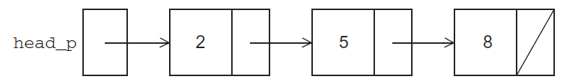
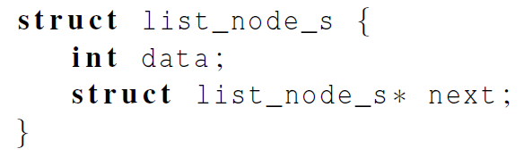
Linked Lists

Slide 67
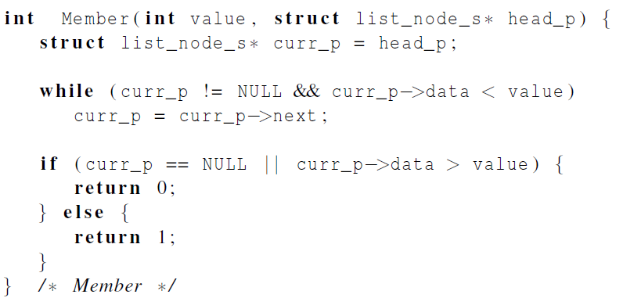
Linked List Membership

Slide 68
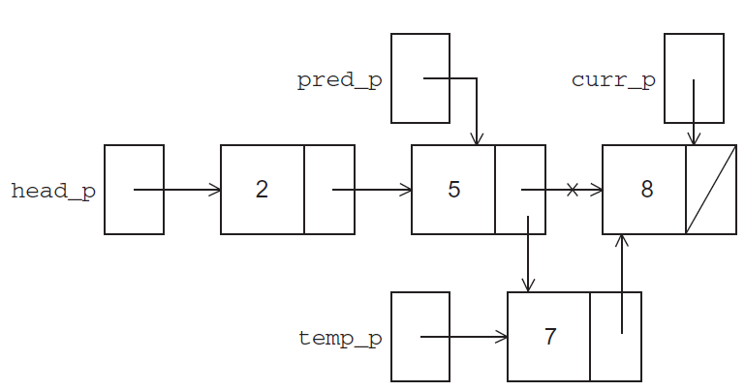
Inserting a new node into a list

Slide 69
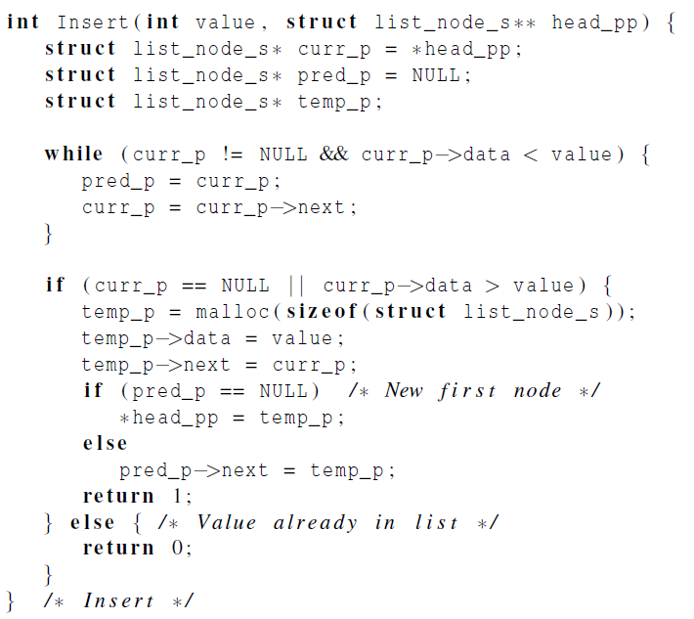
Inserting a new node into a list

Slide 70
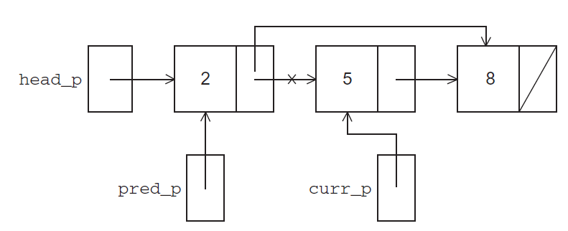
Deleting a node from a linked list

Slide 71
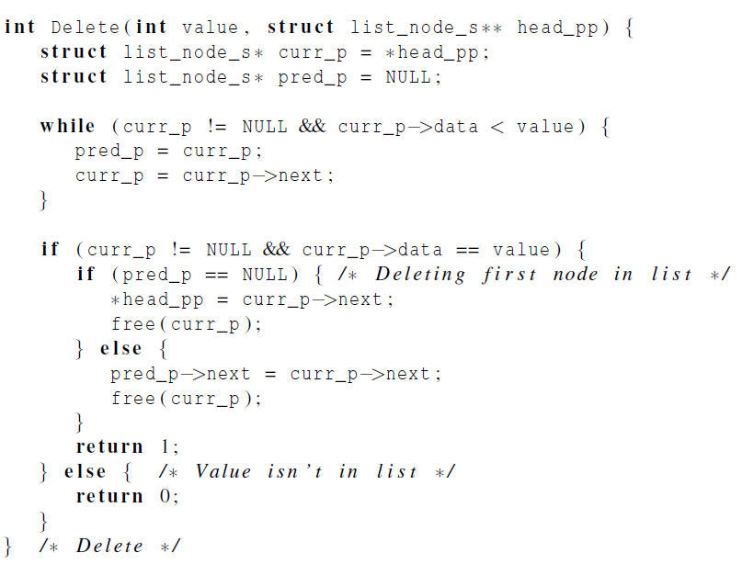
Deleting a node from a linked list

Slide 72
A Multi-Threaded Linked List
Let’s try to use these functions in a Pthreads program.
In order to share access to the list, we can define head_p to be a global variable.
This will simplify the function headers for Member, Insert, and Delete
since we won’t need to pass in either head_p or a pointer to head_p
we’ll only need to pass in the value of interest.

Slide 73
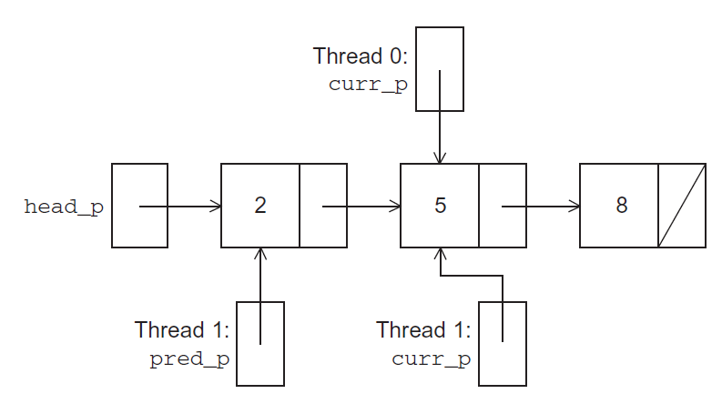
Simultaneous access by two threads
Thread0: Member(5)
Thread1: Delete(5)
Problem: Element 5 may be deleted even before thread 0 returns.

Slide 74


Simultaneous access by two threads
Thread0: Member(8)
Thread1: Delete(5)
Problem: thread1 may free the memory used for the node storing 5 before thread0 can advance to the node storing 8.

Slide 75
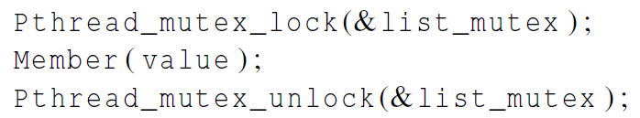
Solution #1
An obvious solution is to simply lock the list any time that a thread attempts to access it.
A call to each of the three functions can be protected by a mutex.
In place of calling Member(value).

Slide 76
Issues
We’re serializing access to the list.
If the vast majority of our operations are calls to Member, we’ll fail to exploit this opportunity for parallelism.
On the other hand, if most of our operations are calls to Insert and Delete, then this may be the best solution
since we’ll need to serialize access to the list for most of the operations, and this solution will certainly be easy to implement.

Slide 77

Solution #2
Instead of locking the entire list, we could try to lock individual nodes.
A “finer-grained” approach.

Slide 78

Implementation of Member with one mutex per list node (1)
temp_p

Slide 79

Implementation of Member with one mutex per list node (2)

Slide 80
Issues
This is much more complex than the original Member function.
It is also much slower, since, in general, each time a node is accessed, a mutex must be locked and unlocked.
The addition of a mutex field to each node will substantially increase the amount of storage needed for the list.

Slide 81
Pthreads Read-Write Locks
Neither of our multi-threaded linked lists exploits the potential for simultaneous access to any node by threads that are executing Member.
The first solution only allows one thread to access the entire list at any instant.
The second only allows one thread to access any given node at any instant.

Slide 82
Pthreads Read-Write Locks
A read-write lock is somewhat like a mutex except that it provides two lock functions.
The first lock function locks the read-write lock for reading, while the second locks it for writing.

Slide 83
Pthreads Read-Write Locks
So multiple threads can simultaneously obtain the lock by calling the read-lock function, while only one thread can obtain the lock by calling the write-lock function.
Thus, if any threads own the lock for reading, any threads that want to obtain the lock for writing will block in the call to the write-lock function.

Slide 84

Pthreads Read-Write Locks
If any thread owns the lock for writing, any threads that want to obtain the lock for reading or writing will block in their respective locking functions.

Slide 85

Protecting our linked list functions

Slide 86

Linked List Performance
100,000 ops/thread
99.9% Member
0.05% Insert
0.05% Delete
If there is very few Inserts/Deletes, the RW locks do a very good job of allowing concurrent access to the list.

Slide 87

Linked List Performance
100,000 ops/thread
80% Member
10% Insert
10% Delete
If there are a relatively large # of Inserts/Deletes, there is very little difference between RW lock and single mutex.

Slide 88
Caches, Cache-Coherence, and False Sharing
Recall that chip designers have added blocks of relatively fast memory to processors called cache memory.
The use of cache memory can have a huge impact on shared-memory.
A write-miss occurs when a core tries to update a variable that’s not in cache, and it has to access main memory.

Slide 89

Pthreads matrix-vector multiplication

Slide 90

Q: 为什么8M*8（或8*8M）的矩阵计算时间要大于8K*8K的时间？
y = A*x
With 1 thread, 8M*8 requires 14% more time than 8K*8K, and 8*8M requires 28% more time than 8K*8K.
The above differences are partially attributed to cache performance.
Efficiency of multi-thread version is even worse for 8M*8 and 8*8M.

Slide 91

A
x
y
Cache line
8
1
8
1
*
=
8
A lot of write misses of y
8M
8M

Slide 92
A
x
y
8M
1
1
*
=
8
8
8M
A lot of read misses of x

Slide 93
A
x
y
8M
1
1
core0
thread0
*
=
Single
cache
line
thread1
8
thread2
core1
thread3
8
Multi-threaded cases
8M
false sharing
problem
Cache coherence is enforced at the “cache-line level.” That is, each time any value in a cache line is written, if the line is also stored in another core’s cache, the entire line will be invalidated

Slide 94

Thread-Safety

Slide 95

Thread-Safety
A block of code is thread-safe if it can be simultaneously executed by multiple threads without causing problems.

Slide 96

Example
The tokens are just contiguous sequences of characters separated from the rest of the text by white-space — a space, a tab, or a newline.
Suppose we want to use multiple threads to “tokenize” a file that consists of ordinary English text.

Slide 97
Simple approach
Divide the input file into lines of text and assign the lines to the threads in a round-robin fashion.
The first line goes to thread 0,
the second goes to thread 1,
. . . ,
the t-th goes to thread t,
the t +1st goes to thread 0,
etc.

Slide 98
Simple approach
We can serialize access to the lines of input using semaphores.
After a thread has read a single line of input, it can tokenize the line using the strtok function.

Slide 99

The strtok function
The first time it’s called the string argument should be the text to be tokenized.
Our line of input.
For subsequent calls, the first argument should be NULL.

Slide 100
The strtok function
The idea is that in the first call, strtok caches a pointer to string, and for subsequent calls it returns successive tokens taken from the cached copy.
my_string = strtok(my_line, “\t\n”);
……
my_string = strtok(NULL, “\t\n”);

Slide 101

Multi-threaded tokenizer (1)
Thread 0’s semaphore is initialized to 1, and others are initialized to 0

Slide 102

Multi-threaded tokenizer (2)

Slide 103
Running with one thread
It correctly tokenizes the input stream.
Pease porridge hot.
Pease porridge cold.
Pease porridge in the pot
Nine days old.

Slide 104

Running with two threads
Oops!
Missing…

Slide 105
What happened?
strtok caches the input line by declaring a variable to have static storage class.
This causes the value stored in this variable to persist from one call to the next.
Unfortunately for us, this cached string is shared, not private.

Slide 106

What happened?
Thus, thread 0’s call to strtok with the third line of the input has apparently overwritten the contents of thread 1’s call with the second line.
So the strtok function is not thread-safe.
If multiple threads call it simultaneously, the output may not be correct.

Slide 107
Other unsafe C library functions
Regrettably, it’s not uncommon for C library functions to fail to be thread-safe.
The random number generator random in stdlib.h.
The time conversion function localtime in time.h.

Slide 108

“re-entrant” (thread safe) functions
In some cases, the C standard specifies an alternate, thread-safe, version of a function.
saveptr_p keeps track of where the func is in the input string.
my_string = strtok(my_line, “\t\n”);
……
my_string = strtok(NULL, “\t\n”);
my_string = strtok_r(my_line, “\t\n”, &saveptr);
……
my_string = strtok_r(NULL, “\t\n”, &saveptr);
Notes:
Reentrant adj.再进去的

Slide 109
Concluding Remarks (1)
A thread in shared-memory programming is analogous to a process in distributed memory programming.
However, a thread is often lighter-weight than a full-fledged process.
In Pthreads programs, all the threads have access to global variables, while local variables usually are private to the thread running the function.

Slide 110
Concluding Remarks (2)
When indeterminacy results from multiple threads attempting to access a shared resource, the accesses can result in an error, and we have a race condition.

Slide 111
Concluding Remarks (3)
A critical section is a block of code that updates a shared resource that can only be updated by one thread at a time.
So the execution of code in a critical section should, effectively, be executed as serial code.

Slide 112
Concluding Remarks (4)
Busy-waiting can be used to avoid conflicting access to critical sections with a flag variable and a while-loop with an empty body.
It can be very wasteful of CPU cycles.
It can also be unreliable if compiler optimization is turned on.

Slide 113
Concluding Remarks (5)
A mutex can be used to avoid conflicting access to critical sections as well.
Think of it as a lock on a critical section, since mutexes arrange for mutually exclusive access to a critical section.

Slide 114
Concluding Remarks (6)
A semaphore is the third way to avoid conflicting access to critical sections.
It is an unsigned int together with two operations: sem_wait and sem_post.
Semaphores are more powerful than mutexes since they can be initialized to any nonnegative value.

Slide 115
Concluding Remarks (7)
A barrier is a point in a program at which the threads block until all of the threads have reached it.
A read-write lock is used when it’s safe for multiple threads to simultaneously read a data structure,
but if a thread needs to write to the data structure, then only that thread can access the data structure during the modification.

Slide 116
Concluding Remarks (8)
Some C functions cache data between calls by declaring variables to be static, causing errors when multiple threads call the function.
This type of function is not thread-safe.

Slide 117
Supplementary materials

Slide 118


Returning a value
back

Slide 119


Pthread mutex usage example
pthread_mutex_t mutex; // global count_mutex;
back

