Slide 1


用OpenMP进行共享内存编程
任课教师：王桢

Slide 2
课程内容
参考资料：
并行程序设计导论，Peter S Pacheco, 机械工业出版社， 2016
Chapter 5 Shared-Memory Programming With OpenMP

Slide 3
Roadmap
Writing programs that use OpenMP.
Using OpenMP to parallelize many serial for loops with only small changes to the source code.
Task parallelism.
Explicit thread synchronization.
Standard problems in shared-memory programming.

Slide 4
OpenMP
An API for shared-memory parallel programming.
MP = multiprocessing
Designed for systems in which each thread or process can potentially have access to all available memory.
System is viewed as a collection of cores or CPU’s, all of which have access to main memory.

Slide 5
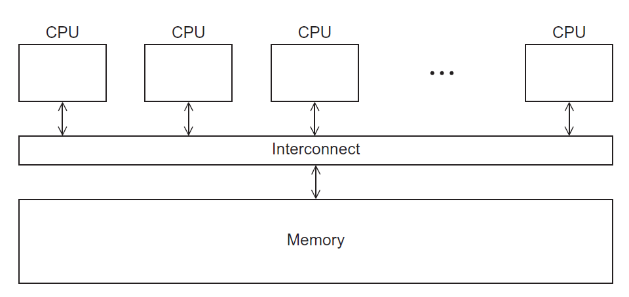
A shared memory system

Slide 6
Pragmas （编译指示）
Special preprocessor instructions.
Typically added to a system to allow behaviors that aren’t part of the basic C specification.
Compilers that don’t support the pragmas ignore them.
#pragma
Notes:
#pragma 编译指示

Slide 7
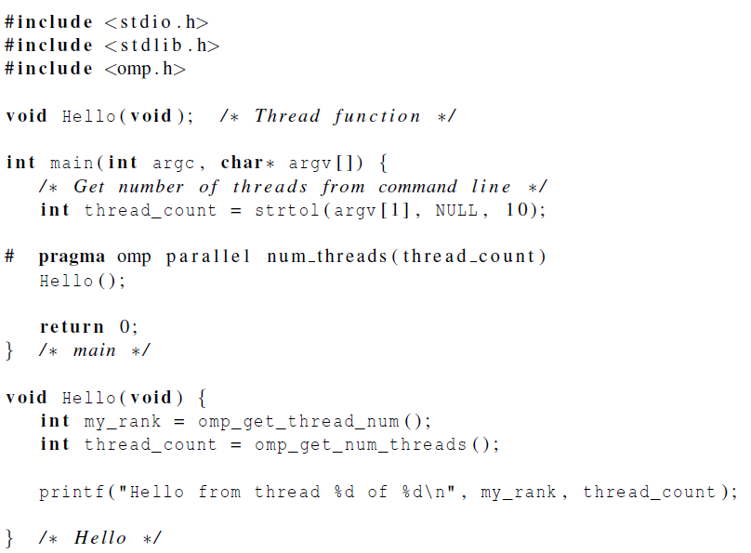

Slide 8
gcc −g −Wall −fopenmp −o omp_hello omp_hello . c
. / omp_hello 4
compiling
running with 4 threads
Hello from thread 0 of 4
Hello from thread 1 of 4
Hello from thread 2 of 4
Hello from thread 3 of 4
possible outcomes
Hello from thread 3 of 4
Hello from thread 1 of 4
Hello from thread 2 of 4
Hello from thread 0 of 4
Hello from thread 1 of 4
Hello from thread 2 of 4
Hello from thread 0 of 4
Hello from thread 3 of 4

Slide 9
OpenMp pragmas
# pragma omp parallel
Most basic parallel directive（指令）.
The number of threads that run the following structured block of code is determined by the run-time system.

Slide 10
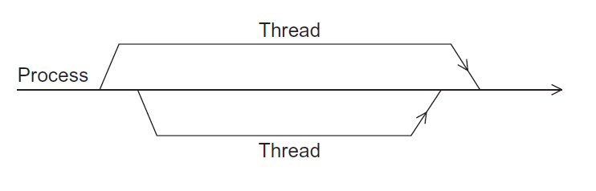
A process forking and joining two threads

Slide 11
Clause（子句）
Text that modifies a directive.
The num_threads clause can be added to a parallel directive.
It allows the programmer to specify the number of threads that should execute the following block.
# pragma omp parallel num_threads ( thread_count )

Slide 12
Of note…
There may be system-defined limitations on the number of threads that a program can start.
The OpenMP standard doesn’t guarantee that this will actually start thread_count threads.
Most current systems can start hundreds or even thousands of threads.
Unless we’re trying to start a lot of threads, we will almost always get the desired number of threads.

Slide 13

Some terminology
The collection of threads executing the parallel block is called a team
the original thread is called the master, and the additional threads are called slaves.

Slide 14
In case the compiler doesn’t support OpenMP
# include <omp.h>
#ifdef _OPENMP
# include <omp.h>
#endif

Slide 15
In case the compiler doesn’t support OpenMP
# ifdef _OPENMP
int my_rank = omp_get_thread_num ( );
int thread_count = omp_get_num_threads ( );
# else
int my_rank = 0;
int thread_count = 1;
# endif

Slide 16

The Trapezoidal Rule

Slide 17
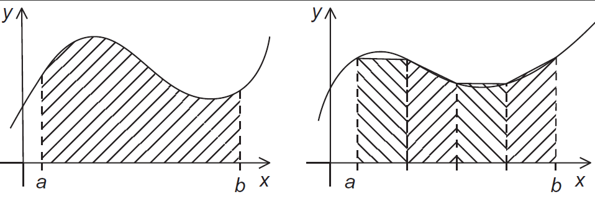
The trapezoidal rule

Slide 18
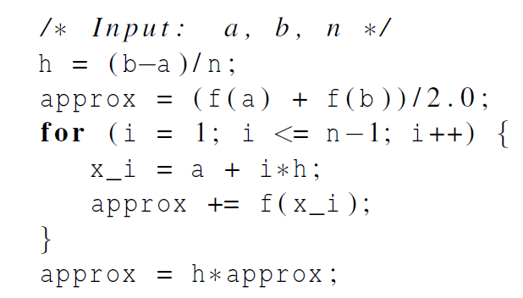
Serial algorithm

Slide 19
A First OpenMP Version
1) We identified two types of tasks:
a) computation of the areas of individual trapezoids
b) adding the areas of trapezoids.
2) There is no communication among the tasks in the first collection, but each task in the first collection communicates with task 1b.

Slide 20
A First OpenMP Version
3) We assumed that there would be many more trapezoids than cores.
So we aggregated tasks by assigning a contiguous block of trapezoids to each thread (and a single thread to each core).

Slide 21
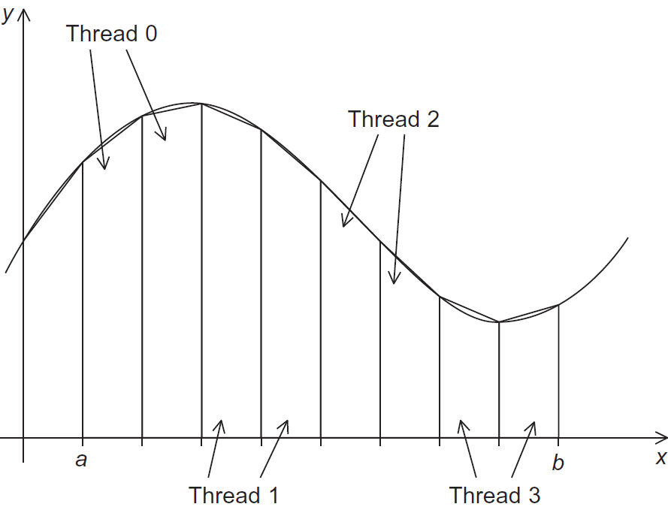
Assignment of trapezoids to threads

Slide 22
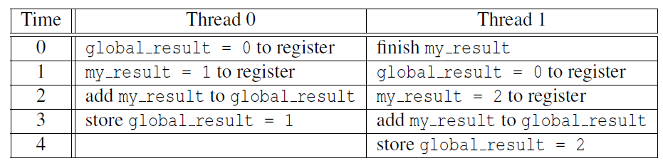

Unpredictable results when two (or more) threads attempt to simultaneously execute: global_result += my_result ;

Slide 23
Mutual exclusion
# pragma omp critical
global_result += my_result ;
only one thread can execute
the following structured block at a time

Slide 24
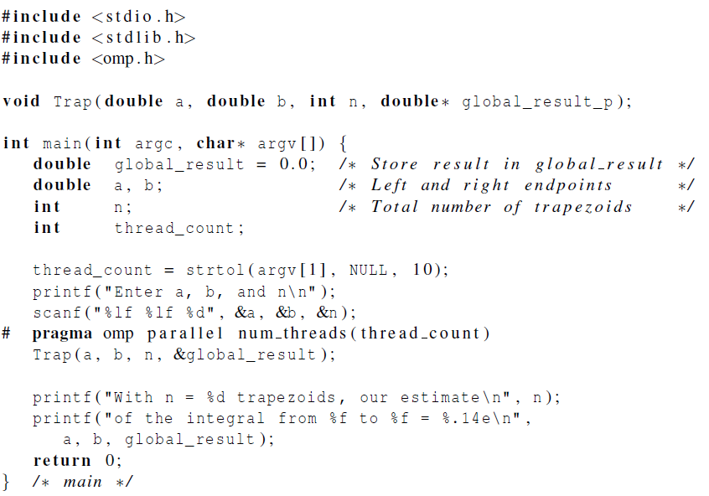

Slide 25
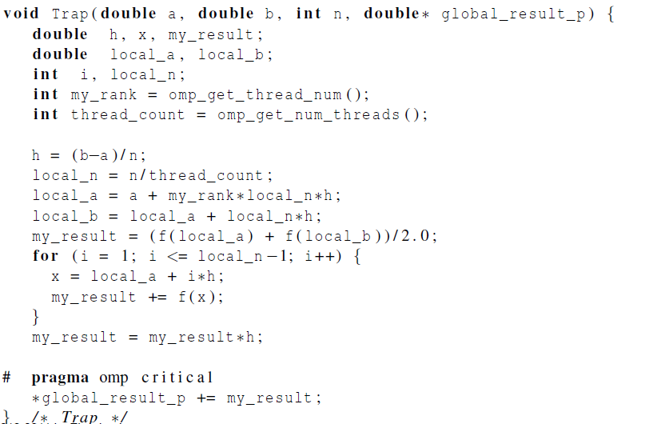

Slide 26

Scope of Variables

Slide 27
Scope
In serial programming, the scope of a variable consists of those parts of a program in which the variable can be used.
In OpenMP, the scope of a variable refers to the set of threads that can access the variable in a parallel block.

Slide 28

Scope in OpenMP
A variable that can be accessed by all the threads in the team has shared scope.
A variable that can only be accessed by a single thread has private scope.
The default scope for variables declared before a parallel block is shared.

Slide 29

The Reduction Clause

Slide 30
We need this more complex version to add each thread’s local calculation to get global_result.
Although we’d prefer this.

Slide 31
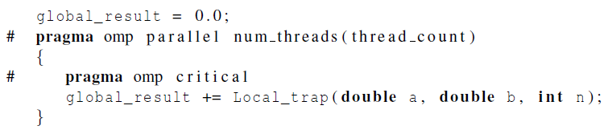
If we use this, there’s no critical section!
If we fix it like this…
… we force the threads to execute sequentially.

Slide 32
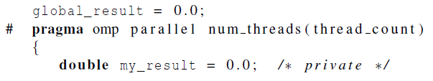
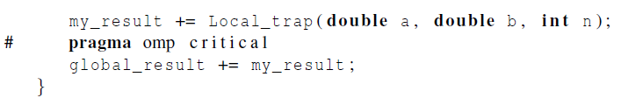
We can avoid this problem by declaring a private variable inside the parallel block and moving the critical section after the function call.

Slide 33

I think we can do better.
Neither do I.
I don’t like it.
Notes:
那些年，我们一起追的女孩

Slide 34
Reduction operators
A reduction operator is a binary operation (such as addition or multiplication).
A reduction is a computation that repeatedly applies the same reduction operator to a sequence of operands in order to get a single result.
All of the intermediate results of the operation should be stored in the same variable: the reduction variable.

Slide 35
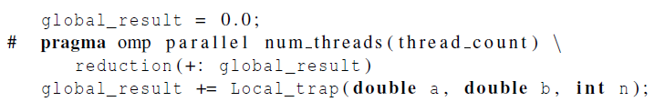
A reduction clause can be added to a parallel directive.
+, *, -, &, |, ˆ, &&, ||

Slide 36

The “Parallel For” Directive

Slide 37
Parallel for
Forks a team of threads to execute the following structured block.
However, the structured block following the parallel for directive must be a for loop.
Furthermore, with the parallel for directive the system parallelizes the for loop by dividing the iterations of the loop among the threads.

Slide 38
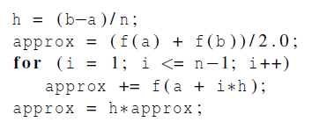
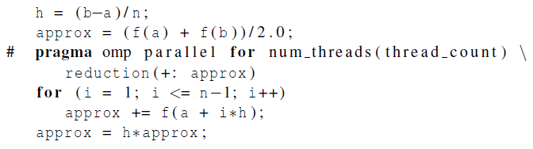

Slide 39
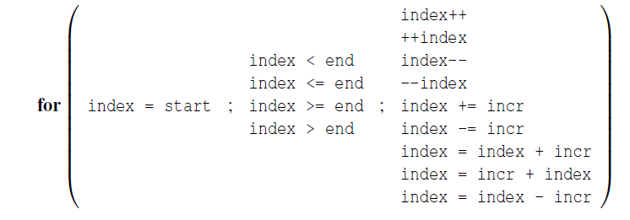
Legal forms for parallelizable for statements

Slide 40
Caveats
The variable index must have integer or pointer type (e.g., it can’t be a float).
The expressions start, end, and incr must have a compatible type. For example, if index is a pointer, then incr must have integer type.

Slide 41
Caveats
The expressions start, end, and incr must not change during execution of the loop.
During execution of the loop, the variable index can only be modified by the “increment expression” in the for statement.

Slide 42
Data dependencies
fibo[ 0 ] = fibo[ 1 ] = 1;
for (i = 2; i < n; i++)
fibo[ i ] = fibo[ i – 1 ] + fibo[ i – 2 ];
note 2 threads
fibo[ 0 ] = fibo[ 1 ] = 1;
# pragma omp parallel for num_threads(2)
for (i = 2; i < n; i++)
fibo[ i ] = fibo[ i – 1 ] + fibo[ i – 2 ];
but sometimes we get this
1 1 2 3 5 8 13 21 34 55
this is correct
1 1 2 3 5 8 0 0 0 0

Slide 43

What happened?
OpenMP compilers don’t check for dependencies among iterations in a loop that’s being parallelized with a parallel for directive.
A loop in which the results of one or more iterations depend on other iterations cannot be correctly parallelized by OpenMP.

Slide 44
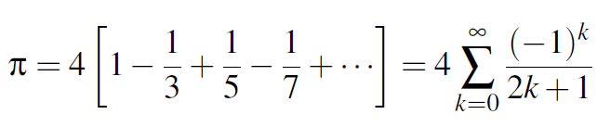
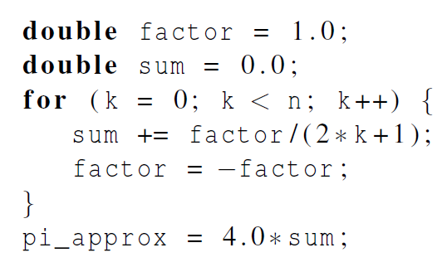
Estimating π

Slide 45
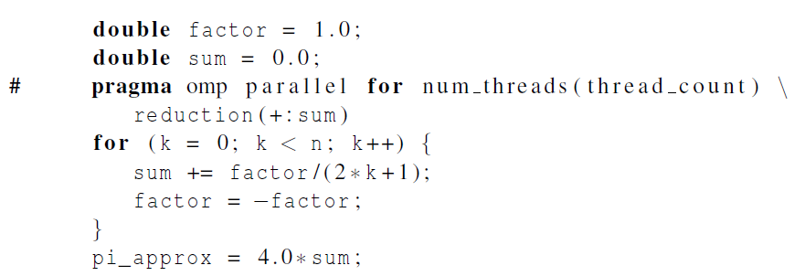
OpenMP solution #1
loop dependency

Slide 46
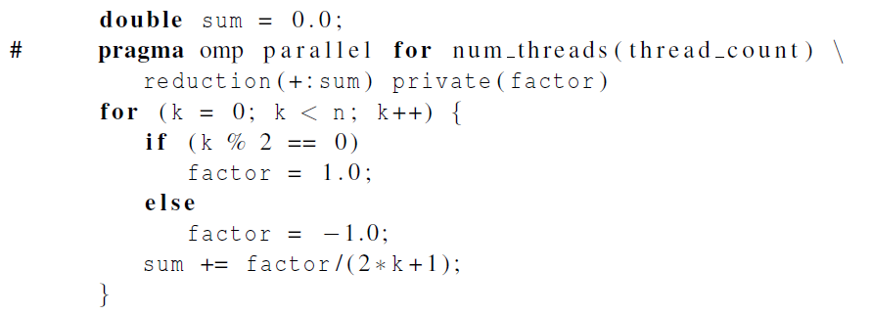
OpenMP solution #2
Insures factor has private scope.

Slide 47

The default clause
Lets the programmer specify the scope of each variable in a block.
With this clause the compiler will require that we specify the scope of each variable we use in the block and that has been declared outside the block.

Slide 48
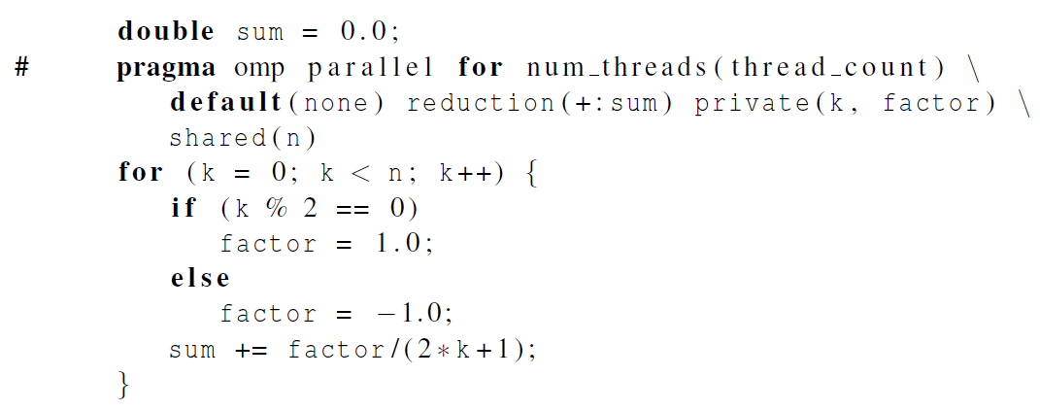
The default clause

Slide 49
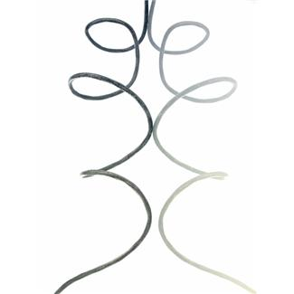
More About Loops in OpenMP: Sorting

Slide 50
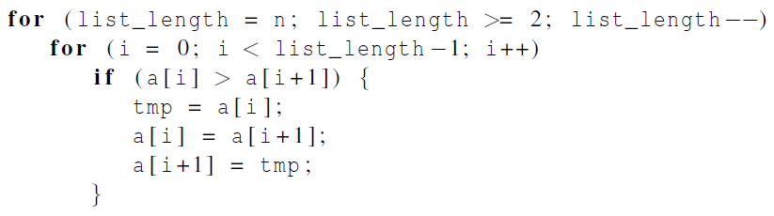

Bubble Sort

Slide 51
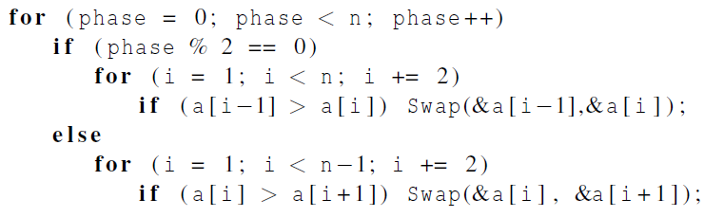
Serial Odd-Even Transposition Sort

Slide 52
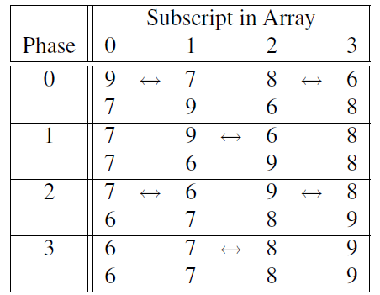
Serial Odd-Even Transposition Sort

Slide 53
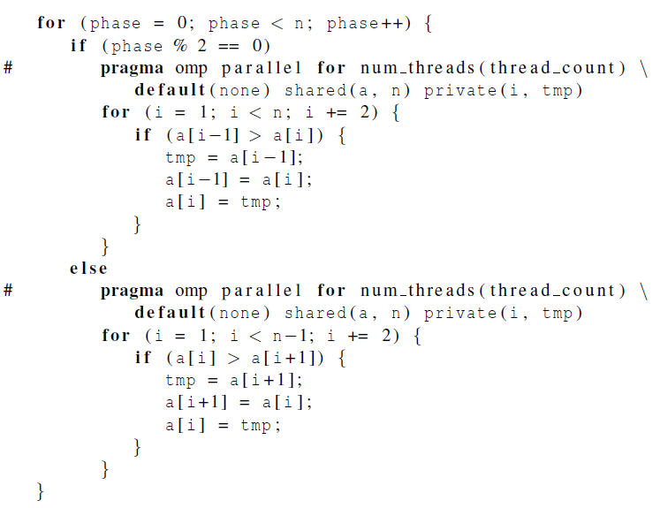
First OpenMP Odd-Even Sort

Slide 54
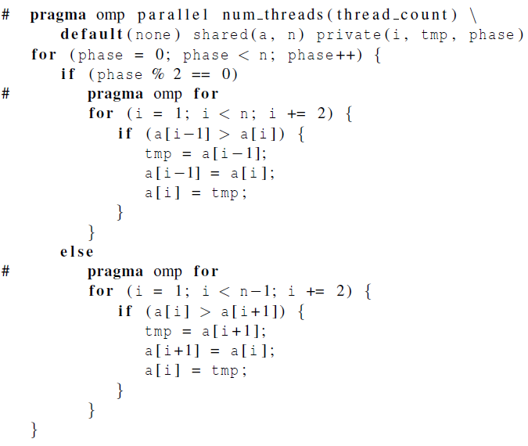
Second OpenMP Odd-Even Sort
Tells OpenMP to parallelize the for loop with existing team of threads

Slide 55
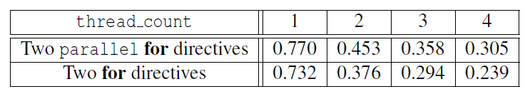

Odd-even sort with two parallel for directives and
two for directives.
(Times are in seconds.)

Slide 56

Scheduling Loops

Slide 57
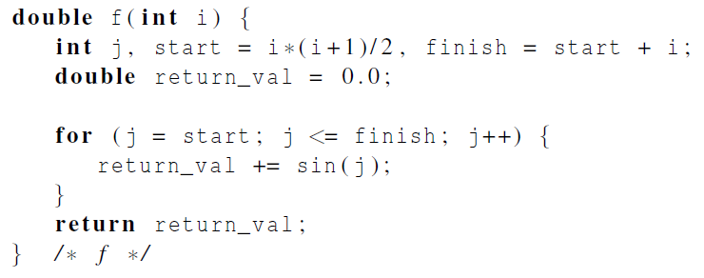
Our definition of function f.
The time required by the call to f
is proportional to the size of i

Slide 58
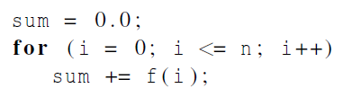
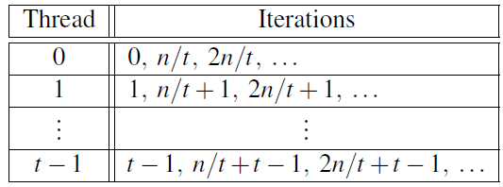
We want to parallelize
this loop.
Assignment of work using cyclic partitioning.

Slide 59
Results
f(i) calls the sin function i times.
Assume the time to execute f(2i) requires approximately twice as much time as the time to execute f(i).
n = 10,000
one thread
run-time = 3.67 seconds.

Slide 60

Results
n = 10,000
two threads
default assignment
run-time = 2.76 seconds
speedup = 1.33
n = 10,000
two threads
cyclic assignment
run-time = 1.84 seconds
speedup = 1.99

Slide 61
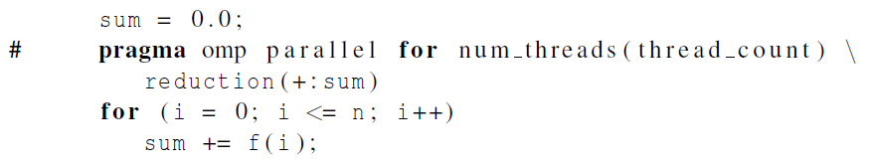
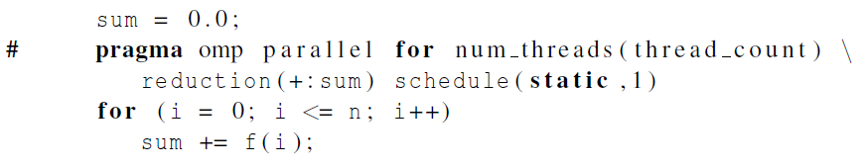
The Schedule Clause
Default schedule:
Cyclic schedule:

Slide 62
schedule ( type , chunksize )
Type can be:
static: the iterations can be assigned to the threads before the loop is executed.
dynamic or guided: the iterations are assigned to the threads while the loop is executing.
auto: the compiler and/or the run-time system determine the schedule.
runtime: the schedule is determined at run-time.

Slide 63

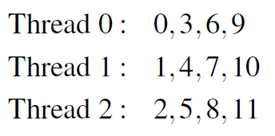
The Static Schedule Type
twelve iterations, 0, 1, . . . , 11, and three threads

Slide 64

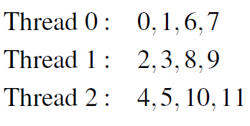
The Static Schedule Type
twelve iterations, 0, 1, . . . , 11, and three threads

Slide 65

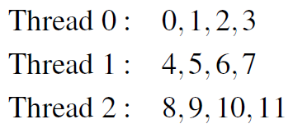
The Static Schedule Type
twelve iterations, 0, 1, . . . , 11, and three threads

Slide 66
The Dynamic Schedule Type
The iterations are also broken up into chunks of chunksize consecutive iterations.
Each thread executes a chunk, and when a thread finishes a chunk, it requests another one from the run-time system.
This continues until all the iterations are completed.

Slide 67
The Guided Schedule Type
Each thread also executes a chunk, and when a thread finishes a chunk, it requests another one.
However, in a guided schedule, as chunks are completed, the size of the new chunks decreases.

Slide 68
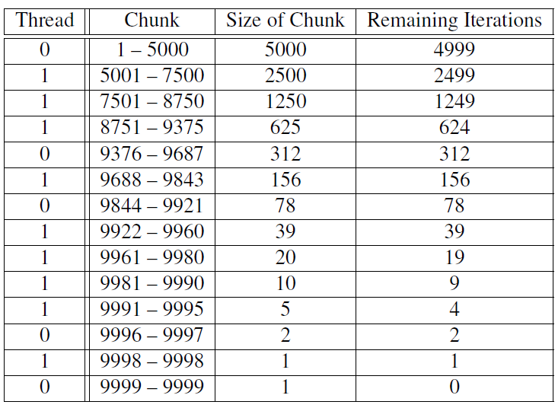
Assignment of trapezoidal rule iterations 1–9999 using a guided schedule with two threads.

Slide 69
The Runtime Schedule Type
The system uses the environment variable OMP_SCHEDULE to determine at run-time how to schedule the loop.
The OMP_SCHEDULE environment variable can take on any of the values that can be used for a static, dynamic, or guided schedule.

Slide 70

Producers and Consumers

Slide 71
Queues
Can be viewed as an abstraction of a line of customers waiting to pay for their groceries in a supermarket.
A natural data structure to use in many multithreaded applications.
For example, suppose we have several “producer” threads and several “consumer” threads.
Producer threads might “produce” requests for data.
Consumer threads might “consume” the request by finding or generating the requested data.

Slide 72
Message-Passing
Each thread could have a shared message queue
When one thread wants to “send a message” to another thread, it could enqueue the message in the destination thread’s queue.
A thread could receive a message by dequeuing the message at the head of its message queue.

Slide 73
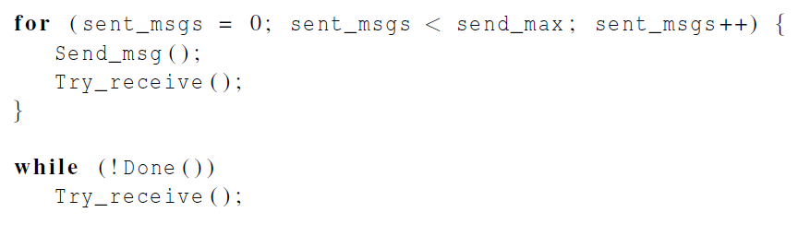
Message-Passing

Slide 74
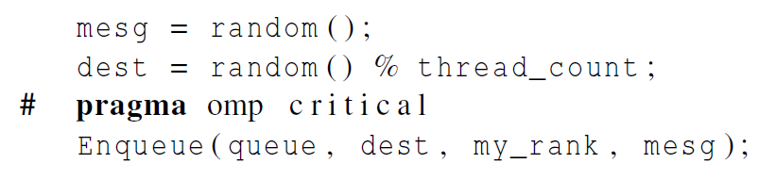
Sending Messages

Slide 75
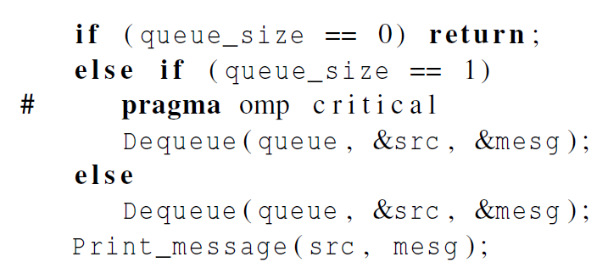
Receiving Messages

Slide 76
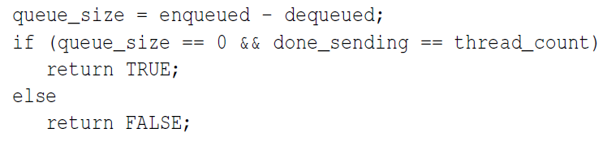

Termination Detection
each thread increments this after completing its for loop

Slide 77
Startup (1)
When the program begins execution, a single thread, the master thread, will get command line arguments and allocate an array of message queues: one for each thread.
This array needs to be shared among the threads, since any thread can send to any other thread, and hence any thread can enqueue a message in any of the queues.

Slide 78

Startup (2)
One or more threads may finish allocating their queues before some other threads.
We need an explicit barrier so that when a thread encounters the barrier, it blocks until all the threads in the team have reached the barrier.
After all the threads have reached the barrier, all the threads in the team can proceed.

Slide 79

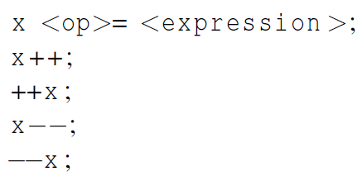
The Atomic Directive (1)
Unlike the critical directive, it can only protect critical sections that consist of a single C assignment statement.
Further, the statement must have one of the following forms:
Notes:
x += y++ 只确保更新x是原子操作

Slide 80
The Atomic Directive (2)
Here <op> can be one of the binary operators
Many processors provide a special load-modify-store instruction.
A critical section that only does a load-modify-store can be protected much more efficiently by using this special instruction.

Slide 81

Critical Sections
OpenMP provides the option of adding a name to a critical directive:
When we do this, two blocks protected with critical directives with different names can be executed simultaneously.
However, the names are set during compilation, and we want a different critical section for each thread’s queue.

Slide 82

Locks
A lock consists of a data structure and functions that allow the programmer to explicitly enforce mutual exclusion in a critical section.

Slide 83
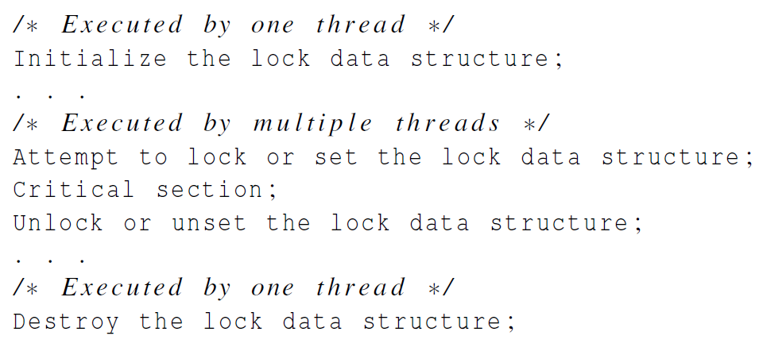
Locks

Slide 84
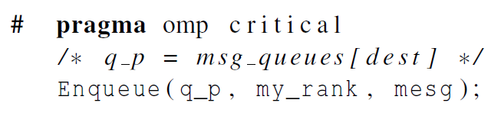
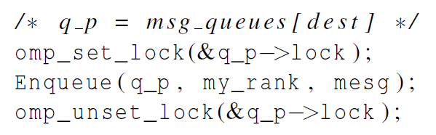
Using Locks in the Message-Passing Program

Slide 85
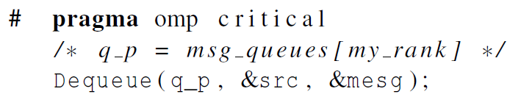
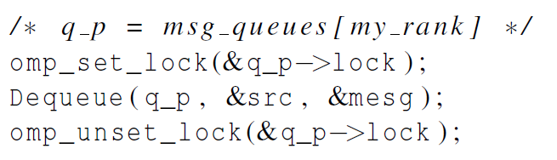
Using Locks in the Message-Passing Program

Slide 86
Some Caveats
You shouldn’t mix the different types of mutual exclusion for a single critical section.
E.g., critical may not exclude atomic.
There is no guarantee of fairness in mutual exclusion constructs.
E.g., it is possible that a thread can be blocked forever
It can be dangerous to “nest” mutual exclusion constructs.

Slide 87

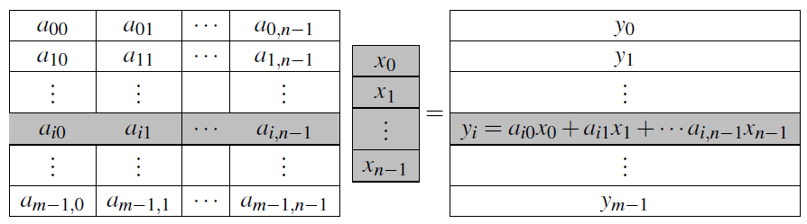
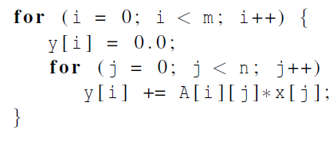
Matrix-vector multiplication
Notes:
Please refer to the detailed slides on cache coherence and thread-safety in Chapter 4.

Slide 88
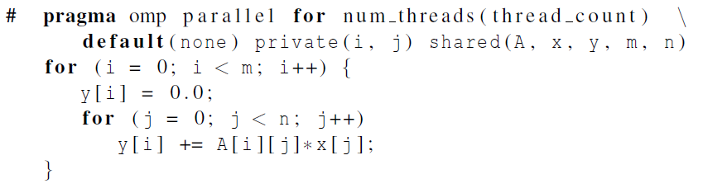

Matrix-vector multiplication
Run-times and efficiencies of matrix-vector multiplication (times are in seconds)
Notes:
Please refer to the detailed slides on cache coherence and thread-safety in Chapter 4.

Slide 89

Thread-Safety
Notes:
Please refer to the detailed slides on cache coherence and thread-safety in Chapter 4.

Slide 90
Concluding Remarks (1)
OpenMP is a standard for programming shared-memory systems.
OpenMP uses both special functions and preprocessor directives called pragmas.
OpenMP programs start multiple threads rather than multiple processes.
Many OpenMP directives can be modified by clauses.

Slide 91
Concluding Remarks (2)
A major problem in the development of shared memory programs is the possibility of race conditions.
OpenMP provides several mechanisms for insuring mutual exclusion in critical sections.
Critical directives
Named critical directives
Atomic directives
Simple locks

Slide 92
Concluding Remarks (3)
By default most systems use a block-partitioning of the iterations in a parallelized for loop.
OpenMP offers a variety of scheduling options.
In OpenMP the scope of a variable is the collection of threads to which the variable is accessible.

Slide 93
Concluding Remarks (4)
A reduction is a computation that repeatedly applies the same reduction operator to a sequence of operands in order to get a single result.

