Slide 1
Directory-Based Cache Coherence

Slide 2
Scalable Shared Memory System
Bus-based MP: good for small multiprocessors, but does not scale
Physical constraints
long wires (low clock frequency), arbitration delay
Protocol constraints
Snoopy/broadcast: bandwidth getting saturated quickly
Contention everywhere:
bus, snooper, memory
How to scale to larger MP?

Slide 3
Scalable Shared Memory System
 |  | Interconnection
 |  | Bus | Point-to-Point
Protocol | Snoopy | Least scalable | More scalable
 | Directory | / | Most scalable

Slide 4
Ways to Scale Bus-Based MP
Approach 1: replace bus with point-to-point interconnection, but keep relying on snooping/broadcast
e.g., AMD Opteron (mesh), IBM Cell (ring), Intel Larrabee (ring)
Still cannot scale to hundreds of processors

Slide 5
Ways to Scale Bus-Based MP
Approach 2: replace broadcast with directory protocol
e.g. SGI Altix system
Leads to distributed shared memory (DSM) multiprocessors
Scaling to tens to hundreds of processors

Slide 6
Directory Protocols

Slide 7
Questions to be considered
Questions:
Which memory a block must be placed in
Where the directory of a particular block can be found
How the directory information is organized
How to handle races in the protocol
How to ensure write propagation and write serialization in a DSM
…….

Slide 8
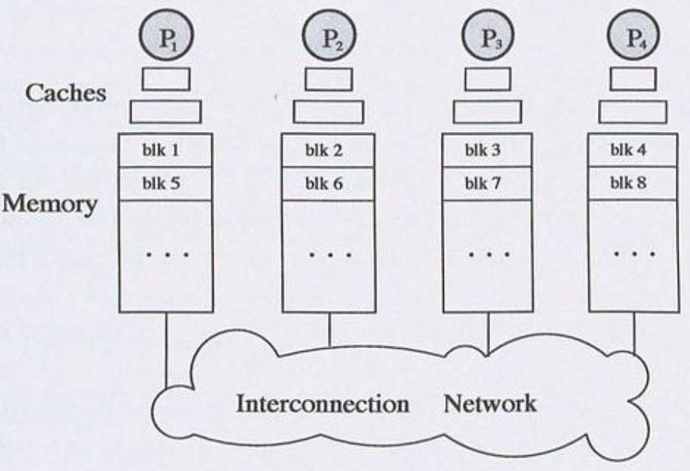
Question 1
Q1: which memory to place a particular block?
One solution: block interleaving
Works against spatial locality of accesses
In most DSMs, block interleaving is not used.

Slide 9
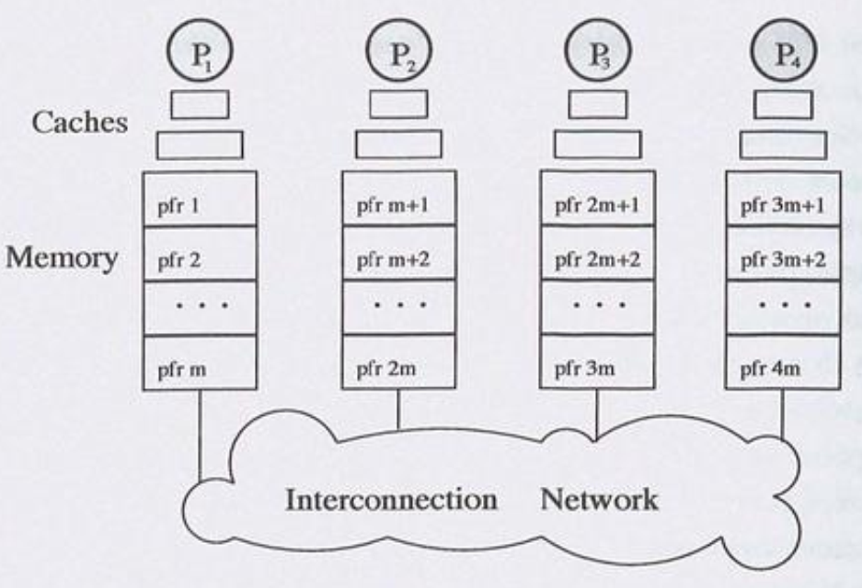
Question 1
Another solution: mapping without interleaving
Consecutive physical page frames (pfr) are mapped to a memory.
OS must be involved in deciding where to allocate
First touch
Processor that first accesses it.
round robin

Slide 10
Finding a Block
A block can only map to a single memory
This memory is referred to as the “home” of the block
The home memory keeps track of which caches may have the copy of a block
in a structure called the “directory”

Slide 11
Question 2
Q2: where is directory stored?
Solution:
Cache-based directory
Kept as a doubly linked list among multiple caches
Maintaining the list is too complicated!
Memory-based directory
Keep directory in the main memory.
Mainstream approach

Slide 12
Centralized Directory
Use a centralized directory to keep track of every block
Which caches have each block
Dirty status of each block
Not scalable
The directory receives requests from all processors
Its central location is far away from most processors

Slide 13
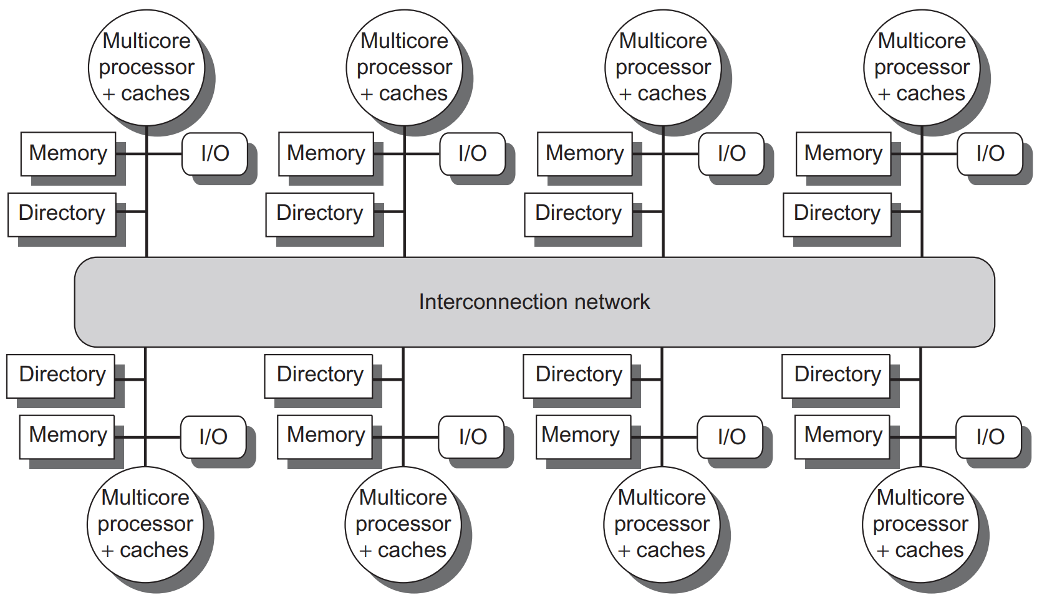
Distributed Directory
The directory is scattered at different nodes.
Keep directory info of a block in home node
Notes:
Figure 5.18 A directory is added to each node to implement cache coherence in a distributed-memory multiprocessor. In this case, a node is shown as a single multicore chip, and the directory information for the associated memory may reside either on or off the multicore. Each directory is responsible for tracking the caches that share the memory addresses of the portion of memory in the node. The coherence mechanism will handle both the maintenance of the directory information and any coherence actions needed within the multicore node.

Slide 14
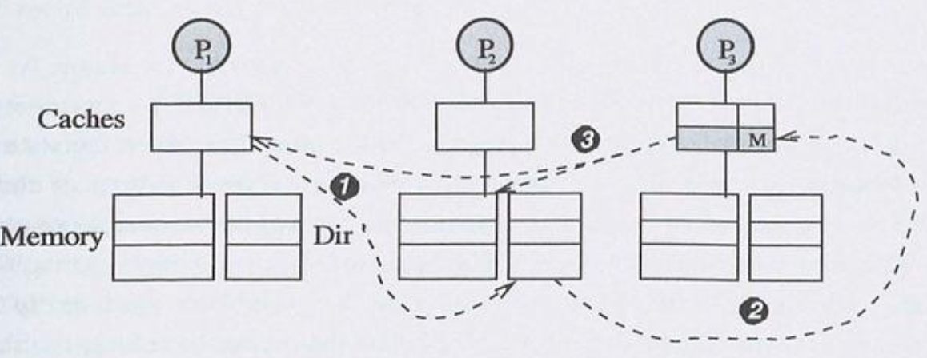
Basic Directory Handling of Load Request
Requestor (P1) sends a Read request to the Home (P2) of the block
The home looks up the directory to find out who has the block and in what state. Then it sends an intervention request to the current owner (P3)
The owner (P3) supplies the block to the requestor (P1) and may update the home as well

Slide 15
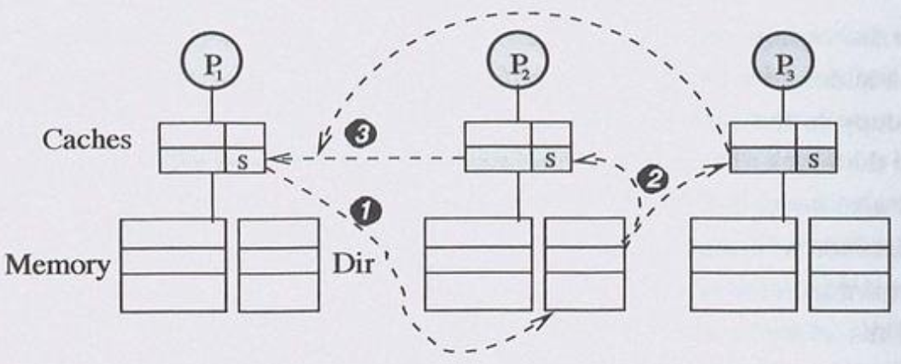
Basic Directory Handling of a Write Req
Requestor (P1) sends a Write request to Home (P2)
Home finds out that P2 and P3 are currently sharers, then it sends invalidation messages to them
Sharers (P2 and P3) reply with Invalidation Acknowledgement to P1

Slide 16
What Info in the Directory?
Information that must be kept at the directory
Which caches are currently sharers or owner
Which state the block is currently cached
Ideally, if the caches support MESI states, then the directory keeps MESI states as well, but:
Transition from Exclusive to Modified in a cache is silent
Hence, the directory cannot tell if a block is cached in Exclusive or Modified state

Slide 17
What Info in the Directory
Hence, the directory may keep 3 states
Shared (S)
The block is cached cleanly, possibly by multiple caches
Uncached (U)
The block is uncached or cached in invalid state.
Exclusive or Modified (EM)
The block is either cached in Exclusive or Modified state in only one cache.

Slide 18
Basic DSM Cache Coherence Protocol

Slide 19
Example
Cache State: MESI
Directory: Full-bit Vector
3 States:
EM (Exclusive or Modified)
S (Shared)
U (Uncached)

Slide 20
Coherence Messages
Issued by requesting processor:
Read:
read request from a processor
ReadX:
read exclusive (write) request from a processor that does not have the block
Upgr:
upgrade request (from Shared to Modified), made by a processor that already has the block

Slide 21
Coherence Messages
Issued by home node:
ReplyD:
home replies with data to requestor
Reply:
home replies not containing data
Inv (Invalidation):
Invalidation request sent by home node to sharers
Int (Intervention):
Intervention request sent by home to owner, asking owner to flush and change to Shared state.

Slide 22
Coherence Messages
Issued by owner of a cache block:
Flush:
owner flushes data to home + requestor
InvAck:
sharer/owner ack Invalidation msg
Ack:
acknowledgement of receipt of non-invalidation msg

Slide 23
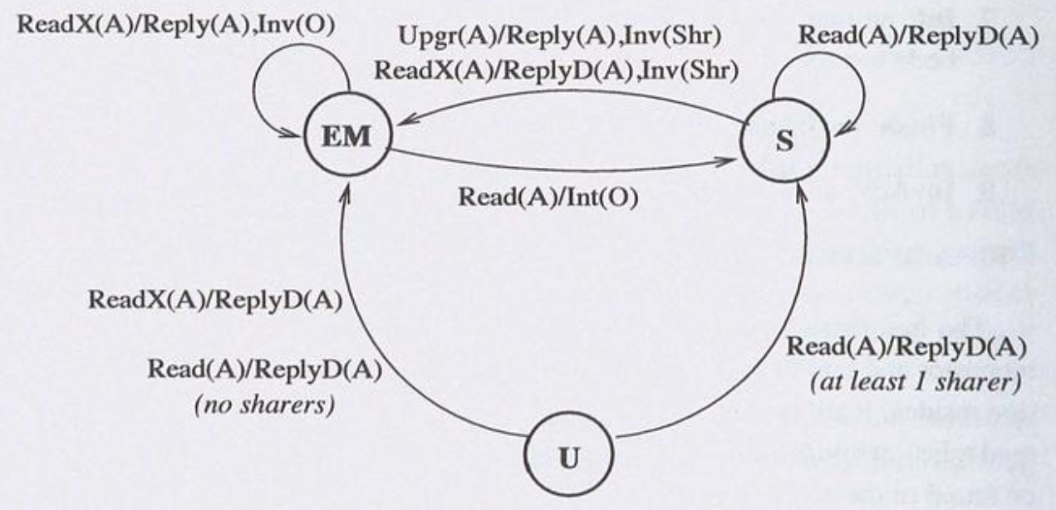
State Transition at the Directory
The invalidation request also contains the ID of the requester, so that the owner knows where to send the block.
The intervention request also contains the ID of the requester, so that the owner knows where to send the block.
Legend:
<Request-type>(<requestor>) / <Reply-type>(<destination>)
O = owner, A = requestor, Shr = sharers
Notes:
EM state:
if a read request is received, the new state will be shared, and an intervention request is sent to the owner of the block.
The intervention request also contains the ID of the requester, so that the owner knows where to send the block.
If a ReadX request is received, the directory needs to send an invalidation to the current owner. The invalidation request also contains the ID of the requester,
So that the owner knows where to send the block.

Slide 24
Full-bit Vector Protocol Visualization
P1
P2
P3
Cache
Dir Ctrl
Dir Ctrl
Dir Ctrl
Main
Memory
Data
State
Sharers
Interconnection Network

Slide 25
Proc Action | State P1 | State P2 | State P3 | Dir State @Home | Network Msg | Hops
R1 | E | - | - | EM, 100 | Read (P1-> H), ReplyD (H->P1) | 2
P1
P2
P3
rd &X
X = 1
E
Dir Ctrl
Dir Ctrl
Dir Ctrl
EM
100
X=1
U
000
Interconnection Network

Slide 26
Proc Action | State P1 | State P2 | State P3 | Dir State @Home | Network Msg | Hops
W1 | M | - | - | EM, 100 | - | 0
P1
P2
P3
wr &X
X=2
X=2
M
X = 1
E
Dir Ctrl
Dir Ctrl
Dir Ctrl
X=1
EM
100
Interconnection Network

Slide 27
Proc Action | State P1 | State P2 | State P3 | Dir State @Home | Network Msg | Hops
R3 | S | - | S | S, 101 | Read (P3->H), Int (H->P1), Flush (P1->H, P3) | 3
P1
P2
P3
Rd &X
S
X = 2
M
X = 2
S
Dir Ctrl
Dir Ctrl
Dir Ctrl
X=2
S
101
X=1
EM
100
Flush
Flush
Read
Int
Interconnection Network

Slide 28
Proc Action | State P1 | State P2 | State P3 | Dir State @Home | Network Msg | Hops
W3 | I | - | M | EM, 001 | Upgr (P3->H), Reply (H->P3) // Inv (H->P1), InvAck(P1->P3) | 3
P1
P2
P3
Wr &X
X = 3
I
X=3
M
X = 2
S
X = 2
S
Dir Ctrl
Dir Ctrl
Dir Ctrl
EM
001
X=2
S
101
Inv
InvAck
Upgr
Interconnection Network
Reply

Slide 29
Proc Action | State P1 | State P2 | State P3 | Dir State @Home | Network Msg | Hops
R1 | S | - | S | S, 101 | Read (P1->H), Int (H->P3), Flush (P3->H, P1) | 3
P1
P2
P3
rd &X
S
X=3
S
X = 2
I
X = 3
M
Dir Ctrl
Dir Ctrl
Dir Ctrl
X=3
S
101
X=2
EM
001
Flush
Int
Interconnection Network

Slide 30
Proc Action | State P1 | State P2 | State P3 | Dir State @Home | Network Msg | Hops
R3 | S | - | S | S, 101 | - | 0
P1
P2
P3
rd &X
X = 3
S
X = 3
S
Dir Ctrl
Dir Ctrl
Dir Ctrl
X=3
S
101
Interconnection Network

Slide 31
Proc Action | State P1 | State P2 | State P3 | Dir State @Home | Network Msg | Hops
R2 | S | S | S | S, 111 | Read(P2->H), ReplyD(H->P2) | 2
P1
P2
P3
rd &X
ReplyD
X = 3
S
X = 3
S
X = 3
S
Read
Dir Ctrl
Dir Ctrl
Dir Ctrl
111
X=3
S
101
Interconnection Network

Slide 32
Summary of State Changes
Proc Action | State P1 | State P2 | State P3 | Dir State @Home | Network Msg | Hops
R1 | E | - | - | EM, 100 | Read (P1-> H), ReplyD (H->P1) | 2
W1 | M | - | - | EM, 100 | - | 0
R3 | S | - | S | S, 101 | Read (P3->H), Int (H->P1), Flush (P1->H, P3) | 3
W3 | I | - | M | EM, 001 | Upgr (P3->H), Reply (H->P3) // Inv (H->P1), InvAck(P1->P3) | 3
R1 | S | - | S | S, 101 | Read (P1->H), Int (H->P3), Flush (P3->H, P1) | 3
R3 | S | - | S | S, 101 | - | 0
R2 | S | S | S | S, 111 | Read(P2->H), ReplyD(H->P2) | 2

Slide 33
Performance Criteria of Directory Schemes
Main criteria:
Traffic on invalidations
Latency of invalidations
Storage overheads
Less important criteria:
Traffic on interventions
Latency of interventions
Invalidation involves multiple sharers vs. intervention involves a single owner
Note:
Invalidation:
Any → Invalid
Intervention:
Exclusive/Modified → Shared

Slide 34
课程内容
参考材料：
Fundamentals of Parallel Computer Architecture. Chapter 11 “Distributed Shared Memory Multiprocessors”.

