Slide 1


More on MPI-related Topics
任课教师：王桢

Slide 2
Pack/Unpack
Serialization: packs data into a contiguous buffer before sending it, and unpacks it from a contiguous buffer after receiving it.
Derived datatypes allow one, in most cases, to avoid explicit packing and unpacking by specifying the layout of the data.

Slide 3
MPI_Pack
MPI_PACK(inbuf, incount, datatype, outbuf, outsize, position, comm)
IN inbuf | input buffer start (choice)
IN incount | number of input data items (non-negative integer)
IN datatype | datatype of each input data item (handle)
OUT outbuf | output buffer start (choice)
IN outsize | output buffer size, in bytes (non-negative integer)
INOUT position | current position in buffer, in bytes (integer)
IN comm | communicator for packed message (handle)
int MPI_Pack(void* inbuf, int incount, MPI_Datatype datatype, void *outbuf, int outsize, int *position, MPI_Comm comm)

Slide 4
MPI_Unpack
MPI_UNPACK(inbuf, insize, position, outbuf, outcount, datatype, comm)
IN inbuf | input buffer start (choice)
IN insize | size of input buffer, in bytes (non-negative integer)
INOUT position | current position in bytes (integer)
OUT outbuf | output buffer start (choice)
IN outcount | number of items to be unpacked (integer)
IN datatype | datatype of each output data item (handle)
IN comm | communicator for packed message (handle)
int MPI_Unpack(void* inbuf, int insize, int *position, void *outbuf, int outcount, MPI_Datatype datatype, MPI_Comm comm)

Slide 5
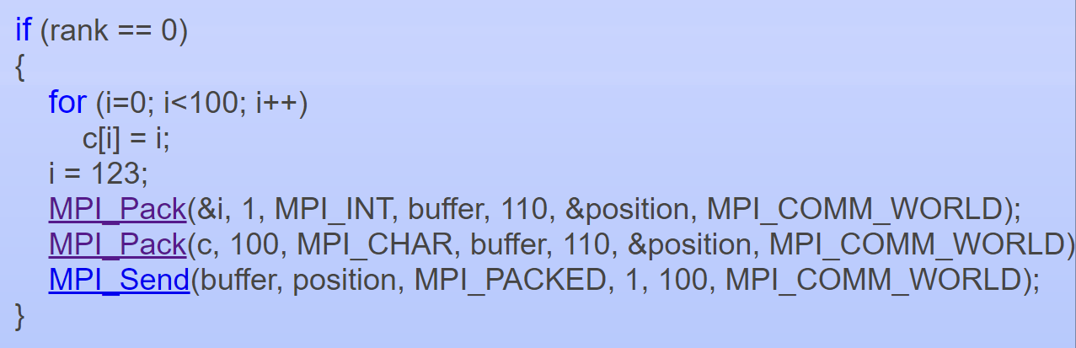
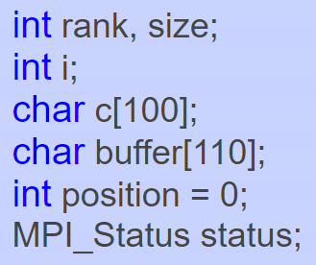
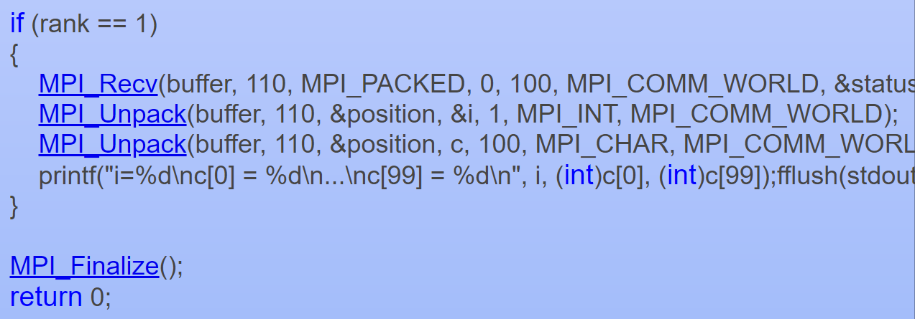
Example

Slide 6
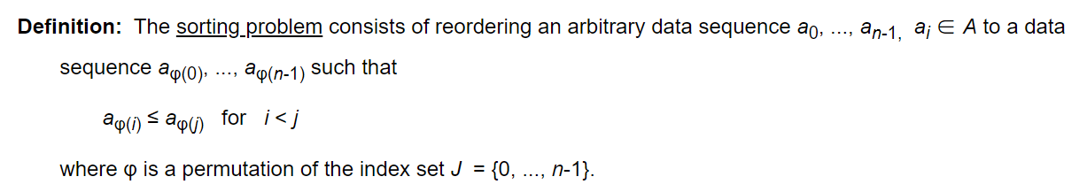
Sorting
Notes:
https://hwlang.de/algorithmen/sortieren/networks/sortieren.htm

Slide 7
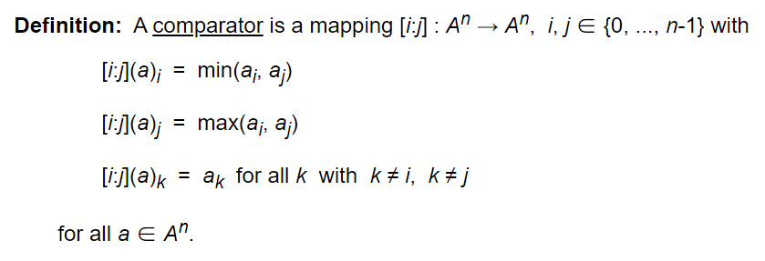
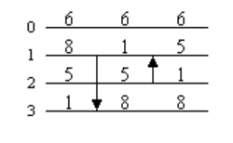
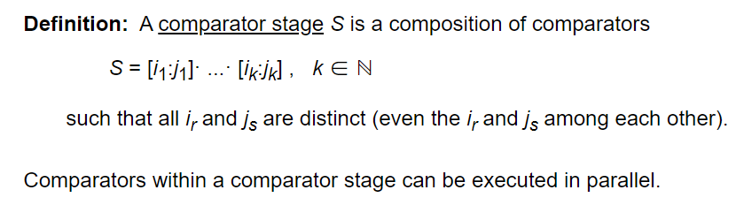
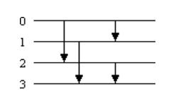
Sorting based on Comparisons
Two stages
Notes:
https://hwlang.de/algorithmen/sortieren/networks/sortieren.htm

Slide 8
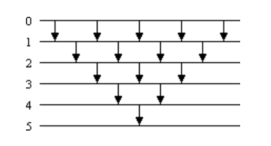
Sorting based on Comparisons
2n-3 = 2*6-3 = 9 stages
Bubblesort consists of O(n) stages with O(n^2) comparators
Easy to prove it is a sorting network☺
Notes:
https://hwlang.de/algorithmen/sortieren/networks/sortieren.htm

Slide 9
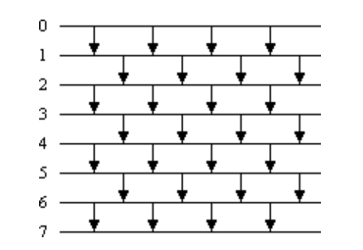
Sorting based on Comparisons
Odd-even transposition sort has O(n) stages with O(n^2) comparators
How to prove it is a sorting network?
Notes:
https://hwlang.de/algorithmen/sortieren/networks/sortieren.htm

Slide 10
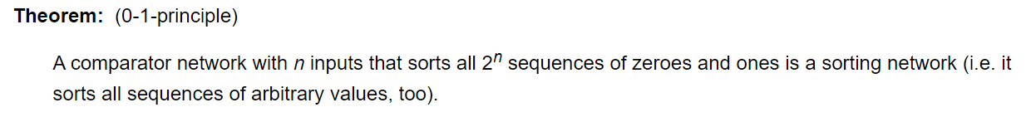
Proof of Odd-Even Transposition Sort
Proposition: The odd-even transposition comparator network for n elements sorts every 0-1-sequence of length n.
Notes:
https://hwlang.de/algorithmen/sortieren/networks/sortieren.htm

Slide 11
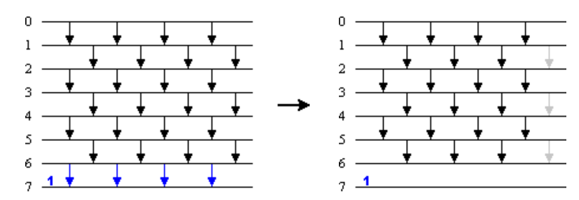
Proof of Odd-Even Transposition Sort
Induction: Let N be an odd-even transposition comparator network for n > 1 elements and let a = a₀, ..., a_{n-1} be a 0-1-sequence.
Case 1: If a_n = 1, then …
Notes:
https://hwlang.de/algorithmen/sortieren/networks/sortieren.htm

Slide 12
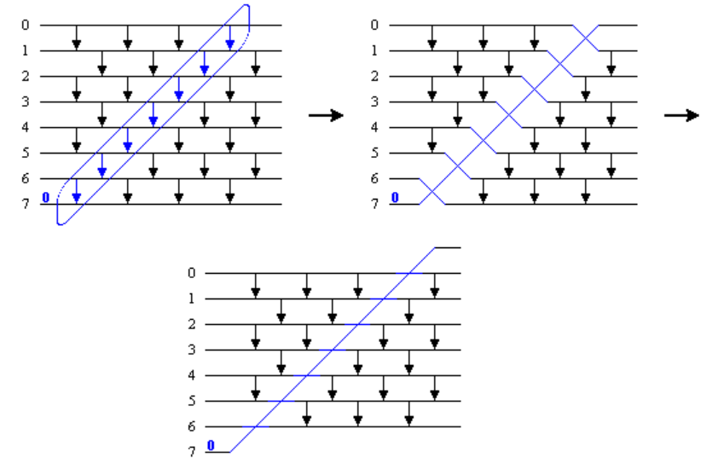
Proof of Odd-Even Transposition Sort
Induction: Let N be an odd-even transposition comparator network for n > 1 elements and let a = a₀, ..., a_{n-1} be a 0-1-sequence.
Case 2: If a_n = 0, then all comparators encountered by this zero perform an exchange (even if no exchange is necessary when the other element is also 0). The corresponding comparators can be replaced by crossing lines. An odd-even transposition comparator network for n-1 elements remains which sorts the sequence a₀, ..., a_{n-2}. The network is crossed by a line that moves a_{n-1} = 0 to its proper position.
Notes:
https://hwlang.de/algorithmen/sortieren/networks/sortieren.htm

