Slide 1
Cache Coherence

Slide 2
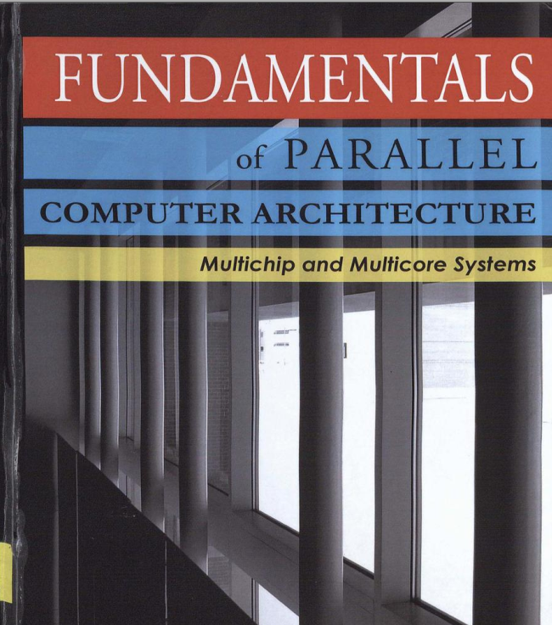
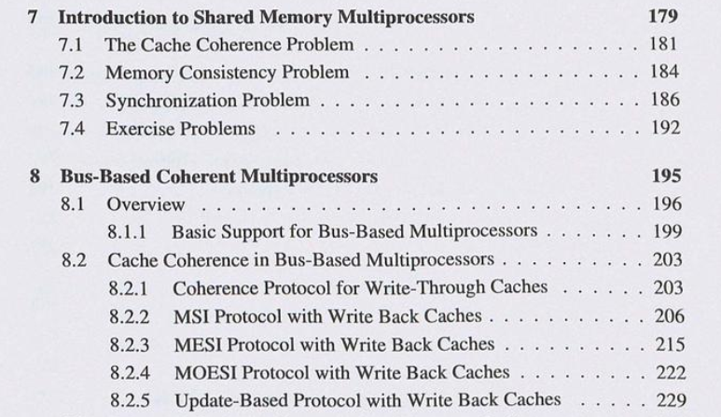
课程内容
参考材料：
Fundamentals of Parallel Computer Architecture. Chapter 7 and 8.

Slide 3



Cache Coherence Problem
Meet 3 months later
Illustration 1:
“You (A) met a friend B yesterday and made an appointment to meet her at a place exactly one month from now.
Later you found out that you have an emergency and cannot possibly meet on the agreed date.
You want to change the appointment to three months from now.”
Constraints
The only mode of communication is mail
In your mail, you can only write the new appointment date and nothing else

Slide 4
Cache Coherence Problem
Question 1: How can you ensure that A will meet B?
Principle 1: When a processor performs a write operation on a memory address, the write must be propagated to all other processors
The write propagation principle

Slide 5
Cache Coherence Problem
Meet 3 months later
Meet 2 months later
Illustration 2:
You have placed a mail on the mailbox telling B to change the meeting month to 3 months from now.
Unfortunately, you find out again that you cannot meet 3 months from now
You need to change it to 2 months from now.

Slide 6
Cache Coherence Problem
Question 2: How can you ensure that A will meet B two months from now?
Principle 2: When there are two writes to the same memory address, the order in which the writes are seen by all processors must be the same.
The write serialization principle

Slide 7
Will This Parallel Code Work Correctly?
sum = 0;
begin parallel
for (i=0; i<2; i++) {
lock(id, myLock);
sum = sum + a[i];
unlock(id, myLock);
end parallel
Print sum;
Suppose a[0] = 3 and a[1] = 7
P₁
…
P₂
P_{n}
Cache
Cache
Cache
Memory
Will it print sum = 10?
Notes:
No, assuming write-back cache
No problem if uncachable
The problem persists with a WT cache
Besides of this, I/O can create coherency problem, too

Slide 8
Cache Coherence Problem Illustration
P1
P2
P3
Cache
Bus
Mem Ctrl
Main Memory
sum=0

Slide 9
Cache Coherence Problem Illustration
P1
P2
P3
rd &sum
sum =0
V
Mem Ctrl
sum=0
rd - read

Slide 10
Cache Coherence Problem Illustration
P1
P2
P3
wr sum
(sum = 3)
sum=0
3
V
D
Mem Ctrl
wr – Write
D – Dirty
V - Valid
sum=0

Slide 11
Cache Coherence Problem Illustration
P1
P2
P3
rd &sum
sum=3
D
sum =0
V
Mem Ctrl
sum=0

Slide 12
Cache Coherence Problem Illustration
P1
P2
P3
wr &sum
(sum = 7)
sum=3
D
sum=0
7
V
D
Mem Ctrl
sum=0

Slide 13
Cache Coherence Problem Illustration
P1
P2
P3
rd &sum
print sum=3
sum=3
D
sum=7
D
Mem Ctrl
sum=0

Slide 14
Questions
Do P1 and P2 see the same value of sum at the end?
How is the problem affected by cache organization?
For example: What happens if we use write-through caches instead?
What if we do not have caches, or sum is uncachable. Will it work?

Slide 15
Main Observations
P1 - Write propagation: values written in one cache must be propagated to other caches
P2 - Write serialization: values written successively on the same data must be seen in the same order by all caches
Need a protocol to ensure both properties
Called cache coherence protocol
Cache coherence protocol can be implemented in hardware or software
Overheads of software implementations are often very high

Slide 16
Cache Coherence Problem
What do we do about it?
Organize the mem hierarchy to make it go away
Detect and take actions to eliminate the problem
Cache coherence protocols
Snooping
Each core tracks sharing status of each block
Directory based
Sharing status of each block kept in one location

Slide 17
Snooping-Based Coherence Protocol

Slide 18
Basic Idea: Snooping-Based Coherence
Processor-Side:
Add a snooper to each node to snoop all bus transactions
Caches (via cache controllers) react by changing cache line states
Memory-Side:
Memory controller (MC) also snoops bus transactions
MC reacts by deciding whether to read line from memory and return it

Slide 19
Coherence Correctness Requirements
Write propagation: on a snooped write,
Update: snooped value updates local copy
Invalidate: local copy invalidated to force future read to re-fetch the line
Write serialization
Bus provides global ordering of writes
Each snooper reacts in bus order

Slide 20
Recall: CPU读Cache
CPU读Cache
Read through
即直接从内存中读取数据；
Read allocate
先把数据读取到Cache中，再从Cache中读数据

Slide 21
Recall: CPU写Cache
若cache hit命中，有两种处理方式：
Write-through（直写模式）
在数据更新时，把数据同时写入Cache和内存
优点是操作简单；
缺点是因为数据修改需要同时写入存储，数据写入速度较慢
Write-back（回写模式）
在数据更新时只写入缓存Cache，只在数据被替换出缓存时，被修改的缓存数据才会被写到内存
优点是数据写入速度快，因为不需要写内存
缺点是一旦更新后的数据未被写入后端存储时出现系统掉电的情况，数据将无法找回
Notes:
1. 若hit命中，有两种处理方式：
Write-through: write is done synchronously both to the cache and to the backing store。Write-through（直写模式）在数据更新时，把数据同时写入Cache和后端存储。此模式的优点是操作简单；缺点是因为数据修改需要同时写入存储，数据写入速度较慢。
Write-back (also called write-behind): initially, writing is done only to the cache. The write to the backing store is postponed until the cache blocks containing the data are about to be modified/replaced by new content。Write-back（回写模式）在数据更新时只写入缓存Cache。只在数据被替换出缓存时，被修改的缓存数据才会被写到后端存储（即先把数据写到Cache中，再通过flush方式写入到内存中）。此模式的优点是数据写入速度快，因为不需要写存储；缺点是一旦更新后的数据未被写入存储时出现系统掉电的情况，数据将无法找回。
2. 若miss，有两种处理方式：
Write allocate (also called fetch on write): data at the missed-write location is loaded to cache, followed by a write-hit operation. In this approach, write misses are similar to read misses.。Write allocate：先把要写的数据载入到Cache中，写Cache，然后再通过flush方式写入到内存中； 写缺失操作与读缺失操作类似。
No-write allocate (also called write-no-allocate or write around): data at the missed-write location is not loaded to cache, and is written directly to the backing store. In this approach, only the reads are being cached。No write allocate：并不将写入位置读入缓存，直接把要写的数据写入到内存中。这种方式下，只有读操作会被缓存。

Slide 22
Recall: CPU写Cache
若cache miss，有两种处理方式：
Write allocate（写分配模式）
把要写的地址所在的块先从内存调入cache中，然后写cache
Write no-allocate (也称为no-write allocate，非写分配模式)
并不将写入位置的数据读入缓存，直接把要写的数据写入到内存中

Slide 23
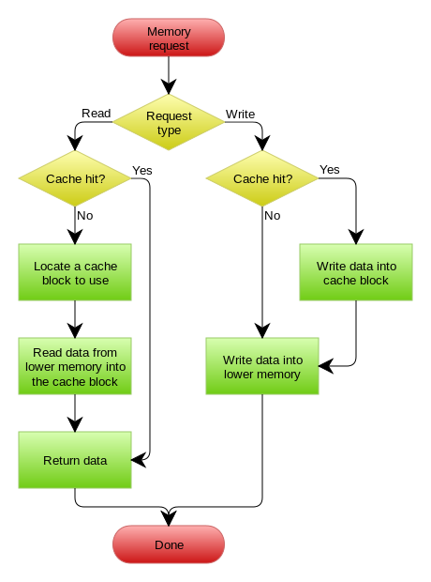
Write-through +
Write no-allocate
Read
allocate
Write
through
Write
no-allocate

Slide 24
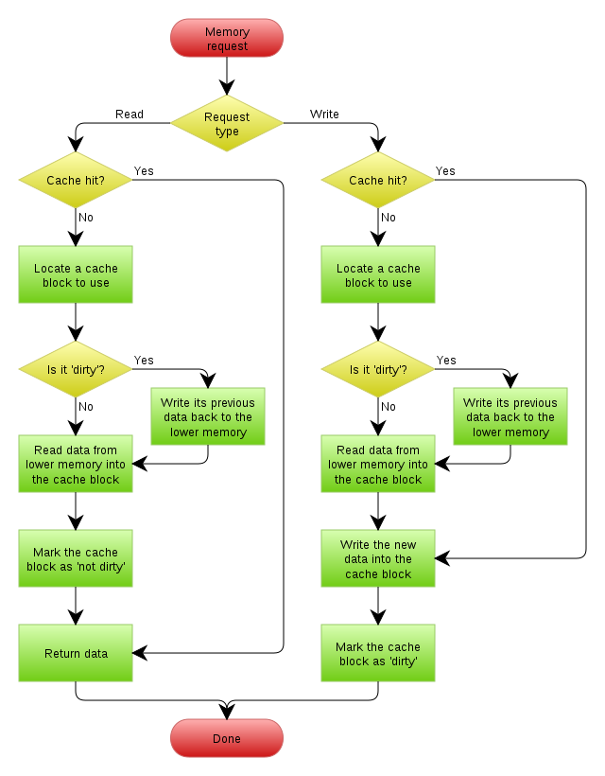
Write-back +
Write allocate
Write
back
Read
allocate
Write
allocate

Slide 25
Coherence with Write-through Caches
sum = 0;
begin parallel
for (i=0; i<2; i++) {
lock(id, myLock);
sum = sum + a[i];
unlock(id, myLock);
end parallel
Print sum;
Suppose a[0] = 3 and a[1] = 7
P₀
P₁
P_{n}
= snooper
Bus-based SMP implementation choice in the mid 80s

Slide 26
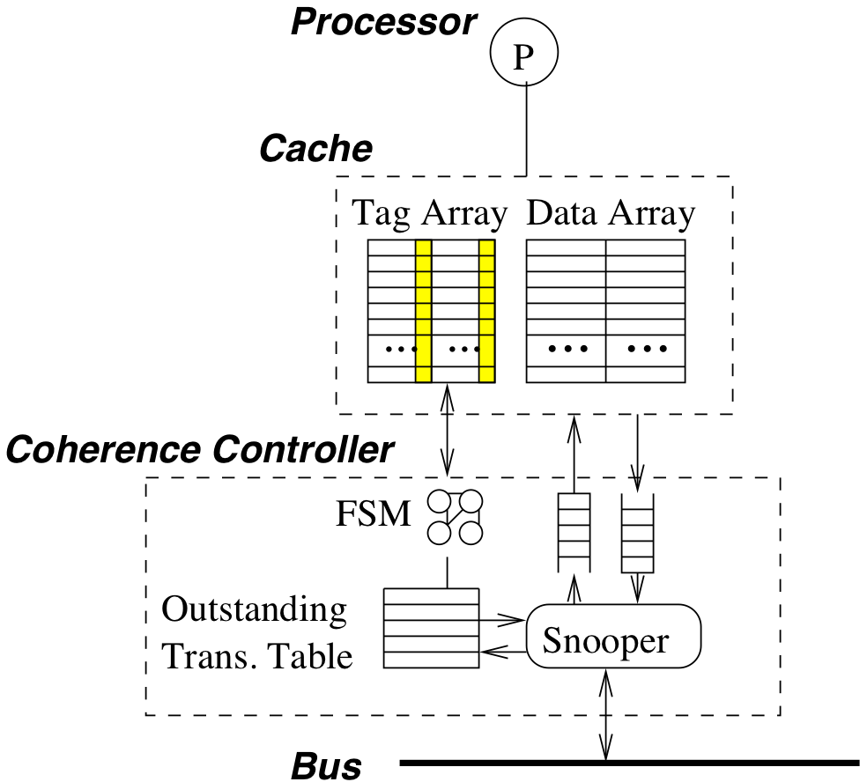
Snooper Architecture
Coherence controller is added
Snooper snoops all bus transactions
If a bus transaction is relevant, an action is taken
Finite State Machine (FSM) determines the new state
Outstanding transaction table keeps transactions that are pending (not completed yet)

Slide 27
Coherence Protocol for Write-Through Caches

Slide 28
Coherence Protocol for Write-Through Caches
The simplest cache coherence protocol
Assume a single level cache
which may get requests from the processor side, as well as from the bus side as snooped by the snooper
P₀
P₁
P_{n}
cache
cache
cache
memory

Slide 29
Coherence Protocol for Write-Through Caches
Processor requests to the cache include:
PrRd: processor-side request to read a cache block
PrWr: processor-side request to write a cache block
Snooped requests to the cache include:
BusRd: snooped request that indicates there is a read request to a block made by another processor.
BusWr: snooped request that indicates there is a write request to a block made by another processor.

Slide 30
Coherence Protocol for Write-Through Caches
Cache States
Valid (V): the cache block is valid and clean
the cached value is the same with that in the lower level memory component
Invalid (I): the cache block is invalid
Accesses to this cache block will generate cache misses
There is no dirty state in the write-through cache
since all writes are written through to the lower level.

Slide 31
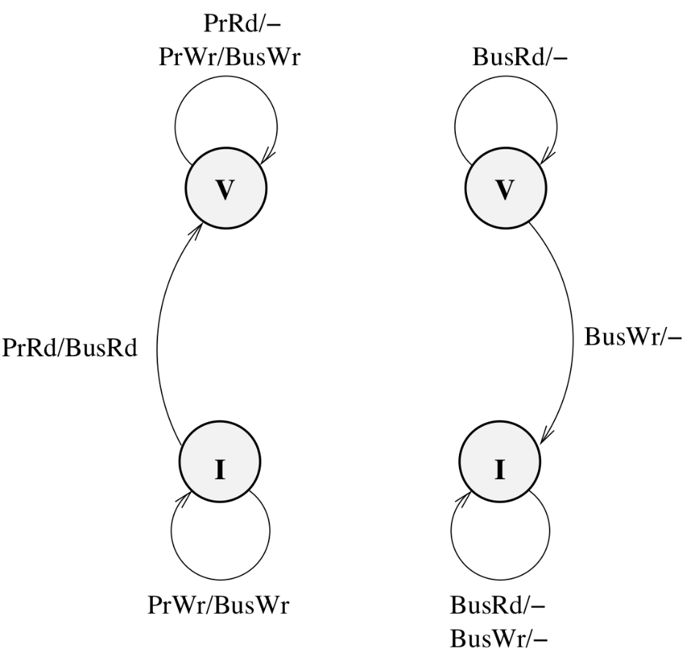
Assume that the caches use:
Write no-allocate policy
Write invalidate cache coherence policy
Notation:
Triggering event / action (or response taken as a result of the event).
since the cache uses a write no-allocate policy, the write is propagated down to the lower level using BusWr without fetching the block into the cache. Therefore, the state remains invalid.
Response to
processor-side requests
response to
snooper-side requests
Notes:
那么在写失效（write miss）时，即所要写的地址不在cache中，该怎么办呢？一种办法就是把要写的内容直接写回main memory，这种办法叫做no write allocate policy；另一种办法就是把要写的地址所在的块先从main memory调入cache中，然后写cache，这种办法叫做write allocate policy。
When there is a processor write request, since the cache uses a write no-allocate policy, the write is propagated down to the lower level using the BusWr transaction without fetching the block into the cache. Therefore, the state remains invalid.

Slide 32
State Transition Diagram
Key points: write invalidates all other caches
Therefore, we have:
Modified line: exists as Valid in only 1 cache
Clean line: exists as Valid in at least 1 cache
Invalid state represents invalidated line or not present in the cache

Slide 33
Problem with Write-Through Caches
High bandwidth requirement
due to each write causing a write propagation
What if we use write-back caches?
Write hits stop at the cache → eliminate most bus write transactions

Slide 34
MSI Protocol with Write-back Caches

Slide 35
MSI Writeback Invalidate Protocol
States
Invalid (I)
Shared (S): one or more copies, and memory copy is up-to-date
the cache block is valid, potentially shared by multiple processors
Modified (M): only one copy
the cache block is valid in only one cache
the value is (likely) different from the one in the main memory

Slide 36
Modified vs. Dirty
Modified state extends dirty state in a write-back cache
Modified state implies exclusive ownership
Dirty:
(1) cached value is different from the value in main memory
Modified:
(1) cached value is different from the value in main memory
(2) cached only in one location

Slide 37
MSI Writeback Invalidate Protocol
Processor-side Requests:
PrRd (read)
processor-side request to read a cache block
PrWr (write)
processor-side request to write to a cache block

Slide 38
MSI Writeback Invalidate Protocol
Bus-side Requests:
BusRd: snooped request that indicates there is a read request to a cache block made by another processor
BusRdX: snooped request that indicates there is a read exclusive (write) request to a cache block made by another processor (instead of BusWr)
Flush: snooped request that indicates that an entire cache block is written back to the main memory by another processor

Slide 39
Basic MSI Writeback Invalidate Protocol
Actions
Update state
perform bus transaction
flush value onto bus
Invalidation: Any → Invalid
Intervention: Modified → Shared

Slide 40
Processor Initiated Transactions
PrRd/-
PrWr/-
PrRd/-
PrWr/BusRdX
M
S
PrWr/BusRdX
PrRd/BusRd
I

Slide 41
Bus Initiated Transactions
BusRd/-
BusRd/Flush
M
S
BusRdX/Flush
BusRdX/-
I
BusRd/-
BusRdX/-
Notes:
If the cache block is in the Modified state, the copy in the cache is the only valid copy in the entire system. Therefore, when a BusRd transaction is snooped, indicating that a processor suffered a read miss and trying to fetch the block, the processor that has the modified copy of the block must respond by flushing the block on the bus.
After flushing, the resulting state is the shared state. The cache that issues the BusRd request must pick up the flushed block as a reply to its request and place it in its cache in a shared state. In addition, the main memory must also snoop the flushed block and update the corresponding block in the main memory. This is due to a requirement called clean sharing, in which if a block is shared in multiple caches, its value has to be clean, i.e., the same with the one in the main memory.
If a BusRdx transaction is snooped, the processor that has the modified copy of the block must respond by flushing the block on the bus, and then transitioning into the Invalidate state. This flush may sound redundant since the processor that issues a BusRdx is going to overwrite the cache block. So why flush the block that is going to be overwritten? The answer is that a typical cache block is large, containing multiple bytes or words. The bytes that have been modified are not necessarily the same bytes that another processor wants to overwrite or modify. Another processor may want to write to other bytes, but read from the bytes that have been modified. Therefore, flushing the entire block is a correctness requirement, and the processor that issues the BusRdX must pick the block up and place it in the cache prior to writing to it.

Slide 42
Question 1
What are the actions at memory controller (MC)?
Snooped a BusRd: read and supply data
Snooped a BusRdX: read and supply data
Snooped a Flush: update main memory
P₀
P₁
P_{n}
cache
cache
cache
memory controller (MC)
memory

Slide 43
Question 2
Q: Upon snooping BusRdX, if a cache line’s state is M, why do we need to Flush the cache line?
This flush may sound redundant
since the processor that issues a BusRdX is going to overwrite the cache block
BusRdX/Flush
M
I

Slide 44
Question 2
Answer:
a typical cache block is large, containing multiple bytes
The bytes that have been modified are not necessarily the same bytes that another processor wants to overwrite
Another processor may want to write to other bytes, but read from the bytes that have been modified.
Flushing the entire block is a correctness requirement
The processor that issues the BusRdX must pick the block up and place it in the cache prior to writing to it.

Slide 45
MSI Visualization
P1
P2
P3
Cache
Snooper
Snooper
Snooper
Bus
Mem Ctrl
Main Memory
X=1

Slide 46
MSI Visualization
P1
P2
P3
rd &X
BusRd
Snooper
Snooper
Snooper
Mem Ctrl
X=1

Slide 47
Proc Request | State P1 | State P2 | State P3 | Bus Request | Data Supplier
R1 | S | - | - | BusRd | Mem
P1
P2
P3
X=1
S
Snooper
Snooper
Snooper
Mem Ctrl
X=1
Notes:
On a read from Processor 1, a BusRd is posted, the main memory responds with the block; Processor 1 gets the block and stores it in its cache with a shared state.

Slide 48
Proc Request | State P1 | State P2 | State P3 | Bus Request | Data Supplier
W1 | M | - | - | BusRdX | Mem
P1
P2
P3
wr &X
(X=2)
X=1
2
S
M
Snooper
Snooper
Snooper
BusRdX
Note that the main memory snoops BusRdX and responds with the block.
Here the memory controller does not know whether supplying the data is necessary or not
The processor can ignore the reply from the memory controller.
Mem Ctrl
X=1
Notes:
On a write from Processor 1, it does not know if other caches have the same block or not, so a BusRdX is posted on the bus to invalidate the same block in other caches. The main memory snoops the BusRdX and responds with the block. Note that here the memory controller does not know whether supplying the data is necessary or not, since it cannot distinguish between the case in which Processor 1 already has the block but needs to upgrade its state to modified, or it does not have a block and needs to fetch it from memory.
After posting the BusRdX on the bus, effectively, the write has been serialized, so the cache state can safely transition to modified, and the block can be written to. Note that, at some time later, the reply from memory comes. The processor can either ignore the reply, or put it in its cache in the Modified state while delaying its write until it has finished doing so.

Slide 49
MSI Visualization
P1
P2
P3
rd &X
X=2
M
Snooper
Snooper
Snooper
BusRd
Mem Ctrl
Note: the memory controller also attempts to fetch the block from the main memory because it does not know if eventually a cache will supply the data or not.
X=1
Notes:
When Processor 3 makes a read request, a BusRd is posted on the bus. Processor 1’s snooper picks it up, checks its cache tag, and finds that it has the block in modified state. This means that Processor 1 has the latest (and the only valid) copy and flushes it in response to the snooped request. The block state transitions to shared after that. In the mean time, the memory controller also attempts to fetch the block from the main memory because it does not know if eventually a cache will supply the data or not. Processor 3 snoops the flush, and by matching the address of the block being flushed with its outstanding read transaction, it knows that the flushed block should be treated as the reply to its read request. So the block is picked up and stored in its cache in the shared state.
The main memory which has been trying to fetch the block from memory will also snoop the flushed block, pick it up, cancel its memory fetch, and overwrite the stale copy of the block in memory.

Slide 50
Proc Request | State P1 | State P2 | State P3 | Bus Request | Data Supplier
R3 | S | - | S | BusRd | P1 cache
P1
P2
P3
X=2
M
S
X=2
S
Snooper
Snooper
Snooper
Flush
Mem Ctrl
Note: The main memory will also snoop the flushed block, pick it up, cancel its memory fetch, and overwrite the stale copy of the block in memory.
X=1
2
Cancel memory read
Notes:
The main memory which has been trying to fetch the block from memory will also snoop the flushed block, pick it up, cancel its memory fetch, and overwrite the stale copy of the block in memory.

Slide 51
Question 3
Is there a correctness problem if the main memory has supplied a stale copy before the owner has a chance to flush its block?
Answer: this cannot be allowed to occur.
Solution: to give enough time for all processors to finish snooping and responding to a bus request, before the memory controller replies with a block.

Slide 52
Proc Request | State P1 | State P2 | State P3 | Bus Request | Data Supplier
W3 | I | - | M | BusRdX | Mem
P1
P2
P3
wr &X
X=3
X=2
S
I
X=2
3
S
M
Snooper
Snooper
Snooper
BusRdX
Note: the main memory snoops BusRdX and responds with the block.
Here the memory controller does not know whether supplying the data is necessary or not
The processor can ignore the reply from the memory controller.
Mem Ctrl
X=2

Slide 53
Proc Request | State P1 | State P2 | State P3 | Bus Request | Data Supplier
R1 | S | - | S | BusRd | P3 cache
P1
P2
P3
rd &X
3
S
X=2
I
X=3
M
S
Snooper
Snooper
Snooper
BusRd
Flush
Mem Ctrl
Coherence
Miss
Update memory as well
X=2
3
Notes:
When P1 attempts to read the block, it suffers a cache miss as a result of the earlier invalidation that it received. This type of miss is referred to as a coherence miss because it arises due to coherence actions (invalidations). So P1 posts a BusRd and P3 responds by flushing its cache block and transitions its state to shared. The flushed block also updates the main memory copy; as a result, the cache blocks are now clean.

Slide 54
Proc Request | State P1 | State P2 | State P3 | Bus Request | Data Supplier
R3 | S | - | S | - | -
P1
P2
P3
rd &X
X=3
S
X=3
S
Snooper
Snooper
Snooper
Mem Ctrl
X=3

Slide 55
Proc Request | State P1 | State P2 | State P3 | Bus Request | Data Supplier
R2 | S | S | S | BusRd | Mem
P1
P2
P3
rd &X
X=3
S
X=3
S
X=3
S
Snooper
Snooper
Snooper
BusRd
Mem Ctrl
Question:
should P1 or P3 flush the block to supply the block?
X=3

Slide 56
Discussion
Although not required for correctness, P1 or P3 can definitely do that
In fact, in MESI protocol, cache-to-cache transfer is employed
BusRd/-
S

Slide 57
Summary of State Changes
Proc Request | State P1 | State P2 | State P3 | Bus Request | Data Supplier
R1 | S | - | - | BusRd | Mem
W1 | M | - | - | BusRdX | Mem
R3 | S | - | S | BusRd | P1 cache
W3 | I | - | M | BusRdX | Mem
R1 | S | - | S | BusRd | P3 cache
R3 | S | - | S | - | -
R2 | S | S | S | BusRd | Mem

Slide 58
MESI Protocol with Write-back Caches

Slide 59
Problem with MSI protocol
Each read-write sequence incurs two bus transactions
BusRd + BusRdX
regardless of whether the block is stored in only one cache or not.
Penalizing programs that have little data sharing is unacceptable!
Sequential program (no data sharing)
Highly optimized parallel program (little data sharing)

Slide 60
MESI (4-state) Invalidation Protocol
MESI adds an exclusive state
to distinguish between shared by multiple caches vs. shared by one cache (exclusively cached)
Four states:
Invalid
modified (dirty)
shared (two or more caches may have copies)
Exclusive: (only this cache has clean copy, same value as in memory)

Slide 61
Question
How can we check whether there are existing copies in other caches?
To achieve that, a new bus line can be added.
Called “COPIES-EXIST” or “C” bus line
High value: when there is at least one cache that asserts (声明）it.
Low value: when there are no cached copies

Slide 62
MESI (4-state) Invalidation Protocol
Bus-side Requests:
BusRd:
snooped request that indicates there is a read request to a cache block made by another processor
BusRdX:
snooped request that indicates there is a read exclusive (write) request to a cache block made by another processor which doesn’t have the block
BusUpgr:
snooped request that indicates that there is a write request to a cache block that another processor which already has in its cache

Slide 63
BusRdx vs. BusUpgr
BusUpgr:
If a cache already has a valid copy, and only needs to upgrade its value, it posts a BusUpgr.
The memory controller ignores the BusUpgr.
BusRdx:
If a cache does not have the block in the cache and needs the memory (or another cache) to supply it, it posts a BusRdx.
The memory controller fetches the block when it snoops a BusRdx.

Slide 64
MESI (4-state) Invalidation Protocol
Bus-side Requests:
Flush:
snooped request that indicates that an entire cache block is written back to the main memory by another processor
FlushOpt
Snooped request that indicates that an entire cache block is posted on the bus in order to supply it to another processor.

Slide 65
Flush vs. FlushOpt
Flush: mandatory, needed for write propagation
FlushOpt: optional, not required for correctness.
Implemented as a performance enhancing feature that can be removed without impacting correctness
Based on a premise that obtaining data from another cache is faster than from the memory
Also referred to as “cache-to-cache transfer”

Slide 66
Processor Initiated Transactions
PrRd/-
PrWr/-
PrRd/-
PrWr/-
M
E
PrWr/BusRdX
PrRd/BusRd(!C)
PrWr/BusUpgr
S
I
PrRd/BusRd(C)
PrRd/-
!C: no copies exist
C: other copies exist

Slide 67
Bus Initiated Transactions
M
BusRdX/Flush
E
BusRd/FlushOpt
BusRd/Flush
BusRdX/FlushOpt
S
I
BusRdX/FlushOpt
BusUpgr/-
BusRd/-
BusRdX/-
BusUpgr/-
BusRd/FlushOpt
Note: FlushOpt = cache-to-cache transfer

Slide 68
MESI Visualization
P1
P2
P3
Cache
Snooper
Snooper
Snooper
Bus
Mem Ctrl
Main Memory
X=1

Slide 69
MESI Visualization
P1
P2
P3
rd &X
BusRd
Snooper
Snooper
Snooper
Mem Ctrl
X=1

Slide 70
Proc Action | State P1 | State P2 | State P3 | Bus Action | Data From
R1 | E | - | - | BusRd | Mem
P1
P2
P3
X=1
E
Snooper
Snooper
Snooper
Mem Ctrl
X=1

Slide 71
Proc Action | State P1 | State P2 | State P3 | Bus Action | Data From
W1 | M | - | - | - | -
P1
P2
P3
wr &X
(X=2)
X=1
E
2
M
Snooper
Snooper
Snooper
Mem Ctrl
No bus transactions!
X=1

Slide 72
MESI Visualization
P1
P2
P3
rd &X
X=2
M
Snooper
Snooper
Snooper
BusRd
Mem Ctrl
X=1

Slide 73
Proc Action | State P1 | State P2 | State P3 | Bus Action | Data From
R3 | S | - | S | BusRd/Flush | P1’s cache
P1
P2
P3
X=2
M
S
X=2
S
Snooper
Snooper
Snooper
Flush
Mem Ctrl
X=1
2

Slide 74
Proc Action | State P1 | State P2 | State P3 | Bus Action | Data From
W3 | I | - | M | BusUpgr | -
P1
P2
P3
wr &X
X=3
X=2
S
I
X=2
3
S
M
Snooper
Snooper
Snooper
BusUpgr
Mem Ctrl
Note: BusUpgr instead
of BusRdX. Mem Ctrl
knows it can ignore the
request
X=2

Slide 75
Proc Action | State P1 | State P2 | State P3 | Bus Action | Data From
R1 | S | - | S | BusRd/Flush | P3’s cache
P1
P2
P3
rd &X
X=2
3
I
S
X=3
M
S
Snooper
Snooper
Flush
Snooper
BusRd
Mem Ctrl
X=2
3

Slide 76
Proc Action | State P1 | State P2 | State P3 | Bus Action | Data From
R3 | S | - | S | - | -
P1
P2
P3
rd &X
X=3
S
X=3
S
Snooper
Snooper
Snooper
Mem Ctrl
X=3

Slide 77
Proc Action | State P1 | State P2 | State P3 | Bus Action | Data From
R2 | S | S | S | BusRd/FlushOpt | P1/P3’s cache
P1
P2
P3
rd &X
X=3
S
X=3
S
X=3
S
Snooper
Snooper
Snooper
FlushOpt
BusRd
Mem Ctrl
Referred to as
Cache-to-cache transfer
in Illinois MESI protocol
X=3

Slide 78
Summary of State Changes
Proc Action | State P1 | State P2 | State P3 | Bus Action | Data From
R1 | E | - | - | BusRd | Mem
W1 | M | - | - | - | -
R3 | S | - | S | BusRd/Flush | P1’s cache
W3 | I | - | M | BusUpgr | -
R1 | S | - | S | BusRd/Flush | P3’s cache
R3 | S | - | S | - | -
R2 | S | S | S | BusRd/FlushOpt | P1/P3’s cache

Slide 79
Summary
Cache Coherence Problem
Snooping-Based Coherence Protocol
Coherence Protocol for Write-Through Caches
MSI Protocol with Write-back Caches
MESI Protocol with Write-back Caches

