Slide 1

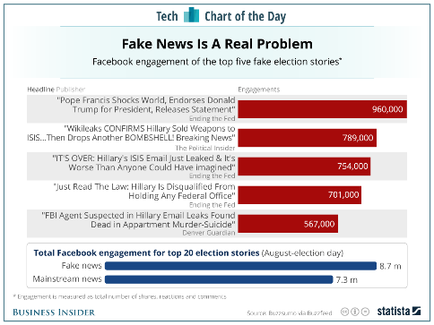
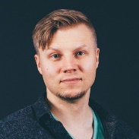

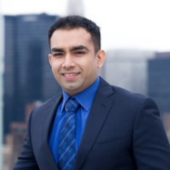
“In Search of the Real Fake News”
Introduction to Data Science
2020/2021 Period I
A text classification system for predicting whether a news article is real or fake
Final Project
2020 October 14
Jaakko
Kuurne
Teemu
Pöyhönen
Dean
Rahman

Slide 2

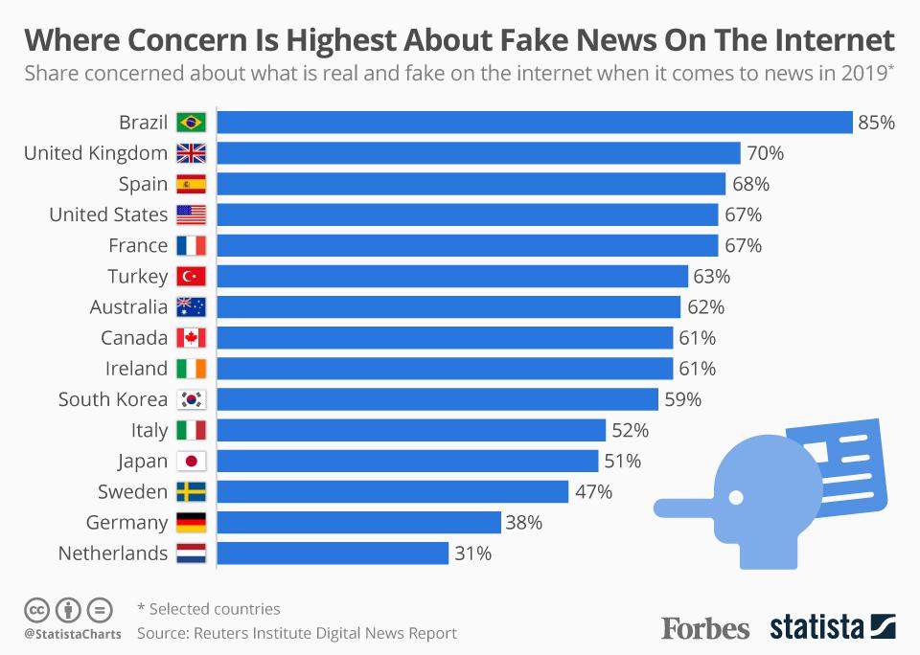
“As Fake News Spreads Lies, More Readers Shrug at the Truth”-- New York Times
To understand the importance of fake news in the upcoming US and worldwide elections,
we have to look only at what happened in the last US Presidential election
2016, US
2019, Worldwide
The problem has gotten worse and it is far from a US-only problem

Slide 3
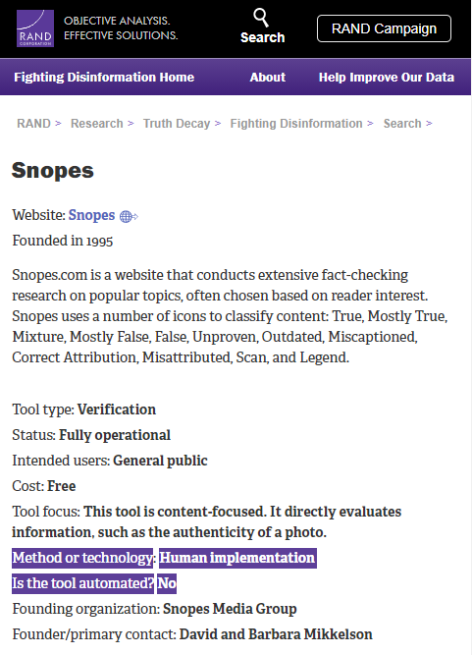
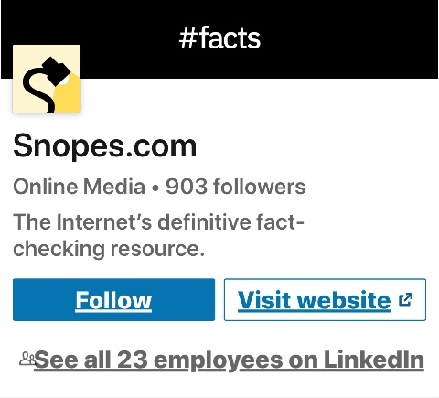
The disinformation is manually detected by human truth warriors
but they are surprisingly few in number for such a critical problem
There are fewer than 40 US truth warrior organizations,
most operating WITHOUT automation, with only 3-23 human employees
Notes:
Each and every one of you can create fake news, I can create fake news In a country like the US there are 200 million+ people who can unintentionally spread fake news by sharing the wrong post
This gigantic monstrosity is countered by only 40 truth warrior organizations with each 3-25 employees Moreover, with even this few people, our research shows that ALL these organization are still only reading the articles one by one

Slide 4
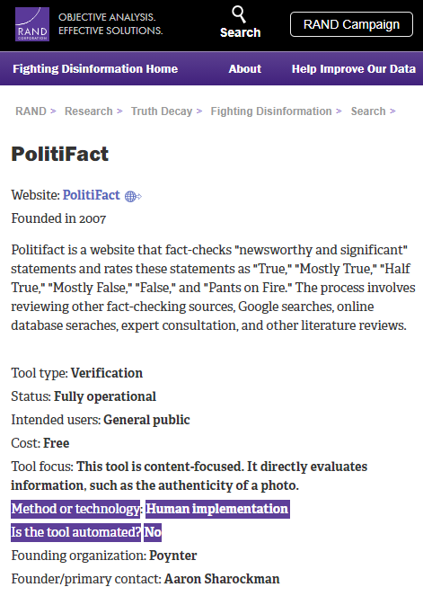
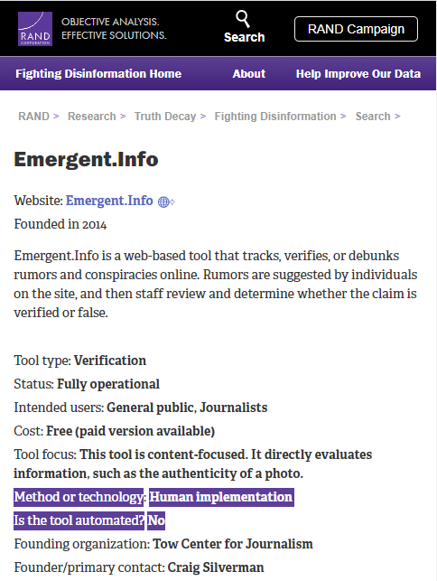
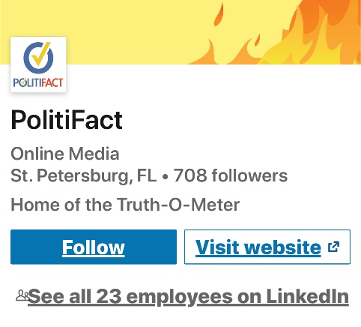
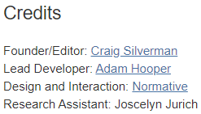
The disinformation is manually detected by human truth warriors
but they are surprisingly few in number for such a critical problem
Has no Linkedin page but website suggests 3 employees
There are fewer than 40 US truth warrior organizations,
most operating WITHOUT automation, with only 3-23 human employees
Notes:
Each and every one of you can create fake news, I can create fake news In a country like the US there are 200 million+ people who can unintentionally spread fake news by sharing the wrong post
This gigantic monstrosity is countered by only 40 truth warrior organizations with each 3-25 employees Moreover, with even this few people, our research shows that ALL these organization is still only read the articles one by one

Slide 5
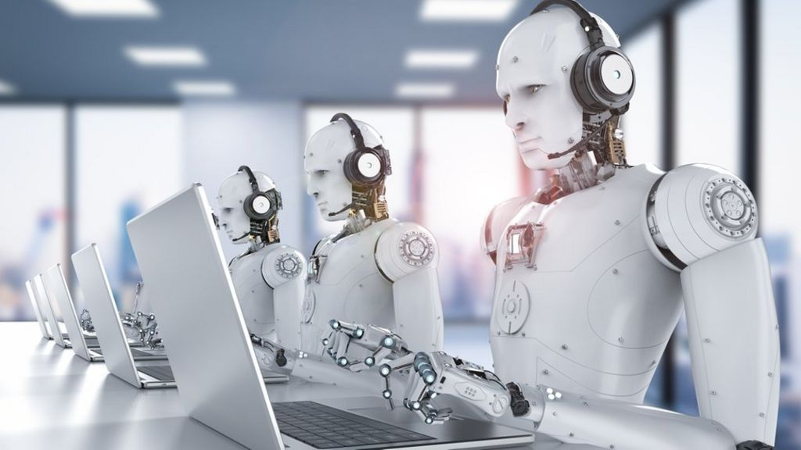
We seek to extend the efforts of the few human warriors through automation

Slide 6
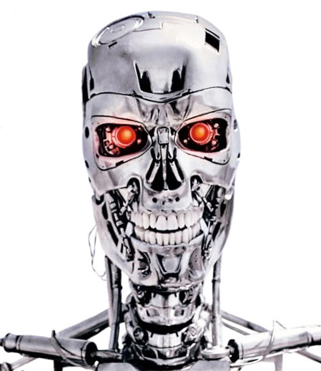
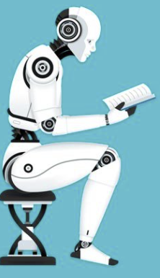

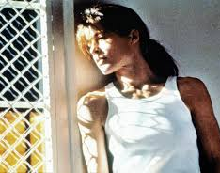

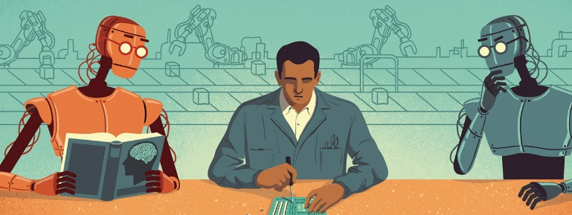
We seek to extend the efforts of the few human warriors through automation
*
Our model puts in placeholder assessments
Think Terminator 2, not Terminator 1
Assessment can still be post-edited by live humans
Humans can prioritize based on probabilistic assessments by model
Yes, but can we trust the model?
News
B
B: Not Fake
A
A: Fake

Slide 7


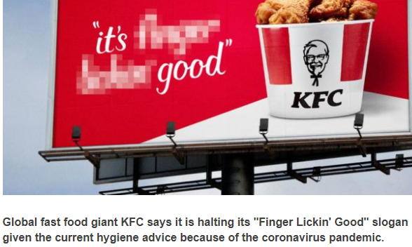






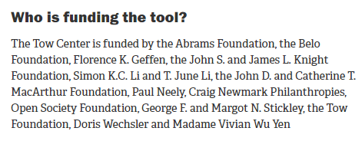


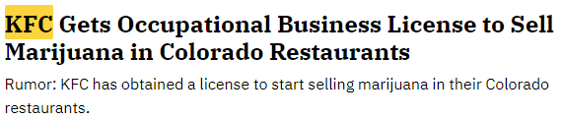


Commercialization
Our app available for free to non-profit orgs in exchange for gold label data to continually improve our model
Our app then extended (for pay) to for-profit social media/news outlets, automatically certifying shared content
There is 22% probability this story is fake
B: Not Fake
A: Fake
B: Not Fake
A: Fake
B: Not Fake
A: Fake
There is 87% probability this story is fake
Notes:
We want to start out making the app available for free for truth warriors in exchange for their ongoing data to improve our model Next we want to scale and eventually have every post shared on every social media outlet stamped with our assessment

Slide 8
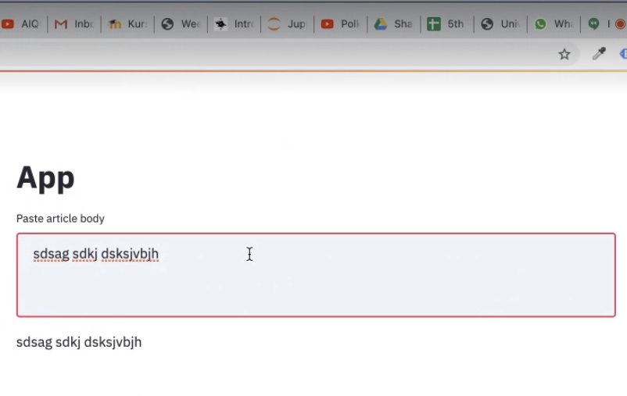
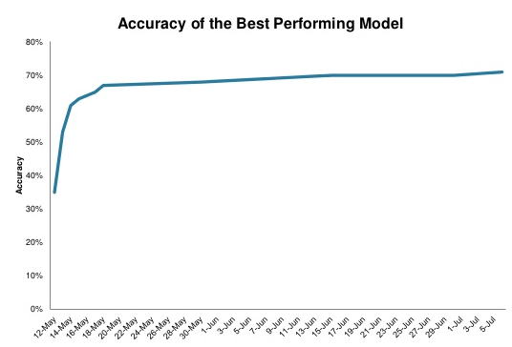
Picture Our Concept
To become an established brand, we enable social/media new consumers to paste in an article URL or simply text in order to obtain our assessment
Articles with URLs along with our assessments are collected to chart our accuracy over time

