Slide 1
Compass Conversational AI
August 1, 2025
Transforming member experience through AI-powered conversations across voice, chat, and agent assist.

Slide 2
The challenge: Rising expectations, constrained resources
Payers are being asked to do more with fewer resources without giving up the experience members take for granted.
What members expect
What service teams face
Immediate responses
Rising contact volumes
Personalized interactions
Long training ramps and agent attrition
Consistency on every channel
Growing operational cost
Service available around the clock
Fragmented customer experiences
Resolution on the first try
Pressure to improve CX while reducing spend

Slide 3
Business impact: The cost of inefficient experience
Where the effects show up when engagement is not AI-assisted.
For customers
For operations
For the business
Long wait times
Inconsistent answers
Repeating themselves at every handoff
Higher churn risk
High average handle time
Repetitive inquiries consuming capacity
Slow onboarding of new representatives
Escalations and limited peak scalability
Higher cost per interaction
Increased staffing requirements
Lower customer retention
Reduced operational efficiency

Slide 4
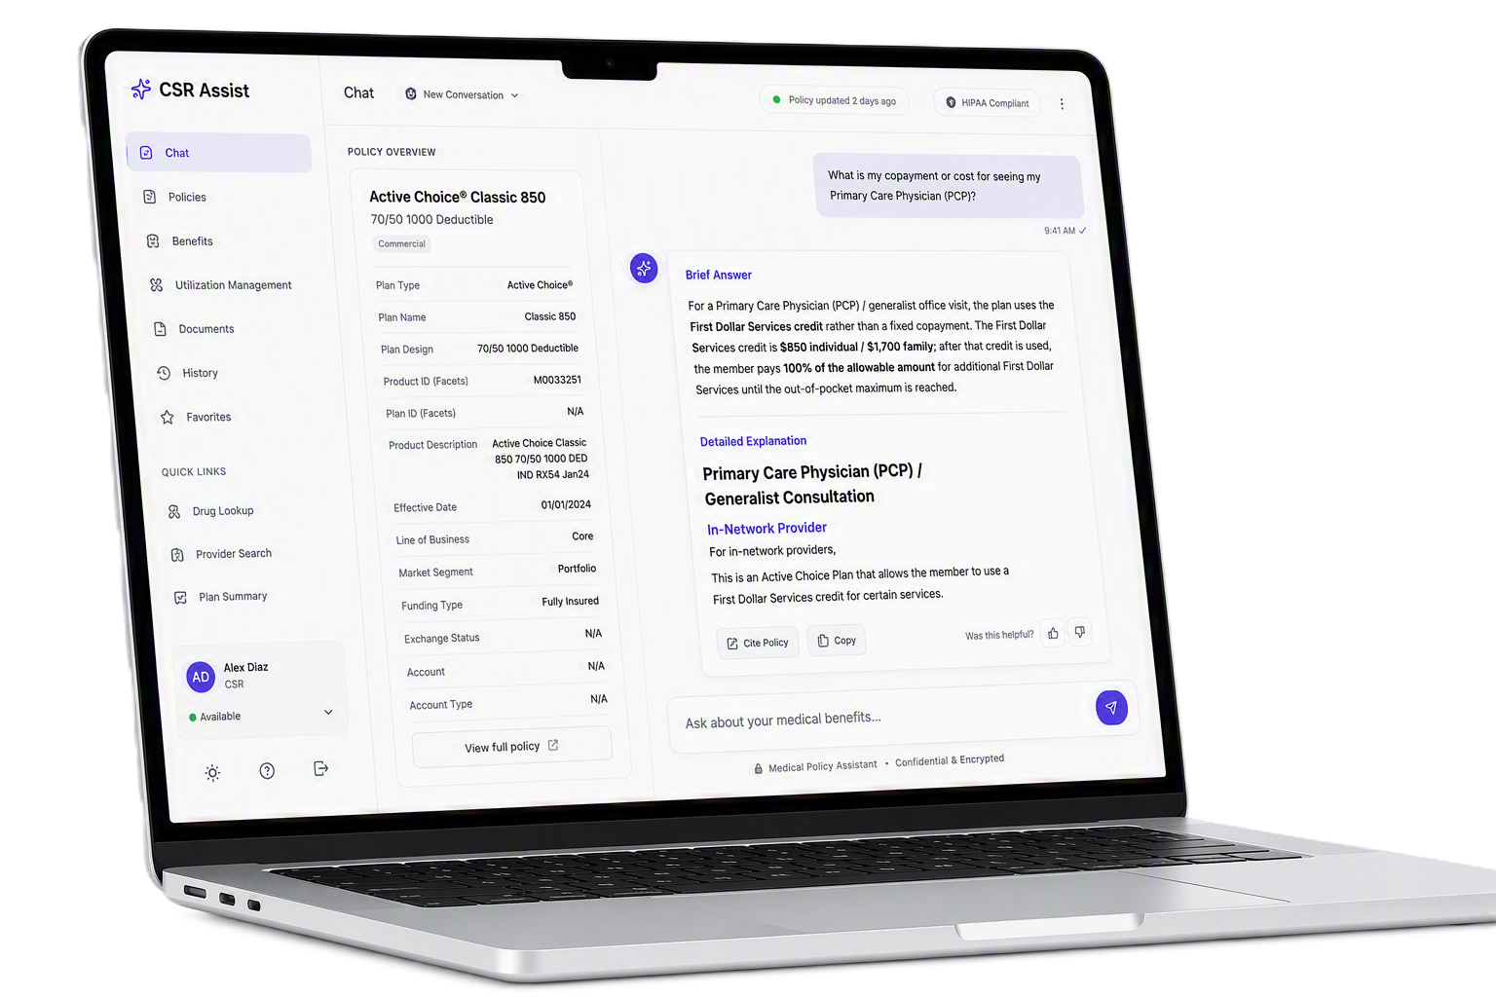
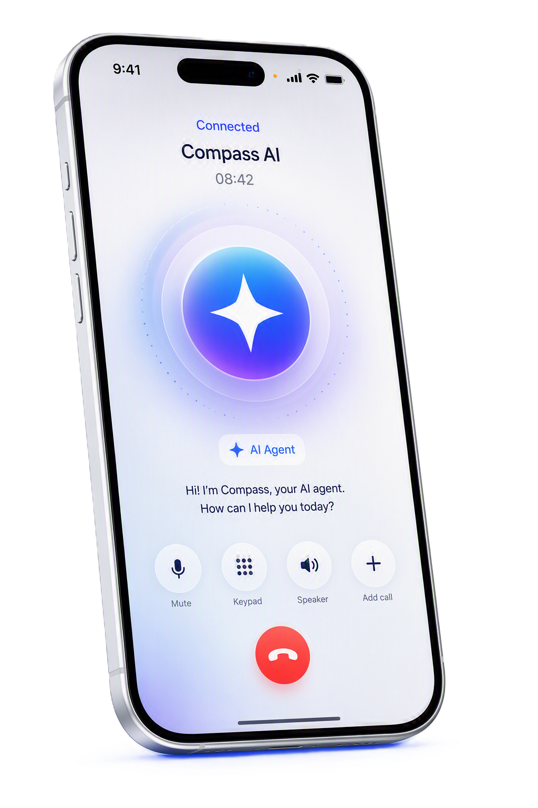
Exceptional member experience delivered at scale
Compass improves customer satisfaction, raises agent productivity, and reduces cost to serve through intelligent interactions on every channel.
CSR Assist
AI guidance and knowledge for representatives, live in the interaction.
Compass Voice
Conversational voice automation and self-service.
Compass Chat
Digital engagement across web and messaging.

Slide 5
Solution: Compass CSR Assist
Every representative works with the knowledge and judgment of your most experienced agent.
Capabilities
Outcomes
Real-time guidance in the interaction
Knowledge retrieval and summarization
✓
Reduced average handle time
Suggested responses
✓
Faster agent onboarding
98% accurate vs human < 80% accuracy
✓
More consistent answers
Reduced call handle time
✓
Higher first-contact resolution
Higher first call resolution
✓
Improved employee satisfaction

Slide 6
Solution: Compass Voice
Intelligent self-service on the phone with a natural handoff when a person is needed.
Capabilities
Outcomes
Outcomes
Lower live-agent call volume
Natural language conversation
Reduced operational cost
Multi-language support
Higher self-service rates
Reduced average handle time
✓
Automated resolution of routine inquiries
Improved customer satisfaction
Faster agent onboarding
✓
Personalized experience
Service coverage beyond business hours
More consistent answers
✓
Guardrails keep conversations safe
Higher first-contact resolution
✓
Seamless agent handoff with context
Improved employee satisfaction
✓

Slide 7
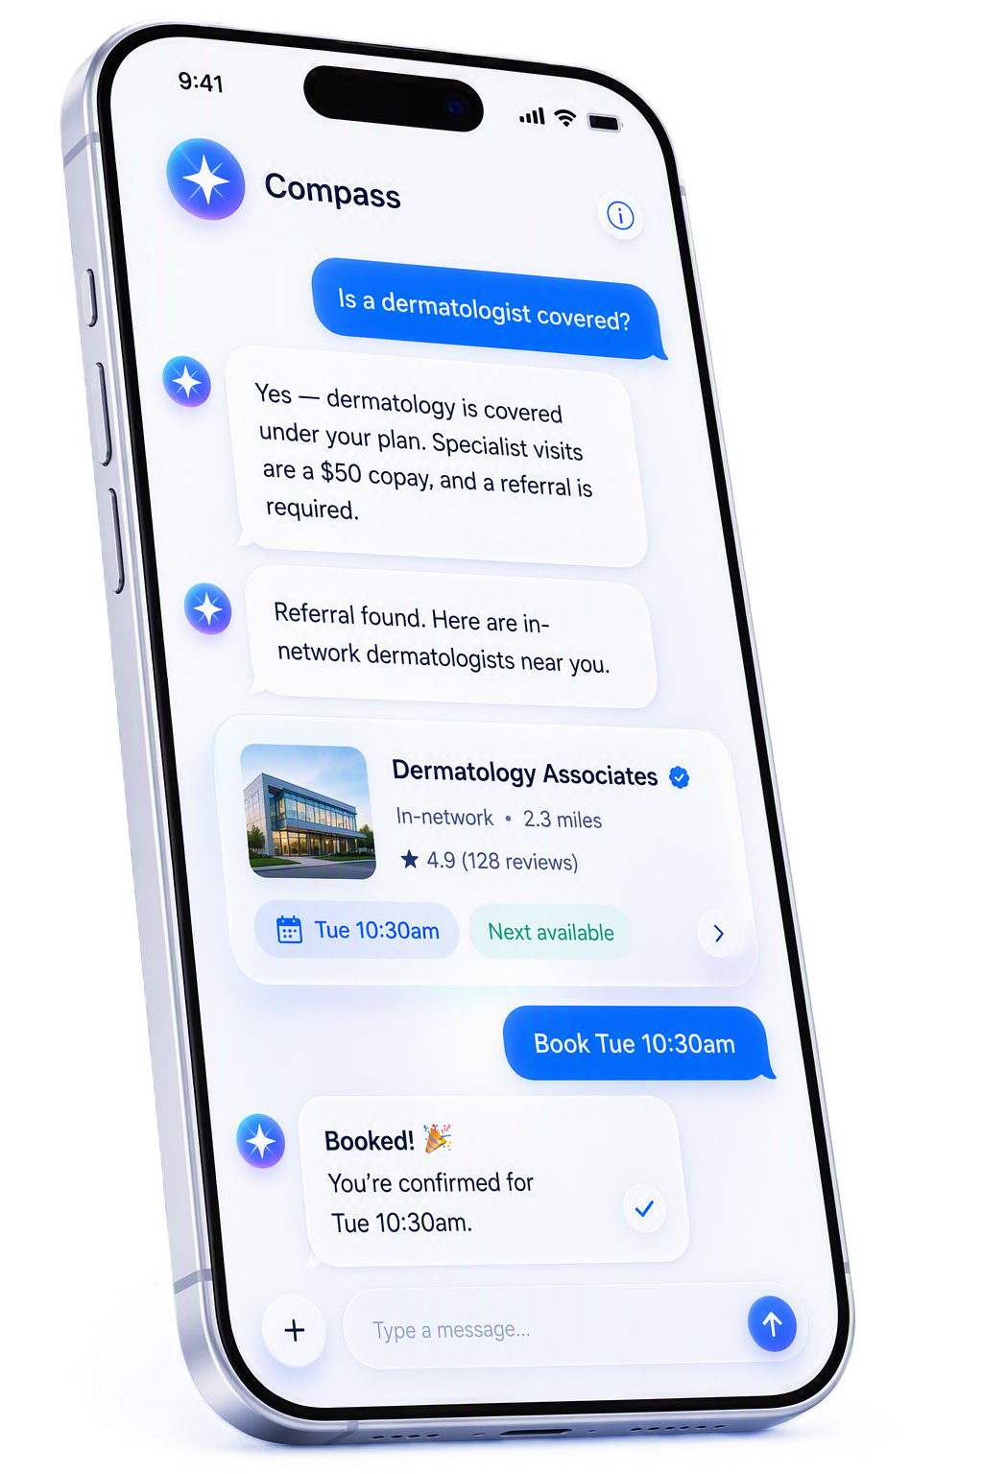
Solution: Compass Chat
Support on the channels customers already use with the same answers they would get on the phone.
Capabilities
Outcomes
Outcomes
Web chat
Higher digital containment
Reduced support cost
Mobile and messaging channel
Reduced average handle time
Stronger customer engagement
✓
Automated resolution of routine inquiries
Faster service delivery
Faster agent onboarding
✓
Personalized, account-aware interactions
Improved conversion on service journeys
More consistent answers
✓
Conversations that carry across channels
Higher first-contact resolution
✓
Live agent escalation
Improved employee satisfaction
✓

Slide 8
Member journey with Compass after new diagnosis
MEMBER PERSONA
Recently diagnosed; wants calm, accurate answers about treatment coverage, providers, medications, devices, diagnostics, authorizations, and support.
Goal: confidence, clarity, and a personalized next-step plan.
1
2
3
4
5
6
Receives diagnosis
Seeks coverage clarity
Engages chat or voice
Calls a human agent
Agent uses CSR Assist
Receives support plan
MEMBER ACTION
Processes new diagnosis
Reviews the plan portal
Asks the chat or voice agent
Conversation needs human touch
Agent queries the copilot
Gets a personalized summary
KEY NEED
What do I do next?
Is treatment covered?
Providers, meds, diagnostics?
What else should I be thinking of? I’m worried.
Accurate, member-specific answer
My coverage and next steps
COMPASS CAPABILITY
Empathetic entry point and next steps
Web chat benefit inquiry in easy to understand language
Digital AI chat and voice navigation
Warm handoff with conversation context
Desktop assistant retrieves rules and programs
Tailored benefit and care support plan
EMOTION
Anxious → supported
Uncertain → oriented
Overwhelmed → heard
Concerned → reassured
Relieved → confident
Clear → empowered
AI RETRIEVES AND SYNTHESIZES
Plan benefits
Providers
Prior auth
Medications
Devices
Condition programs
Ancillary services
Member context

Slide 9
How it works together
How We Meet the Member
Chat
Voice
Web
Text
Mobile
Consumer touchpoints that make service feel simple.
Outcomes
Agentic Orchestration
1
2
3
4
Plans, routes, calls systems, escalates when needed, and moves the journey forward.
Identify intent
Resolve or route
Call systems
Transfer context
✓
Reduced average handle time
✓
Faster agent onboarding
Knowledge Layer
✓
More consistent answers
Trusted content
Member context
History
Policies
Trusted knowledge, member context, history, benefits, policies, and continuous learning.
Higher first-contact resolution
✓
✓
Improved employee satisfaction

Slide 10

Why Compass
01
Purpose-built for service
Designed for customer engagement and service operations, not adapted from a general tool.
02
One unified platform
Voice, chat, and agent assistance delivered through a single strategy and knowledge layer.
Outcomes
03
Faster time to value
Configurable workflows and knowledge integration shorten the path to production.
✓
Reduced average handle time
04
Human-centered by design
✓
Faster agent onboarding
Automation where it helps, with clean transitions to a person when judgment is required.
✓
More consistent answers
05
Enterprise ready
✓
Higher first-contact resolution
Secure, scalable, and built to carry mission-critical customer interactions.
✓
Improved employee satisfaction

Slide 11
Enterprise grade trust
Controls, oversight, and transparency built into every Compass interaction.
Security
Governance
Responsible AI
Role-based access controls
Conversation monitoring
Human oversight in the loop
Data protection controls
Performance reporting
Transparency in AI-assisted answers
Outcomes
Secure system integrations
Audit capabilities
Configurable guardrails
Continuous optimization
✓
Reduced average handle time
✓
Faster agent onboarding
✓
More consistent answers
✓
Higher first-contact resolution
✓
Improved employee satisfaction

Slide 12
How we measure the return
Targets are set against your current baselines during discovery.
Customer experience
Agent productivity
Operational efficiency
Organizational impact
CSAT and NPS
Average handle time
Automation and containment rate
Capacity to absorb peak demand
Time to first response
First-contact resolution
Effort per resolved issue
Time to proficiency for new hires
Cost per interaction
Consistency across channels
Workforce utilization
Reallocation of service resources

Slide 13
Implementation approach
PHASE 1
PHASE 2
PHASE 3
PHASE 4
Discovery
Configuration
Pilot
Scale
03
Align on the highest-value starting point.
Connect knowledge and design the workflow.
Launch safely, learn fast, optimize in production.
Expand across the enterprise with governance.
Business objectives
Knowledge integration
Controlled production rollout
Enterprise deployment
Use case prioritization
Workflow setup
User feedback
Additional use cases
Success metrics and baselines
AI model tuning
Performance optimization
Continuous improvement
Prioritized launch scope
Configured Compass experience
Validated results
Repeatable operating model
Start with the right use cases
Configure for real workflows
Prove outcomes in production
Scale what works
Discovery
Configuration
Pilot
Scale

Slide 14

Where do we go from here?
01
02
03
04
05
Executive strategy session
Customer service assessment
Use case prioritization workshop
Solution demonstration
Pilot program definition

Slide 15
A platform engineered for confident conversations
Compass connects member channels, intelligent orchestration, enterprise data, and live escalation in one extensible foundation.
CUSTOMER / CHANNELS
STELLARUS PLATFORM
HUMAN HANDOFF
Customer Portal
Stellarus Portal
Auth & customer configuration
Custom UI
Stellarus UI
Customer CCaaS (e.g., Genesys)
Chat broker
Data enrichment
Conversation management
Escalations
Stellarus SDK
Stellarus AI
Data services
Sierra.ai • CSR agent
Benefis service
Member agent · future
Extensible data · future
A reusable core lets Compass scale across channels, customers, and service moments without losing the context that makes interactions feel personal.

