Slide 1
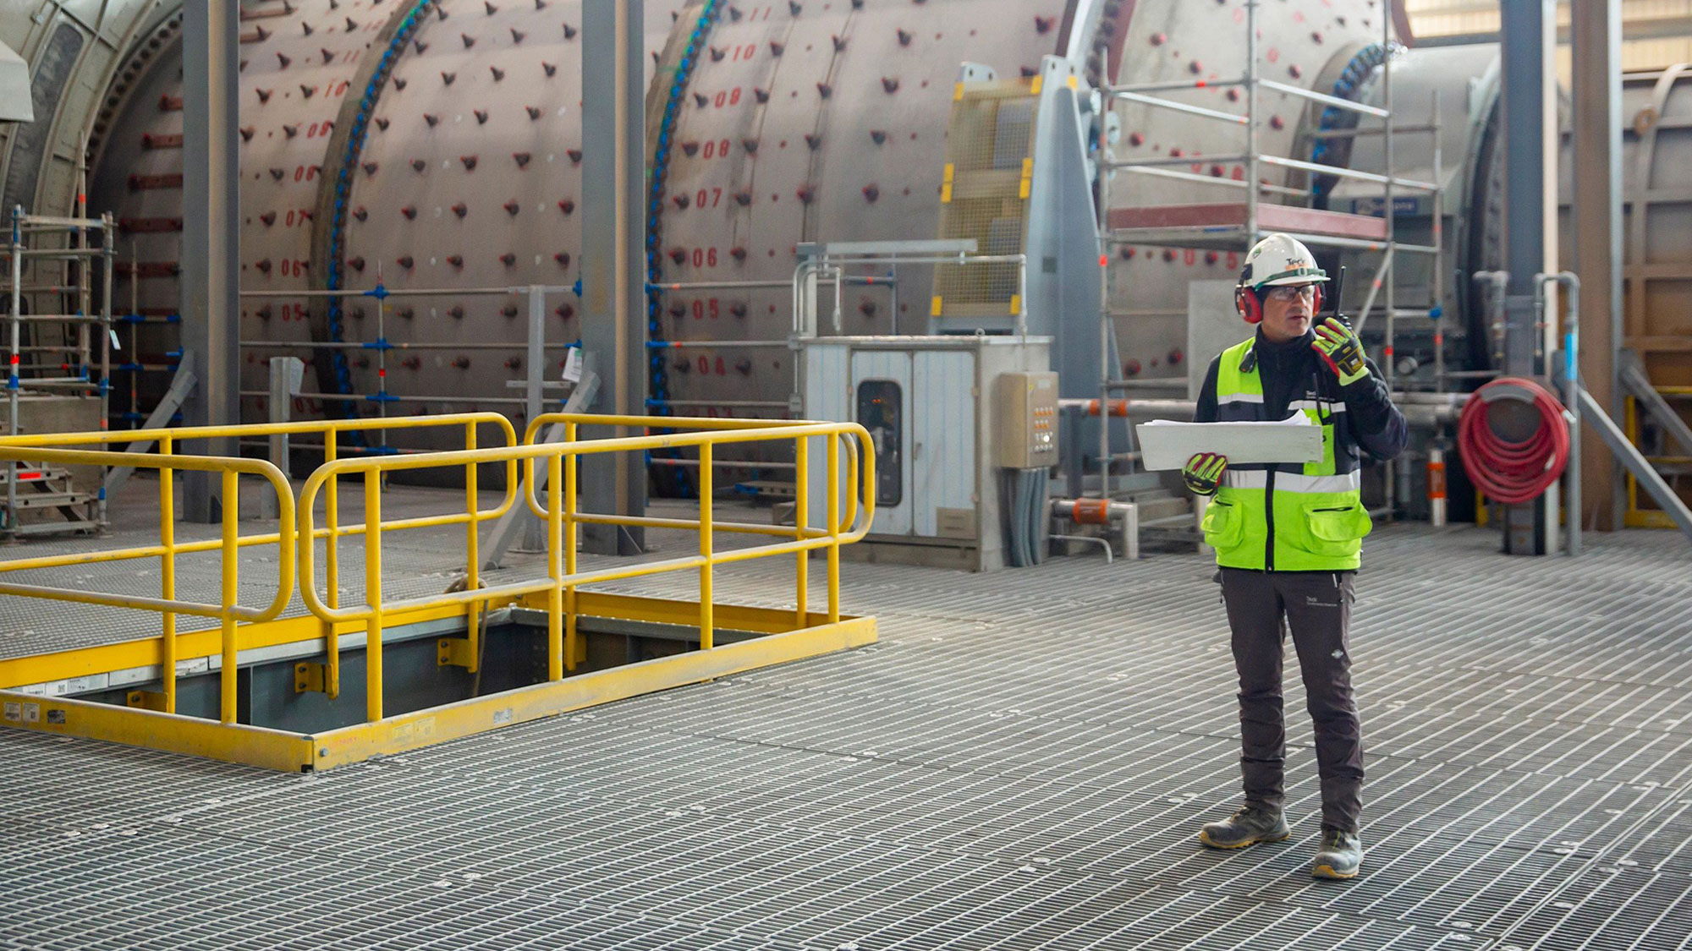
<PROJECT_TITLE> report <MONTH> <YEAR>
<CREATION_DATE>

Slide 2

<PROJECT_TITLE> Report – <MONTH> <YEAR>
SUMMARY
The <MILL_NAME> reline was scheduled for <MONTH> <START_DAY>-<END_DAY>.

Slide 3
High Level Summary of Delays
The <TOTAL_DELAY_HOURS>-hour delay was primarily caused by :
Manually fill in summary.

Slide 4
Delays by Type

Slide 5
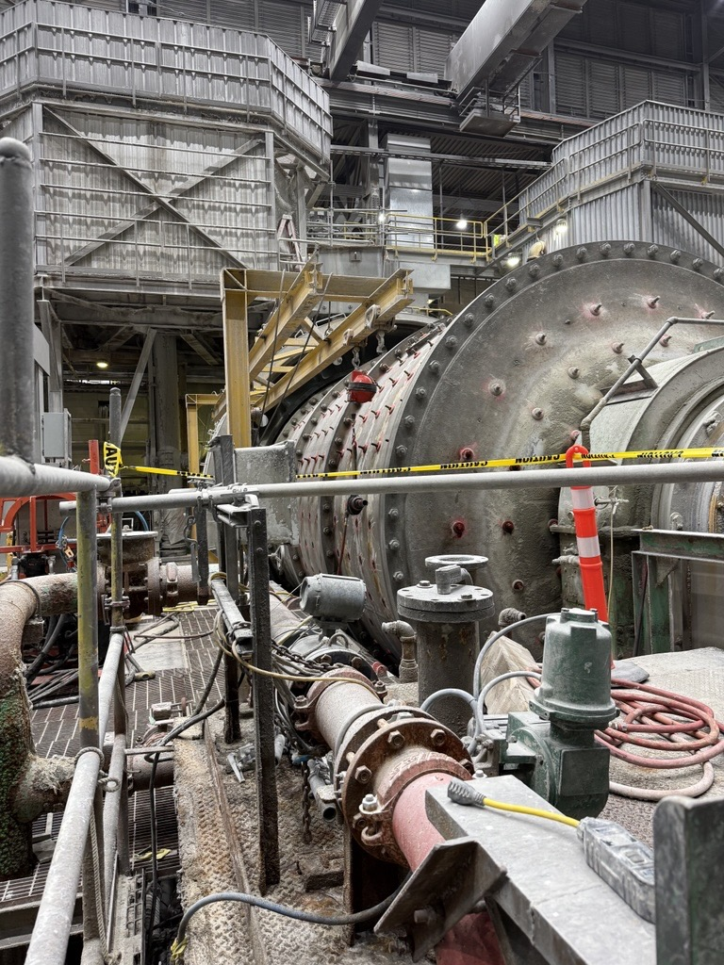
Recommendations
The following should be prepared in advance of future relines:
Prioritize preparation:
Draining mill, critical parts / tools staged. Crew ready to work on the morning of the first day. 5
Load level: personnel are trained on setting the ideal load level. This pays dividends for inching throughout the project.
Ownership of critical equipment: inch drive, adjust-a-veyor, thunderbolt.
PMs completed in advance, critical spares available.
Ensure efficient shift change
Hot change if possible
Stagger breaks

Slide 6
Summary of Major Delays
PHASE | TASK | DELAY (HRS) | Type | NOTES

Slide 7
phase level delay breakdown

Slide 8
Reline Phases
Each reline phase and their delays:
No. | PHASE | PHASE DELAY (HRS) | CUMULATIVE DELAY (HRS) | RATIONALE

Slide 9
Reline Progress

Slide 10
Reline Phases & Their Delays

Slide 11
INCHING

Slide 12
Inching Performance

Slide 13

Time to First Inch – Day vs Night
Time to first inch was measured as the difference between the shift start time (7:00 AM days, 7:00PM nights) and the first time the inch drive starts for each shift.

Slide 14
Detailed delay analysis

Slide 15
Phase <phase_num>: <phase_name> - Timeline

Slide 16

Phase <phase_num>: <phase_name> Delayed Tasks
Planned Duration (hrs) | Actual Duration (hrs)
2.0 | 6.9
TASK NAME | PLANNED DURATION | ACTUAL DURATION | DELAY (HRS) | NOTES
Delay - waiting for load level | 0.0 | 4.6 | 4.6 | Challenges getting load level set. Even with delays, the load level was arguably too high, which hindered progress moving forward.
Delay - scanning mill | 0.0 | 0.3 | 0.3 | Scanning of the mill was not factored into the original schedule. This was an additional 0.3-hour delay.

Slide 17
Appendix

Slide 18
Delays by Type – Raw Data
DELAY TYPE | COUNT | FREQUENCY OF OCCURRENCE | TOTAL DELAY (HRS) | PERCENTAGE OF TOTAL DELAY
General
Found Work
Preparation
Equipment Failure / Unavailability
Safety
Manpower Shortage

