Slide 1
Biomedical Image Analysis with Python BIOF-063
DAY 2: Basic Image Manipulation
10/25/2023
Instructor: Jahandar Jahanipour

Slide 2
Outline
Python Basics Recap
Image Manipulation

Slide 3
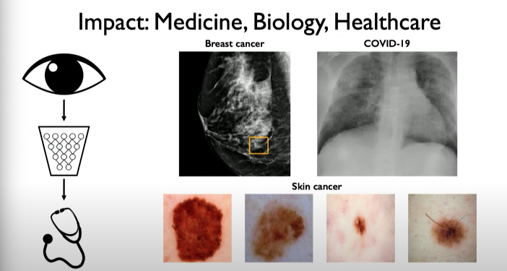
Biomedical Image Processing
Source: https://dair-ai.notion.site/Lecture-3-Deep-Computer-Vision-e43a17b50f7e4b5f8393c070b22340a3

Slide 4
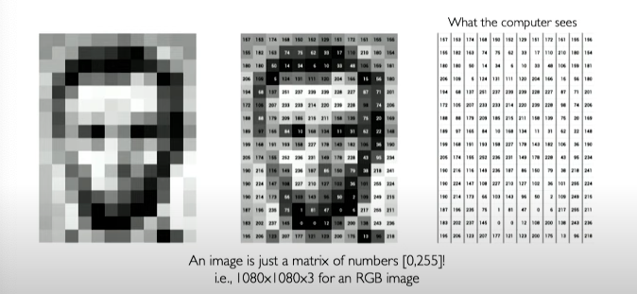
How Computer Sees: Images are numbers (Array of numbers)
Source: MIT 6.S191 Introduction to Deep Learning (2022)

Slide 5
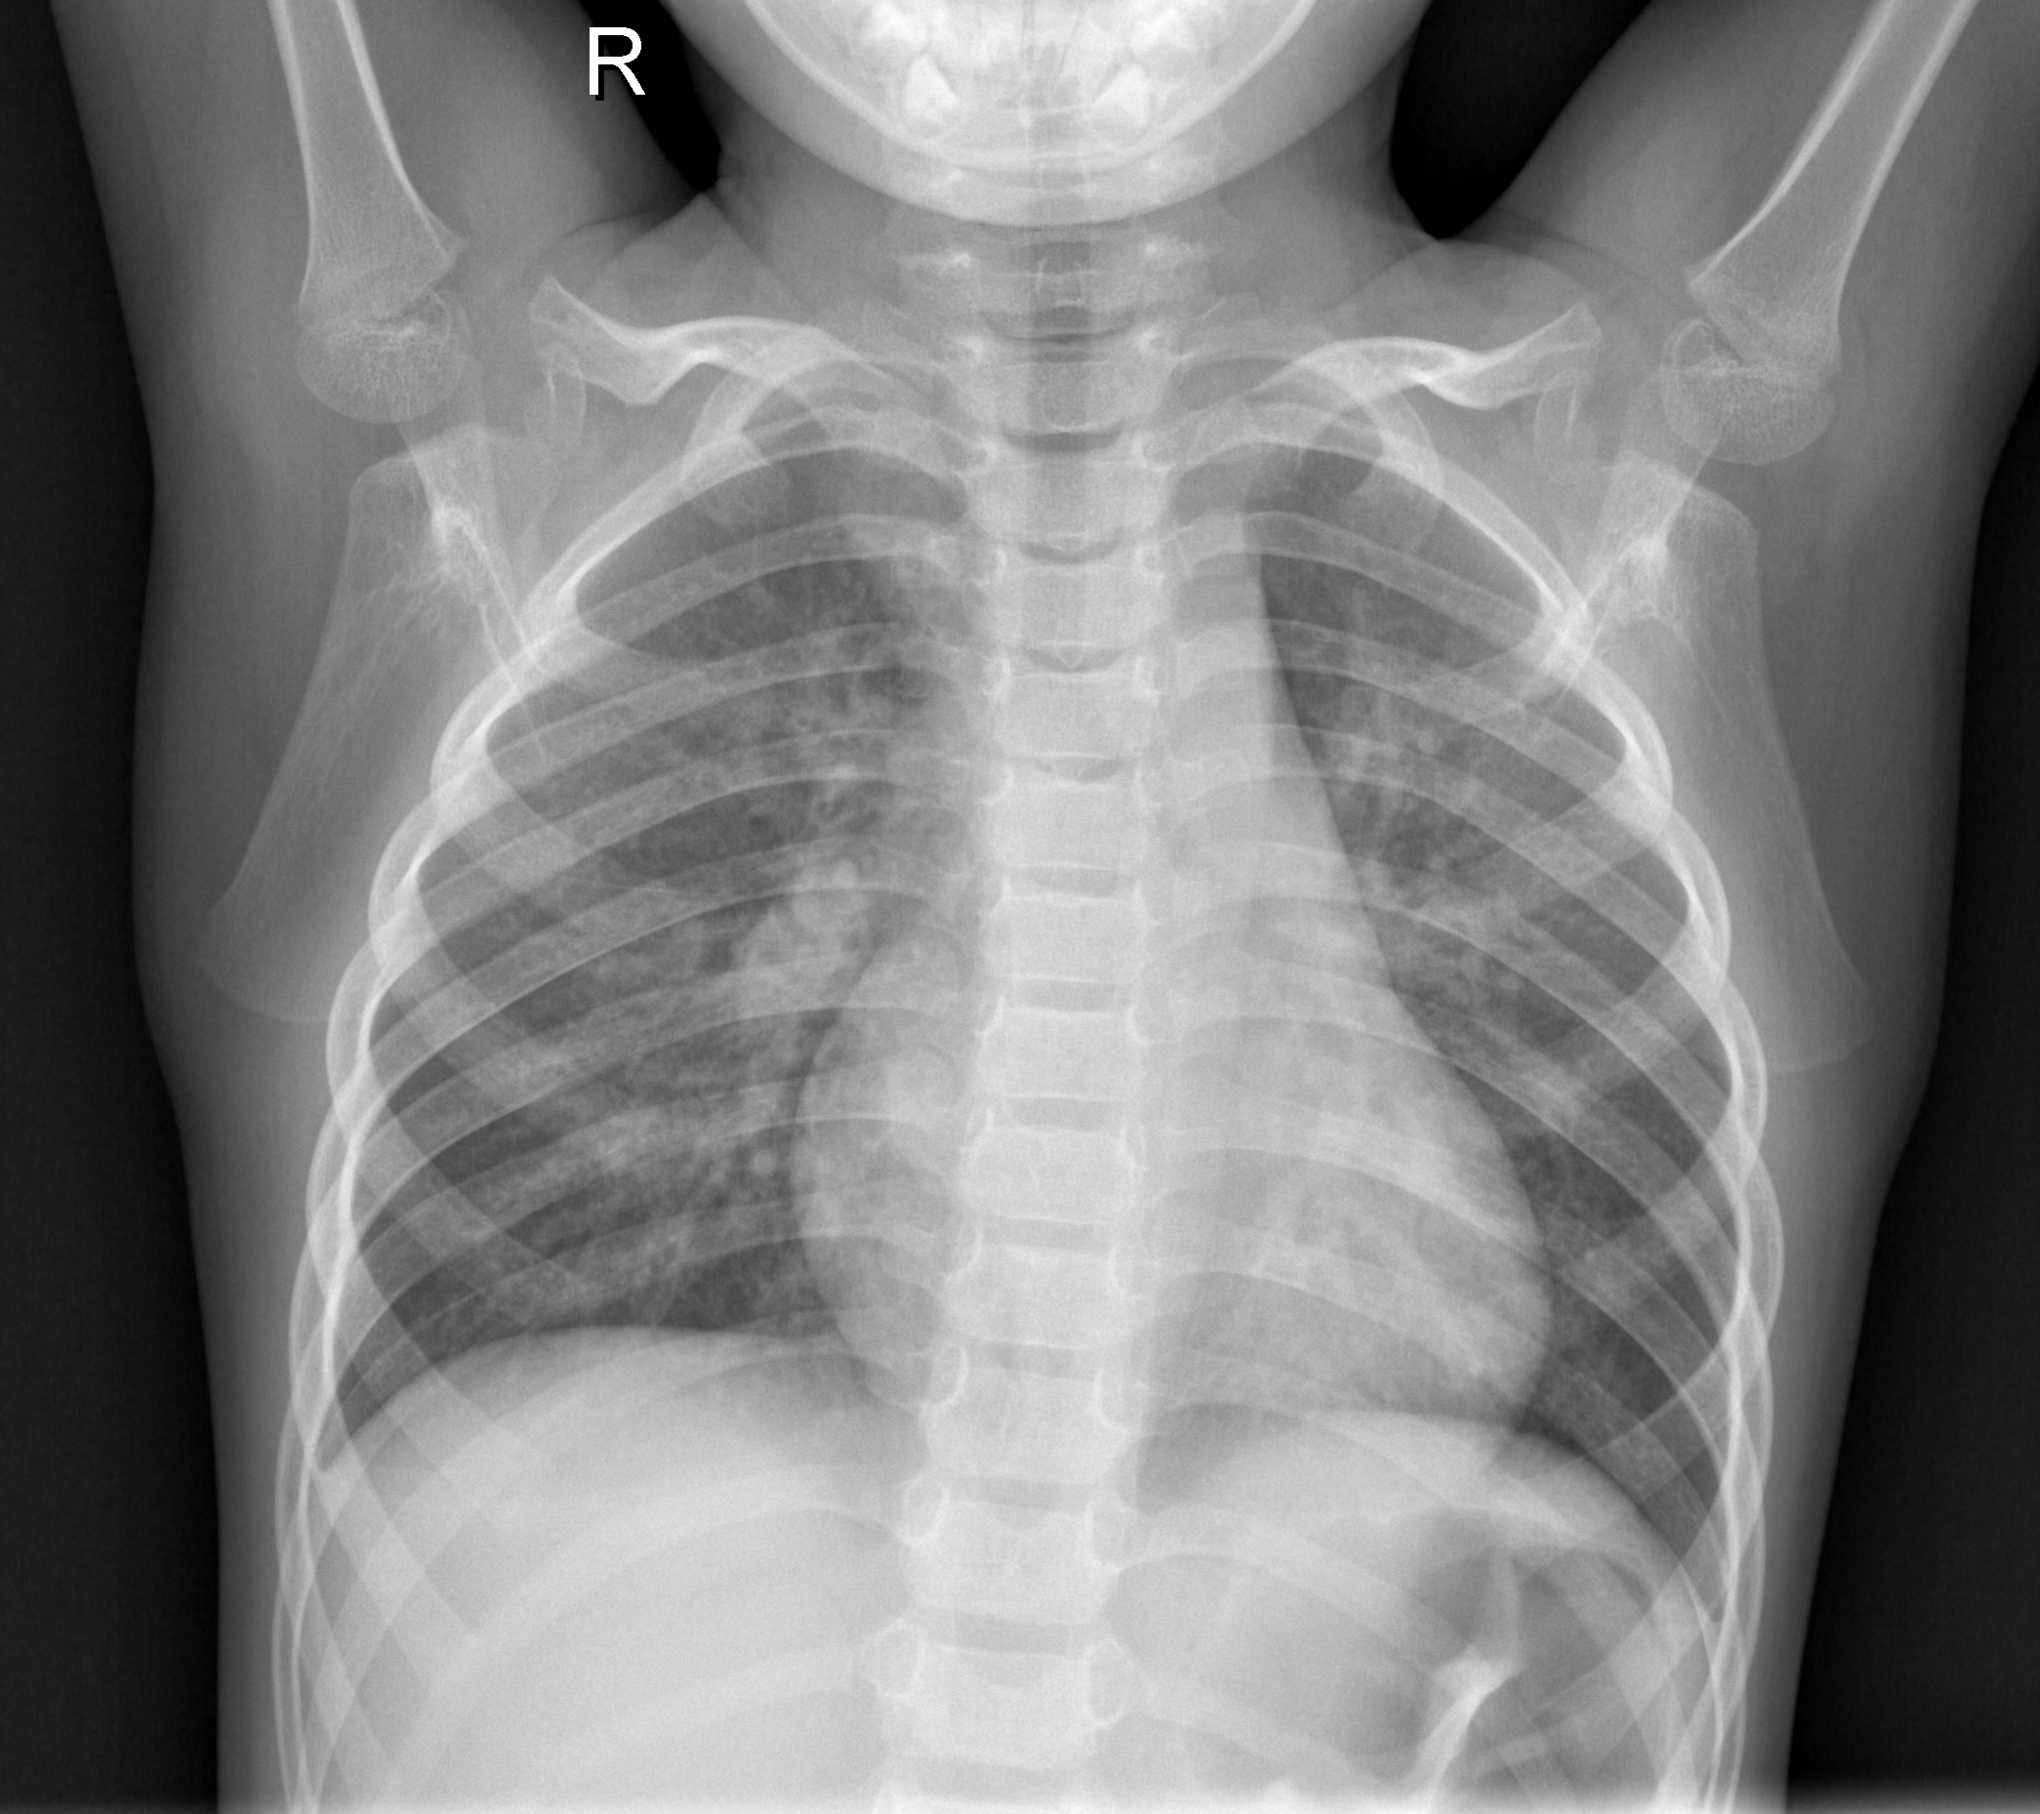
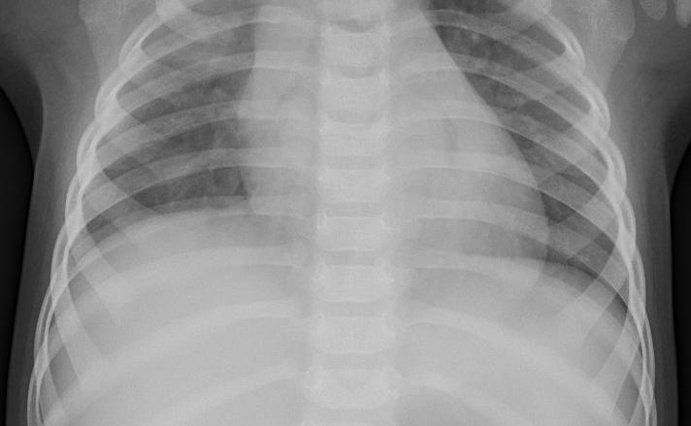
X-Ray
Source: https://data.mendeley.com/datasets/rscbjbr9sj/2

Slide 6
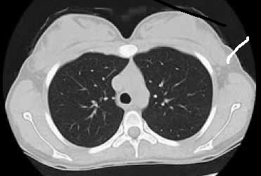
CT Scan
Source: https://www.kaggle.com/datasets/mohamedhanyyy/chest-ctscan-images

Slide 7
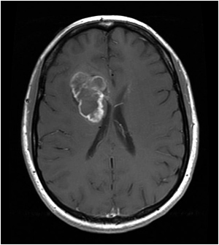
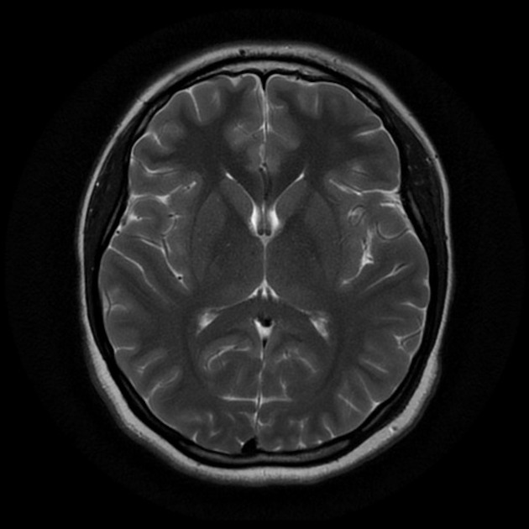
MRI
Source: https://www.kaggle.com/datasets/navoneel/brain-mri-images-for-brain-tumor-detection

Slide 8
Basic Image Manipulation
DEMO

Slide 9
Conclusion: Python Libraries for Image Processing
 | Scikit-Image | OpenCV
Speed | Slow | Fast
Documentation | Good | Bad
Datatype | float | uint8

