Slide 1
Biomedical Image Analysis with Python BIOF-063
DAY 3: Image filtering and enhancement
10/26/2023
Instructor: Jahandar Jahanipour

Slide 2
Conda Environment
A self-contained, isolated workspace where you can install and manage different packages and dependencies for a specific project or task
Avoid interference of different versions of python or packages
Create:
conda create -n <env_name> python=3.9
Activate:
conda activate <env_name>
Note 1: The environment activate will add the name of the environment at the beginning of the line.
Note 2: The default environment in conda is called base

Slide 3
Napari: A fast, interactive viewer for multi-dimensional images in Python
https://napari.org/stable/index.html
Install: conda create -y -n napari-env -c conda-forge python=3.9 conda activate napari-env python -m pip install "napari[all]"
Run: napari

Slide 4
Enabling GitHub Copilot
Follow the instructions from: https://docs.github.com/en/copilot/getting-started-with-github-copilot?tool=jetbrains
GitHub student developer pack: https://education.github.com/pack
Github Copilot-X https://github.com/features/preview/copilot-x

Slide 5
Jupyter Notebook
Install (https://jupyter.org/install): Pip install jupyter
Run (from command line/terminal): cd <folder/containing/ipynb_file> jupyter notebook

Slide 6
Google CoLab
Free cloud-based platform provided by Google that allows users to write and execute Python code collaboratively in a web-based environment
https://colab.google
https://colab.research.google.com
Jupyter Notebook Integration: Jupyter Notebook-like interface
Cloud-Based: Runs on Google's cloud infrastructure - Leverage Google's computational resources
Free Access to GPU/TPU: Valuable for machine learning enthusiasts
Collaboration: Real-time collaboration with others, similar to Google Docs
Pre-installed Libraries: Colab comes with many Python libraries pre-installed - NumPy, pandas, Matplotlib, and TensorFlow
Easy Data Access: Import data from various sources, including Google Drive, Google Sheets, and external URLs
Notebook Sharing: Share Colab notebooks with others by providing a link – sseful for sharing code, data analysis, tutorials…

Slide 7
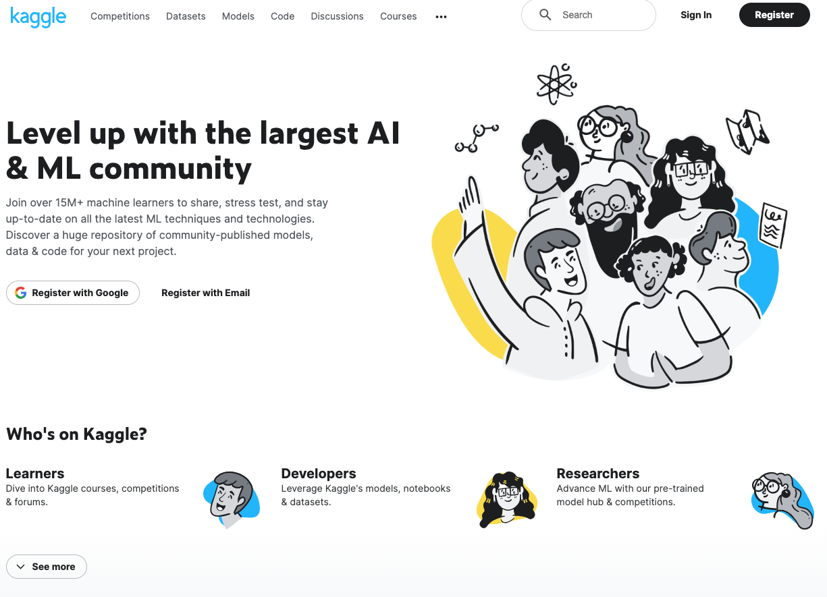
Kaggle
https://www.kaggle.com/

Slide 8
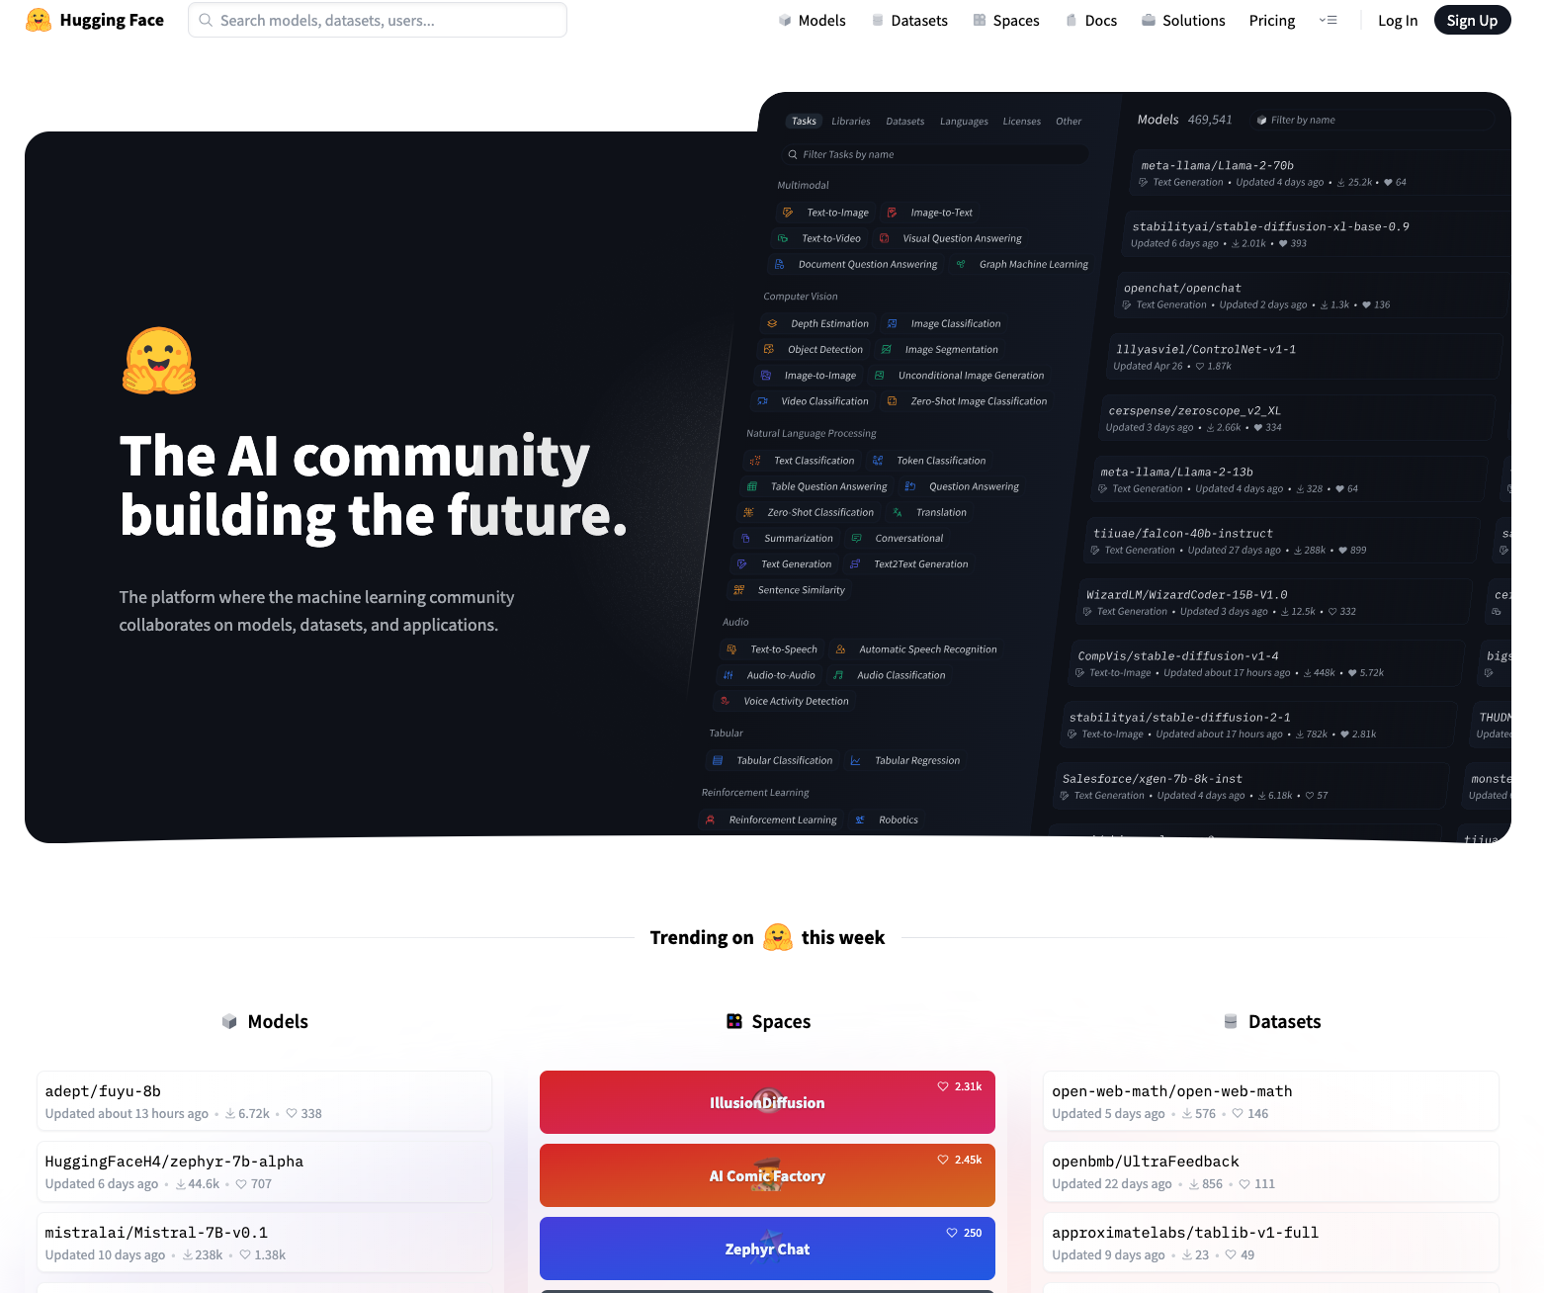
Hugging Face
https://huggingface.co/

Slide 9
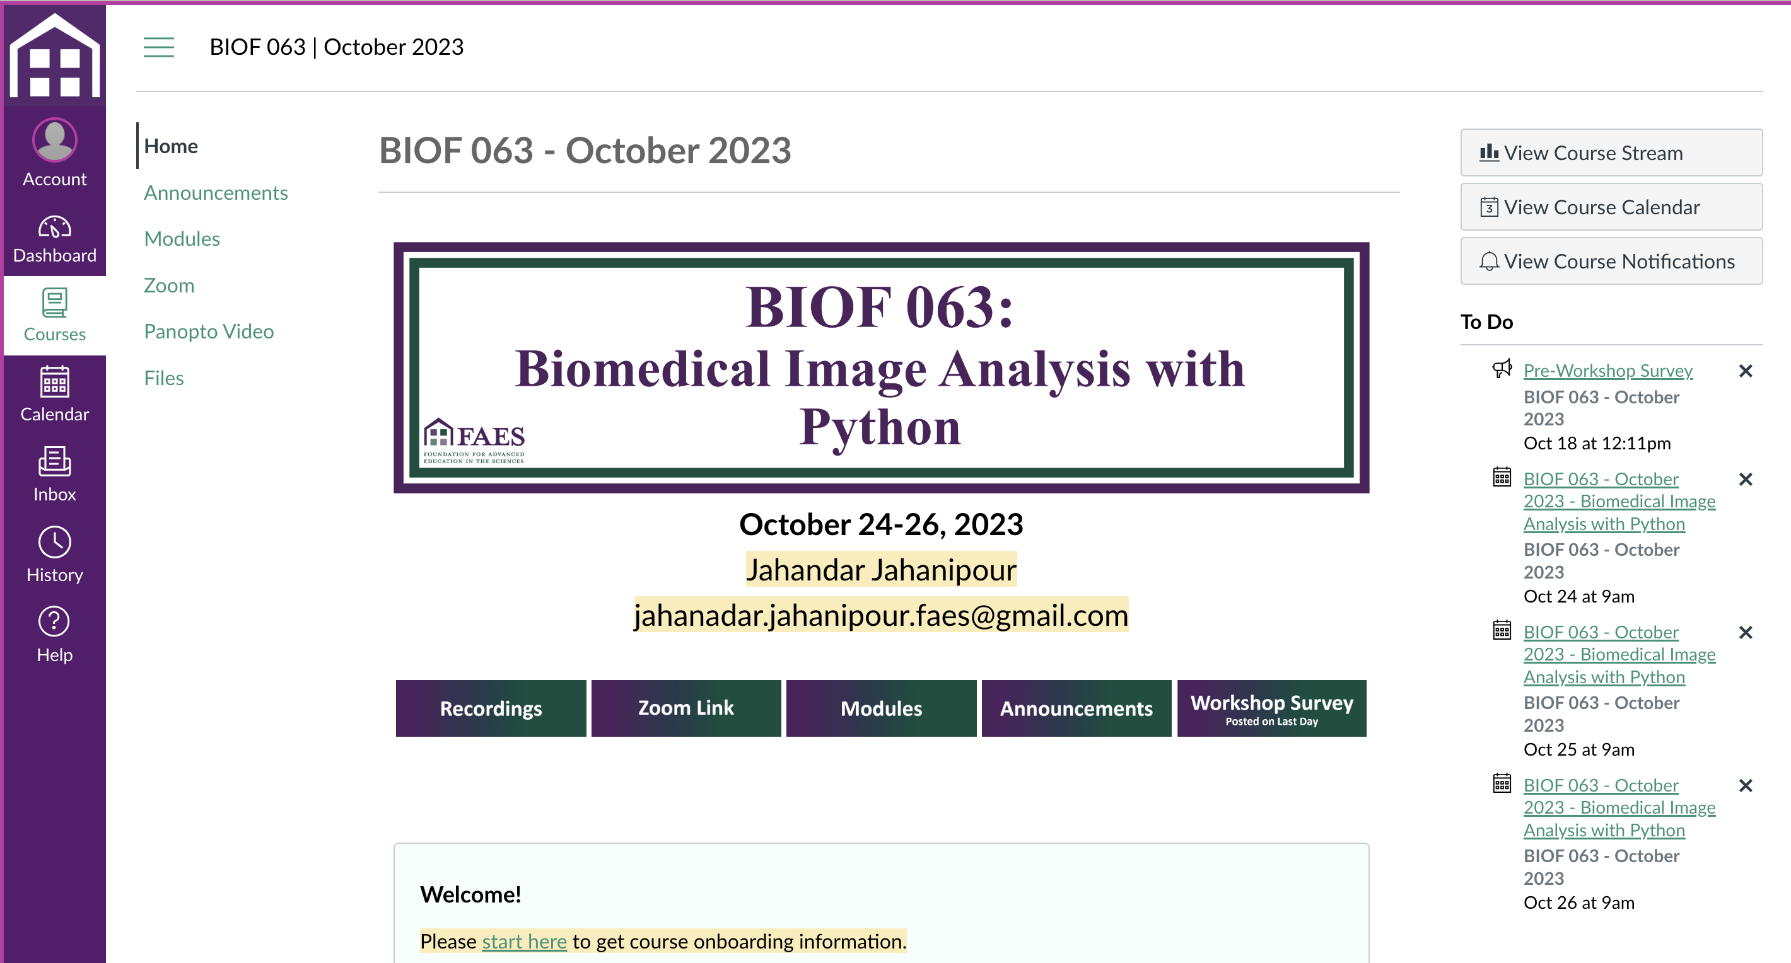
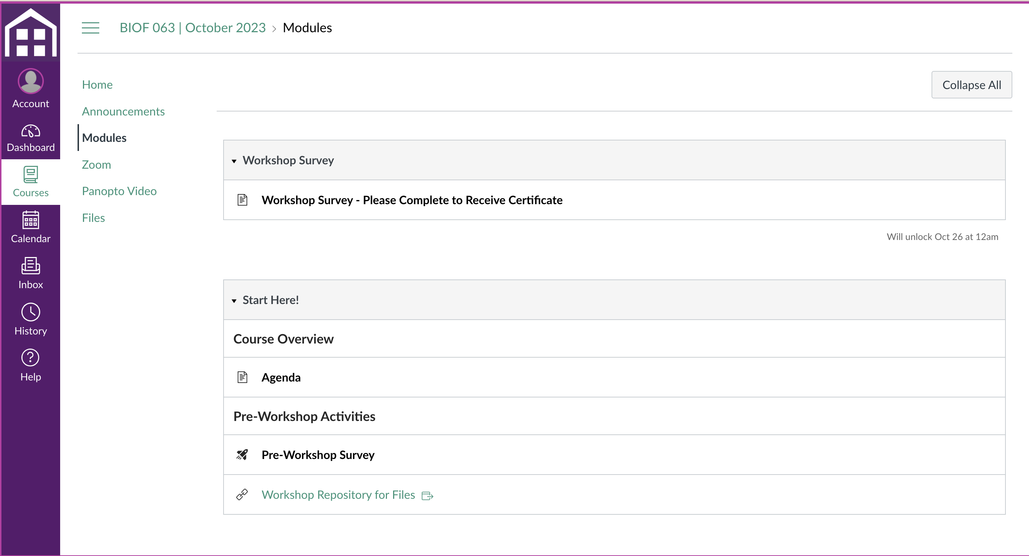
Survey
Don’t forget to do the survey:
Canvas -> Modules -> Workshop Survey

