Slide 1
Biomedical Image Analysis with Python BIOF-063
DAY 1: Python Recap
10/24/2023
Instructor: Jahandar Jahanipour

Slide 2

About Me…
AI-enthusiast
AI in Healthcare
Co-founder: easy-tensorflow
Ex-Postdoctoral Fellow – NIH
Principle Data Science Analyst – Mayo Clinic

Slide 3
Outline
Introduction
Installing Python
Python Basics
3rd party libraries

Slide 4
Why this workshop?
Academia/Research
As a Biologists you can independently write and execute code
Self-sufficiency in data analysis and experimentation
Gain co-authorship opportunities by contributing to computational aspects
Industry
High demand for Python skills across various industries
Python proficiency opens doors to well-paying job roles
Versatility to work different fields like data science, AI, and more

Slide 5
Installing Python: What is Python?
Programming language to use a system of rules and syntax to create computer program
Program example 1: Calculator
Program example 2: Denoise microscopic image
What software you need:
Python Interpreter: Run/execute python code
python.exe (https://www.python.org)
python.exe (https://www.anaconda.com)
Python.exe (https://docs.conda.io/projects/miniconda/en/latest/)
Editor: Write & edit the code
PyCharm (https://www.jetbrains.com/pycharm)
VSCode (https://code.visualstudio.com)
Python IDE (https://www.python.org)
Spyder
Jupyter Notebook

Slide 6
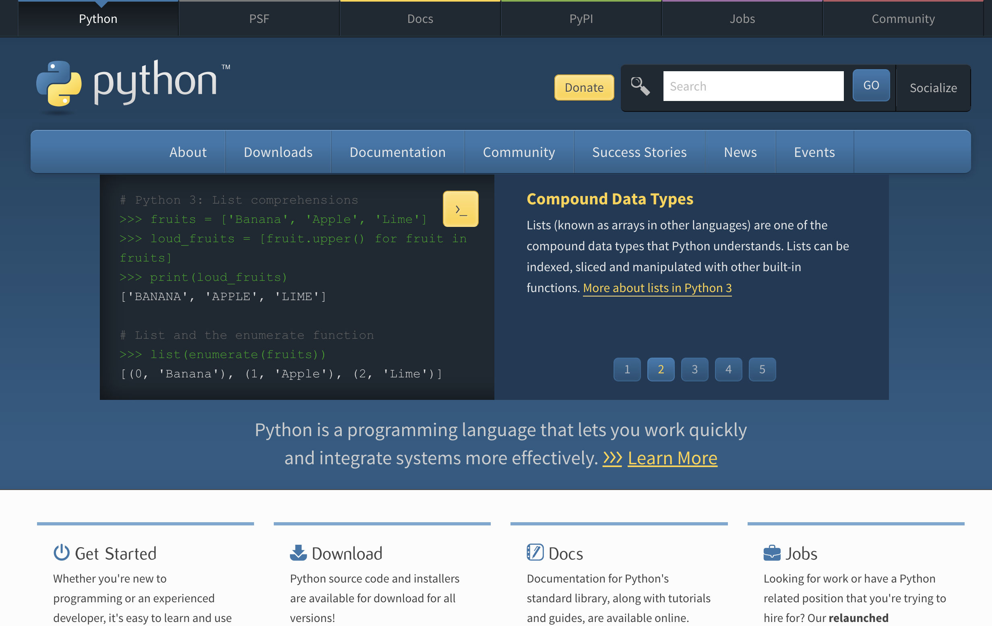
Installing Python: Where to Download/Install?
python.org
Editor: IDLE
Python interpreter: python.exe
Cons:
Code Assistance
Autocompletion
Debugging
Built-in Terminal

Slide 7
Installing Python: www.python.org
DEMO

Slide 8
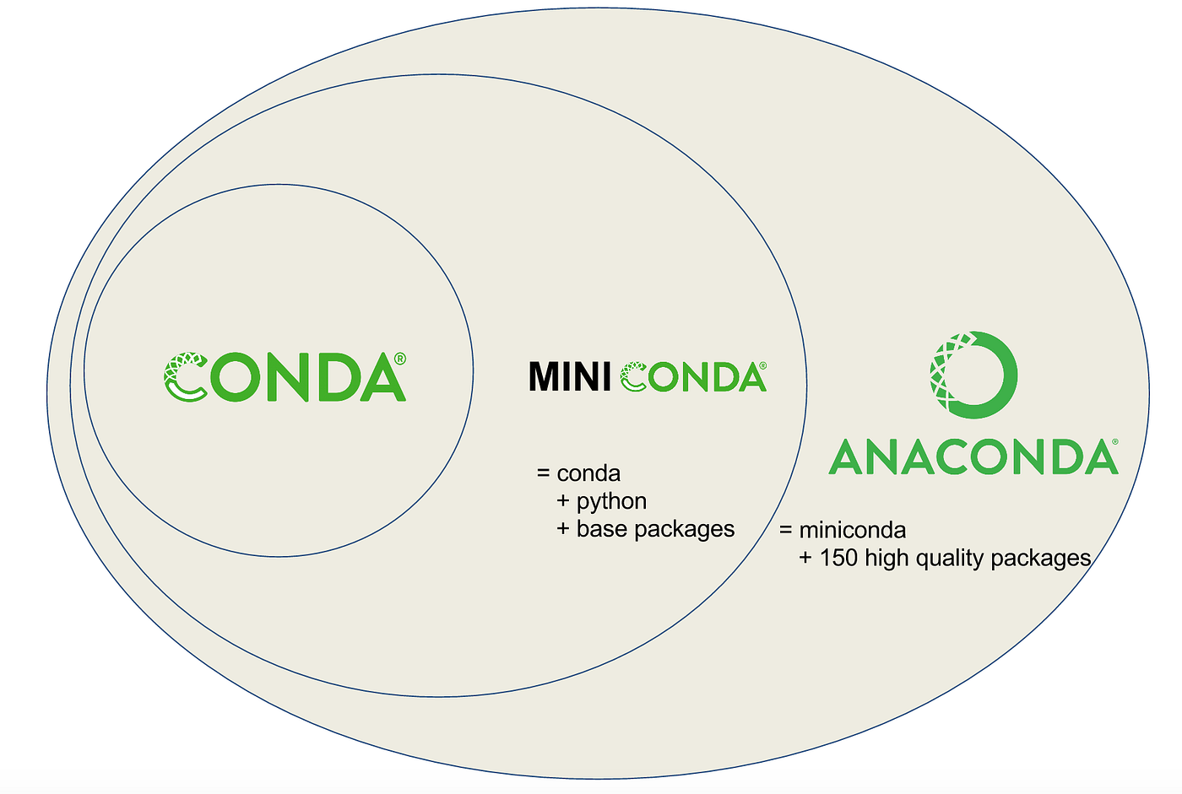
Installing Python: Where to Download/Install?
Anaconda:
Full Python distribution with pre-installed packages.
Easy IDE installation.
Lightweight and efficient, especially for resource-constrained systems.
Large download size due to numerous included packages.
Miniconda:
Lightweight and efficient, especially for resource-constrained systems.
Minimal Python installer with no pre-installed packages.
We will Install Miniconda

Slide 9
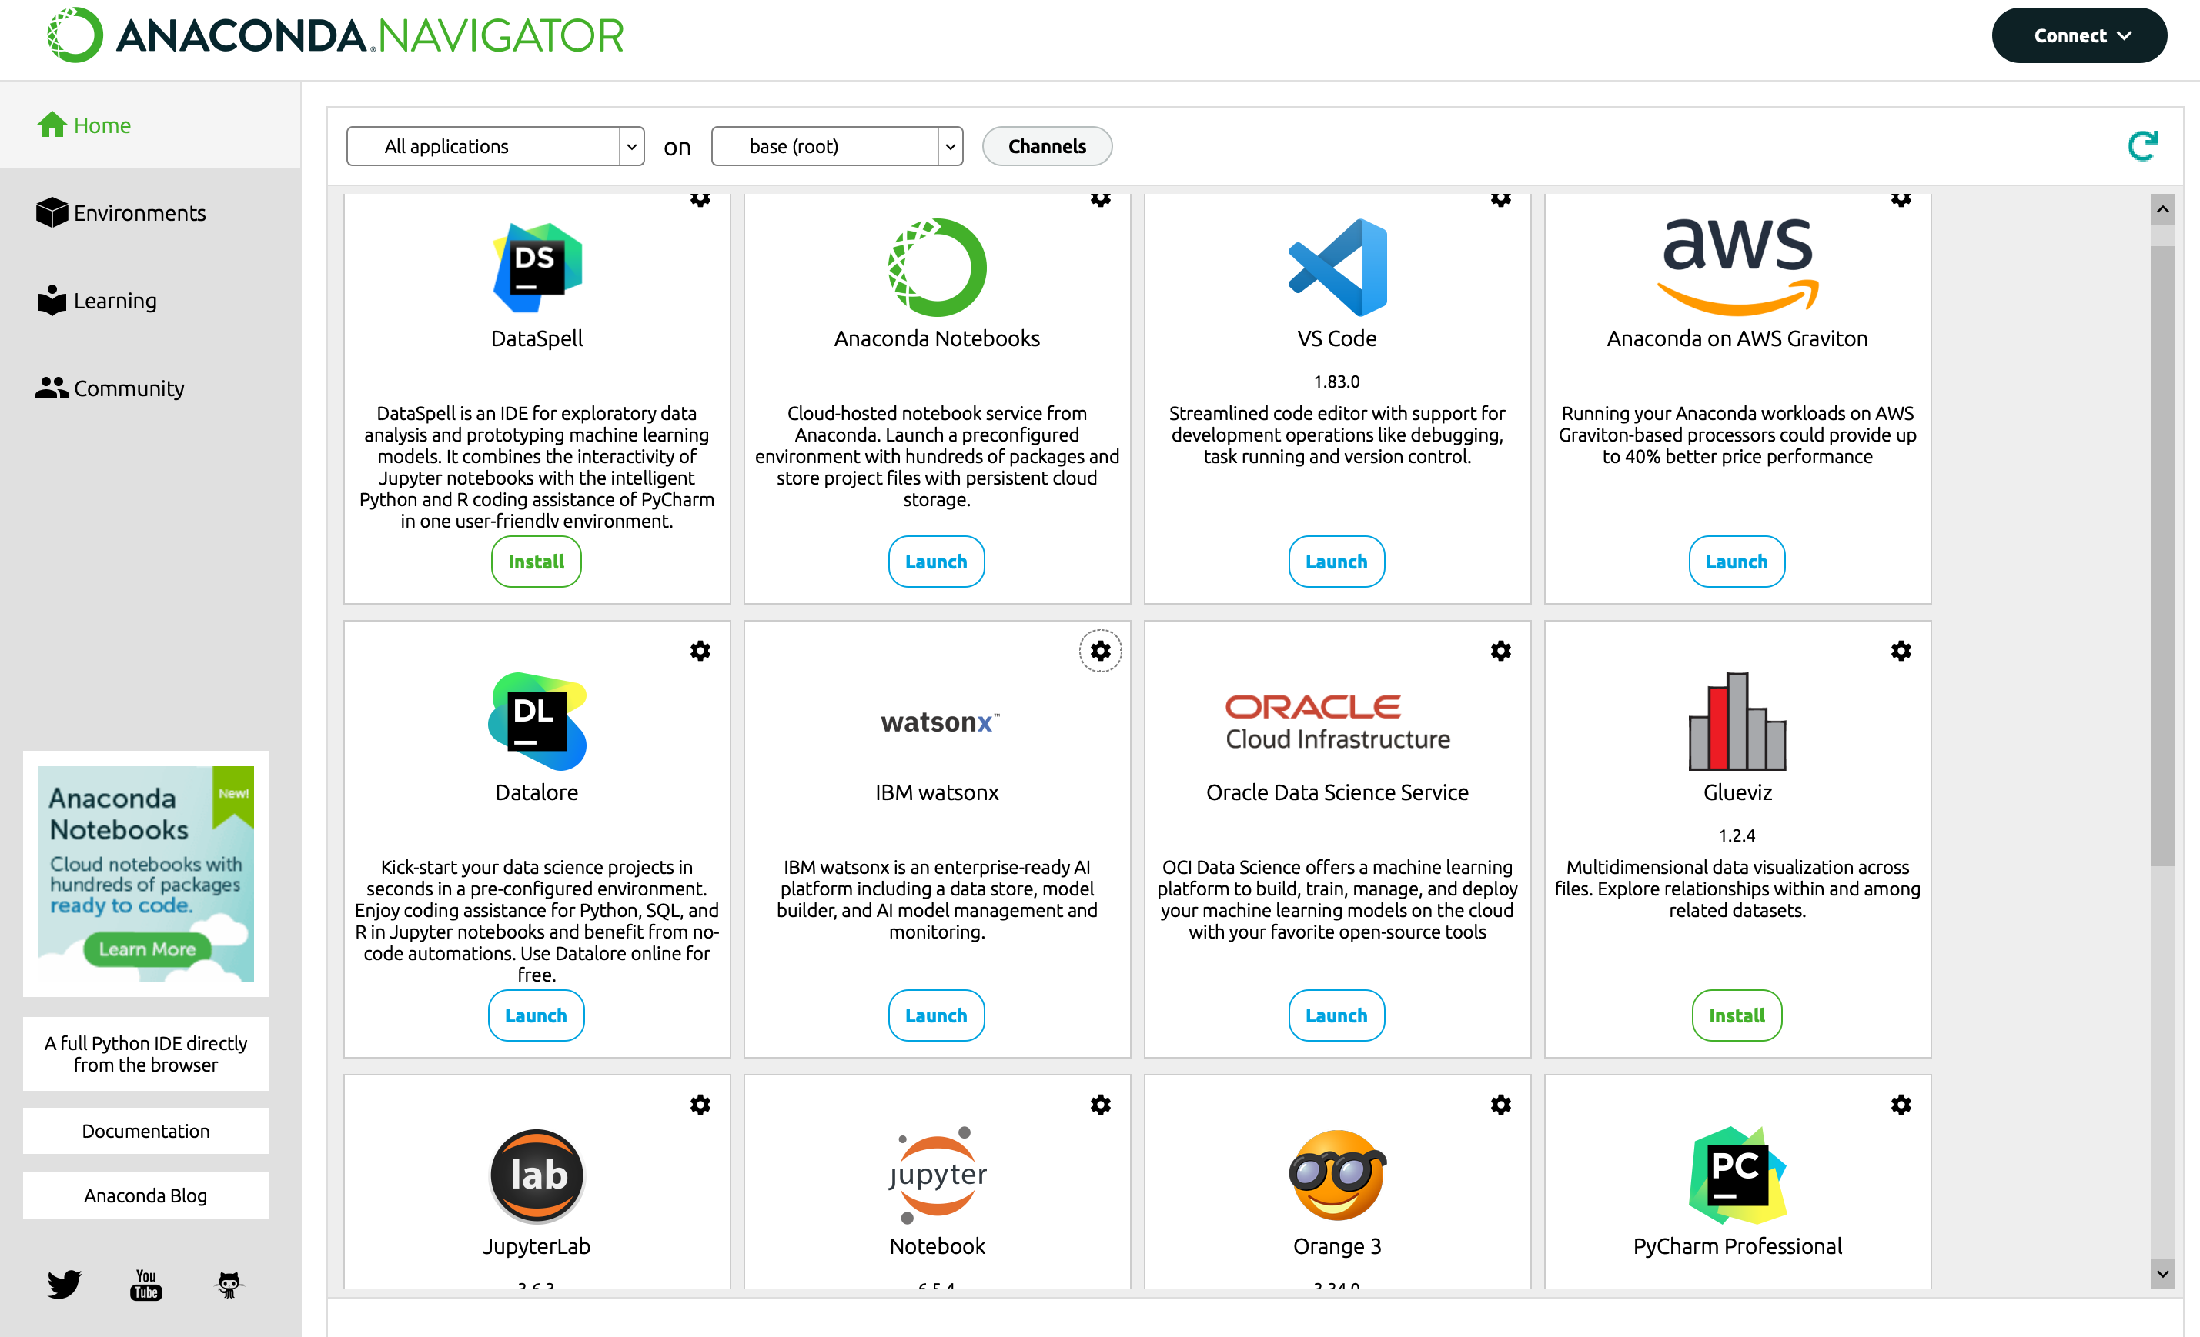
Installing Python: How does Anaconda look like?

Slide 10
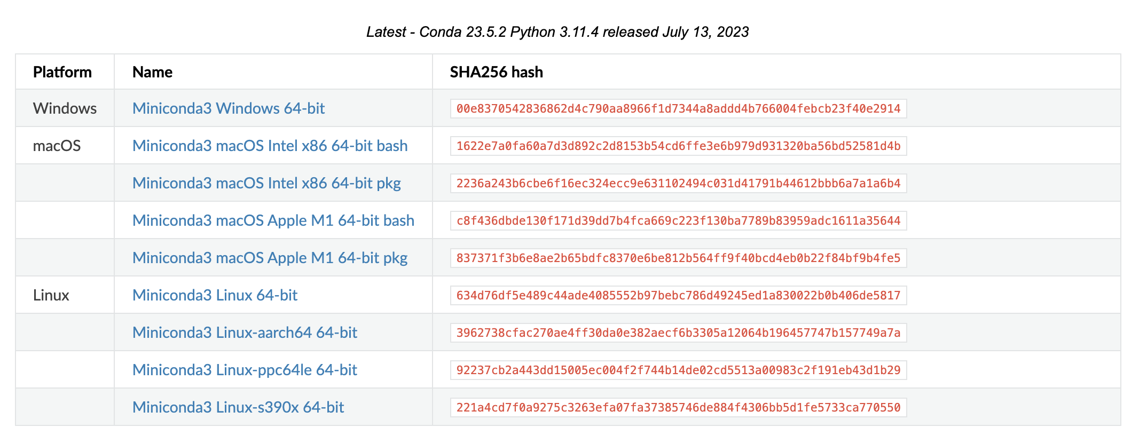
Installing Python: Install miniconda
https://docs.conda.io/projects/miniconda/en/latest/
Note 1: Remember the path you installed the miniconda (we will need it later)
Note 2: Don’t install in a path containing “space”: C:\Program Files\miniconda ✕ ✕ ✕
Note 3: It does not matter if we have multiple pythons installed on the computer

Slide 11
Installing Python: Find Python executable
Locate the folder you installed miniconda
Default Location:
Windows: C:\Users\<username>\AppData\Local\miniconda3
Mac: /Users/<username>/miniconda3/bin/python
Linux: /home/<username>/anaconda3
Find python executable (from command line/terminal):
Windows: where python
Mac/linux: which python
Initialize conda (from command line/terminal):
Windows: 1) <path_to_conda>\condabin\conda.bat activate 2) conda init
Mac: 1) source<path_to_conda>/bin/activate 2) conda init

Slide 12
Installing Python: Installing miniconda
DEMO

Slide 13
Installing Python: Editor VS IDE
Aspect | Editor | IDE
Purpose | Primarily for text editing | Integrated development environment designed for software development
Functionality | Basic text editing features like typing and formatting | Offers a wide range of tools, including code editing, debugging, compiling, and project management
Language Support | language-agnostic | Tailored to specific programming languages with features like syntax highlighting & code completion
Workflow | Suitable for simple text files and quick edits | Ideal for complex software projects, offering an all-in-one solution
Resource Usage | Light | Heavy
Examples | Notepad, Vim | Visual Studio, PyCharm, Spyder

Slide 14
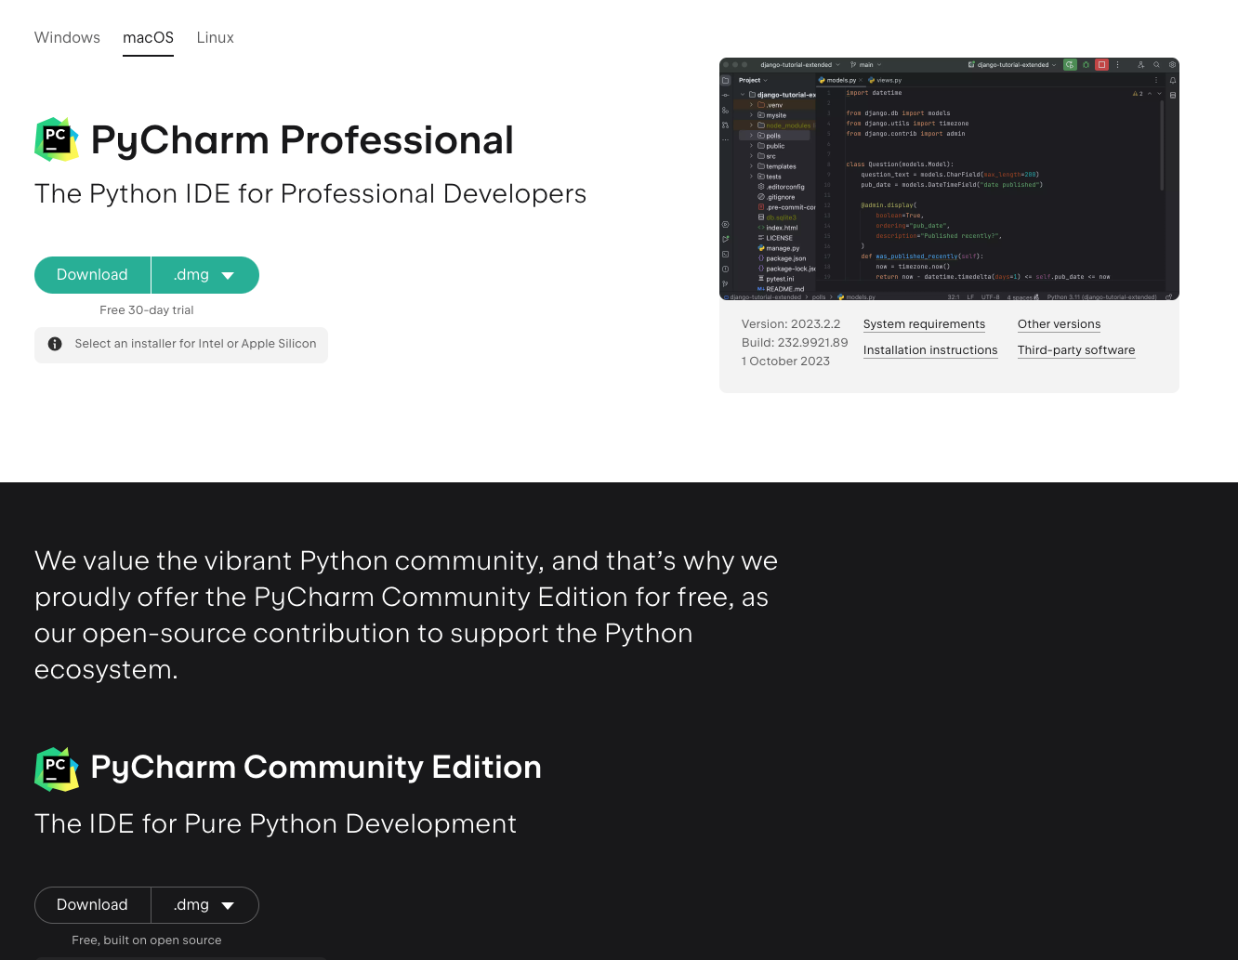
Installing Python: Installing IDE
https://www.jetbrains.com/pycharm/download/

Slide 15
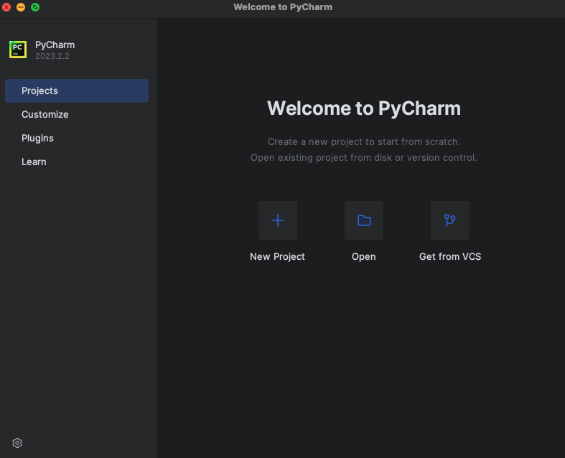
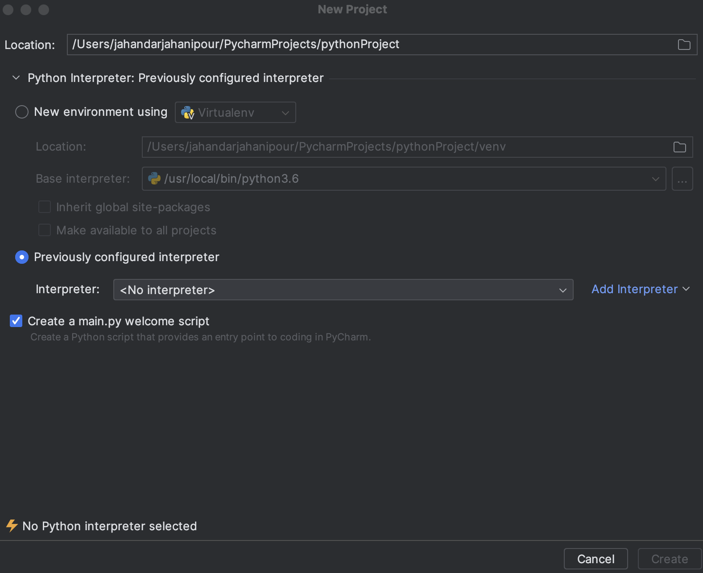
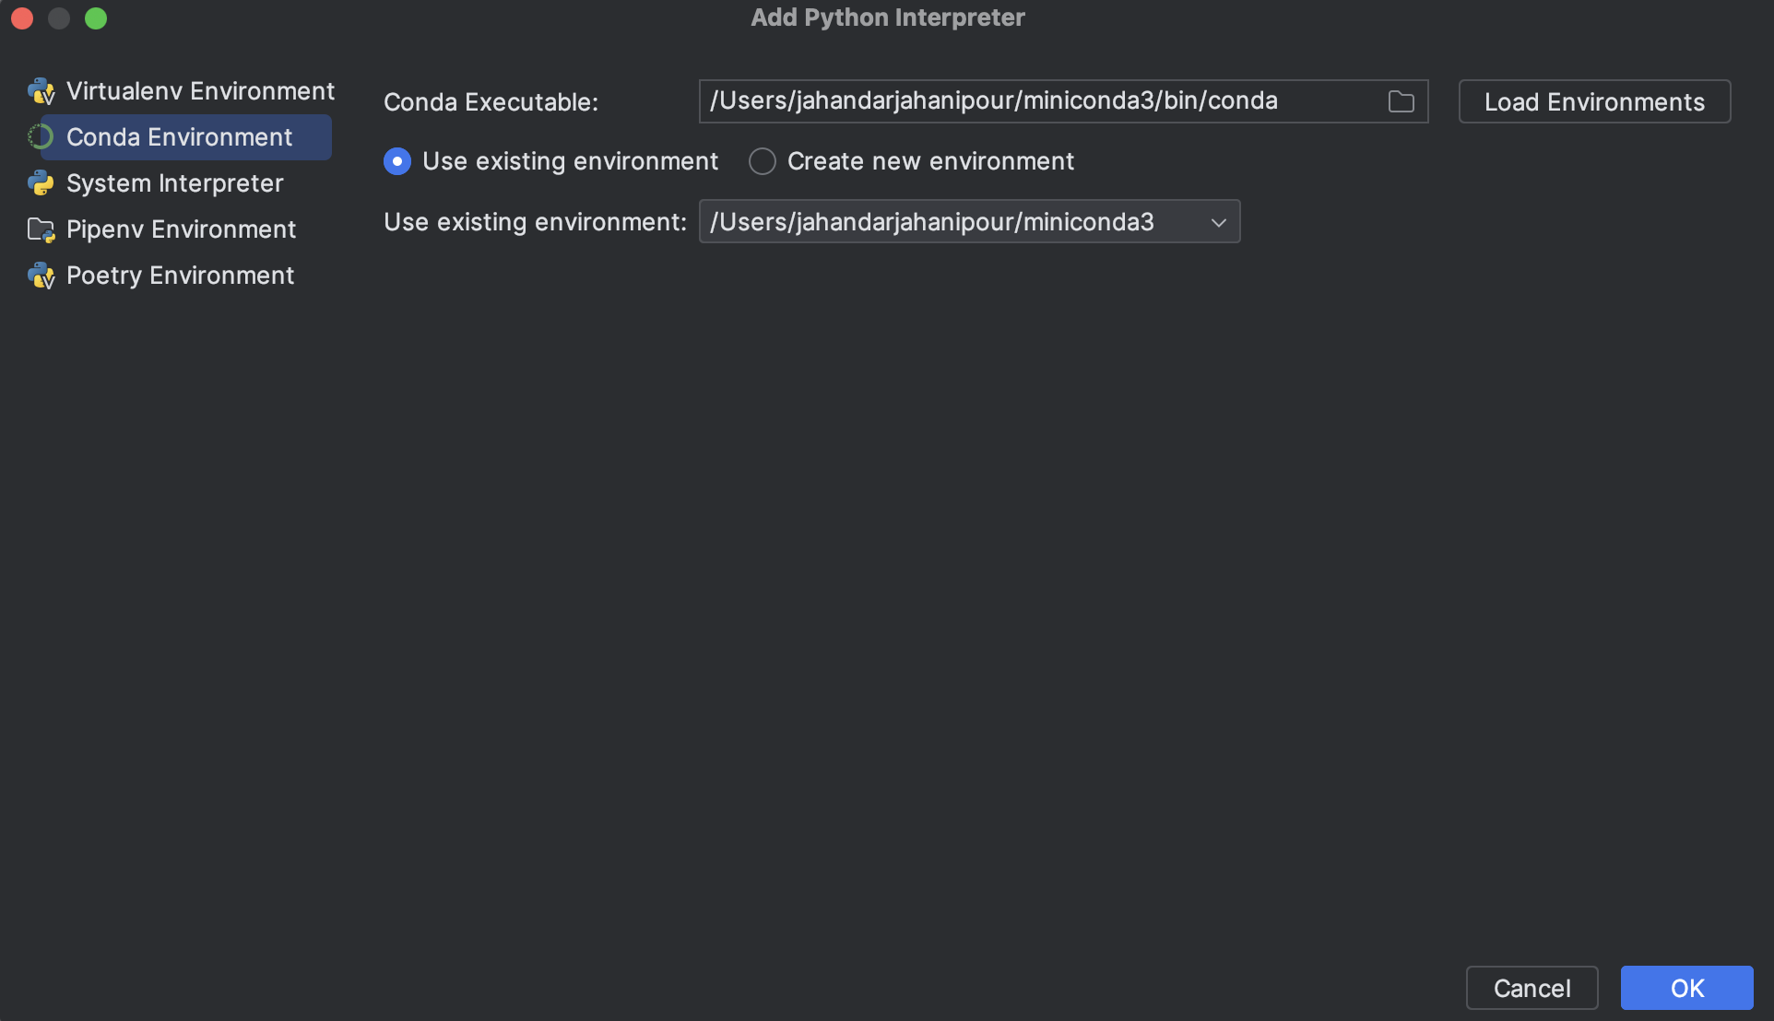
Installing Python: Connecting IDE to Interpreter

Slide 16
PyCharm Notes
Always right click on the screen and debug the file you want to debug

Slide 17
Installing Python: Installying PyCharm
DEMO

Slide 18
Python Basics
DEMO

Slide 19
Python Library - Package
A 3rd party library or package is external code written by other developers that can be imported and used in your own Python programs.
Advantages:
Saves Time: no reinvention the wheel.
Enhances Functionality: Access to a wide range of specialized tools and functions.
Community Support: Benefit from contributions and updates by the developer community.
Focus on Core Logic: Allows developers to focus on their application's core logic.
Types of 3rd Party Libraries:
Standard Libraries: Included with Python installation. (os – sys – math - …)
External Libraries: Developed by other organizations or individuals. (Numpy – Matplotlib – TensorFlow - …)
Installing 3rd Party Libraries:
From command line / Terminal:
pip install numpy
conda install numpy
Importing a library in Python:
import numpy as np

Slide 20
Python Library - Package
DEMO

Slide 21
Python Library - NumPy
DEMO

