Slide 1
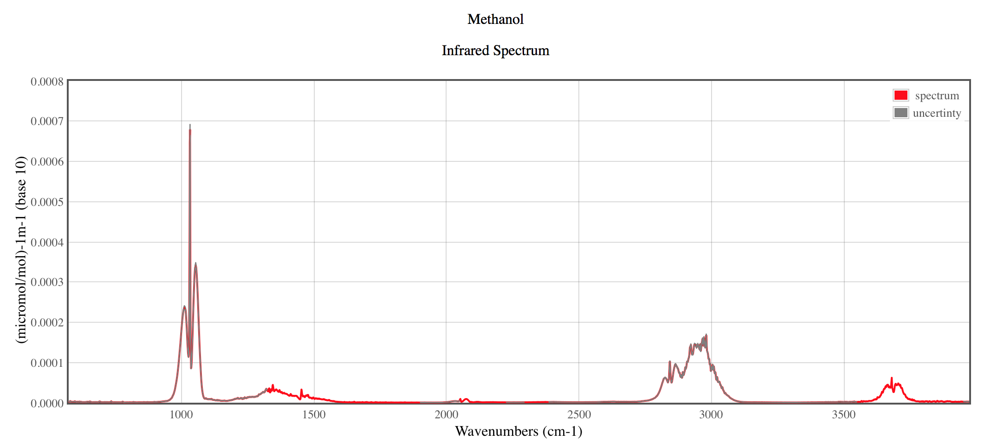
Methanol: IR spectrum vs MD simulations (DFTB+, NVT, T=333.15K, dftb3/3ob)
Experiment: http://webbook.nist.gov/cgi/cbook.cgi?ID=C67561&Units=SI&Type=IR-SPEC&Index=18#IR-SPEC
Experiment
Theory

