Slide 1
COMP 523
22 August 2012

Slide 2
Agenda
Introductions
Logistics
Selecting a project
Working with a client

Slide 3
Logistics
Web Site: http://www.cs.unc.edu/Courses/comp523-f12/
This course is
4 credits EE APPLES
CI (Implication: document iterations)
Programming Languages distribution group
Final is project presentations MONDAY DEC 10
Weekly team meetings with me, client, team
NO INCOMPLETES

Slide 4
How the Course Will Run
Meetings
Weekly team meetings with me: organizational and technical
Meetings with the client as appropriate (probably weekly)
Weekly team meetings
Regular deliverables
Description and dates will be posted on web
Multiple executable deliverables to client
Multiple classroom demos
Class dates BUT will consider reasoned
arguments about project-specific exceptions

Slide 5
Course Objectives
Overview of the practice of software engineering
Awareness of software engineering (and failures) in the real world
why software development is more than coding
Hands on experience of the full process
Working on a team
Individual assignments: broader view
Awareness of new technologies

Slide 6
Grading
75% project
individual contribution multiplier (.7 – 1.1)
25% process (includes professionalism)
7% requirements, 8% design and development, 10% completion
25% code
20% documentation
5% final presentation
15% technology presentation
10% individual assignments

Slide 7
Individual Contribution
Rare that it will go over 1.0
Basically, you can’t do better than the project
But there are always exceptional circumstances
Inputs
Peer evaluations
My evaluation
Client evaluation
Consultant evaluations

Slide 8
Professionalism
You are representing the university, the department, this class and yourself
You are expected to
show common courtesy
make it to meetings promptly or notify people
meet your commitments
Remember that your web site is publicly available and may be accessed by outside people

Slide 9
Team Roles: Assign ASAP
Client Manager
Client contact point
Meetings
Requirement changes
Project Manager
Meetings with me
Team meetings
Schedule
Editor
Documentation control
Polish
NOT only writer
Chief Developer
Architecture
Assignments

Slide 10
Selecting a Project

Slide 11
Process
Written descriptions
http://www.surveymonkey.com/s/TN9NSJZ
Presentations on Monday
Preferences by 8 pm (Google doc)
Assignments by 8 am Tuesday
First client meeting in class on Wednesday

Slide 12
Considerations
Does the topic interest you?
Do you think you can work with the client?
Platform to be used
Web, mobile, language, OS, …
Learn new or strengthen skills

Slide 13
Working with the Client

Slide 14
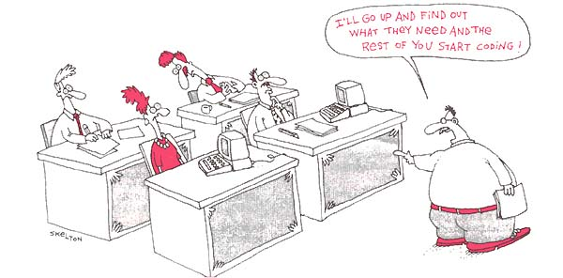
First Steps
To build something, we first must understand what it is we’re building
Establish expectations
Understandable by both the client and the developer
Need to understand
Concept
Users
Use cases
Requirements

Slide 15


Start with a Concept
MUST BE CRISP AND SIMPLE
How do you tell people about your project
Why are you doing it
What makes it unique or different
brochure elevator speech tweet

Slide 16
Clients vs. Users
The client is the person “paying the bill”
The users are the ones that will
Use your system
Maintain your system
Administer your system
Know
How they perform their tasks now
Their skill level
Their time constraints, tolerances, expectations

Slide 17
Talking to the client
Active listening
Restate what you hear
NOT “I hear you”
How to extract information
Ask them to “tell stories”
Focus on the interface: that’s what the user sees
Start the design process with the customer
Draw pictures!

Slide 18
User Stories
From the USER’s perspective
Capture what the user is trying to do
Different stories may trigger same function
BUT different concerns, sequences, constraints
Examples
Same user planning a trip for business or pleasure
Or buying an item for himself or as a gift

Slide 19
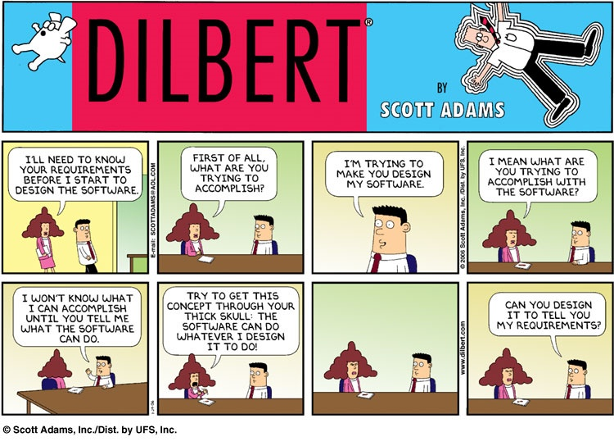
Requirements

