Slide 1
Software Engineering
05 September 2012

Slide 2
Software Engineering

Slide 3
Engineering
Turning ideas into reality
Creating something useful
from other things
using science and math

Slide 4
Software Engineering vs. Other Engineering Disciplines
Maturity
Roman aqueducts 2000 years ago
Software engineering 50 years ago
Startup costs
Barriers to entry
Rate of change

Slide 5
Software Engineering Objective
The right software
delivered defect free,
on time and
on cost,
every time.
Carnegie Mellon Software Engineering Institute

Slide 6
Common Mistakes
Over committing (“big eyes”)
Unrealistic schedules
Training
Access to people or materials
Hours in the day
Level of detail
Vague descriptions
Over specification
Not knowing your user
Assuming that you’ll get it right the first time

Slide 7
Different Types of Projects
Consider 4 different types of systems
COMP 523 projects
Productivity suites
Commercial web sites
Airplane systems
Pacemakers
How do they differ in criticality?
What does that mean for the development process?

Slide 8
All software projects are different
but …
Requirements will change.
Surprises will happen.
Schedules will slip.
Life will happen.

Slide 9
Transparency
Track what you do AND document it
…not as an afterthought
Living, heavily-used documentation

Slide 10
Software Engineering Process
Requirements
Design
Implementation
Test
Maintenance

Slide 11
Documentation Principles
Need to reflect changes
Not just change, but CAPTURE change
Version control
Need to keep all documents synchronized
Only say it once
Danger of shared ownership: If many own, no one owns
Practical consideration: Responsibility vs. authority

Slide 12
Why Written Requirements?
Unambiguous
Defines goals
Cost of finding a requirements bug later can be 100 times more expensive

Slide 13
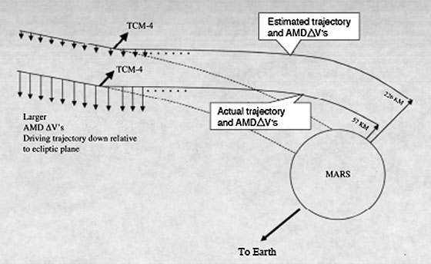
Mars Climate Orbiter (December 1998)
Intended to orbit Mars
Supposed to provide output in newton seconds
Instead crashed into it
Instead provided pound-force seconds
Minimum distance:
80 km

Slide 14
From Client to Plan
user stories and personas
use cases and user types
requirements
functional spec
user manual and plan
Notes:
What does the client want to do?
User stories – his (or her) terms
Use cases – your terms
Extract the essence: requirements
Requirements document as a tool
This product should …
Translate to a system: functional spec

Slide 15
Fundamental Steps
Step
Documentation
Requirements
Design
Implementation
Test
Deployment
Maintenance
Functional Spec
Design Document
Code
Test Plan
User Documentation
Design Document

Slide 16
Our Requirements Process
Personas and User Stories
Types and Use Cases
Requirements

Slide 17
Our Requirements Phase
What does the client want to do?
User stories – his (or her) terms
Use cases – your terms
Extract the essence: requirements
Requirements document as a tool
This product should …
Translate to a system: functional spec

Slide 18
What is a Functional Spec?
Defines
what the functionality will be
NOT how it will be implemented
Describes
features of the software product
product's behavior as seen by external observer
Contains
technical info and data needed for design
What a contractor bids on

Slide 19
Why a Spec?
Allows you to communicate with your client and users
Easier to change than code
Basis for schedule
Record of design decisions

Slide 20
What’s in a Functional Spec?
Overview: project description
Use cases and (optionally) personas
Interfaces: anything the USER sees or uses
Requirements
…as much as you know
Note: your functional spec may go through multiple iterations

Slide 21
Users

Slide 22
Understanding Users
Identify the user groups
Understand their goals
Determine the total user experience
How users perform their tasks now
Task and goal descriptions, importance ranking, strategies, measures, and targets
Stories and scenarios describing how they currently perform their tasks
Notes:
Distribute User Requirements WP.
Requirements cover current and desired ways of working.
“Work” is not meant to imply just business activity, but also, leisure and other activities.
Question for students: What are some of these non-work activities? (e-mail to friends and family, web shopping, making greeting cards, kids homework, etc.)
User segments and goals: Users types fall into categories. The users in each category are in the same category partly because they have similar goals.
User tasks, etc.: Need to understand the tasks of each group of users in great detail. How do users rate the importance of the tasks they want or need to perform to get their jobs done, or to accomplish a goal in their everyday lives? How frequently do they perform each task? What are their strategies for completing them? Perhaps they have found some shortcuts. How do users know if they have completed their task successfully?
Question for students: For example, if the task is to find a product on the web and buy it, how does a user know he’s been successful? (get confirmation he bought it? arrives in the mail?) What if it takes him 4 hours of searching to find the product, and he could have driven to a store and bought it in less time? What if he finds it quickly, but it’ll cost much more than at he store? All of these criteria are user-defined ways of measuring success.
Users are described very precisely in this work product. So is the context in which they work - their environment.
Metrics: Measurable ways to know if the new ways of doing the tasks meet user requirements.
Stories and scenarios - you have already worked with these in your exercise. Let’s talk more about these now.
Reference (from UE web site):
Definition: A clear articulation of how users currently work, what they expect to be able to do and how they wish to do it Purpose: Provide a comprehensive understanding on the users' expectations to support both conceptual and detail design
Led by: User Research
Assisted by: Market Planning
Used by (primary): All Roles
Created during: Understanding Users
Content: user segments and goals
user tasks, strategies, measures, and targets
task ranking in terms of importance to users
scenarios and stories that clearly communicate and demonstrate the users' requirements
characterization of the users (roles, responsibilities, skills, training, abilities, special needs)
characterization of the user environment (physical, cultural, social)
target measures for evaluating the design throughout the project

Slide 23
Why User Stories
From the USER’s perspective
Capture what the user is trying to do
Different stories may trigger same function
BUT different concerns, sequences, constraints
Examples
Same user planning a trip for business or pleasure
Or buying an item for himself or as a gift
Comes from agile programming model
SHORT: fit on an index card
Learn them from the client

Slide 24
User Characterization
Knowledge and experience
Age and gender
Physical handicaps
Characteristics of tasks and jobs
Psychological characteristics

Slide 25
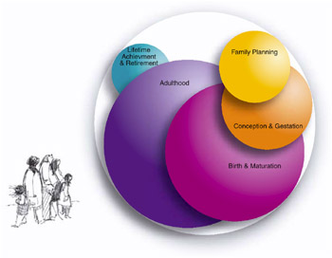
Personas
A description of a fictitious user representing a distinct user group
User groups are based on unique characteristics
Each persona represents a unique set of goals for design
Personas drive User-Centered Design (UCD)
Data-based personas
Microsoft
Persona Power
Notes:
Now that you have some experience creating a persona and a story, let’s talk about why we do this.
Personas have gained popularity as a design tool over the past 3 or 4 years. Alan Cooper has been the primary proponent of the method. Personas help designers keep the user in mind when designing. In fact, an integral part of the method involves finding photos of people to represent the personas and post them or create handouts with the photos.
Personas take advantage of one of the skills we have as humans: to relate to other humans. By depicting users as actual people, we can be more focused on how user swill interact with the design.

Slide 26
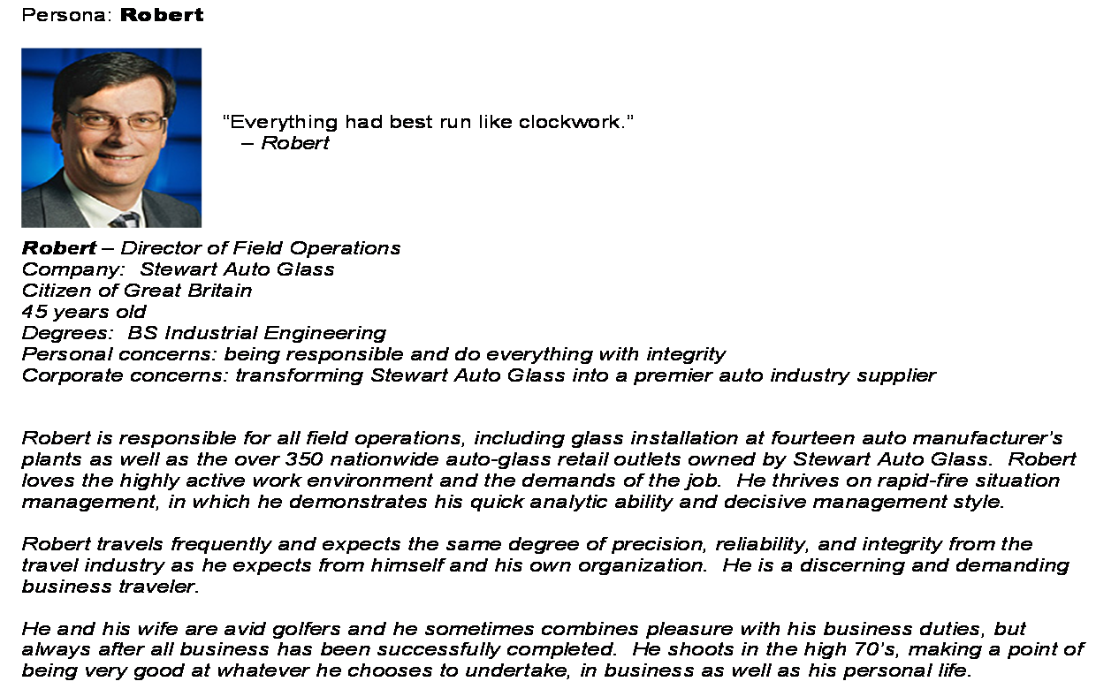
Persona excerpt (hotel reservation)
Notes:
Here’s a excerpt from a persona taken from your User Requirements WP.

Slide 27
Purported Benefits of Personas
Establishes users’ goals and needs
Provides manageable set of users
Reduces gathering of user requirements
Focuses on what users will use
Prioritizes design efforts
Resolves disagreements over design decisions
Reduces usability tests

Slide 28
User Types: Broad, easily described
Typically self-explanatory
Never more than a sentence or phrase
User, not new user, experienced user

Slide 29
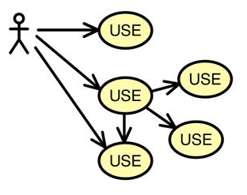
Generalizing to Use Cases
A statement of the functionality users expect and need, organized by functional units
Different from user stories because they are from the software’s perspective
Functional units are any natural division
Relationships between user types and use cases
User activities, decisions, and objects involved
In terms of user types: classifications that the system recognizes
Notes:
Use Cases are depictions of bits of function, the sum total of which make up the functionality of the new offering.
These depictions take into account what the different types of users (roles), and which roles perform which use cases.
A use case calls out the objects users use to perform the various activities, and the criteria that define whether the task performance has been successful.
We’re going to cover this more extensively tomorrow.
Reference (from UE web site)
Definition: A statement of the functionality users expect and need organized by functional units
Purpose: To define the scope of the design and common units that can be shared across the design
Led by: User Experience Design
Used by (primary): User Experience Design
Created during: Understanding Users
Content:
functional units to be designed (a use case)
relationships between user roles and use cases
user activities, decisions, and objects involved (an initial designer's task model)
task-level success criteria that satisfies user requirements for the tasks to be evaluated

Slide 30
Documenting Use Cases
UML diagrams are often used
Requires tools
Will discuss later, not use for now
We will use simple text description
Examples from prior years
Butterfly Lab
Foreign Language Resource Center

Slide 31
Requirements

Slide 32
Types of Requirements
Functional : services needed
Usability : how easy it is to do it
Performance: speed, capacity, memory
Reliability and availability: failure rates
Error handling: how to handle
Interface: user and program
Constraints: systems and tolerances
(Inverse: what it won’t do)

Slide 33
A requirement must be …
Documented
Expressed precisely
Expressed as what, not how
Prioritized
essential, desirable, optional
primary, secondary, tertiary
Testable

Slide 34
The set of requirements must be…
Consistent
Three requirements:
Only basic food staples will be carried
Everyone will carry water
Basic food staples are flour, butter, salt, and milk
Complete
The function tells whether 3 numbers produce an equilateral, isosceles, or scalene triangle.

Slide 35
Requirement Level
Two phases
Requirements written at customer level
Developer will convert in order to do design
Once agreement exists with customer, developer “translates” them into his language
Example
Customer: User must never lose more than 10 minutes of work
Developer: Autosaving is required

