Slide 1
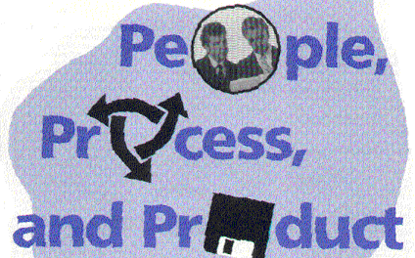
the 3 P’s:
17 September 2012

Slide 2
Interactions
There is no “right answer”
Typically people and product are fixed
… can adapt process
(which is where we will start)

Slide 3
Processes

Slide 4
Fundamental Steps
Requirements
Design
Implementation
Test
Deployment
Maintenance

Slide 5
Processes
Differ by
  how often you do the steps
  Focus and emphasis
Points on the spectrum
Differences in overhead
Three fundamental processes
  Waterfall
  Spiral
  Iterative

Slide 6

Waterfall
Do it once
Traditional model
Used for large next version releases,
especially when
well understood product
tightly coupled changes

Slide 7
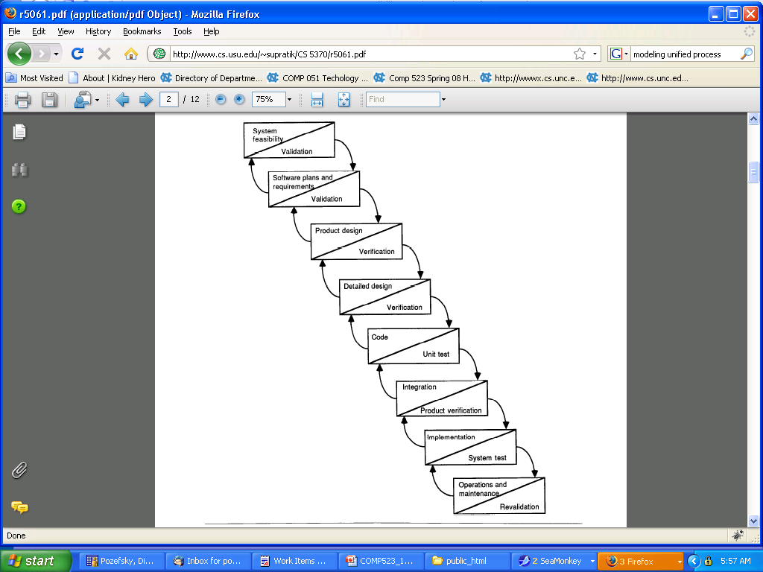
Waterfall
1970s
Built on 1950’s stage-wise process
Recognized the need for feedback
  Limited
  Heavy process

Slide 8
Waterfall
Pros
  Simple documentation management
  Clean design phase
Cons
  Least flexibility
  No early feedback

Slide 9

Iterative (a.k.a. Agile)
Many iterations
Each iteration is on a fixed cycle
  Typically biweekly
Used for projects with
lots of small independent, but well understood, changes
small development team
strong client involvement

Slide 10
Iterative
Reaction to waterfall
Derived from “evolutionary” process
  Requirements and specs evolve over time
Two well-known models
  Extreme programming
  SCRUM

Slide 11
Iterative (a.k.a. Agile)
Pros
  Fast feedback on problems
  Very adaptable to any changes
  Lots of versions to work with
  Heavy user involvement
Cons
  Document maintenance
  Code maintenance
  Requires good automation

Slide 12

Spiral
Few iterations
Each iteration adds new requirements
Used often for projects with less well defined requirements

Slide 13

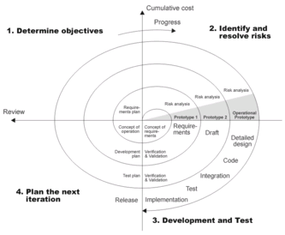
Spiral
Risk based
Barry Boehm 1988
“A Spiral Model of Software Development and Enhancement”

Slide 14
Spiral
Pros
  Adaptation to changes based on risks
  Good customer interaction
  Early version
  Limited iterations provide phase structure
Cons
  Document maintenance

Slide 15
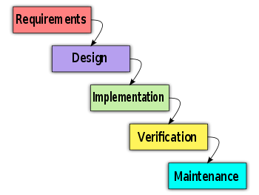
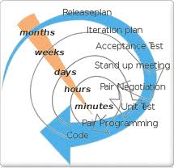
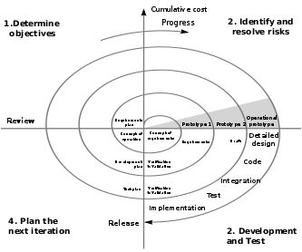
Historical Perspective
Waterfall: 1970, built on 1950’s stage- wise processes
Recognized need for feedback
Iterative (agile): late 70s,modeled on evolutionary model
Didn’t work well for large products
Spiral: 1988, risk-based

Slide 16
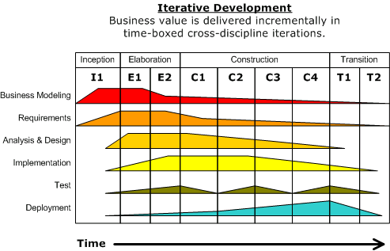
Unified Process
Variant of Spiral
Identifies that iterations differ
Also known as Rational Unified Process (Rational products)
Core Processes
Phases

