Slide 1
REQUIREMENTS Project management tools
17 September 2012

Slide 2
REQUIREMENTS

Slide 3
Sources of requirements
People
Stakeholders
Who are the stakeholders?
Issues:
Conflicting requirements
Wants vs. needs
Helping the customer articulate the requirements
Use cases
Hardware constraints
Laws of physics and nature
Social responsibility

Slide 4
Social responsibility
Privacy
Security
How it will (can) be used
Does it have the potential for misuse?
Can it be used to harm people?

Slide 5
Sources of Requirements: People vs. Other
decision support system for military tactics
unconstrained
video game
Type of application
corporate accounting system
manufacturing control system
enhancement to corporate accounting system
highly constrained
flight control system for airliner
missile guidance system
relatively low
% of requirements gathered from people
relatively high
(Brackett, CMU)

Slide 6
PROJECT MANAGEMENT TOOLS

Slide 7
Tools to Help
Product flow
Dependencies and relationships of deliverables
Work breakdown structure
The parts
PERT charts
Program Evaluation and Review Technique
Critical Path Method
Equivalent to PERT charts
Gantt charts
Schedule overview

Slide 8
Product Flow
Identify sequences and dependencies
Distinguish new from existing components
Important if you have many different deliverables

Slide 9
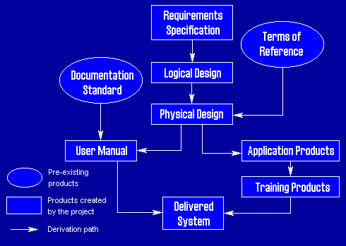
Product Flow

Slide 10
Work Breakdown Structure
Need to break down the tasks into component parts and tasks
Level of detail important:
The more detailed, the better
Lacks any time component

Slide 11
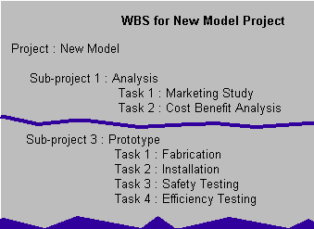
Work Breakdown

Slide 12
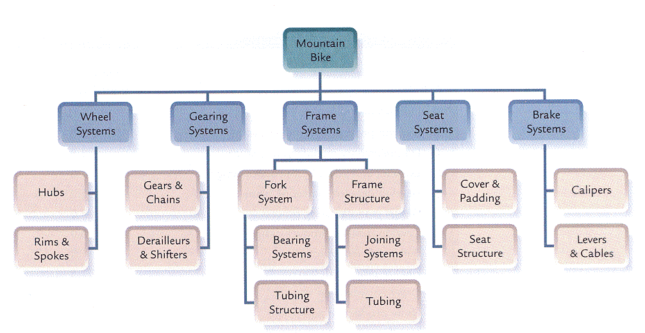
Graphical WBS

Slide 13
PERT Charts
Critical path identification
Program Evaluation and Review Technique
Also known as activity networks
Developed by Navy in 1958
Three stages:
Planning (tasks and sequence)
Scheduling (start and finish times)
Analysis (float and revisions)
Two different models
Activities are nodes (most common) or arcs

Slide 14
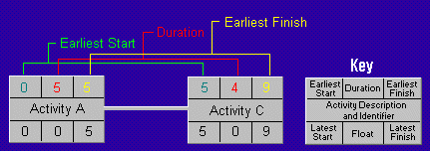
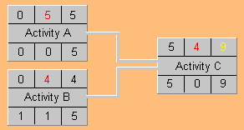
Pert Charts

Slide 15
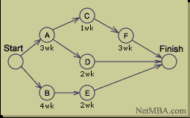
CPM: Critical Path Method
Alternative to PERT
Dupont 1957
Graphical view of project
Predicts time required to complete
Shows which activities are critical to maintaining the schedule
Lacks the built in model of float
Easy to use informally

Slide 16
Planning
Identify the specific activities and milestones.
Determine the proper sequence of the activities.
Construct a network diagram.
Estimate the time required for each activity.
Determine the critical path (longest path through the network).
Update the PERT or CPM chart as the project progresses

Slide 17
Gantt Charts
Milestone charts
Invented by Harvey Gantt in 1916
Advantages
Less detailed
Amenable to management overlays

Slide 18
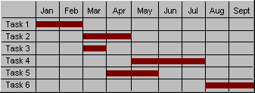
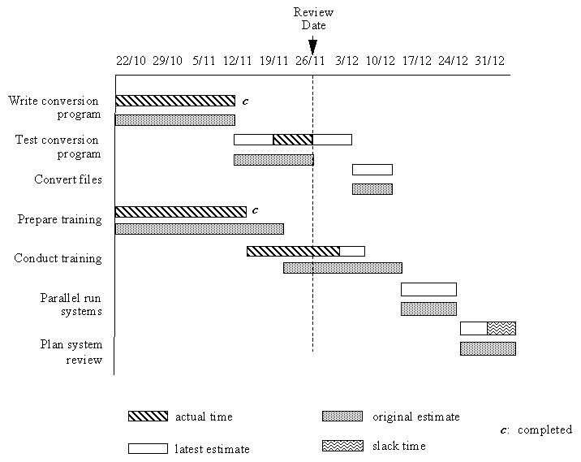
Gantt Chart with Overlays
Note that dates are Day/Month

Slide 19
Scheduling Steps with Tools
Put together minimal solution
Primary requirements
Start with external commitments
Functional spec
Milestones
Introduce internal milestones
Work breakdown structure
Product Flow
PERT Chart or CPM, Gantt chart
Focus on the risks
Add next level of features where possible
Secondary requirements

Slide 20
Resources
No shortage of available tools
dmoz.org/Computers/Software/Project_Management
Project Management as a discipline
Degrees
Certification
Project Management Institute

