Slide 1
DESIGNING YOUR SYSTEM
19 September 2012

Slide 2
One More Process

Slide 3
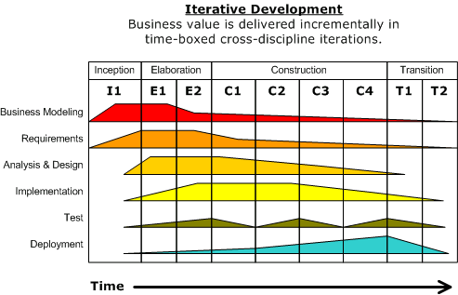
Unified Process
Variant of Spiral
Identifies that iterations differ
Also known as Rational Unified Process (Rational products)
Core Processes
Phases

Slide 4
Designing your System

Slide 5
Requirements to Product
You understand what you want to build
Model the real world in software
Choose an architecture to do it: borrow or invent?
Design the components for the architecture
Build them

Slide 6
Models

Slide 7

Modeling
Based on abstraction
Looking only at relevant information
Hiding details
Create multiple views
As orthogonal as possible
Each view has information that is unique
Each view has information that appears in other views
Common information is consistent
How many views?

Slide 8
Why Modeling?
Simplify in order to understand
Consider building a house
How do we model?
What are the equivalent pieces for software?

Slide 9
Example of a System Model
Three views
Functional: what is done
Data: entity relationships
Dynamic: state transitions
Why these three?
Duplicative?
Missing?

Slide 10
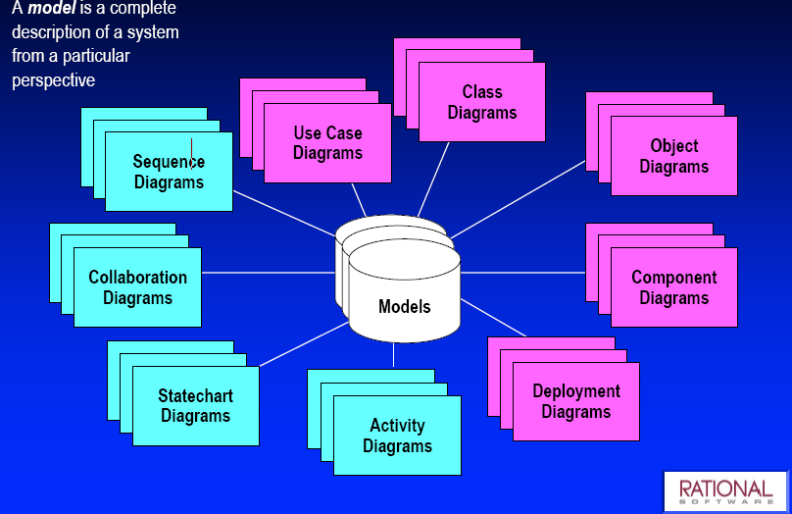
Software Models

Slide 11
Modeling Languages and Processes
Language: syntax, usually graphical, used to express design
Process: steps to take to create a design
Many processes, not a lot of agreement
General consensus has built around UML as a language
We’ll look at UML later
Rational Unified Process built around UML

Slide 12
Patterns
Helping to Build Models

Slide 13
What is a Pattern?
A solution to a problem in a context
A structured way of representing design information in prose and diagrams
A way of communicating design information from an expert to a novice
Requirement: shows when and how to apply

Slide 14

Origin of Patterns
Came from the field of (building) architecture
Christopher Alexander, late 70s
The Timeless Way of Building (1979)
Describes
Common architectural motifs
How they come together to form a cohesive, livable environment
Patterns from town planning to decorative detail

Slide 15
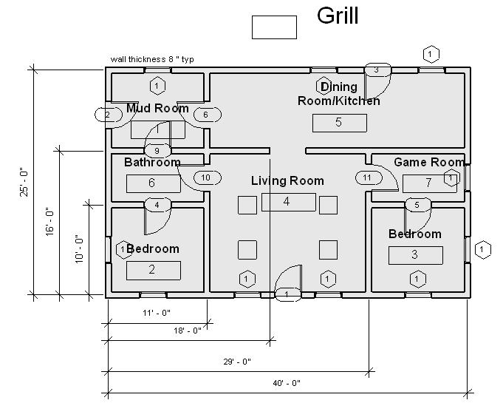
Architectural Example: Door Placement
If room has two doors and people move through it, keep both doors at one end of the room

Slide 16
A Favorite Quote
Current architectural methods result in
products that fail to meet the real
demands and
requirements of its users,
society and its individuals, and are
unsuccessful in fulfilling the quintessential purpose
of all design
and engineering endeavors:
to improve the human condition.
– Christopher Alexander

Slide 17
Alexander’s Patterns
Five parts:
Name: short familiar, descriptive name or phrase
usually indicative of the solution
Example: illustrate prototypical application
pictures, diagrams, and/or descriptions
Context: situations in which the pattern applies
Problem: relevant forces, constraints, interactions
Solution: relationships and rules to construct artifacts
often listing several variants
What do you need to change for software?

Slide 18
Properties of Patterns
Encapsulation: independent, specific, precise applicability
Generativity: describes how to build
Equilibrium: solution minimizes constraint conflicts
Abstraction: of empirical experience and everyday knowledge
Openness: can be extended up or down
Composibility: hierarchically related
What do you need to change for software?

Slide 19
Design Patterns
All the same benefits are true in software
Cunningham and Beck recognized in late 80s
Community formed in early 90s
The Book:
Gamma, Helm, Johnson and Vlissides, Design Patterns: Elements of Reusable Object-Oriented Software (1995)
Define 23 patterns
Three categories:
Structural – ways to represent ensembles of information
Creational – creating complex objects
Behavioral – capturing the behavior of object

Slide 20
Patterns Exist at All Levels
Machine code
Assemblers
High Level Languages
Abstract Data Types (queues, stacks)
Objects
Patterns
Software Architectures

Slide 21
Software Architectures

Slide 22
Software Architecture
What is an architecture?
External view
What does that mean for software?
Two definitions
User interface (product architecture)
Highest level design (software architecture)

Slide 23
Software Architecture Goals
Extensibility: adding new features
Tradeoff of generality and time
How might it be extended?
Changeability: requirements changes
Simplicity: ease of understanding and implementing
Efficiency: speed and size

Slide 24
Key Characteristics
Cohesion
degree to which communication takes place within the module
Coupling
degree to which communication takes place between modules
Min-max problem:
minimize coupling; maximize cohesion

Slide 25
Categorizing Software Architectures (Shaw and Garlan)
Model-View-Controller
Data flows
Viewed as data flowing among processes
Independent components
Components operating in parallel and communicating occasionally
Virtual machines
Treats an application as a program written in a special-purpose language
Layered architectures
Packages of function with a strong hierarchical uses relationship
Repository
Application built around data

Slide 26
Why Categorize?
Recognize patterns
Reuse designs
Learn from other similar applications
Reuse classes
Simplify communication

Slide 27
Examples of Use (real quotes)
… is based on the client-server model and uses remote procedure calls ...
Abstraction layering and system decomposition provide the appearance of system uniformity to clients …
The architecture encourages a client server model …
We have chosen a distributed, object-oriented approach
The easiest way … is to pipeline the execution …

Slide 28
Well-known Architectures
Model-View Controller
Data flows
Independent components
Virtual machines
Layered architectures
Repository

Slide 29
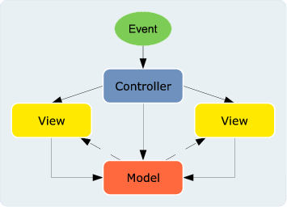
Model-View-Controller
Originally designed for SmallTalk
Early OO language (1970’s)
Steve Burbeck, 1987
First paper

Slide 30
Data Flow Design
Data flowing among processes
Two categories:
Pipes and filters
Filters: processes
Pipes: input streams
Batch sequential
Pipe and filter where input streams are batches of data
filter
filter
filter
pipe
filter
filter
filter
filter
filter
filter
filter
filter
filter
filter
filter
filter
pipe
filter
filter
filter
pipe
Collect
mortgage funds
Mortgage
pool
Account
balances
Collect
unsecured funds
Unsecured
pool

Slide 31
Independent Components
Components
operating in parallel
communicating occasionally
Different types
Client-server
Parallel communicating processes
Event systems
Service Oriented Architecture
Notes:
Client-server
Browser-web server most familiar example
Separate systems with narrow interface
Sometimes expanded to three tiers (why?)
Façade pattern (single unified interface)
Parallel communicating processes
Several processes executing at the same time
Typically modeled with sequence diagrams
Observer pattern (one-to-many dependencies)
Event systems
Set of components waiting for input
Example: word processor waiting for user input
State transition diagrams
State pattern (alter behavior depending on state)
Service Oriented Architecture

Slide 32
Client-Server and Facade
Façade
«exposed»
Browser-web server most familiar example:
Separate systems with narrow interface
1
Client
2
Key concept: limit exposed interface
«not exposed»
«not exposed»
P
«not exposed»
«not exposed»
«not exposed»
Adapted from Software Engineering: An Object-Oriented Perspective by Eric J. Braude (Wiley 2001), with permission.

Slide 33
Parallel Communicating Processes
processes
Session:
session m
Session:
session k
Account:
customer n
checking
Customer:
customer n
actions
Customer:
customer n+1
create
Account:
customer
n+1 saving
retrieve
create
retrieve
deposit
withdraw
Duration of process
3 types of processes, 2 instances of each
sequence diagram
Adapted from Software Engineering: An Object-Oriented Perspective by Eric J. Braude (Wiley 2001), with permission.

Slide 34
Observer Design Pattern
Client of this
system
Single source of data with a number of clients that need to be updated
1
Request others be notified
1..n
Source
notify()
Observer
update()
2
Notify all observers
ConcreteObserver
observerState
update()
ConcreteSubject
state
3
Determines if change needed
Gamma et al

Slide 35
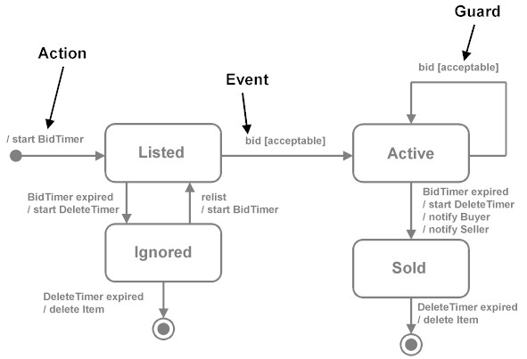
Event Systems and State Transition Diagrams
Set of components waiting for input
Set of components waiting for input

Slide 36
Services Oriented Architecture
Collection of services
Direct communication
Coordinating service
Different technologies
Early ones: DCOM CORBA (brokers)
Web Services
Lots of different models and tools: REST (REpresentational State Transfer using HTTP just one)

Slide 37
Virtual machines
Treats an application as a program written in a special language
Payoff is that the interpreter code is the basis for multiple applications
Two types
Interpreters (JVM)
Rule-based systems (AI)

Slide 38
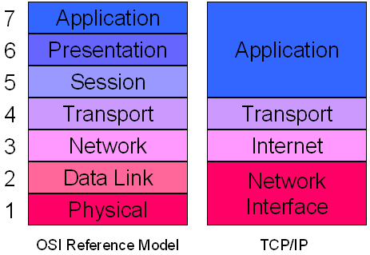
Layered Architecture: Network
OSI
TCP/IP

Slide 39
Repository
A system built around data
Two types
Databases
Hypertext systems

Slide 40
A Typical Repository System
GUI
Analysis
process
1
Analysis
process
n
Control
…...
…...
DBMS
Database
Adapted from Software Engineering: An Object-Oriented Perspective by Eric J. Braude (Wiley 2001), with permission.

Slide 41
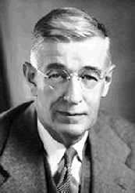
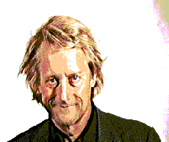
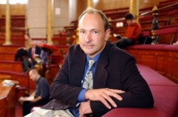
Hypertext: Basis of the Web
Motivated by Vannevar Bush in 1945
“As We May Think” (Atlantic Monthly)
Theoretical machine, "memex," to enhance human memory by allowing the user to store and retrieve documents linked by associations
Invented by Ted Nelson in the 1960s
Popularized with HTML (Tim Berners-Lee)

Slide 42
Ted Nelson
"If computers are the wave of the future, displays are the surfboards."
Xanadu: 1974
"give you a screen in your home from which you can see into the world's hypertext libraries... offer high-performance computer graphics and text services at a price anyone can afford... allow you to send and receive written messages... [and] make you a part of a new electronic literature and art, where you can get all your questions answered...“
Computer Lib/Dream Machines
For more details, see pdf

Slide 43
Summary
Model-View-Controller Web application
Data flow systems Pipes and filters
Batch sequential
Independent components Client-server
Parallel communicating processes
Event systems
Service Oriented Architecture
Virtual machines Interpreters
Rule-based systems
Layered architectures
Repositories Databases
Hypertext systems

Slide 44
Examples from Prior Years

Slide 45
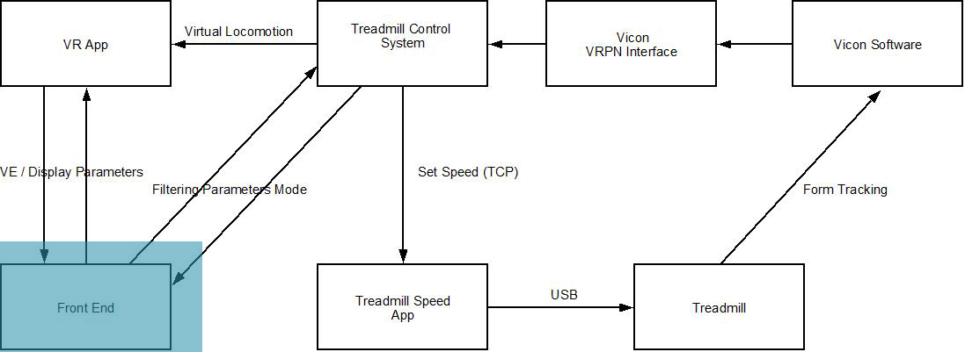
Virtual Reality for Stroke Patients

Slide 46
Social Welfare Web Site
Templates
(Few)
Configs
(Many)
Processor
SAS Files
Command Line Client
GUI Client
Interpreter
Velocity Library

Slide 47
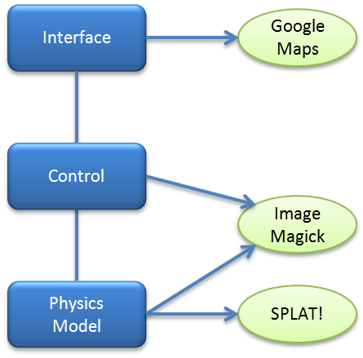
Wireless Deployment

