Slide 1
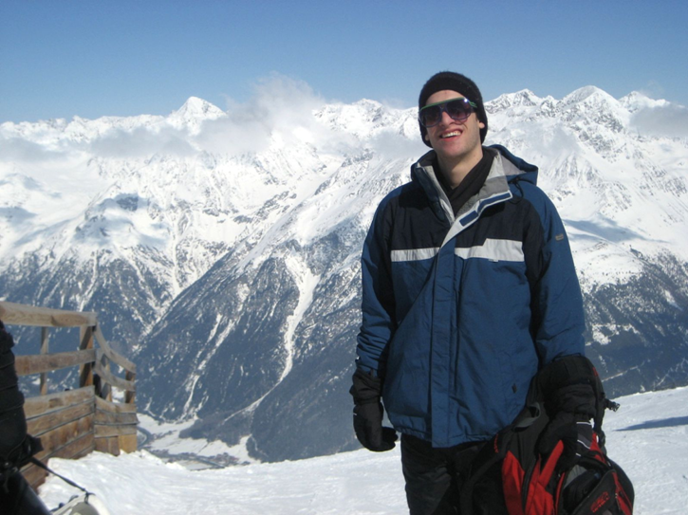
Information Session
Study Abroad Opportunities for Science Student
Tuesday, November 8, 5-6 PM
107 Wilson Hall
Summer Programs (Organic and Physical Chemistry, research in Singapore ..)
Semester or Year-long exchange programs in France, Spain, Great Britain, Germany, … (get a full year of science credits while abroad)
Returning students will tell about their experience in Spain, Sweden, France, ..
Learn about a new program in France:
Take many science classes in English while studying French. Only 1 year of college French required.
Get more information at the UNC Study Abroad Office and from Prof. Tomas Baer (Chemistry)

