Slide 1
Software Engineering
07 September 2011

Slide 2
Engineering
Turning ideas into reality
Creating something useful
from other things
using science and math

Slide 3
Software Engineering vs. Other Engineering Disciplines
Maturity
Roman aqueducts 2000 years ago
Software engineering 50 years ago
Startup costs
Barriers to entry
Rate of change

Slide 4
Software Engineering Objective
The right software
delivered defect free,
on time and
on cost,
every time.
Carnegie Mellon Software Engineering Institute

Slide 5
Common Mistakes
Over committing (“big eyes”)
Unrealistic schedules
Training
Access to people or materials
Hours in the day
Level of detail
Vague descriptions
Over specification
Not knowing your user
Assuming that you’ll get it right the first time

Slide 6
Different Types of Projects
Consider 4 different types of systems
COMP 523 projects
Productivity suites
Commercial web sites
Airplane systems
Pacemakers
How do they differ in criticality?
What does that mean for the development process?

Slide 7
All software projects are different
but …
Requirements will change.
Surprises will happen.
Schedules will slip.
Life will happen.

Slide 8
Transparency
Track what you do AND document it
…not as an afterthought
Living, heavily-used documentation

Slide 9
Software Engineering Process
Requirements
Design
Implementation
Test
Maintenance

Slide 10
Fundamental Steps
Step
Documentation
Requirements
Design
Implementation
Test
Deployment
Maintenance
Functional Spec
Design Document
Code
Test Plan
User Documentation
Design Document

Slide 11
Why Written Requirements?
Unambiguous
Defines goals
Cost of finding a requirements bug later can be 100 times more expensive

Slide 12
Documentation Principles
Need to reflect changes
Not just change, but CAPTURE change
Version control
Need to keep all documents synchronized
Only say it once
Danger of shared ownership: If many own, no one owns
Practical consideration: Responsibility vs. authority

Slide 13
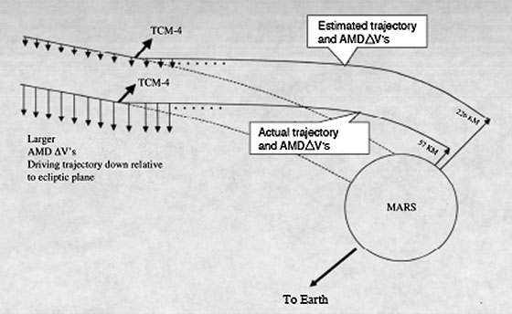
Mars Climate Orbiter (December 1998)
Intended to orbit Mars
Supposed to provide output in newton seconds
Instead crashed into it
Instead provided pound-force seconds
Minimum distance:
80 km

Slide 14
Our Requirements Phase
What does the client want to do?
User stories – his (or her) terms
Use cases – your terms
Extract the essence: requirements
Requirements document as a tool
This product should …
Translate to a system: functional spec

Slide 15
Concept: Essence of Project
Refer back if losing your way
Remind yourself and others why
Prominent: first page of your web

Slide 16
Process
Personas and User Stories
Types and Use Cases
Requirements

Slide 17
Understanding Users
Identify the user groups
Understand their goals
Determine the total user experience
How users perform their tasks now
Task and goal descriptions, importance ranking, strategies, measures, and targets
Stories and scenarios describing how they currently perform their tasks
Notes:
Distribute User Requirements WP.
Requirements cover current and desired ways of working.
“Work” is not meant to imply just business activity, but also, leisure and other activities.
Question for students: What are some of these non-work activities? (e-mail to friends and family, web shopping, making greeting cards, kids homework, etc.)
User segments and goals: Users types fall into categories. The users in each category are in the same category partly because they have similar goals.
User tasks, etc.: Need to understand the tasks of each group of users in great detail. How do users rate the importance of the tasks they want or need to perform to get their jobs done, or to accomplish a goal in their everyday lives? How frequently do they perform each task? What are their strategies for completing them? Perhaps they have found some shortcuts. How do users know if they have completed their task successfully?
Question for students: For example, if the task is to find a product on the web and buy it, how does a user know he’s been successful? (get confirmation he bought it? arrives in the mail?) What if it takes him 4 hours of searching to find the product, and he could have driven to a store and bought it in less time? What if he finds it quickly, but it’ll cost much more than at he store? All of these criteria are user-defined ways of measuring success.
Users are described very precisely in this work product. So is the context in which they work - their environment.
Metrics: Measurable ways to know if the new ways of doing the tasks meet user requirements.
Stories and scenarios - you have already worked with these in your exercise. Let’s talk more about these now.
Reference (from UE web site):
Definition: A clear articulation of how users currently work, what they expect to be able to do and how they wish to do it Purpose: Provide a comprehensive understanding on the users' expectations to support both conceptual and detail design
Led by: User Research
Assisted by: Market Planning
Used by (primary): All Roles
Created during: Understanding Users
Content: user segments and goals
user tasks, strategies, measures, and targets
task ranking in terms of importance to users
scenarios and stories that clearly communicate and demonstrate the users' requirements
characterization of the users (roles, responsibilities, skills, training, abilities, special needs)
characterization of the user environment (physical, cultural, social)
target measures for evaluating the design throughout the project

Slide 18
User Characterization
Knowledge and experience
Age and gender
Physical handicaps
Characteristics of tasks and jobs
Psychological characteristics

Slide 19
Personas
A description of a fictitious user representing a distinct user group
User groups are based on unique characteristics
Each persona represents a unique set of goals for design
Personas help direct the design
Will cover later
Notes:
Now that you have some experience creating a persona and a story, let’s talk about why we do this.
Personas have gained popularity as a design tool over the past 3 or 4 years. Alan Cooper has been the primary proponent of the method. Personas help designers keep the user in mind when designing. In fact, an integral part of the method involves finding photos of people to represent the personas and post them or create handouts with the photos.
Personas take advantage of one of the skills we have as humans: to relate to other humans. By depicting users as actual people, we can be more focused on how user swill interact with the design.

Slide 20
User Stories
Comes from agile programming model
SHORT: fit on an index card
Learn them from the client

Slide 21
Why User Stories
From the USER’s perspective
Capture what the user is trying to do
Different stories may trigger same function
BUT different concerns, sequences, constraints
Examples
Same user planning a trip for business or pleasure
Or buying an item for himself or as a gift

