Slide 1
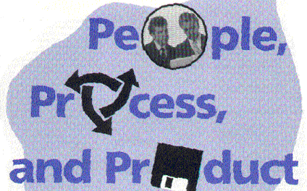
the 3 P’s:
14 September 2011

Slide 2
Interactions
There is no “right answer”
Typically people and product are fixed
… can adapt process
(which is where we will start)

Slide 3
Processes

Slide 4
Fundamental Steps
Requirements
Design
Implementation
Test
Deployment
Maintenance

Slide 5
Processes
Differ by
how often you do the steps
Focus and emphasis
Points on the spectrum
Differences in overhead
Three fundamental processes
Waterfall
Spiral
Iterative

Slide 6

Waterfall
Do it once
Traditional model
Used for large next version releases,
especially when
well understood product
tightly coupled changes

Slide 7
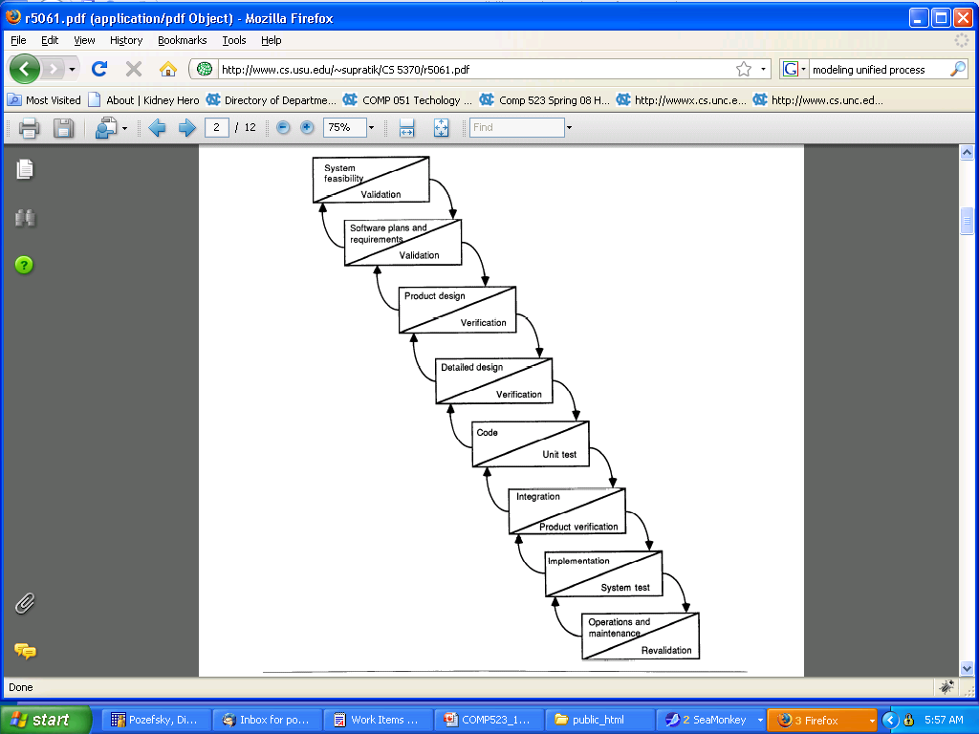
Waterfall
1970s
Built on 1950’s stage-wise process
Recognized the need for feedback
Limited
Heavy process

Slide 8
Waterfall
Pros
Simple documentation management
Clean design phase
Cons
Least flexibility
No early feedback

Slide 9

Iterative (a.k.a. Agile)
Many iterations
Each iteration is on a fixed cycle
Typically biweekly
Used for projects with
lots of small independent, but well understood, changes
small development team
strong client involvement

Slide 10
Iterative
Reaction to waterfall
Derived from “evolutionary” process
Requirements and specs evolve over time
Two well-known models
Extreme programming
SCRUM

Slide 11
Iterative (a.k.a. Agile)
Pros
Fast feedback on problems
Very adaptable to any changes
Lots of versions to work with
Heavy user involvement
Cons
Document maintenance
Code maintenance
Requires good automation

Slide 12

Spiral
Few iterations
Each iteration adds new requirements
Used often for projects with less well defined requirements

Slide 13

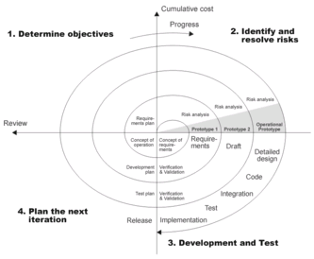
Spiral
Risk based
Barry Boehm 1988
“A Spiral Model of Software Development and Enhancement”

Slide 14
Spiral
Pros
Adaptation to changes based on risks
Good customer interaction
Early version
Limited iterations provide phase structure
Cons
Document maintenance

Slide 15
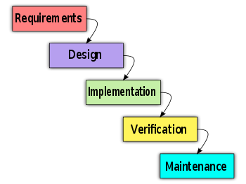
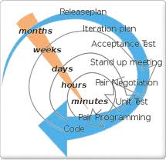
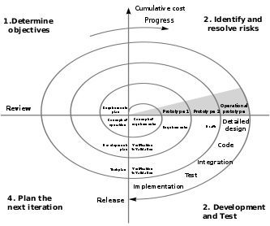
Historical Perspective
Waterfall: 1970, built on 1950’s stage- wise processes
Recognized need for feedback
Iterative (agile): late 70s,modeled on evolutionary model
Didn’t work well for large products
Spiral: 1988, risk-based

Slide 16
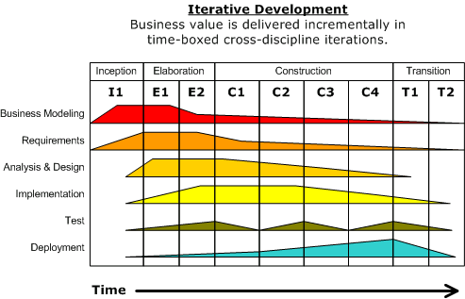
Unified Process
Variant of Spiral
Identifies that iterations differ
Also known as Rational Unified Process (Rational products)
Core Processes
Phases

Slide 17
People

Slide 18
Importance of People
Most important factor in the quality of software is the quality of the programmers
If your life depended on a particular piece of software, what would you want to know about it?
that the person who wrote it was “both highly intelligent and possessed by an extremely rigorous, almost fanatical desire to make their program work the way it should.”
Terry Bollinger (2001)

Slide 19
Peopleware DeMarco and Lister
People are primary
Goal-driven human processes are self-healing
Rule-driven processes are fragile
Public communication
Space
Cave and Commons
Stewart Brand, How Buildings Learn

Slide 20
Knowledge Workers …
FUNDAMENTAL CONFLICTS
prefer closed offices but communicate better in open ones
congregate in particular geographical areas
move around in the course of their work
collaborate
concentrate
work in the office
communicate with people who are close by
don't care about facilities gewgaws
Davenport, Why Office Design Matters 2005

Slide 21
Tuckman Team Stages
Forming - polite but untrusting
Storming - testing others
Norming - valuing other types
Performing - flexibility from trust
Adjourning - disengagement
Tuckman, Bruce. (1965). Developmental sequence in small groups. Psychological bulletin, 63, 384-399.

Slide 22
Good Team Member
Core Competency: problem-solving ability
Personal Attributes
Openness
Supportiveness
Action orientation
Positive personal style

Slide 23
Positive Team Relationships
Constructive: for all team members
Productive: brings out the best thinking in all team members
Mutual Understanding: seeking to understand others’ perspectives
Self Corrective

Slide 24
Effective Team Problem Solving
Focus
clear about what you are doing
Climate
positive
inclusive
focus on the issue…not the person
Open Communication
Issues identified,
discussed,
prioritized
and acted on

Slide 25
Styles in Conflict Resolution
Collaborator
Works to find a solution that satisfies all concerns
Accommodator
Neglects own concerns to satisfy others
Compromiser
Tries to satisfy others without giving up own concerns
Competitor
Pursues own concerns at other’s expense
Avoider
Evades the situation and never addresses

Slide 26
Additional Reference
Larson and LaFasto
Teamwork: What Must Go Right/What Can Go Wrong
When Teams Work Best
Accumulated information from 600 teams

Slide 27
Product includes ALL Deliverables
Remember:

