Slide 1
Functional spec Scheduling
19 September 2011

Slide 2
FUNCTIONAL SPEC

Slide 3
Purpose of the Spec
Everyone agrees that this is what you will implement
Must include
Clear statement of the function
Overview
Use cases
Prioritized requirements
Must be succinct enough for client to read

Slide 4
Sources of requirements
People
Stakeholders
Who are the stakeholders?
Issues:
Conflicting requirements
Wants vs. needs
Helping the customer articulate the requirements
Use cases
Hardware constraints
Laws of physics and nature
Social responsibility

Slide 5
Social responsibility
Privacy
Security
How it will (can) be used
Does it have the potential for misuse?
Can it be used to harm people?

Slide 6
Sources of Requirements: People vs. Other
decision support system for military tactics
unconstrained
video game
Type of application
corporate accounting system
manufacturing control system
enhancement to corporate accounting system
highly constrained
flight control system for airliner
missile guidance system
relatively low
% of requirements gathered from people
relatively high
(Brackett, CMU)

Slide 7
SCHEDULING

Slide 8
“80% of software projects fail”
Standish Report (1995)
16.2% completed on-time and on-budget with all features and functions as initially specified.
52.7% completed and operational but over-budget, over the time estimate, and offers fewer features and functions than originally specified.
31.1% cancelled at some point during the development cycle.
Sauer et al (2007)
67% “delivered close to budget, schedule, and scope expectations” with experienced project managers

Slide 9
Project Management
Discipline of
planning,
organizing, and
managing resources
to bring about
the successful completion of
specific project goals and objectives

Slide 10
Should we eliminate risk?
Patton: Take calculated risks. That is quite different from being rash.
Nehru: The policy of being too cautious is the greatest risk of all.
Herodotus: Great deeds are usually wrought at great risks.
The Net: No risk => no challenge

Slide 11
Sources of Risk
Top management commitment
User commitment
Misunderstood requirements
Inadequate user involvement
Mismanaged user expectations
Scope creep
Lack of knowledge or skill
Keil et al, “A Framework for Identifying Software Project Risks,” CACM 41:11, November 1998

Slide 12
Technical Risks
New features
New technology
Developer learning curve
Changes that may affect old code
Dependencies
Complexity
Bug history
Late changes
Rushed work
Tired programmers
Slipped in “pet” features
Unbudgeted items

Slide 13
Scheduling
Process
Within the Steps
Put together minimal solution
Start with external commitments
Introduce internal milestones
Focus on the risks
Add next level of features where possible
Identify components
Identify dependencies
Estimate (guess)
Prefer educated guess
Lay out assignments and time frames

Slide 14
Project Plan for this project
Use simple Excel spreadsheet (or equivalent)
Deliverable/Milestone | Responsible | Due | Revision 1 | Delivered
project web site | Sam | 20-Jan |  | 20-Jan
architecture | Jane (all) | 8-Feb | 15-Feb | 23-Feb
project plan | Harry | 10-Feb | 15-Feb | 16-Feb
initial user interface | Sam | 13-Feb | 15-Feb | 18-Feb
contract | Jane | 20-Feb | 15-Feb | 18-Feb

Slide 15
Questions project plan answers
What is Joe working on this week?
Who can help me if I run into trouble?
If I have to choose an activity to be late, which one will impact the project more?

Slide 16
What needs to be in the plan?
All Deliverables
Code
Design
Test
Documentation
Learning
Presentation and demo prep
Reviews

Slide 17
REVIEWS AND INSPECTIONS

Slide 18
Reviews and Inspections
Why?
Developer can’t correct unseen errors
More eyes to catch problems
Earlier is cheaper
Integration fix typically 3-10 times the cost at design
Difference in terms
Review implies completed work, often reviewed by someone at a different level
Inspection implies peer review of work in progress

Slide 19
Inspections
Introduced by Michael Fagan in 1976 (IBM Systems Journal)
Formalized process
Specific roles and steps
Heavy preparation and follow-up
Used for documents and code
In 1999, survey identified 117 checklists covering requirements, design, code, testing, documentation and process

Slide 20
PROJECT MANAGEMENT TOOLS

Slide 21
Tools to Help
Product flow
Dependencies and relationships of deliverables
Work breakdown structure
The parts
PERT charts
Program Evaluation and Review Technique
Critical Path Method
Equivalent to PERT charts
Gantt charts
Schedule overview

Slide 22
Product Flow
Identify sequences and dependencies
Distinguish new from existing components
Important if you have many different deliverables

Slide 23
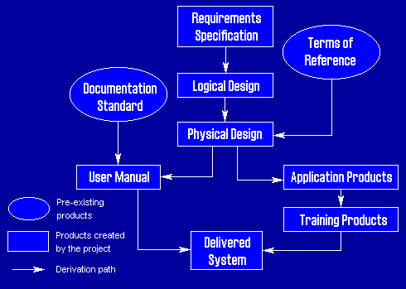
Product Flow

Slide 24
Work Breakdown Structure
Need to break down the tasks into component parts and tasks
Level of detail important:
The more detailed, the better
Lacks any time component

Slide 25
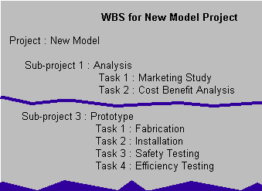
Work Breakdown

Slide 26
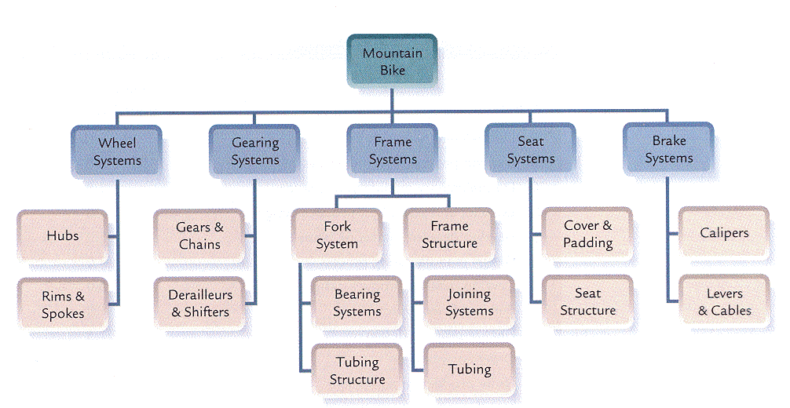
Graphical WBS

Slide 27
PERT Charts
Critical path identification
Program Evaluation and Review Technique
Also known as activity networks
Developed by Navy in 1958
Three stages:
Planning (tasks and sequence)
Scheduling (start and finish times)
Analysis (float and revisions)
Two different models
Activities are nodes (most common) or arcs

Slide 28
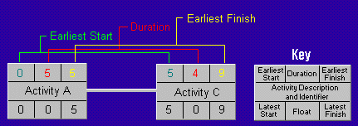
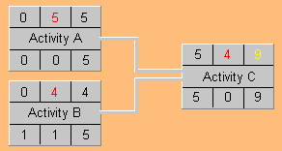
Pert Charts

Slide 29
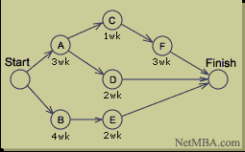
CPM: Critical Path Method
Alternative to PERT
Dupont 1957
Graphical view of project
Predicts time required to complete
Shows which activities are critical to maintaining the schedule
Lacks the built in model of float
Easy to use informally

Slide 30
Planning
Identify the specific activities and milestones.
Determine the proper sequence of the activities.
Construct a network diagram.
Estimate the time required for each activity.
Determine the critical path (longest path through the network).
Update the PERT or CPM chart as the project progresses

Slide 31
Gantt Charts
Milestone charts
Invented by Harvey Gantt in 1916
Advantages
Less detailed
Amenable to management overlays

Slide 32
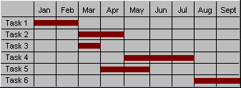
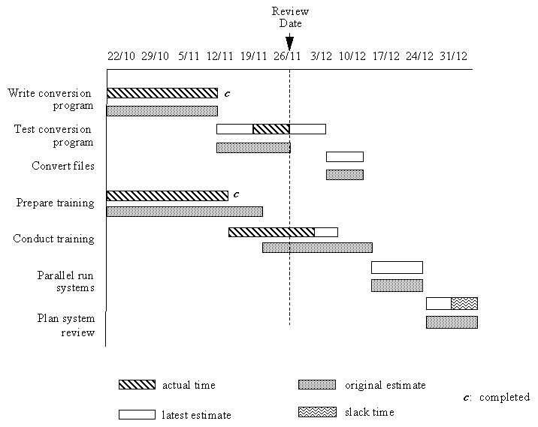
Gantt Chart with Overlays
Note that dates are Day/Month

Slide 33
Scheduling Steps with Tools
Put together minimal solution
Primary requirements
Start with external commitments
Functional spec
Milestones
Introduce internal milestones
Work breakdown structure
Product Flow
PERT Chart or CPM, Gantt chart
Focus on the risks
Add next level of features where possible
Secondary requirements

Slide 34
Resources
No shortage of available tools
dmoz.org/Computers/Software/Project_Management
Project Management as a discipline
Degrees
Certification
Project Management Institute

