Slide 1
design
26 September 2011

Slide 2
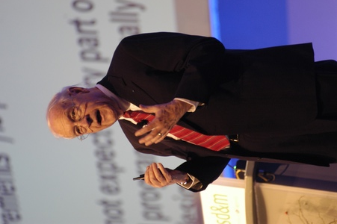


Guest Speaker: Next Monday

Slide 3
Well-known Architectures
Model-View Controller
Data flows
Independent components
Virtual machines
Layered architectures
Repository

Slide 4
Repository
A system built around data
Two types
Databases
Hypertext systems

Slide 5
A Typical Repository System
GUI
Analysis
process
1
Analysis
process
n
Control
…...
…...
DBMS
Database
Adapted from Software Engineering: An Object-Oriented Perspective by Eric J. Braude (Wiley 2001), with permission.

Slide 6
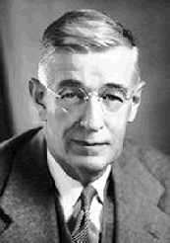


Hypertext: Basis of the Web
Motivated by Vannevar Bush in 1945
“As We May Think” (Atlantic Monthly)
Theoretical machine, "memex," to enhance human memory by allowing the user to store and retrieve documents linked by associations
Invented by Ted Nelson in the 1960s
Popularized with HTML (Tim Berners-Lee)

Slide 7
Ted Nelson
"If computers are the wave of the future, displays are the surfboards."
Xanadu: 1974
"give you a screen in your home from which you can see into the world's hypertext libraries... offer high-performance computer graphics and text services at a price anyone can afford... allow you to send and receive written messages... [and] make you a part of a new electronic literature and art, where you can get all your questions answered...“
Computer Lib/Dream Machines
For more details, see pdf

Slide 8
Summary
Model-View-Controller Web application
Data flow systems Pipes and filters
Batch sequential
Independent components Client-server
Parallel communicating processes
Event systems
Service Oriented Architecture
Virtual machines Interpreters
Rule-based systems
Layered architectures
Repositories Databases
Hypertext systems

Slide 9
Examples from Prior Years

Slide 10
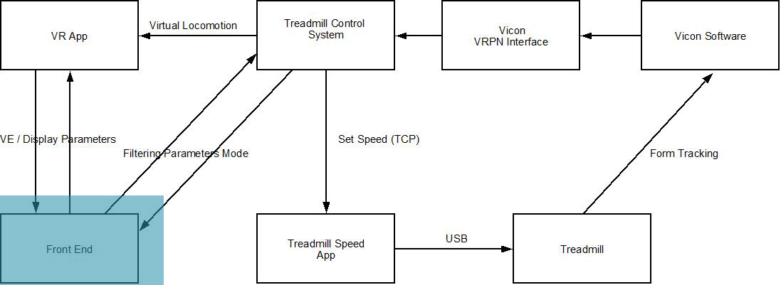
Virtual Reality for Stroke Patients

Slide 11
Social Welfare Web Site
Templates
(Few)
Configs
(Many)
Processor
SAS Files
Command Line Client
GUI Client
Interpreter
Velocity Library

Slide 12
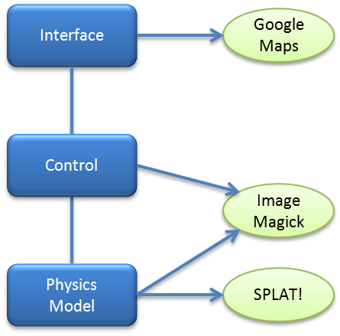
Wireless Deployment

Slide 13
Design

Slide 14
Design Overview
Start with a picture of your architecture
What other models are needed?
Data flow?
Data model?
State transition?
Key considerations
What are the hard parts of the work?
What are the critical areas?

Slide 15
Detailed Design
Build on well understood patterns from the system design
Goal is to prepare the project for implementation
Includes
Module definitions
Processes (if relevant)
Data definitions
Design decisions

Slide 16
Domain Classes
Object-oriented paradigm, not implementation
Domain = application specific
Classes defined in natural language
Used to explain the architecture and design
Classes derived from the requirements
Need not match the implementation
Hard to not fall into that trap

Slide 17
Domain Classes = Implementation Classes?
Benefits
Simplicity of mapping
Drawbacks
Later changes
No worse off then if not matched
May be too early for implementation decisions

Slide 18
Defining Domain Classes
Begin with Use Cases
Identify nouns
External agents are not domain classes
Are these key classes for the application?
Are there others?
Identify attributes and functionality for each class
Validate
Walkthrough use cases
Try changes and extensions
Look for
Missing attributes or functions
Changes that reach every where

Slide 19
Use Cases for a Teacher Portal
teacher presented with view with his content
read messages from other teachers and administrators
schedule an assessment
selects class
selects test based on difficulty and subject
create new test
create new question
type of question
introductory text
possible answers
correct answer
edit existing question
edit full test
post message
content
recipient
view class content
Classes
Attributes
Functions

Slide 20
Use Cases for a Teacher Portal
teacher presented with view with his content
read messages from other teachers and administrators
schedule an assessment
selects class
selects test based on difficulty and subject
create new test
create new question
type of question
introductory text
possible answers
correct answer
edit existing question
edit full test
post message
content
recipient
view class content
Classes
Attributes
Functions

Slide 21
Use Cases for a Teacher Portal
teacher presented with view with his content
read messages from other teachers and administrators
schedule an assessment
selects class
selects test based on difficulty and subject
create new test
create new question
type of question
introductory text
possible answers
correct answer
edit existing question
edit full test
post message
content
recipient
view class content
Classes
Attributes
Functions

Slide 22
Use Cases for a Teacher Portal
teacher presented with view with his content
read messages from other teachers and administrators
schedule an assessment
selects class
selects test based on difficulty and subject
create new test
create new question
type of question
introductory text
possible answers
correct answer
edit existing question
edit full test
post message
content
recipient
view class content
Classes
Attributes
Functions

Slide 23
Back to Detailed Design
What are we starting with?
Domain classes
System design models
Use cases
What do we need to do?
Define implementation classes that
realize the domain classes
within the architecture framework
and implement the functions defined in the use cases

Slide 24
Design Principles
Same as architecture:
Correctness
Robustness
Flexibility
Reusability
Efficiency

Slide 25
Correctness
Always a goal. Others may be negotiable.
Definition: satisfies all of the application’s requirements
How do we know the requirements are correct?
Approaches
Inspections
Readable (“I didn’t have time to write a short letter, so I wrote a long one instead.”)
Modular
Formal verification
Invariants, pre- and post-conditions
Usually used only in critical components

Slide 26
Robustness
Ability to handle anomalous situations
Techniques
Verifying input
Initialization
Parameter checking
Range
Constraints
Husk and kernel

Slide 27
Importance of Robustness: USS Yorktown (1998)
Guided missile cruiser that suffered widespread system failure off the coast of Virginia
Dead in the water for more than two hours
Crew member mistakenly entered a zero in a data field of an application
Divide by zero
Buffer overflow
Shut down the propulsion system

Slide 28
Flexibility
Requirements changes
Adding more of the same function
New type of member, account, question or game
Adding new type of function
Printing what was only displayed, withdrawing when only depositing was allowed, creating a new game
Changing function
Allowing reverse as well as forward, overdraft protection

Slide 29
Using XML: Interpreter Model
Design issues
Encapsulating things that may change
Late binding
Separation of instruction and data
Examples
Layout of your interface
Description of changeable data

Slide 30
Reusability
How to make it reusable
Match real world concepts
Avoid unnecessary coupling
Document
Complete specification (assertions, constraints)
Explanation of function and algorithm
Generic names

