Slide 1

User Interfaces
5 October

Slide 2
What Makes a Good Design?
Let’s look at designs you like
… and those you don’t
Top 10 list
Biggest Mistakes

Slide 3
The UI Iceberg
Look
10%
Toolkits and style guides help with look and feel, the tip of the usability iceberg.
Real usability gains come from system and application objects perceived by users.
Visuals
Feel
30%
Interaction
Techniques
The things you use
60%
Object Model
Notes:
The usability of an interface is determined by the visuals, interaction techniques and object model. Like an iceberg, the part that is hidden is larger than the part you see.
We estimate these components contribute to usability in the proportions shown.

Slide 4
Consider well-known sites
What is the object model?
Ebay
Amazon
Facebook

Slide 5
User Interface Models
Object-action
Choose the object and then the action to perform
Windows GUI:
select the file, right click for actions
Action-object
Choose the action and then the object
Windows command line:
“copy” file_a file_b

Slide 6
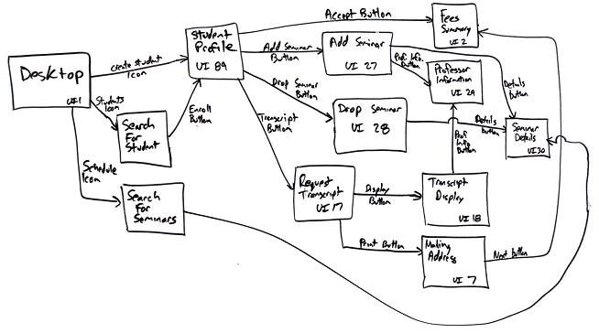
Fundamental Concepts
What the user needs to do
The order that he does it
Is it natural?
How much does he have to remember?

Slide 7
GUI or not to GUI?
How often is the task done?
How many objects are done at a time?
Physical limitations
Environment

Slide 8
Interaction Styles
Command line
Question and answer
Form based
Menu
Natural language
Speech
GUI
Gesture
Virtual reality
Augmented reality
Ubiquitous (unaware)
Perceptual
Text
Other

Slide 9
Good Screen Design
Consistency:
use of pull-downs vs. entry
Starting in the upper left corner:
first thing to fill in
Simple navigation
Grouping and alignment
Keep related issues together
Hierarchy for importance
Pleasing visuals
Captions for clarity

Slide 10
Three Types of Windows
ABC alert message
Caution: “age” must be < 120
OK
Property – information only
Properties of automobile 189
Alert – information that needs to be seen before continuing. Developer determined.
Property
Value
Brand
Toyota
Model
Camry
ID
893-8913-789014
Help
Dialogue – input from user and subsequent action
Word
___________________
This screen All screens

Slide 11
Why Classify?
Use the right type of window
Consider purpose when designing
Example: alert window must be seen; property window not as critical

Slide 12
Rollovers
Information that is optional and selected by the user
But it often can’t be copied.
It doesn’t remain visible.
Are those important for this usage?
This is a rollover window, designed to provide on-the-fly amplification

Slide 13
The content is all there…
Type
checking
saving
mmf
CD
Branch
Main St.
Elm St.
High St.
Privileges
newsletter
discounts
quick loans
First name
Middle name
Last name
Street
City
State/county
OK
Apply
Cancel
Help
Adapted from Software Engineering: An Object-Oriented Perspective by Eric J. Braude (Wiley 2001), with permission.

Slide 14
But it can be better
New Customers
Name
Address
First
Street
Middle
City
Last
State/county
Branch
Account type
Privileges
Main St.
checking
newsletter
saving
Elm St.
discounts
money market
High St.
quick loans
CD
OK
Apply
Cancel
Help
Adapted from Software Engineering: An Object-Oriented Perspective by Eric J. Braude (Wiley 2001), with permission.

Slide 15
Use of White Space
More advice than you could ever want
Active and passive
Classy vs. mass-produced
Clutter or incomplete
…

Slide 16
GUI Screen Design Process
Know Your User or Client
Understand the Business Function
Understand the Principles of Good Screen Design
Select the Proper Kinds of Windows
Develop System Menus
Select the Proper Device-Based Controls
Select the Proper Screen-Based Controls
Organize and Lay Out Windows
Choose the Proper Colors
Create Meaningful Icons
Provide Effective Messages, Feedback, Guidance, and Language Translation
Test, Test, and Retest
Wilbert Galitz

Slide 17
Visualization and Information Design
How to present results
Visualization usually refers to dynamically created results
Data
Information
Information design usually refers to crafted piece
Edward Tufte

Slide 18
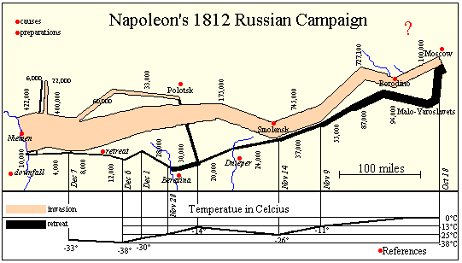
Minard: Napoleon’s March to Moscow
Width of band shows size of army at each position.
Black band shows retreat tied to temperature and time

