Slide 1
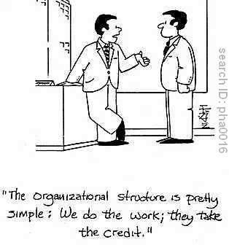
ORGANIZATION
10 October 2011
How and why companies organize as they do

Slide 2
Why is Organization Needed?
Control communications cost
Channel of communications costs about 2 hours per week
Optimal number 3-7
Others
Responsibility
Decision Making

Slide 3
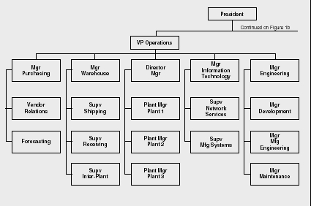
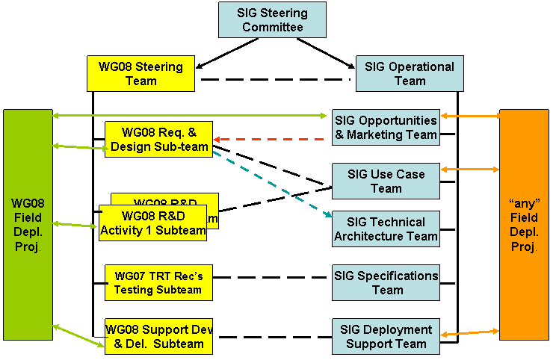
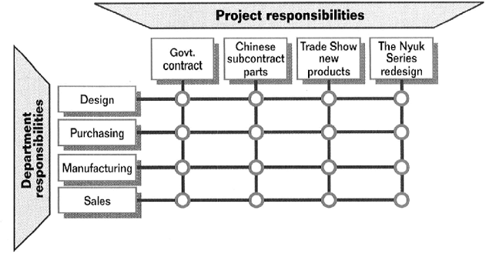
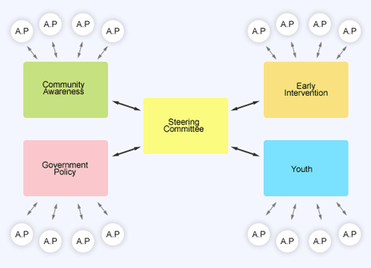
Organization Structures
Hierarchical
Peer
Requires leader of team or aspects
Subteam
Peer within
Gatekeeper for external
Matrix

Slide 4
What can you tell from an organization?
The formal structure
NOT the informal working mode
When you are going to work, which do you care about?
How much impact does the formal structure have?

