Slide 1
Extreme Programming
17 October 2011

Slide 2
1960’s
60’s
“Cowboys” wrote software anyway that they could
Difference between best programmers and worst as high as 28:1 (many sources)
1968
Edsger Dijkstra, “GOTO Statement Considered Harmful” (CACM)
Recognition that rules can improve the average programmer
The start of software engineering?

Slide 3
Structuring Software Development
Few rules helped immensely
Good rules and practices developed over the 70’s and 80’s
If a few rules are good, more are better…
Late 80’s, major focus on process as a key to quality
ISO 9000
Malcolm Baldrige National Quality Award

Slide 4
ISO
International body
150 national standards organization
US: ANSI
Originally technical standards
Has broadened its scope
Quality

Slide 5
ISO 9000 and 9001
ISO 9000
Generic management system standard
First published in 1987
Revision in 2000
Not the process but the management of the process
Compendium of best practices
ISO 9001
requirements that must be fulfilled
Most recent update 2008

Slide 6
ISO 9001 Requirements
Business
customer requirement based
Communication and validation
internal audits
evaluation and improvements
problem management and effectiveness monitoring
non-conformances and bad product
quality policy
formal statement from management
understood and followed at all levels by all employees
used to establish employee measurable objectives
quality system
regularly audited and evaluated for conformance and effectiveness
decisions based on recorded data
records that trace raw materials and products to the source

Slide 7
Why not apply to software development?
Companies started codifying their practices
Large documents and people to manage them
Rise of the project manager
“Honored in the breach”
More large projects and more late or failed projects

Slide 8
1995 Standish Group Study
50% software projects challenged
2x budget
2x completion time
2/3 planned function
30% impaired
Scrapped
20% success
Examples
http://web.mit.edu/Saltzer/www/publications/Saltzerthumbnails.pdf

Slide 9
Software Engineering Processes
Differ by how often you do the steps
Points on the spectrum
Differences in overhead
Three fundamental models
Waterfall
Spiral
Iterative
Widely used models
Integrated Product Development
Unified Software Development Process
Extreme Programming

Slide 10
All models address the 4 P’s of Software Engineering
People: those doing it
Product: what is produced
Process: manner in which it is done
Project: the doing of it

Slide 11
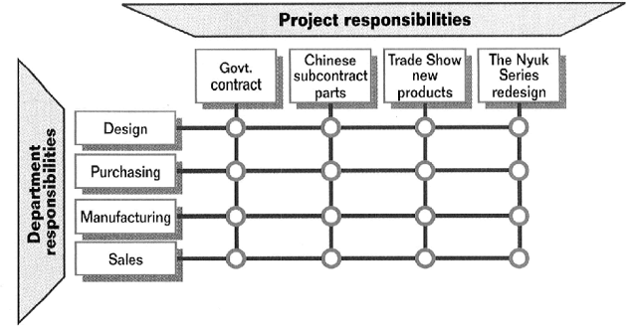
Integrated Product Development (IBM)
Originated at GE
Cross-functional teams at all phases
Phased approval (easy to start, easy to kill)
Concept
Plan
Ship
Sunset

Slide 12
Unified (Software Development) Process
Iterations within phases
4 phases and core workflows for each
Inception
Elaboration
Construction
Transition
Requirements
Analysis
Design
Implementation
Test

Slide 13
Agile Methodologies

Slide 14
Agile Methodologies
Keep only those rules and processes that help
Antidote to bureaucracy
License to hack
Key characteristics
Adaptive
People-oriented

Slide 15
Agile Manifesto
February 2001
Representatives from
Extreme Programming
SCRUM
DSDM
Adaptive Software Development
Crystal
Feature-Driven Development
Pragmatic Programming

Slide 16
Extreme Programming

Slide 17
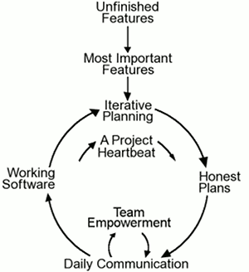
Extreme Programming
Complete development process
First code drop 2-3 weeks after start (what is the start?)
Customer part of the development team
Iterative development to the max
Derive requirements with customer through hands-on experimentation
Agile methodology

Slide 18
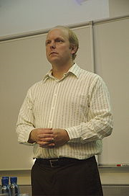
History
Kent Beck considered the inventor
Ideas developed in the early 90’s
First project at Daimler Chrysler in 1996
Smalltalk
Design patterns
Extreme programming

Slide 19
XP Bills of Rights
Developer has a right to
Clear requirements and priorities
Determine how long a requirement will take to implement
Revise estimates
Always produce quality code
Customer has a right to
An overall plan
See progress in a running system
Change requirements and priorities
Be informed of changes to schedule and have input as to how to adapt
Cancel in the middle and still have something to show for the investment

Slide 20
XP Bills of Rights
Developer has a right to
Clear requirements and priorities
Determine how long a requirement will take to implement
Revise estimates
Always produce quality code
Customer has a right to
An overall plan
See progress in a running system
Change requirements and priorities
Be informed of changes to schedule and have input as to how to adapt
Cancel in the middle and still have something to show for the investment

Slide 21
XP Value System
Communication
Focus on people, not documentation
Simplicity
Of process and code
Feedback
Mechanism to make useful progress
Courage
To trust in people (Bollinger: what you would like to know about software that your life depended on)

Slide 22
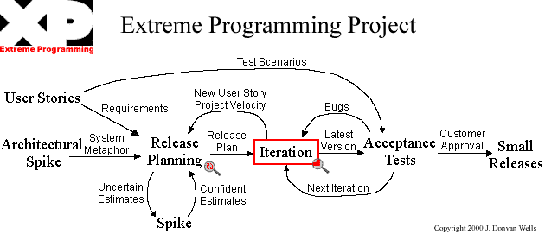
Extreme Programming Flowchart
http://www.extremeprogramming.org/

Slide 23
User Stories
Use cases
Written by customer
Used for planning
Developers estimate by story
Stories basis for iteration
Used to build acceptance tests
Remember that correctness equals meeting requirements

Slide 24
System Metaphor
Initial system design
About the level that you’re producing

Slide 25
Spikes
Technology explorations
Focus on high risk items
Typically considered throw-away code
If not, needs to be agreed to by the whole team

Slide 26
Release Planning
Each iteration has its own plan
Function OR date (other is adjusted accordingly)
(Recall 4 variables: function, date, resources, quality)
Planning adapts as the project progresses
Measure project velocity
Number of user stories and tasks completed
Next iteration looks at planned vs. actual time
Allowed to plan last iteration’s number for this iteration

