Slide 1
Extreme Programming (CONT)
19 October 2011

Slide 2
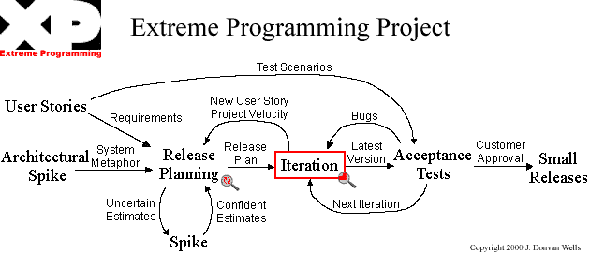
Extreme Programming Flowchart
http://www.extremeprogramming.org/

Slide 3
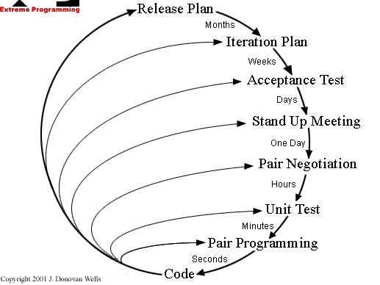
Feedback Loops

Slide 4
Iteration
Scope: all parts of the system
Only add functions needed for current user stories
Recommendation: 3 weeks
Moving people around
Backup and training
Code is owned by the whole team
Pair programming
Re-factoring

Slide 5
Pair Programming
Two people working at a single computer
Built-in backup and inspections
Collaboration builds better code
Mechanical model
One drives, the other talks
Keyboard slides between the two
Logical model
One tactical, the other strategic
Both think about the full spectrum but bring different perspectives

Slide 6
Pair Programming Experiments
Typical numbers show the total manpower consumed not very different
Numbers range, but no more than ¼ additional manpower
Implication: actual time is reduced
Improved satisfaction also improves productivity
Williams et al, “Strengthening the Case for Pair-Programming”

Slide 7
Refactoring
Each iteration adds just the function needed
If you continue to add new functions every two weeks, code can get messy
Refactoring is the cleaning up of the code at the end of the iteration
Critical to maintaining quality code
(Also applies to the design)
Difference between refactoring & rewriting?

Slide 8
The Rules of Extreme Programming
Planning
Managing
Designing
Coding
Testing

Slide 9
Planning Managing
User stories written
Each release creates schedule
Frequent small releases
Project divided into iterations
Each iteration starts with planning
Dedicated open work space
Sustainable pace
Stand up meeting starts each day
Project velocity measured
Move people around
Fix XP when it breaks

Slide 10
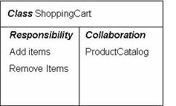
Designing Coding
Simplicity
Choose a system metaphor
Use CRC cards for design sessions
Spike solutions to reduce risk
No functionality is added early
Refactor whenever and wherever possible
Customer is always available
Code must be written to agreed standards
Code the unit test first
All production code pair programmed
Only one pair integrates code at a time
Integrate often
Set up a dedicated integration computer
Collective ownership

Slide 11
Testing
All code must have unit tests
All code must pass all unit tests before released
When a bug found, tests created
Acceptance tests run often and score published

Slide 12
When to Use XP
Types of projects
High risk
Poorly understood requirements
Team
Small size: 2 to 12
Needs to include customer
Automated testing
Timing issue

Slide 13
What Makes a Project XP
Paradigm
see change as the norm, not the exception
optimize for change
Values
communication, simplicity, feedback, and courage
honor in actions
Power sharing
business makes business decisions
development makes technical decisions
Distributed responsibility and authority
people make commitments for which they are accountable
Optimizing process
aware of process and whether it is working
experiment to fix
acculturate new team members
Ward Cunningham, Ron Jeffries, Martin Fowler, Kent Beck

Slide 14
NOT everyone loves XP

Slide 15
References
Agile Methodologies www.martinfowler.com/articles/newMethodology.html
Discussion http://xp.c2.com/ExtremeProgrammingRoadmap.html

Slide 16
More on Trust in People

Slide 17
Egoless Programming
Weinberg 1971, The Psychology of Computer Programming
During the “cowboy” era
Re-issued in 1998
Observed that programmers needed to be team players
Accept inspections and reviews
Open to corrections and critiques

Slide 18
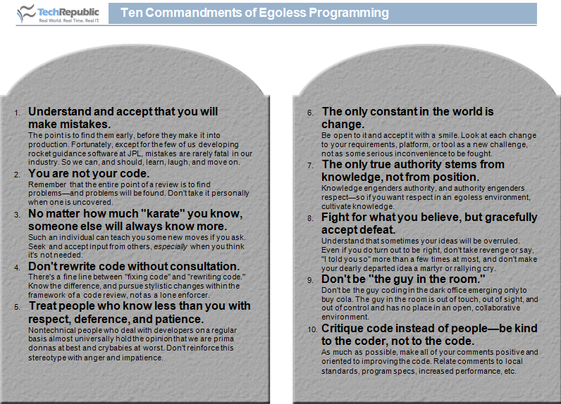
(Lamont Adams)

Slide 19
But pride of ownership is critical to quality

Slide 20
Software Craftsmanship
Emphasizes coding skills of the developers
Recognition of importance of the individual
Basis
Pragmatic Programmer (Hunt and Thomas)
Software Craftsmanship (McBreen)
Manifesto
First conference 2009
Fundamentals
Apprenticeship
Pride in your work

Slide 21
Can Craftsmanship Help the Software Crisis?
Craftsmen sign their work
basis for reputation
hiring on portfolio
Forget licensing
Exploit productivity differences between individuals
not managing hordes of 'average' programmers
small teams of good developers
pay differentials
Expose the fallacy of good enough software
Software development is a social, intellectual activity
not mechanical : engineering wrong metaphor
mythical man month problem still exists
Apprenticeship more effective than training
software development as a craft
not the same as being taught how to program.

