Slide 1
Testing, continued
28 November 2011

Slide 2
Best (and Worst) Testing Practices (Boris Beizer)
Unit testing to 100% coverage: necessary but not sufficient for new or changed
Integration testing: at every step; not once
System testing: AFTER unit and integration testing
Testing to requirements: test to end users AND internal users
Test execution automation: not all tests can be automated
Test design automation: implies building a model. Use only if you can manage the many tests
Stress testing: only need to do it at the start of testing. Runs itself out
Regression testing: needs to be automated and frequent
Reliability testing: not always applicable. statistics skills required
Performance testing: need to consider payoff
Independent test groups: not for unit and integration testing
Usability testing: only useful if done early
Beta testing: not instead of in-house testing

Slide 3
Usability Testing

Slide 4
Usability Testing
Frequency with which the problem occurs
Common or rare?
Impact of the problem if it occurs
Easy or difficult to overcome?
Persistence of the problem
One-time problem or repeated?

Slide 5
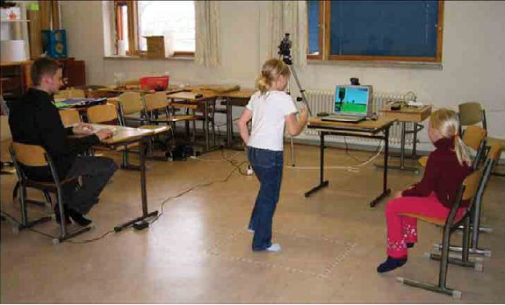
Wizard of Oz Testing
Inputs and outputs are as expected
How you get between the two is “anything that works”
Particularly useful when you have
An internal interface
Choices to make on user interfaces
Children’s Intuitive Gestures in Vision-Based Action Games
CACM Jan 2005, vol. 48, no. 1, p. 47

Slide 6
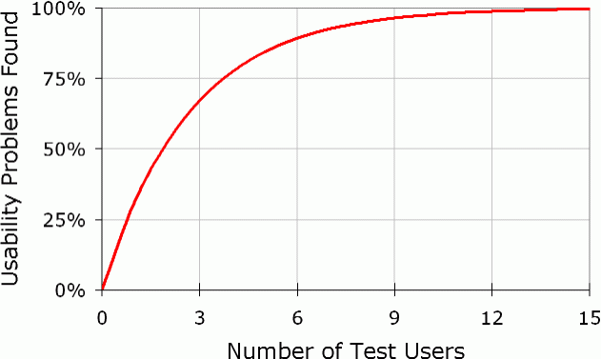
Number of Usability Test Users Needed
Usability problems found = N(1-(1-L)^{n})
N = total number of usability problems in the design
L = proportion of usability problems discovered by a single user
n = number of users
L=31%

Slide 7
Using as an Estimator
Found 100 problems with 10 users
Assumption: each user find 10% of problems
How many are left?
found = N(1-(1-L)^{n})
100 = N(1-(1-.1)¹⁰)
N = 100/(1-.9¹⁰)=154
54 left

Slide 8
Test Measurements

Slide 9
Test Coverage Metrics
Statement coverage
basic block coverage
Decision coverage
Each Boolean expression
Condition coverage
Each entity in Boolean expressions
Path coverage
loops
Advantages of different models?

Slide 10
Estimating how many bugs are left
Historical data
Capture-recapture model

Slide 11
Historical Data
Lots of variants based on statistical modeling
What data should be kept?
When are releases comparable?
Dangers with a good release
Test forever
Adversarial relation between developers and tester
Dangers with a bad release
Stop too soon

Slide 12
Capture-recapture model
Estimate animal populations: How many deer in the forest?
Tag and recount
If all tagged, assume you’ve seen them all
Applied to software by Basin in 73
Number of errors = |e₁| * |e₂| / |e₁ ∩ e₂ |
where e_{n} = errors found by tester n
2 testers: 25, 27, 12 overlap: 56 total errors
What’s wrong with this model (aside from the fact the denominator can be 0)?
Assumptions about independence of testers

Slide 13
Test Tools

Slide 14
Test Tools: Unit Test
What do they do?
Regression testing framework
Incrementally build test suites
Typically language specific
What is available?
JUnit most well known
SUnit was the first (Smalltalk)
xxUnit where xx represents every language known to CS!
http://www.testingfaqs.org/t-unit.html
http://tejasconsulting.com/open-testware/feature/unit-test-tool-survey.html

Slide 15
Performance Test Tools
What do they do?
Orchestrate test scripts
Simulate heavy loads
What is available?
JMeter
Grinder

Slide 16
Other Test Tools
Tons of test tools
Two web sites as starting points
http://www.xprogramming.com/software.htm
http://www.softwareqatest.com/qatweb1.html

Slide 17
Other Quality Improvers

Slide 18
Other Ways of Improving Quality
Reviews and inspections
Formal specification
Program verification and validation
Self-checking (paranoid) code
Deploy with capabilities to repair

Slide 19
Formal Methods and Specifications
Mathematically-based techniques for describing system properties
Used in inference systems
Do not require executing the program
Proving something about the specification not already stated
Formal proofs
Mechanizable
Examples: theorem provers and proof checkers

Slide 20
Uses of Specifications
Requirements analysis
rigor
System design
Decomposition, interfaces
Verification
Specific sections
Documentation
System analysis and evaluation
Reference point, uncovering bugs

Slide 21
Examples
Abstract data types
Algebras, theories, and programs
VDM (Praxis: UK Civil aviation display system CDIS), Z (Oxford and IBM: CICS), Larch (MIT)
Concurrent and distributed systems
State or event sequences, transitions
Hoare’s CSP, Transition axioms, Lamport’s Temporal Logic
Programming languages!

Slide 22
References

Slide 23
References
Bugs
Therac-25: http://courses.cs.vt.edu/~cs3604/lib/Therac_25/Therac_1.html
Patriot missile: http://www.fas.org/spp/starwars/gao/im92026.htm
Ariane 5: http://www.esa.int/export/esaCP/Pr_33_1996_p_EN.html
Testing
Whittaker, How to Break Software (presentation)

