Slide 1
B2C Model

Slide 2
The Problem
Finding destination and hotel information that is tailored to your specific needs.
Takes hours to research and plan a vacation.
Why?
  Brick-and-mortar travel agents have largely disappeared (55% decrease since 2002)
Notes:
http://travel.usatoday.com/flights/story/2011-08-29/Travel-agents-Were-doing-very-well-Mr-President/50180084/1

Slide 3

Pre-Internet Travel Planning
Travel Agent:
  Knew you on a personal basis
  Provided customized travel recommendations
  You could trust them
http://www.baltimoresun.com/media/photo/2011-06/62336028.jpg

Slide 4
Current Travel Planning
  Average traveler spends 30 hours and visits 22 sites planning
    Tripadvisor, Fodor’s, Lonelyplanet, etc.
  Book on another website
  Online booking engines don’t provide personalized recommendations
Notes:
travel.nytimes.com/2012/04/22/travel/are-travel-agents-back.html?pagewanted=all; http://www.businessinsider.com/vayable-tour-guide-travel-planning-jamie-wong-interview-2012-8; http://www.thinkwithgoogle.com/insights/featured/five-stages-of-travel/

Slide 5

Result: Frustration
Users are tired of automated travel planning
  Over 50% of leisure travelers don’t enjoy using the Web to plan and book their vacations
  Top Complaint: “I had to sift through too much information.”
http://www.computerzen.com.au/fixing_and_troubleshooting_computers/queensland/brisbane/
Notes:
http://travel.usatoday.com/news/2010-11-16-travelagents16_CV_N.htm; http://blog.deem.com/removing-frustration-online-travel-booking/

Slide 6
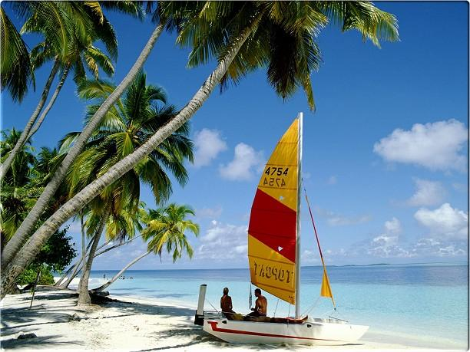
The Solution: Tripstr
    Personalized travel recommendations based on how you travel.
http://datingsymbol.com/2011/02/12/top-10-romantic-destinations-around-the-world/

Slide 7
What We Do
Connect You With Like-minded Travelers
Mine Web Data & Match With Your Preferences
Tripstr Destination Experts
Individualized Recommendations

Slide 8
This Means:
    Less stress
    Better vacations
    Unforgettable experiences

Slide 9
How It Works

Slide 10


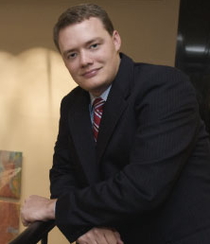
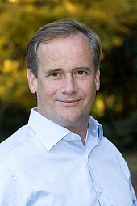



Tripstr Team
Core Team Members
Lead Consultants

