Slide 1
Saluki: Finding Taint-style Vulnerabilities with Static Property Checking
Jacek Janczura

Slide 2
Outline
Why security of machine code is important?
What are Taint-style Vulnerabilities
Control flow graph
Over approximation vs under aproximation
Implicit vs explicit flow
Problem
Gole
Criteria
  How to measure
  Fast thing not complete
  Automatic – many kinds of binaries
Conclusion
Saluki: Finding Taint-style Vulnerabilities with Static Property Checking | Jacek Janczura
Seite <number>

Slide 3




Why security of machine code is important?
Vendors continue to ship vulnerable programs to consumers
Vendors often do not ship source code
We as consumers need something to check if provided software is secure.
Saluki: Finding Taint-style Vulnerabilities with Static Property Checking | Jacek Janczura
Seite <number>

Slide 4
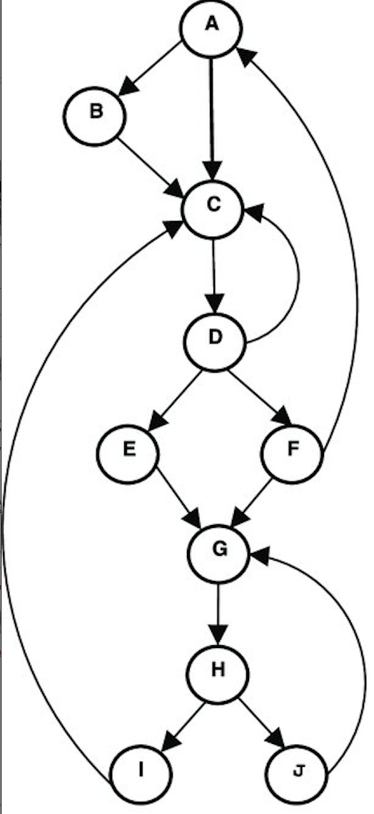
Control Flow Graph - CFG
https://www.researchgate.net/figure/An-example-of-creating-the-dominator-tree-b-from-a-sample-control-flow-graph-a-A_fig4_321640065
Saluki: Finding Taint-style Vulnerabilities with Static Property Checking | Jacek Janczura
Seite <number>
Notes:
Control Flow Graph - representation, using graph notation, of all paths that might be traversed through a program during its execution. All the jumps, all the reads from the registers.

Slide 5
Implicite vs explicite
for i in {1..4}; do echo "Welcome $i";done – Explicite (loop)
printf 'Welcome %d\n' {1..4} – Implicite (loop)
Saluki: Finding Taint-style Vulnerabilities with Static Property Checking | Jacek Janczura
Seite <number>
Notes:
Notice that explicit mean that you use the explicit iterator in a loop: i, while implicit you are doing a loop without using any iterator .

Slide 6
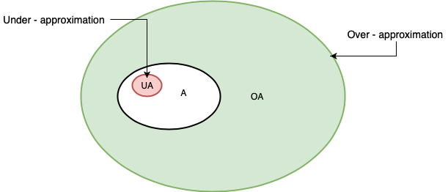
Over – approximation vs under - approximation
Dynamic analysis
Static analysis
Saluki: Finding Taint-style Vulnerabilities with Static Property Checking | Jacek Janczura
Seite <number>
Notes:
Static analysis – over approximation – many false positives
Dynamic approximation – to small – no possibility of false positive

Slide 7
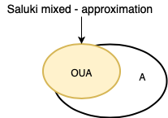
Saluki approximation
Mixture of under and over approximation.
Saluki: Finding Taint-style Vulnerabilities with Static Property Checking | Jacek Janczura
Seite <number>

Slide 8
Hier steht ein Kurztitel
Fließtext Blindtext arcilis ipsuntis mil il Hervorhebung im Fließtext cupti qui blandig endella borehent,
aliciae labores molor sum fugiate cullatusam:
  Kipitium quae quiatus andandunt landio et aut mi
  Neseque volenisci vellacearit harum velestis reicipis as ipsum quodicipsunt velectur
  Sunt alisinvel essi nia quam quid
  Eum dolupta turit, con nobis et volore, opta con corro doluptas dolupis doluptas dolu
  Ventore ntiusam aspelignim
  Volore dolecta turibus, quibea consequo experit aspero velluptas nos conseri orempos
  Ad milliassi solorio molupta pe inciatiis eniet earu
Hervorhebung als Fazit Blindtext suntis mil il moloribus cupti qui blandig endella borehent.
Saluki: Finding Taint-style Vulnerabilities with Static Property Checking | Jacek Janczura
Seite <number>

